Slide 1
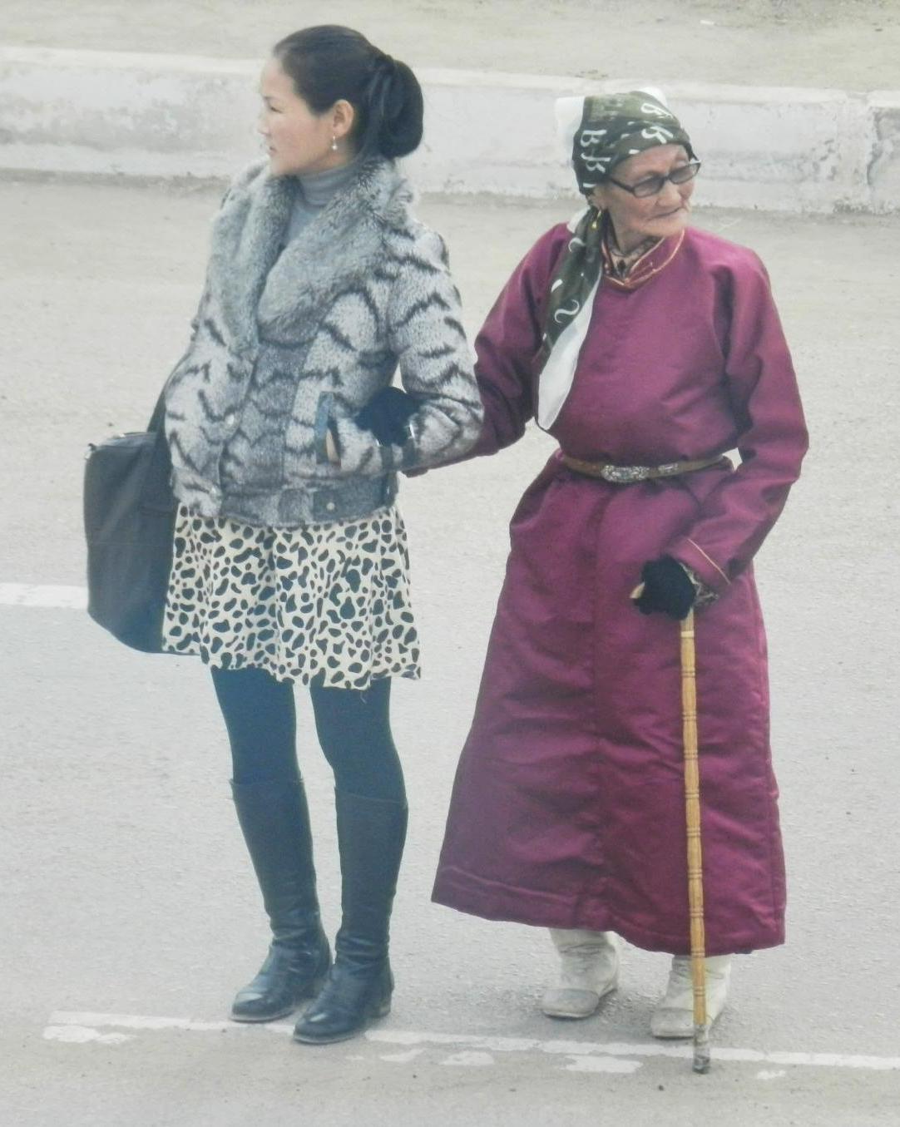

A Biblical Perspective on Aging
Jim Sutherland

Slide 2
Preview:
We want to live.
Sin caused decay, aging and death.
Aging is a curse.
Aging is a blessing to a Christian.
Retirement
Redemptive purposes of aging.
Forestalling aging
Evaluating our life
Counsel to the young

Slide 3

Life is a “gracious gift” (1 Pet. 3:7). Today is a present from God, a kind gift.
Long life is an even greater gift.
  ¹⁵ He will call upon me, and I will answer him; I will be with him in trouble, I will deliver him and honor him. ¹⁶ With long life will I satisfy him and show him my salvation." (Psa 91:15-16 Quotations are from the New International Version, 1984)
  Abraham died at a “good old age, an old man and full of years”. Notice—a good old age.
  Then why are we often embarrassed to give our age?

Slide 4
Life is Good, But Not Easy
Life is full of trouble-- ¹⁰ The length of our days is seventy years-- or eighty, if we have the strength; yet their span is but trouble and sorrow (Psa 90:10 ).
But life is still basically good, or there would be mass suicide.
The great majority of people want to live longer, not shorter.

Slide 5
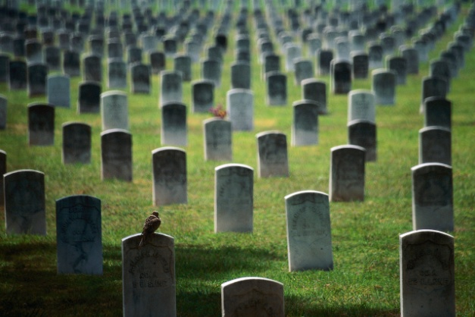
Death and Sickness
Are Unnatural
They were not part of creation, but came due to sin—that of Adam and Eve.
  Death is judicial, not natural. It is a sentence.
  Therefore, just as sin entered the world through one man, and death through sin, and in this way death came to all men, because all sinned-- (Rom 5:12 ).
Aging and death should feel wrong.
It is the “new normal”--“There is a time for everything, and a season for every activity under heaven: 2 a time to be born and a time to die” (Ecc 3:1-2 ). We can accept God’s sentence. For Christians, it’s a half-way house.

Slide 6

Death Is Temporary
Immediately after the first sin, the tree of eternal life was barred (Gen. 3:22-24). God in mercy did not allow us to live forever in a state of sin. We die, looking forward to eternal life in a sinless state.
  In heaven, “There will be no more death or mourning or crying or pain, for the old order of things has passed away." (Rev 21:4 )
  In paradise, God gives access once again to the tree of life (Rev. 2:7; 22:2,14).

Slide 7
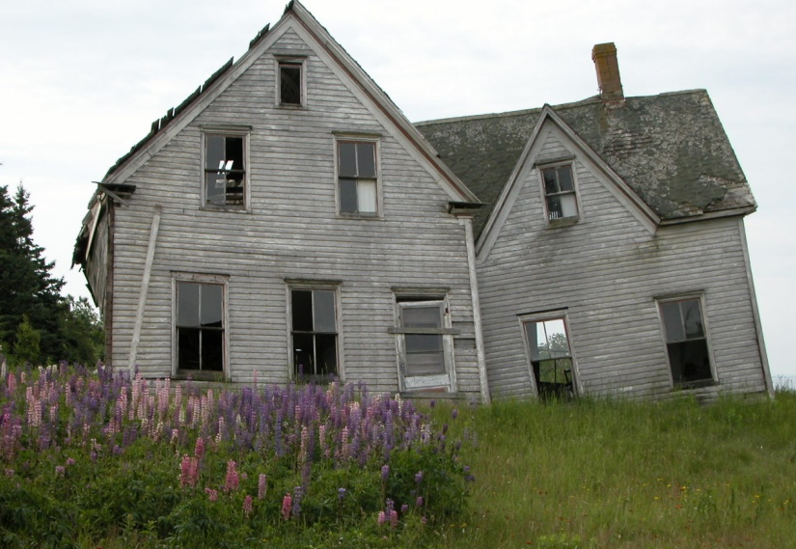
The World is Aging and in Decay
²⁰ For the creation was subjected to frustration, not by its own choice, but by the will of the one who subjected it, in hope ²¹ that the creation itself will be liberated from its bondage to decay and brought into the glorious freedom of the children of God. (Rom 8:20-21 ).
Everything breaks down,
not just people.

Slide 8
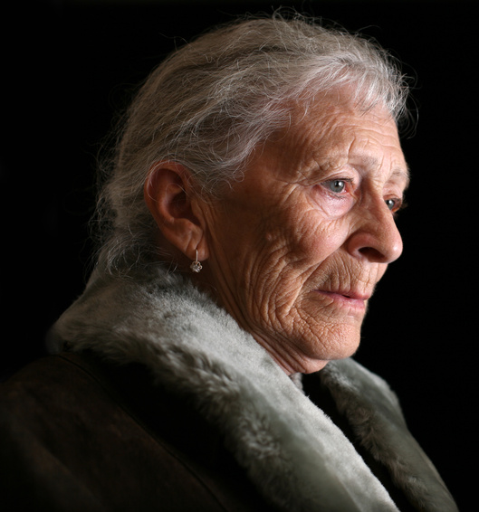
Life Spans Have Decreased
Methuselah died at age 969 (Gen. 5:27).
Abraham died at 175 (Gen. 25:8).
“Moses was a hundred and twenty years old when he died, yet his eyes were not weak nor his strength gone.” (Deu 34:7 ).
Today our lifespan is usually about 70-80 years (Psa. 90:10).
In 2003 I visited a Christian lady who was 128 years old on the island of Dominica, then the oldest living person, who was blind, but could speak.

Slide 9
What Are the Problems of Aging?
Barzillai, who supported King David when he fled Absalom, said “How many more years will I live, that I should go up to Jerusalem with the king? ³⁵ I am now eighty years old. Can I tell the difference between what is good and what is not? Can your servant taste what he eats and drinks? Can I still hear the voices of men and women singers? (2 Sam. 19:34-35)

Slide 10

“Days of Trouble” (Eccles. 12:1)
Loss of interest and motivation.
  “the years approach when you will say, ‘I find no pleasure in them’" (Ecc 12:1 )
    Yet the very old generally still wish to live.
Loss of sight
  “the sun and the light and the moon and the stars grow dark, and the clouds return after the rain”; (Ecc 12:2 )
Loss of teeth
  “the grinders cease, because they are few” (Ecc 12:3)

Slide 11
Loss
Loss of hearing: “the sound of grinding fades” (Ecc 12:4)
Loss of mobility: “the strong men stoop” (12:3)
Loss of sleep: “men rise at the sound of birds” (12:4)
Loss of muscle mass and strength
Loss of sexual desire: “desire is no longer stirred” (12:5)

Slide 12
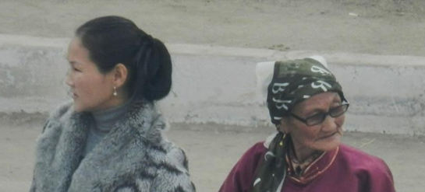
More Loss
Loss of health generally.
Loss of self-image.
  For women, loss of beauty.
  For men, loss of virility, strength and good looks.
  For all, an attack upon our self-image.
  It reveals the basis of our self-esteem.
Loss of usefulness to others. We’re not called upon to serve as we once were.
Loss of importance—in business, socially, and professionally.

Slide 13
Fear and Isolation
More fear: “men are afraid of heights and of dangers in the streets.” (12:4). They cannot defend themselves as they once could.
The elderly are sometimes put away.
  They are warehoused in nursing facilities.
    There often comes a time when the needs of the elderly cannot be met in the home of children. But sometimes we put them there for because they are too great a burden.
  They are sometimes grouped in Sunday School classes and church recreational groups in the USA.

Slide 14
What is our Help in Old Age?
“Do not cast me away when I am old; do not forsake me when my strength is gone.” (Psa 71:9)
God has been helping old people for thousands of years. God has said to His people, "Never will I leave you; never will I forsake you." (Heb 13:5 NIV)
We are not abandoned by God because we are no longer useful to people.
Christians look forward to enjoying a new body: 21 [Jesus] who, by the power that enables him to bring everything under his control, will transform our lowly bodies so that they will be like his glorious body. (Phi 3:21 NIV)

Slide 15
Some Seem to Defy Aging--Caleb
I am still as strong today [at 85] as I was in the day Moses sent me [45 years earlier]; as my strength was then, so my strength is now, for war and for going out and coming in. Now then, give me this hill country about which the Lord spoke on that day, for you heard on that day that Anakim were there, with great fortified cities…” (Josh. 14:11-12)
  “And Caleb drove out from there the three sons of Anak [giants, Num. 13:33] (Josh. 14:14)

Slide 16
Advantages of Aging
Aging itself is an advantage. Long life is not mentioned as among the blessings that the wicked usually enjoy in Ps. 73 and Jer. 12:1-2.
For Christians, we are closer to heaven.
In certain cultures, more respect is given.
There is freedom from certain responsibilities. Among the Lopit tribe of S. Sudan, younger men gather firewood for the aged.
Sometimes there are discounts to seniors [USA].

Slide 17
Aging Advantages
Aches and pains remind us that life is short, to maximize it.
Aging gives us opportunity to glorify God via struggle, something that we cannot do in heaven. (Roger Gulick).

Slide 18

Numbers 8:25-26 “but at the age of fifty, they [Levites] must retire from their regular service and work no longer. 26 They may assist their brothers in performing their duties at the Tent of Meeting, but they themselves must not do the work.”
  This was probably due to physical depletion from sacrifices.
Be “rich toward God” (Lk. 12:21), unlike the rich fool who tried to construct heaven on earth.
  "But God said to him, 'You fool! This very night your life will be demanded from you. Then who will get what you have prepared for yourself?' 21 "This is how it will be with anyone who stores up things for himself but is not rich toward God." Luke 12:20-21
We must save for retirement when we can: “The prudent see danger and take refuge, but the simple keep going and suffer for it.” (Pro 27:12)

Slide 19
The Retirement Equation
Factors influencing retirement:
  Physical and mental health
  National/company policy on retirement
  Presence or lack of retirement income
  The possibility of a second or third career
  The possibility of an early death from inactivity.

Slide 20
Why Some Don’t Retire
In the book Aging Well, George E. Vaillant, M.D. cited a Harvard study on adult development as to why Harvard men aged 75-80 still worked fulltime:
  “I was bored so started a business.”
  “I like challenges, the people, the money.”
  “Nest egg not sufficient after two divorces.”
  “The field I am in is in an exciting phase and people want to pay me.”
  “I love my work. My forthcoming assignment is one of the most difficult of my career.”
  “A writer writes, a painter paints. I enjoy teaching; this is what I do.”
  http://books.google.com/books?id=WoosVi33zcwC&pg=PT152&lpg=PT152&dq=harvard+study+on+retirement+early+death&source=bl&ots=ewaA6DThmN&sig=J-kaPF4LDdZvWHa5eXJaRIcUTq0&hl=en&ei=nFrITtCANZSctwezl4TcCw&sa=X&oi=book_result&ct=result&resnum=4&ved=0CDoQ6AEwAw#v=onepage&q=harvard%20study%20on%20retirement%20early%20death&f=false

Slide 21
Unstoppable: Vonna Biddle
Dr. Henry Krabbendam uses the term “unstoppable”to describe people who do not check out from their service to God, but go “to the wall”.
A friend, Walt Robertson, has this anecdote:
  When I was a teen, our family took a lady named Vonna Biddle back and forth to church with us. She was 65 when she retired as a missionary to Ethiopia with Overseas Missionary Fellowship. She then went to work with Gospel Recordings and was useful there - even going to Narobi for a time - until she retired again in her late 70s. I think she was 80 something when she finally married and loved and cared for her husband in his declining health and buried him. She would then read to people who could not see well enough to do so. The lesson I learned from her is that there is always something left that God will have for us to turn our hands to that we can contribute to his kingdom.

Slide 22
Advantages to Aging
We are hopefully wiser, based upon experience.
  "Sir, What is the secret of your success?" a reporter asked a bank president.
  "Two words."
  "And, sir, what are they?"
  "Good decisions."
  "And how do you make good decisions?"
  "One word."
  "And sir, what is that?"
  "Experience."
  "And how do you get Experience?"
  "Two words."
  "And, sir, what are they?"
  "Bad decisions.“
Age gives unique perspective to understand the times (Frank Brock).

Slide 23
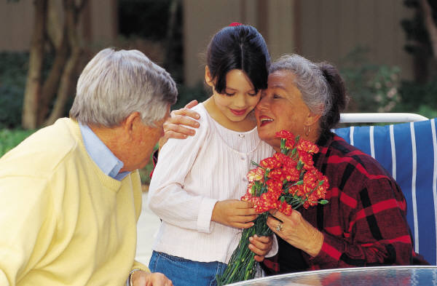
We Should Look More Like Christ
Older Christians should look more like Christ.
  “And we, who with unveiled faces all reflect the Lord's glory, are being transformed into his likeness with ever-increasing glory, which comes from the Lord, who is the Spirit.” (2Co 3:18 NIV)
We take satisfaction in the lives of children and grandchildren (possibly in great-grandchildren). We are blessed when our counsel is sought and when we’re asked to pray for them.

Slide 24
Marriage
This is a time when the couple can enjoy one another, with children grown, and perhaps travel and have quality time together.
Years of growing together can form an amazing bond of unity.

Slide 25
What Redeems Old Age?
To tell the next generations about God’s faithfulness.
  “Even when I am old and gray, do not forsake me, O God, till I declare your power to the next generation, your might to all who are to come.” (Psa 71:18 )
  “…we will tell the next generation the praiseworthy deeds of the LORD, his power, and the wonders he has done. ⁵ He decreed statutes for Jacob and established the law in Israel, which he commanded our forefathers to teach their children, ⁶ so the next generation would know them, even the children yet to be born, and they in turn would tell their children. ⁷ Then they would put their trust in God and would not forget his deeds but would keep his commands.” (Psa 78:2-7 )

Slide 26
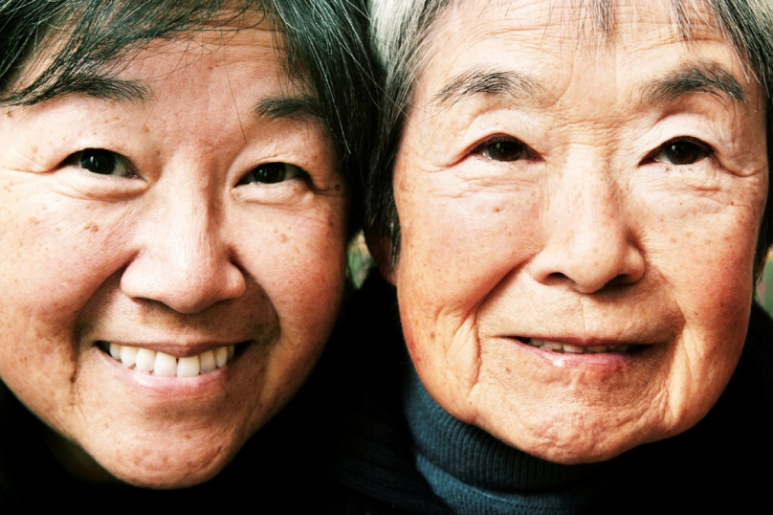
To Perfect Others
We don’t wish to be a burden to others.
  Caring for the elderly is a spiritual test, as marriage, but different in that we deal mostly with infirmity and weakness. It places lopsided demands upon the caregiver—as childhood put lopsided demands upon parents. It isn’t a partnership, as is marriage, but a clearer servanthood. This service increases as the elderly decline.

Slide 27
Dementia
Why does God allow people with mental disease (Alzheimer’s, for example) and other severe diseases to continue to live?
  Perhaps it is to purify those around him or her.
  We may be called, unwillingly, to a ministry of perfecting our family members and others, or to being perfected by them.

Slide 28
Can the Aging Process be Stopped?
People have looked for centuries for the fountain of youth and to alchemy to avoid death.
Miracles of healing and resurrection have this effect (see Matt. 27:52-52, Luke 7:12-15).
Hezekiah begged God not to take his life, and God gave him an extra 15 years.
  Shortly after his being healed, he revealed all his treasure to the Babylonians, enticing them to conquer Judah. (Isaiah 38:1-5, Isaiah 39).

Slide 29
Stewardship of Our Body
Our body is a gift of God to us. Without a body we do not have a ministry. With a limited body, we generally have a limited ministry.
We may not reverse aging, but we can make aging less debilitating.
  By eating properly
  By adequate cardio/muscular exercise
  By continuing to learn—e.g. The Teaching Company
  By testing the physical limits (travel, ministry).
    George Field, at 94, regularly visits a nursing home to share the Good News “with the old folks”, and has been doing this for 35 years (2011).
  By watching our self-talk and attitude.
    “How are you doing?” “All right, for an old man.”

Slide 30
Hit the Gym
We pay now the pain of exercise, or we will pay later in loss of function.
Don’t dig your grave with your own fork.
  Is my diet killing me?
  Part of the fruit of the Spirit is self-control. If we can’t control ourselves, the Spirit can, if we sincerely ask (Rom. 8:13).
If you can’t go to a gym, do pushups, sit-ups, and push-aways (from the table).

Slide 31
Evaluating Our Life
Erik Erikson proposed eight developmental stages in life.
  The eighth and last stage is “integrity versus despair”. At this stage he believes that we look back upon life to see if we have successfully met the challenges of the earlier stages (integration), or if we have not been successful (despair).
Being born in 1946, I can say that I do look back upon my life to see if it has been lived well, and whether or not I’ve accomplished the work God gave me to do (Eph. 2:10--read). This question haunts me.

Slide 32
Criteria
How do we evaluate our life?
  By whether or not we have had a happy marriage?
  If our children are wise and godly?
  If we have had professional and vocational success?
  By how much fruit we’ve seen in ministry?
Whose opinion matters—mine, my spouse’s, my friends’, or the speakers at my funeral?

Slide 33
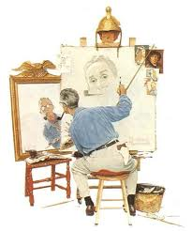
Self-image

Slide 34
Thinking Too Highly of Ourselves
The wicked think too highly of themselves.
  ²[I]n his own eyes [the wicked person] flatters himself too much to detect or hate his sin. (Psa 36:1-2 ).
Christians have the same tendency.
  ³For by the grace given me I say to every one of you: Do not think of yourself more highly than you ought, but rather think of yourself with sober judgment, in accordance with the measure of faith God has given you. (Rom 12:3 ).

Slide 35
Pride
One of my biggest sins has been to think more of myself than facts justify, and far less of others than the facts justify.
  I remember starting a doctoral program, talking far too much in seminars. The longer I was in doctoral studies, the less I said. The longer I live, the greater the appreciation I have for the accomplishments of others, and the less I have of my own.

Slide 36
A More Balanced View
We cannot say with any honesty that we have done our best, at any stage of life. On some days, we may have.
  We have not done everything, all the time, to the glory of God (1 Cor. 10:31).
On the other hand, we may have had more positive impact than we realize. We don’t know the ultimate outcome of a tract or message or witnessing to someone. That is one reason I pass out hundreds of New Testaments. It is like passing out a miracle drug. Some will take it, and be given life.

Slide 37
We Are Saved By Faith
Christians are saved by faith in Christ alone, but faith that is alone, without good works, is not saving faith.
True Christians can rejoice that their name is written in heaven (Luke 10:20).
  Every Christian will receive far more than is deserved, since no one deserves to go to heaven.
  This is consolation enough for us, for now.
  If we have suffered persecution for Jesus, our reward will be great (Matt. 5:11-12).

Slide 38
Our Sins Removed
Instead of despair in old age for our failures, and everyone has failures, we can be thankful that the blood of Christ cleanses us from all sin (1 John 1:7).
Old age gives us the opportunity to try to reconcile with those we have offended.
  I committed sins of omission with regard to a man who was very kind to my family and me. He had cancer, and I wrote to him and called him up and did my best to ask forgiveness and pay him back for his kindness.

Slide 39
An Audience of One
Ultimately, we don’t have to satisfy ourselves in an evaluation, or anyone else—our lives must please God.
The apostle Paul wrote:
  ³ I care very little if I am judged by you or by any human court; indeed, I do not even judge myself.
  ⁴ My conscience is clear, but that does not make me innocent. It is the Lord who judges me.
  ⁵ Therefore judge nothing before the appointed time; wait till the Lord comes. He will bring to light what is hidden in darkness and will expose the motives of men's hearts. At that time each will receive his praise from God. (1Co 4:3-5 ).

Slide 40
Wait to Evaluate
Our judgment is biased. God alone can distinguish among wood, hay and stubble and precious gems in our life.
But Christians have a much better hope of the next life than do those of other religions.
  ¹¹ You have made known to me the path of life; you will fill me with joy in your presence, with eternal pleasures at your right hand. (Psa 16:11 )

Slide 41
Other Religions
Muslims must await the judgment of the two angels, recording their deeds on the right and left shoulders, to see if their good deeds have outweighed their bad deeds by at least a 51-49% ratio.
Hindus believe that they have perhaps thousands of lives ahead of them, the next one dependent upon their good deeds (karma) in the last life.
Buddhism is quite varied, but generally looks forward to Nirvana after many reincarnations, in which a person merges into all that is--an impersonal state of bliss and complete emptiness.
Atheists have nothing but extinction to which to look forward.
The hope of many Jews is their children.

Slide 42
Counsel to the Young
Don’t despise wrinkles. You may be fortunate enough to get some. Those years may seem far away, but will come. Do not despise the elderly (Prov. 23:22).
Care for your parents and grandparents:
  But if a widow has children or grandchildren, these should learn first of all to put their religion into practice by caring for their own family and so repaying their parents and grandparents, for this is pleasing to God. (1Ti 5:4 NIV)

Slide 43
A Warning to Youth
Solomon wrote:
  ⁹ Be happy, young man, while you are young, and let your heart give you joy in the days of your youth. Follow the ways of your heart and whatever your eyes see, but know that for all these things God will bring you to judgment.
  ¹⁰ So then, banish anxiety from your heart and cast off the troubles of your body, for youth and vigor are meaningless. (Ecc 11:9-10 )

Slide 44
Counsel for Youth
Paul gives more direction: Flee the evil desires of youth, and pursue righteousness, faith, love and peace, along with those who call on the Lord out of a pure heart. (2Ti 2:22 )
  You will have far fewer regrets if you do.
Try to emulate Christ in his purity, associations, love and good deeds. That is the goal of life, for the young and, still for the old.

Slide 45
In Summary
Be thankful for the life you have, and enjoy it.
Old age is a gift.
Be a good steward of your age and body.
Care for the elderly.
Wait to evaluate your life.

