Slide 1
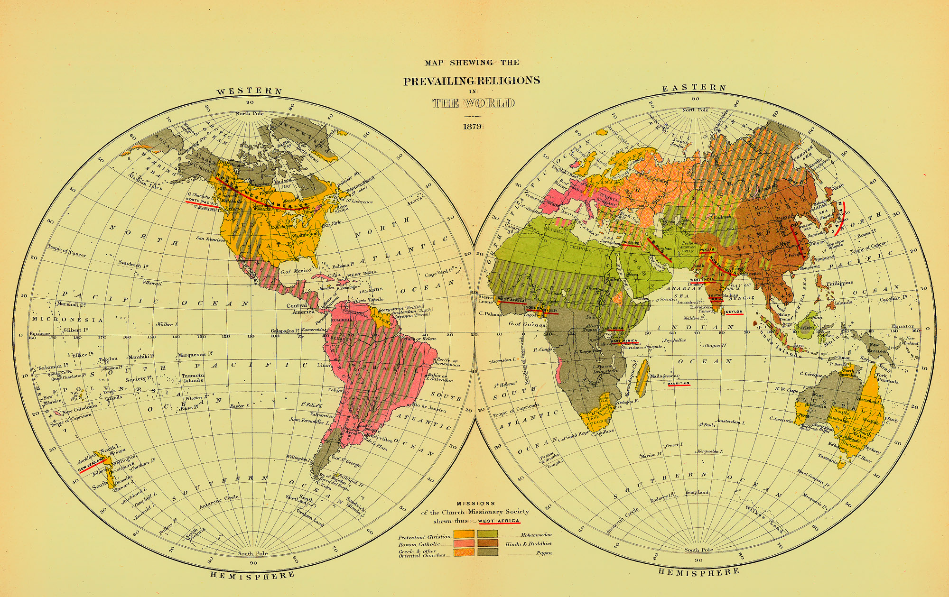
Treasures of the
Day Missions Library
Early African American
Missionaries

Slide 2
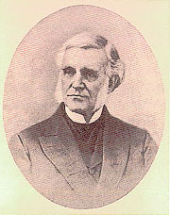
The Day Missions Library
George Edward Day was a professor of Hebrew at Yale who had an avid interest in foreign missions. After his retirement he dedicated himself to building a collection of books related to missions. The Day Missions Library was established in 1892. By 1932, there were more than 20,000 books in the Day Missions Library - 2/3 of the entire Divinity Library collection at that time.

Slide 3
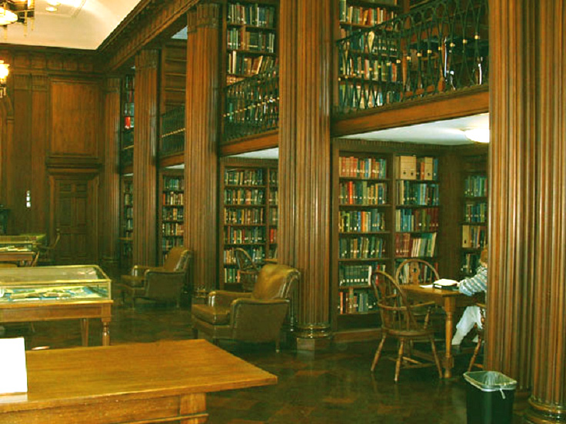
The original Day Missions Library building downtown was replaced by the Day Missions Room when the Divinity School moved to Prospect Street in 1932.

Slide 4
The original focus of the Day Missions Library was on collecting:
the history of missions in various countries
missionary biography
history and annual reports of missionary societies
missionary periodicals
works prepared by missionaries for the use of natives
Now an increasing focus on documenting World Christianity

Slide 5
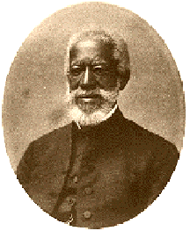
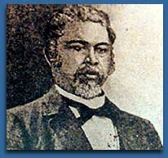
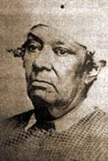
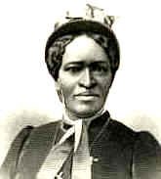
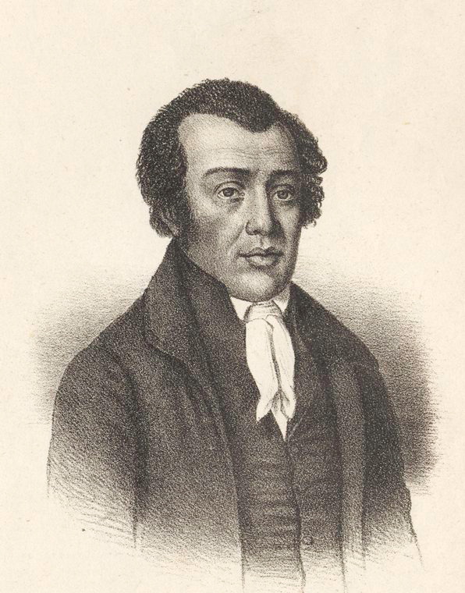
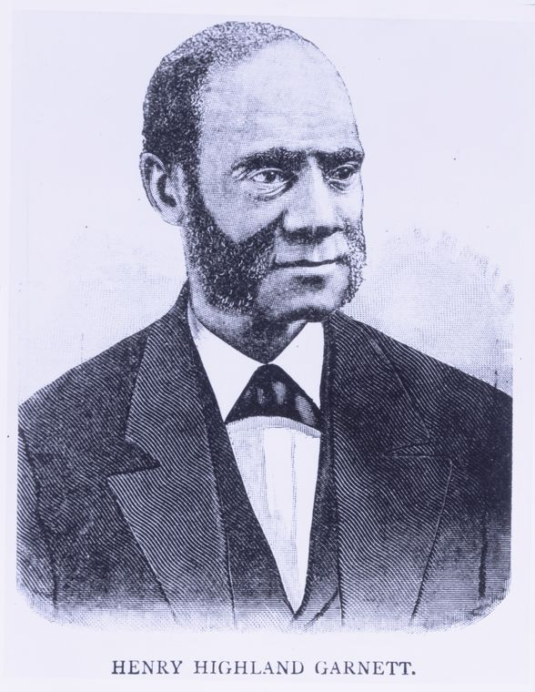
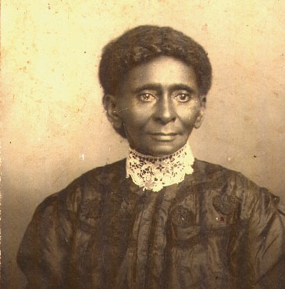
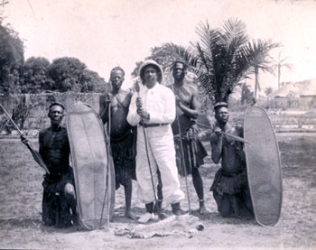
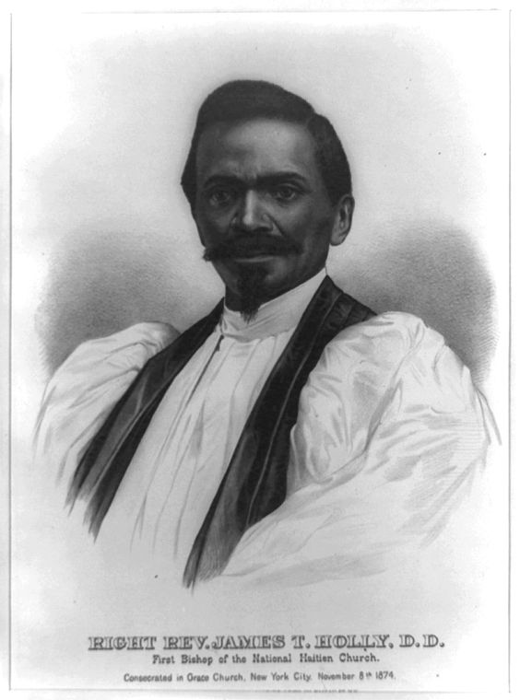
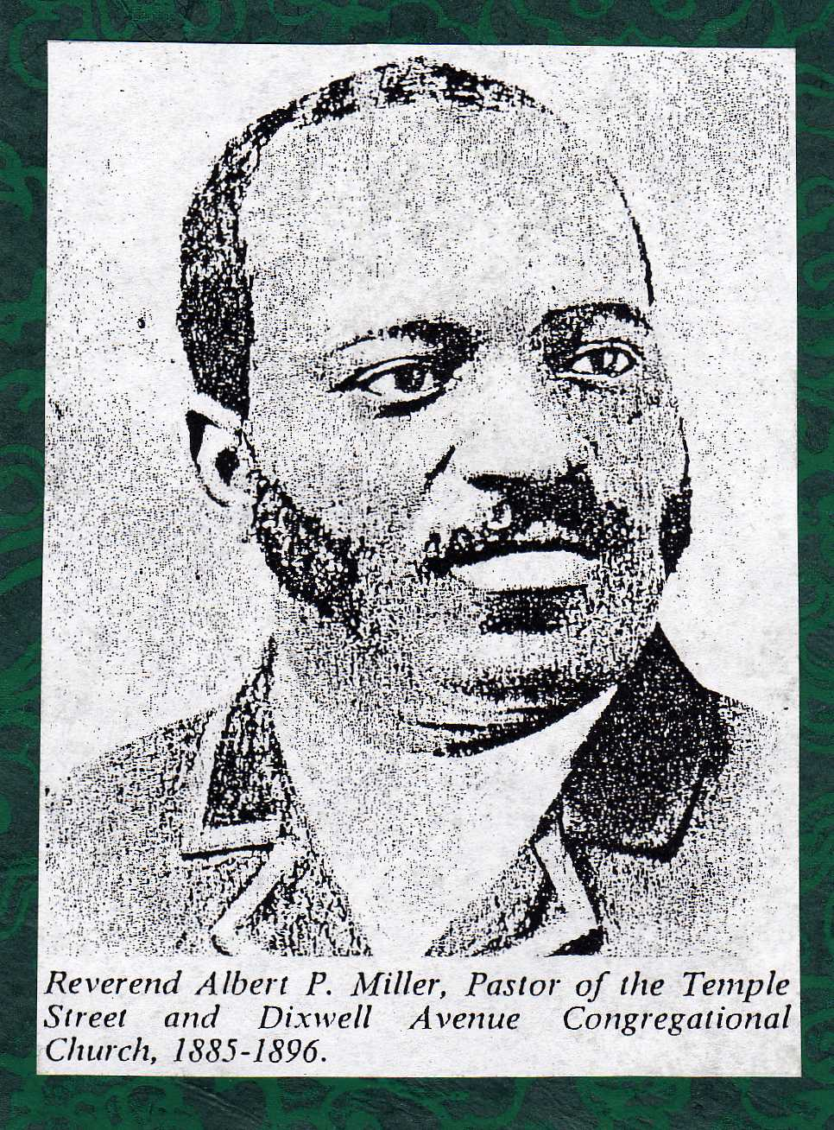
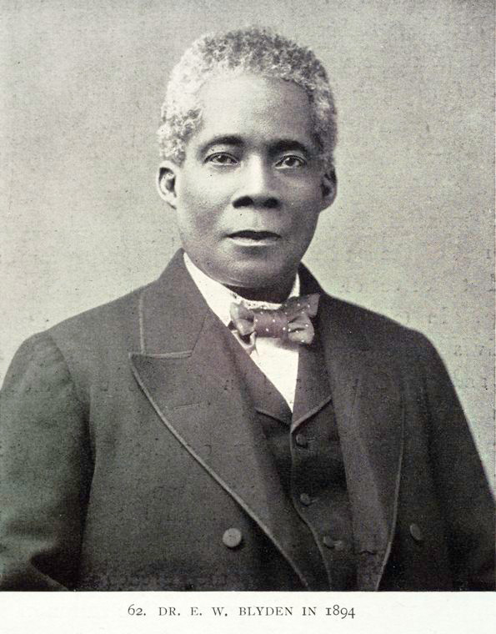
A few stories of adventurous individuals….

Slide 6
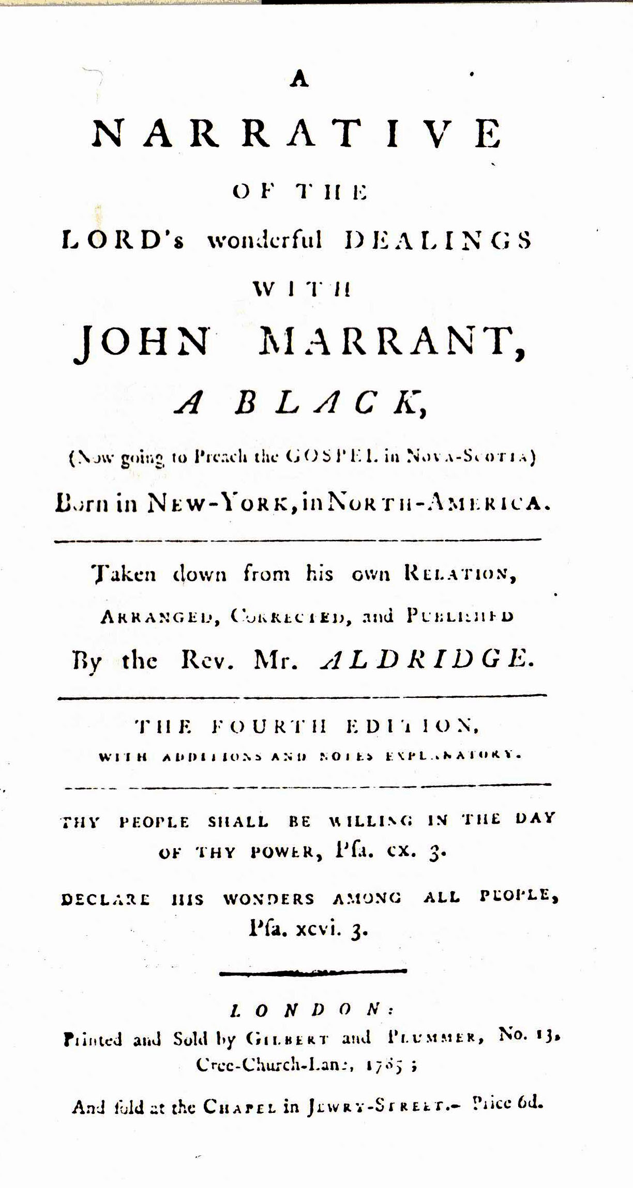
John Marrant, a free Black from New York, was one of America’s earliest missionaries to Native Americans. Marrant was a musician converted by hearing evangelist George Whitefield. Rejected by his family, Marrant lived among and preached to the Cherokee, Creek, Catawar, and Howsaw Indians from 1770 to 1775.
to
NATIVE
AMERICANS

Slide 7
George Liele is considered to be the first American overseas missionary. In 1782, hearing that the British were declaring peace with the colonies, he indentured himself to a British officer in order not to be re-enslaved by his former master's heirs. He and his family moved to Kingston, Jamaica. After two years he had paid back his indenture and was able to devote all his energy to preaching. With four other former American slaves, he formed the First African Baptist Church of Kingston.
to
JAMAICA

Slide 8
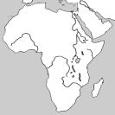
Much of early African American missionary activity was related to movements to repatriate freed Blacks – send them back to Africa. Individuals on either end of the political spectrum were interested in pursuing this idea – Southern landowners who were afraid that the freed Blacks would cause unrest and Northern abolitionists and clergy who thought that Blacks would be happier back in their original homeland. There was tension in the African American community about whether repatriation was a good idea, and if so, where Blacks should go.

Slide 9
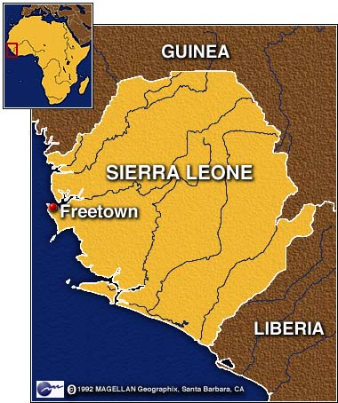
In 1787, British philanthropists founded the "Province of Freedom" which later became Freetown, a British crown colony and the principal base for the suppression of the slave trade. By 1792, 1200 freed slaves from Nova Scotia joined the original settlers, the Maroons. Another group of slaves rebelled in Jamaica and traveled to Freetown in 1800.

Slide 10
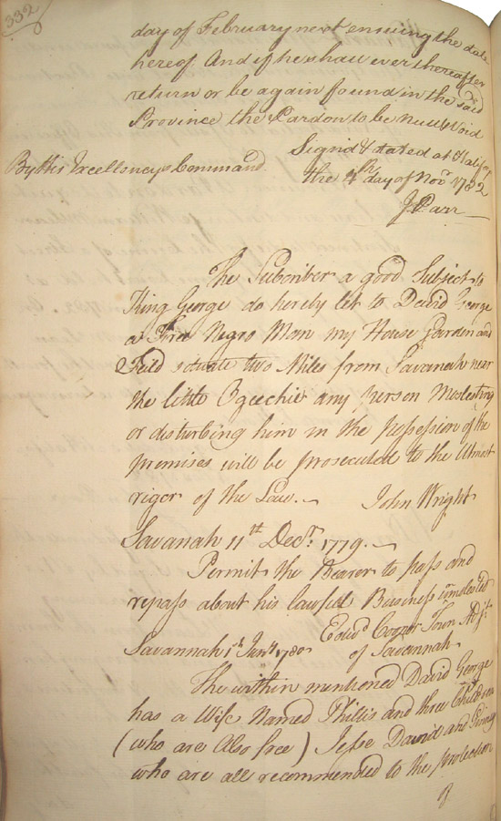
David George left the Silver Bluff, S.C. Baptist Church – the first Black Baptist church in America - to go to Nova Scotia and minister to exiled Blacks there. Later, in 1792, he traveled with 12,000 Black settlers to Sierra Leone, West Africa where Great Britain had established a city of refuge for former slaves.
to
SIERRA
LEONE
Approximately 10,000 Black people emigrated to Nova Scotia, between 1749 and 1816.
Document shown records leases and passports for George and his family.

Slide 11
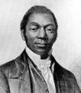

The Mendi Mission was established in Sierra Leone connection with the Amistad revolt. When the thirty-five surviving Africans returned to the Colony of Sierra Leone, the Amistad Committee instructed the Americans to start a "Mendi Mission" in Sierra Leone.
James W. C. Pennington, who unofficially attended Yale Divinity School in 1830s and is believed to be the “First Black Student” at Yale was instrumental in forming the Mendi Mission.

Slide 12
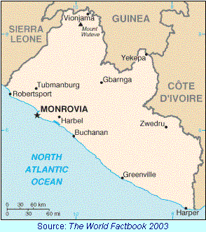
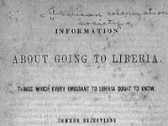
The American Colonization Society was formed in 1817 to send free African Americans to Africa as an alternative to emancipation in the United States. In 1822, the society established on the west coast of Africa a colony that in 1847 became the independent nation of Liberia. By 1867, the society had sent more than 13,000 emigrants.

Slide 13
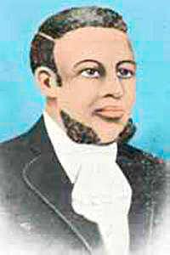
Lott Carey, born a slave in Virginia, became pastor of the African Baptist Church in Richmond and in 1815 led in the formation of the Richmond African Baptist Missionary Society. Carey sailed for Africa in January 1821 with a group of Black emigrants. They initially joined the settlers of the American Colonization Society in Sierra Leone, but in 1822 Carey moved to Monrovia, Liberia where he established the first church in Liberia, Providence Baptist Church, and ministered to the congregation as well as to native tribes.
to
LIBERIA

Slide 14
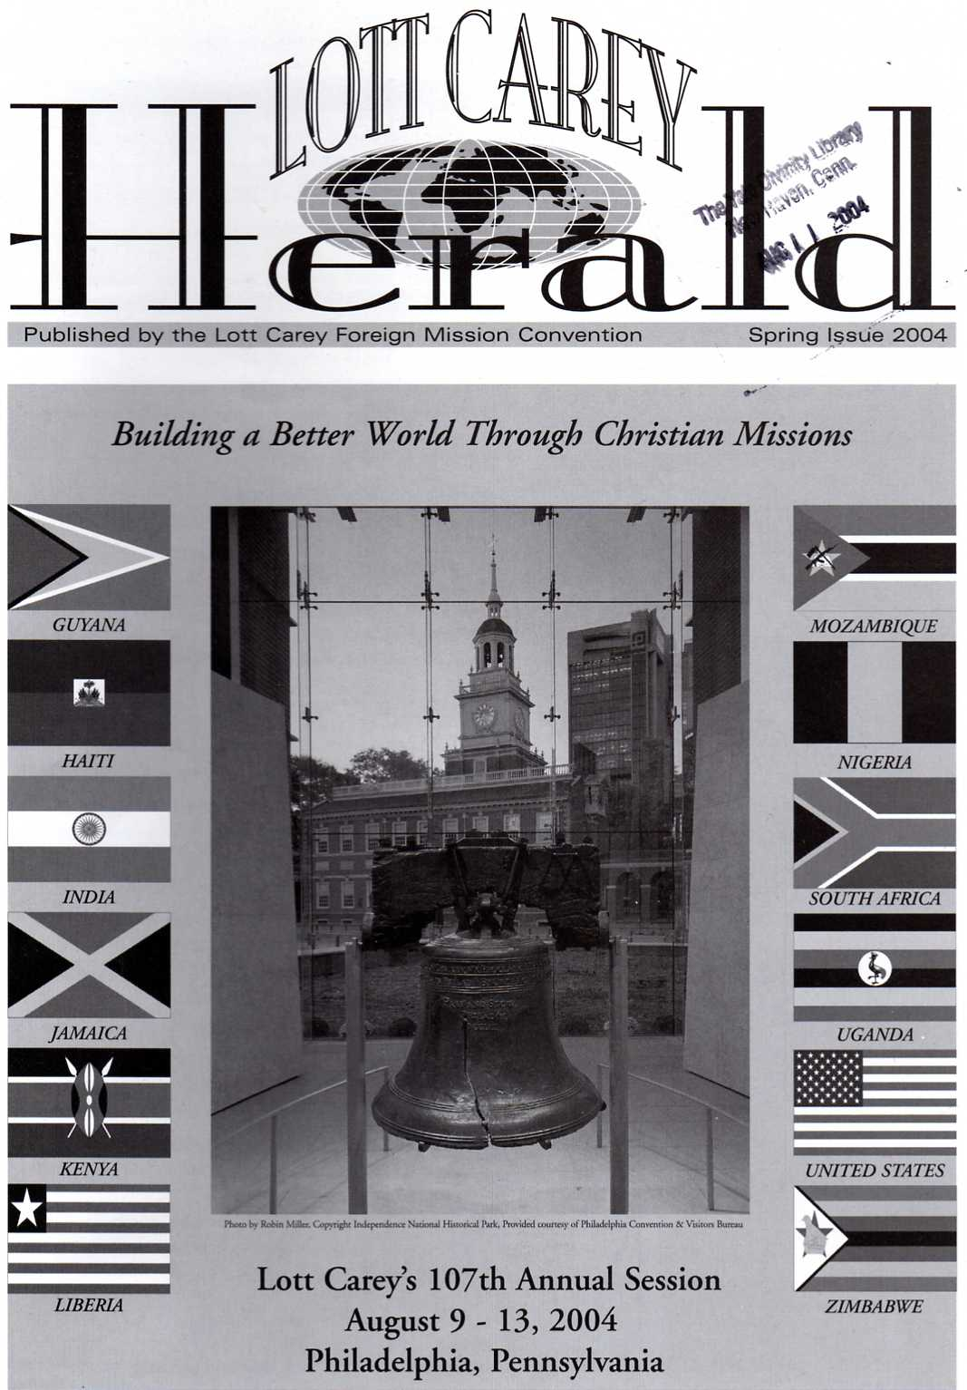
The Lott Carey Foreign Mission Convention, which was named after Carey, continues to be an active mission agency. It was founded in 1897 by African-American Baptists who were committed to a substantial foreign mission thrust – especially on the African continent.

Slide 15
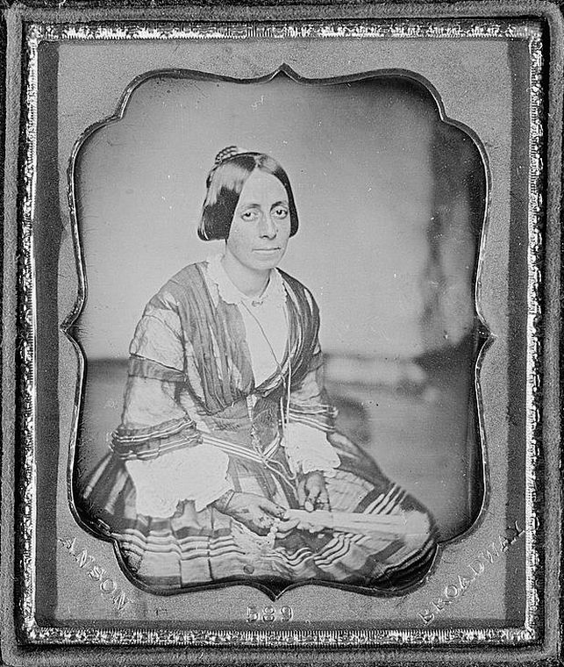
Though not an appointed missionary, Jane Waring Roberts’ life illustrates the important role of African-American women in the settlement of Liberia. Free women of color, in the North as well as the South, played crucial roles in organizing emigration. Jane Waring Roberts, the daughter of a Baptist minister, immigrated to Liberia from Virginia in 1824. Twelve years later, she became the second wife of Joseph Jenkins Roberts, Liberia's first president. In 1887, she started a project to build a hospital at Monrovia.
to
LIBERIA

Slide 16
Born in St. Thomas in the U.S. Virgin Islands, Edward Blyden traveled to the United States, where he gained his first exposure to American racism. After the passage of the 1850 Fugitive Slave Act, he sailed to Liberia in December. Between 1858 and 1861, he was principal of a high school, was ordained as a Presbyterian minister, and served as the editor of the Liberia Herald.
to
LIBERIA

Slide 17
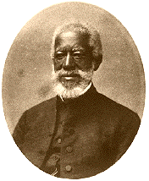
Alexander Crummell unofficially attended Yale Divinity School in the early 1840’s and pastored St. Luke’s Episcopal Church in New Haven. He subsequently graduated with a theological degree from Queens College, Cambridge in 1853 and served as a missionary of the Episcopal Church in Liberia for twenty years.
to
LIBERIA

Slide 18
Born into slavery, Richard Allen purchased his freedom while in his twenties and settled in Philadelphia. Allen founded the African Methodist Episcopal (AME) Church, which quickly became an important pillar in black institutional life. In 1830, he helped organize the American Society of Free Persons of Color and became its first president. Allen argued for Haiti as an alternative to Liberia for emigration of Blacks in America.

Slide 19
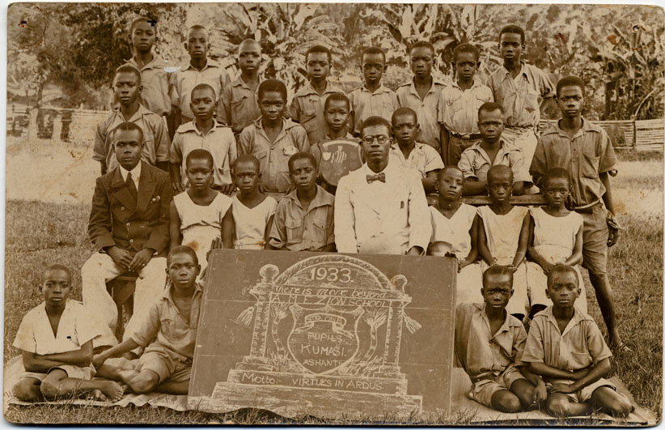
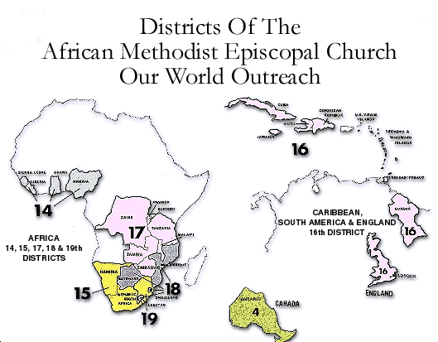
The African Methodist Episcopal Church developed an active mission program in Africa and the Caribbean, which continues into the present era.

Slide 20
Amanda Smith (1837-1915), African Methodist Episcopal Church evangelist and missionary, was born a slave in Maryland in 1837. She preached throughout the country, spent one year in England, two years in India, and 8 years in Monrovia, Liberia, West Africa. She later opened an orphanage in Illinois which was the only institution open to Negro orphans in the state.
to
LIBERIA

Slide 21
Born a slave near Gainesville, Alabama in 1838, Maria Fearing learned to read and write at age thirty-three and worked her way through the Freedman's Bureau School in Talladega to become a teacher. At age fifty-six she went to the Congo, where for more than twenty years she worked as a Presbyterian missionary and eventually established the Pantops Home for Girls.
to
CONGO

Slide 22
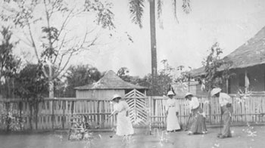
Mary Fearing and other African American missionaries in Congo playing croquet.

Slide 23
to
CONGO
William Henry Sheppard (1865-1927) was one of the earliest African-Americans to become a missionary for the Presbyterian Church. He spent 20 years in Africa, primarily in and around the Congo Free State, and is best known for his efforts in publicizing the atrocities committed against the Kuba and other Congolese peoples by the Belgians.

Slide 24
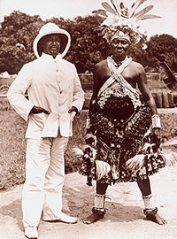
William Sheppard was known as the
“Black Livingstone”

Slide 25
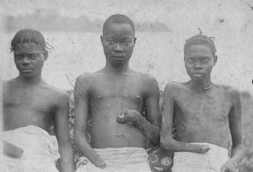
Belgians working in the Congo cut off the hands of villagers who refused to harvest rubber. Reports by William Sheppard helped make the world aware of atrocities being committed against the native tribes.

Slide 26
Born into slavery in Maryland, Henry Highland Garnett escaped to New York with his father at the age of nine. An active abolitionist, he supported emigration and was a missionary for the United Presbyterian Church of Scotland in Jamaica in the 1850s. Returning to the United States, Garnett actively sponsored immigration to Haiti and Africa and was a founding member of the African Civilization Society.
to
JAMAICA

Slide 27
In the mid-nineteenth century, James Theodore Holly, a fourth-generation Northern free man, was one of the strongest proponents of immigration to Haiti. As an agent of the Haitian Bureau of Emigration, he led a group of emigrants from New Haven and Canada in 1861. His wife, his mother, and two of his children died shortly after their arrival in Haiti. Although many settlers left the country, Holly remained on the island until his death. He became the first Episcopal bishop of Haiti in 1874.
to
HAITI

Slide 28
Betsey Stockton was appointed as a missionary to Hawaii in 1822 by the American Board of Commissioners for Foreign Missions. She is recognized as the first single woman missionary to go overseas in the history of modern missions. She served as a domestic assistant and conducted a school, teaching classes to the maka‘āinana (commoners) farmers, their wives and children in Maui
to
HAWAII

Slide 29
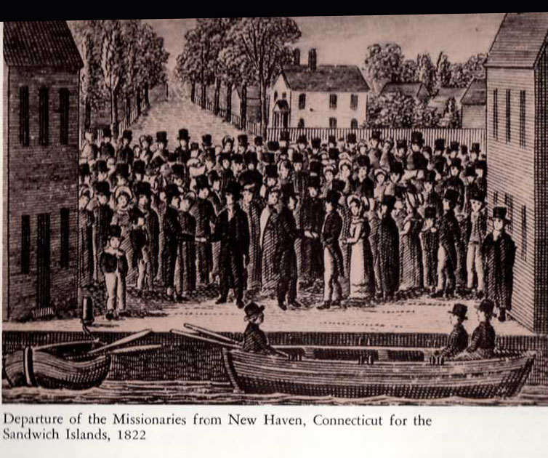

Slide 30
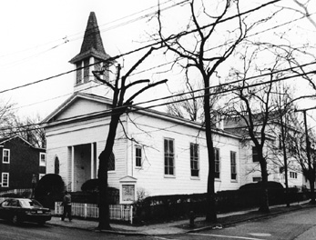
Prior to going to Hawaii, Betsey Stockton had lived in the household of the president of Princeton College, where she had educated herself by reading in his library and had been tutored by Princeton Theological Seminary students. After establishing schools in Hawaii and Canada, she helped to start the first African American Presbyterian Church in Princeton—now known as the Witherspoon Street Presbyterian Church. Later, Stockton founded a night school and persuaded PTS students to teach young African Americans history, English, algebra, and literature.

Slide 31

Some Yale connections…..
Solomon Coles, a former slave, was the first black graduate of Yale Divinity School in 1875. He served as a missionary of the American Missionary Association in Corpus Christi, Texas.
to
TEXAS

Slide 32
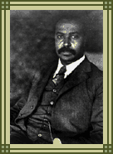
The American Missionary Association originally grew out of a committee organized in 1839 to defend a group of African slaves who had mutinied against their Spanish owners and had brought their slave ship (the Amistad) into U.S. waters to seek protection there. The AMA itself was incorporated in 1846 by the merger of three missionary antislavery societies whose goal was to establish missions for freed slaves overseas.. When the Union armies began freeing slaves during the American Civil War, the AMA opened schools for them. The AMA founded more than 500 schools for freed slaves in the South in the decades following the Civil War.
YDS graduate Henry Hugh Proctor served as vice president of the AMA

Slide 33
Albert P. Miller served as a missionary of West African Mendi Mission for three years before graduating from Yale Divinity School in 1881. He later served as pastor of Pastor of Temple Street/ Dixwell Congregational Church in New Haven from 1885 to1896.
to
SIERRA LEONE

Slide 34
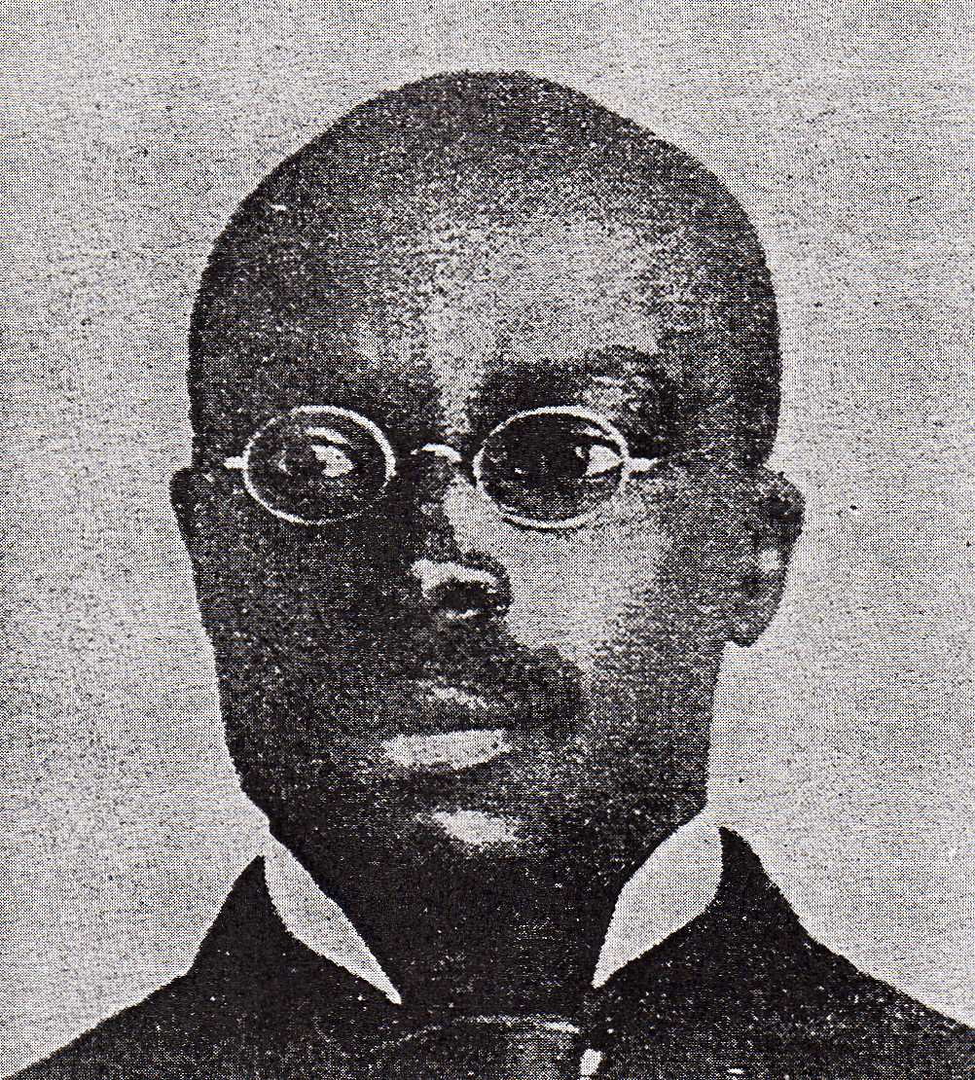
Orishatukeh Faduma was a West African from Sierra Leone who graduated from Yale Divinity School in 1895 and won a scholarship to do further graduate work in religion at Yale. After completion of his studies at Yale, he sought appointment to the American Board of Commissioners for Foreign Missions but was refused a post ostensibly for financial reasons. Subsequently, he accepted an American Misssionary Association appointment to head the mission church and school at Troy, North Carolina. He served for almost fifty years as a missionary educator in the American South and West Africa.

Slide 35
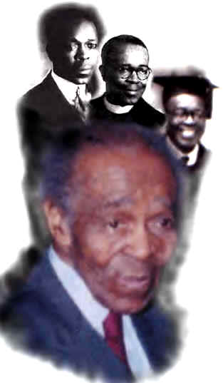
Josephus R. Coan, who graduated from Yale Divinity School in 1933 and died in 2004 at the age of 101, was a missionary in South Africa from 1896 to 1908 before going on to become a renowned Christian educator at the Interdenominational Theological Center in Atlanta.
to
SOUTH AFRICA

Slide 36
How are the stories documented?
Books
Journals
Annual reports
Pamphlets
Manuscripts
Photographs
Artifacts

