Slide 1

African Americans and
Cross-cultural Missions
Jim Sutherland, Director RMNI.org 423-822-1091

Slide 2
Overview of Black Missions
Perhaps 70 African American global missionaries served between 1790 and 1820¹.
Perhaps another 600 served in Africa
between 1820 and 1980².
About 155 were identified in 1998³. Possibly 400-500 serve today, far less than 1 percent of the 126,650 US foreign missionaries⁴. African Americans are about 13 percent of the US population. That would be 16,464 African American missionaries. I’ve located about 110 so far in 2010 that are serving for at least two years.
1 Marilyn Lewis, www.urbana.org/_articles.dfm?Recordid=230
2 Sylvia Jacobs, “African Missions and the Af-Am Christian Churches,” p. 22, Encyclopedia of Af-Am Religions, 1993.
3 Jim Sutherland, Ph.D. dissertation, www.RMNI.org/dissertation, p. 5
4 World Christian Database, 2010

Slide 3
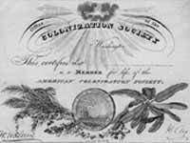
Outstanding AfAm Missionaries
John Marrant by 1775 had somehow preached the Gospel to the Cherokee, Creek, Catawar and Housaw Indians.
George Liele by 1791 had established a church of 350 in Jamaica, despite persecutions.
Prince Williams established a church in the Bahamas in 1790 that spawned 164 other Baptist churches. He pastored from age 70 to 104.
Lott Carey in 1821 was the first African American missionary to Africa. He went to escape racism and to serve his motherland. He was sent by Baptists and the American Colonization Society, established to return Blacks to Africa.
Sources: Sylvia Jacobs, Marilyn Lewis, Alan Neely, Wm. Sereile, Wycliffe Translators

Slide 4
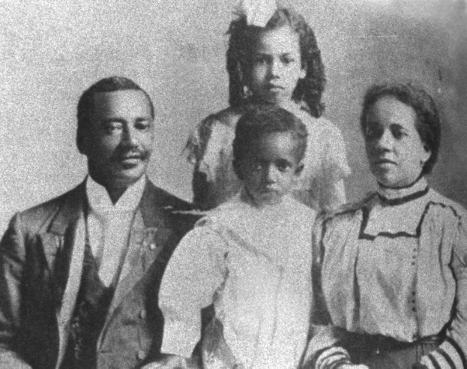
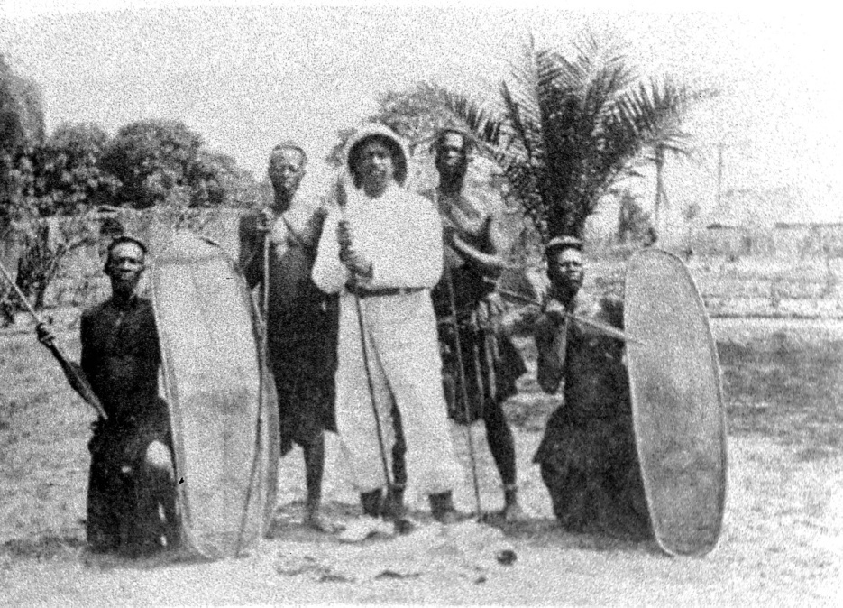
Dr. William Sheppard
Dr. Wm. Sheppard went to the Congo in 1821, becoming head of the American Presbyterian Congo Mission among the Bakuba tribe, going 1200 miles inland.
He build churches, day schools and homes for children rescued from slavery.
His wife published the first book and hymnal in the Bakuba language.
Sources: Wilbur Harr, Sylvia Jacobs, John Hendrick and Winifred Vass

Slide 5
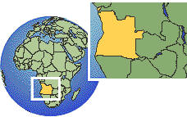
Dr. Aaron McMillan
Dr. Aaron McMillan was a physician and Nebraska legislator before going with the American Board of Commissioners in 1929 to head an Angolan hospital.
He trained assistants, treated over 80,000 patients and performed over 3,000 surgeries during his medical ministry¹.
1 Wilbur Harr, 1945. “The Negro as an American Protestant missionary in Africa”. Ph.D. dissertation, microfilm, University of Chicago, pp 54-55.

Slide 6
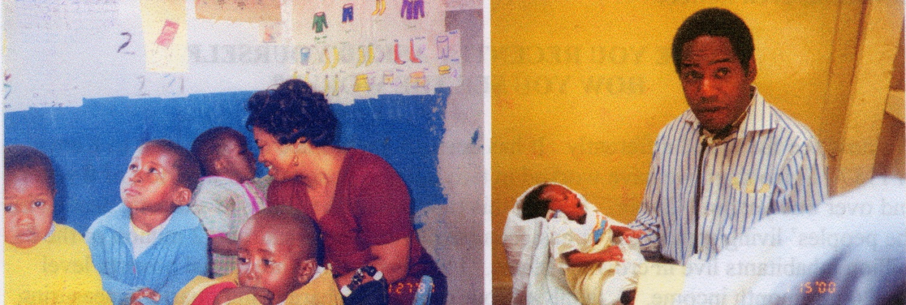
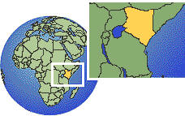
Dr. Michael & Kay Johnson
Dr. Michael Johnson serves with World Gospel Mission in Philadelphia and in Kenya, East Africa. They have a street ministry (The Least of These) to care for abandoned and orphaned children of Nairobi. Kay, his wife, runs development projects in rural Kenya and places orphans.
They have begun inner city ministry in Philadelphia, while continuing work in Kenya. They have started a medical clinic for the poor, spearhead a pro-life ministry and a gun buy-back program.

Slide 7
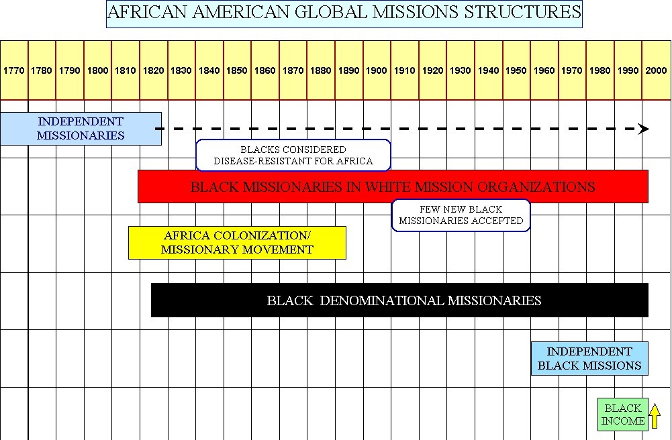
Sources: Wilbur Harr, “The Negro as an American Protestant missionary in Africa,” 1945. Sylvia Jacobs, “African Missions and the African American Christian churches,” 1993; Marilyn Lewis, “Overcoming obstacles: The broad sweep of the African American and Missions,” 2001; Wm. Seraile, “Black American Missionaries,” 1972; U.S. Census Bureau, “Historical income tables—households, Table H-5, 1967-2000”

Slide 8
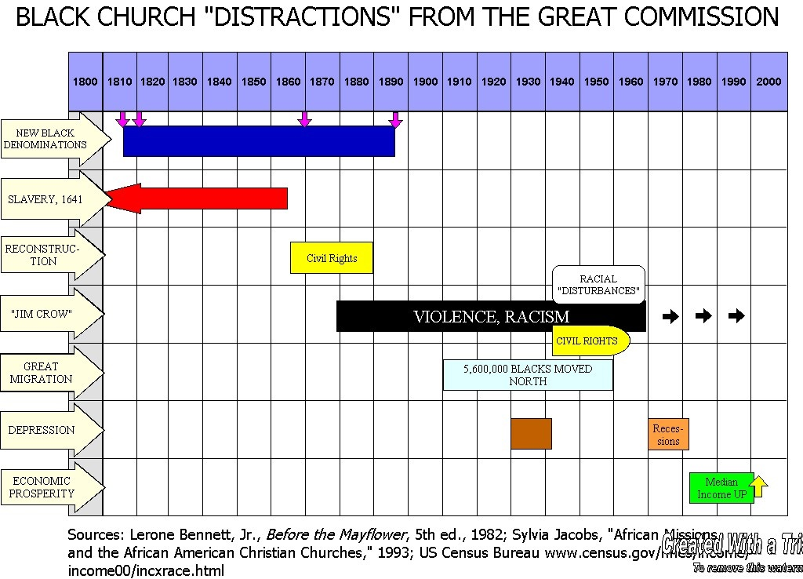
AME AMEZ CME Nat. Bapt. Conv.
Reconstruction
Sources: Lerone Bennett, Jr., Before the Mayflower, 5th ed., 1982; Sylvia Jacobs, “African Missions and the African American Christian Churches,” 1983; U.S. Census Bureau http://www.census.gov/hhes/income/income00/incxrace.html

Slide 9
African American Personal Finances
As of 2008, African Americans had an annual buying power of 803 billion dollars, ranking 17th among world economies in gross national income. Contributions were 1.4% of income¹. Buying power was expected to reach $981 billion by 2010².
This is the first generation with a great chance to have a “piece of the rock.”
1 http://www.targetmarketnews.com/storyid01201001.htm accessed 7/21/102“The US African American Market” MarketResearch.com 2 2http://www.allheadlinenews.com/articles/7002523834 accessed 1/8/07

Slide 10
African American Mission Power
Ghana sent 500 missionaries per year in 2005. Her population in 2008 was 23.4 million and her Gross National Income is 15.1 billion. African Americans spent 17.2 billion on telephone services in 2008.
Sources:
World Christian Database,
The World Bank: http://web.worldbank.org/WBSITE/EXTERNAL/COUNTRIES/AFRICAEXT/GHANAEXTN/0,,menuPK:351978~pagePK:141132~piPK:141109~theSitePK:351952,00.html
Target Market News http://www.targetmarketnews.com/storyid01201001.htm

Slide 11
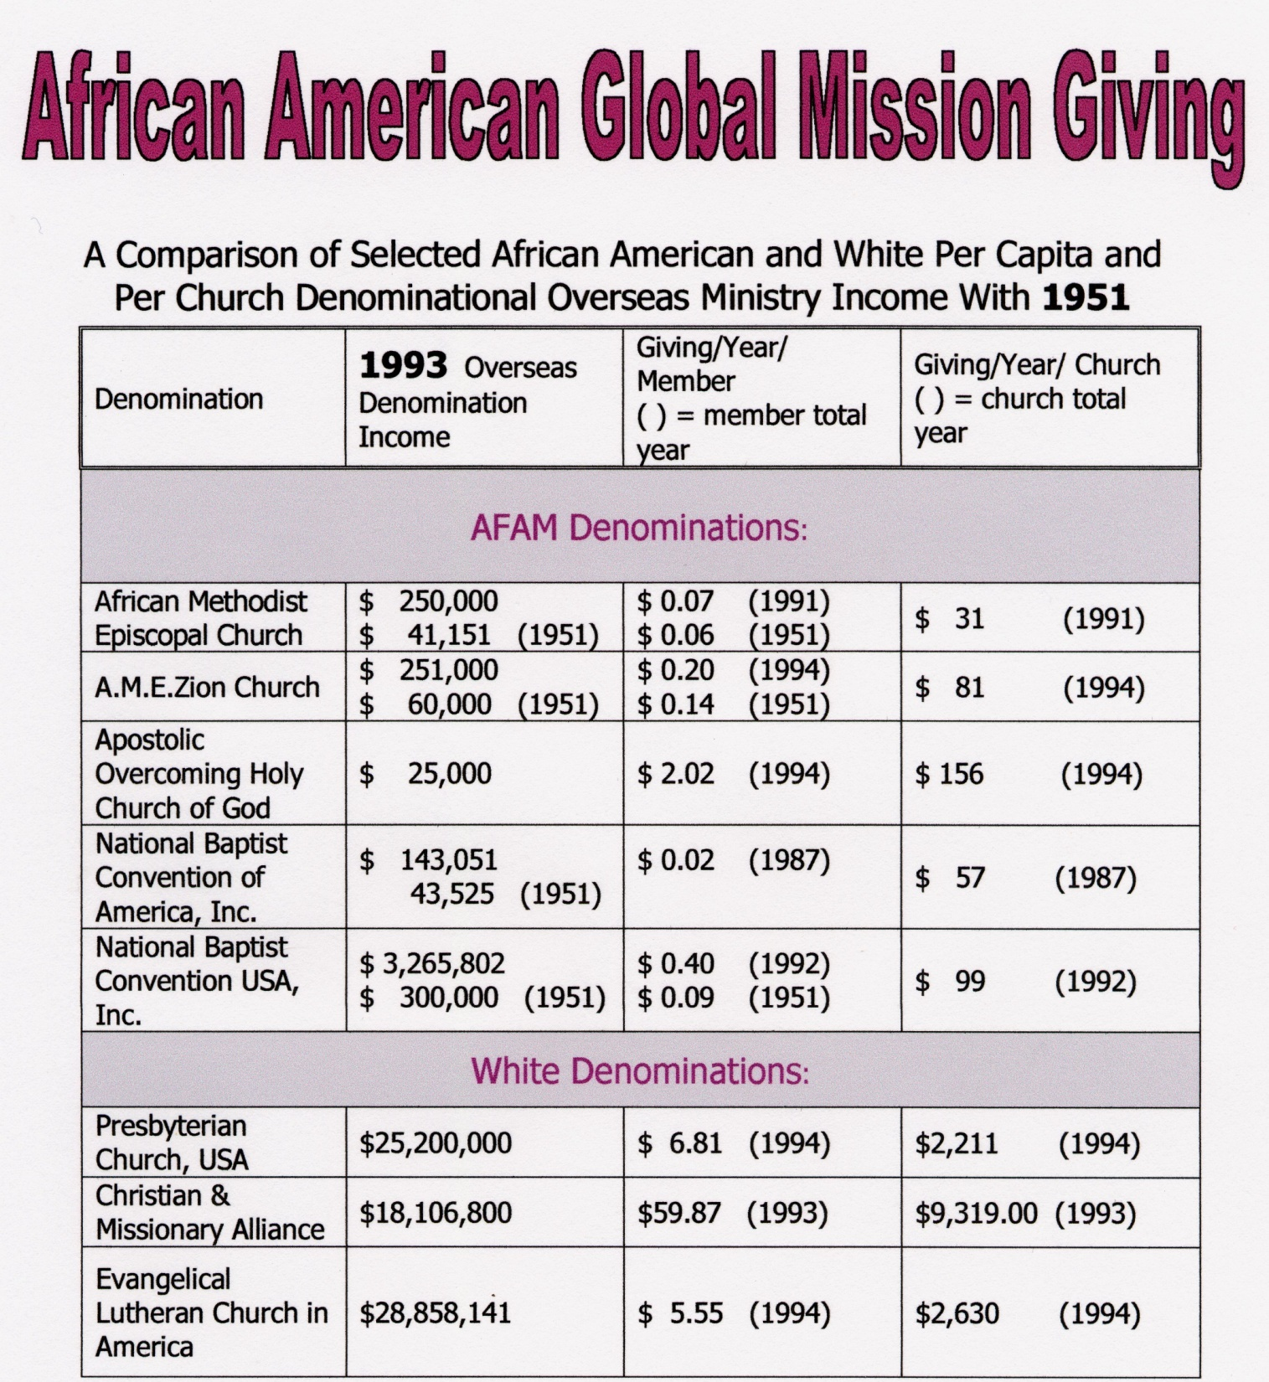

Slide 12
A Traditional Black Church and Global Missions
One traditional church in Chattanooga with a budget of $120,000 spent .4 % on evangelistic home missions (to Blacks).
This church spent NOTHING on global missions. More was spent on the annual men’s breakfast and on the copy machine than on missions.
What percentage of your church budget goes to cross-cultural/global ministry?

Slide 13
Is my religion mostly about God serving ME ?
Some churches focus upon personal peace, wholeness and prosperity.
“Many/most AFAM are 1st generation ‘haves.’ Those who are ‘have nots’ are usually unwilling to leave all for Christ. Until 2nd generation ‘haves’ are born again few if any will leave their community to serve others. Once 2nd generation ‘haves’ move out of AFAM stereotypes of success, a typical service can be affirmed.”
Kyshia Whitlock—African American missionary to Honduras
Note: Kyshia plans to spend the rest of her life in Honduras, and has given herself to orphans.

Slide 14
Outstanding African American Missions Churches
Particularly among newer independent churches, some give substantially.
Rosedale Park Baptist in Detroit gave 1 million to missions over 10 years www.rpbc.net
Christian Stronghold Church in Philadelphia gives at least $110,000 /year for global missions, and supports 6 foreign missionaries They sent short-term teams to Kenya (10 people), Alabama (13 people) and Liberia (6 people) in 2010.

Slide 15
Worlds A, B & C
World A
  The unevangelized world
    =2,106,206,000 as of mid-2014, or 29% of Earth’s population
World B
  The evangelized non-Christian world
    = 2,725,635,000 in mid-2014, or 38%
World C
  The Christian world
    =2,375,619,000 in mid-2014 or 33%
Source: Todd M. Johnson & Peter F. Crossing, “Status of Global Mission, 2014, in the Context of AD 1800-2025,” Int’l Bulletin of Missionary Research, Jan. 2014, p. 29.

Slide 16
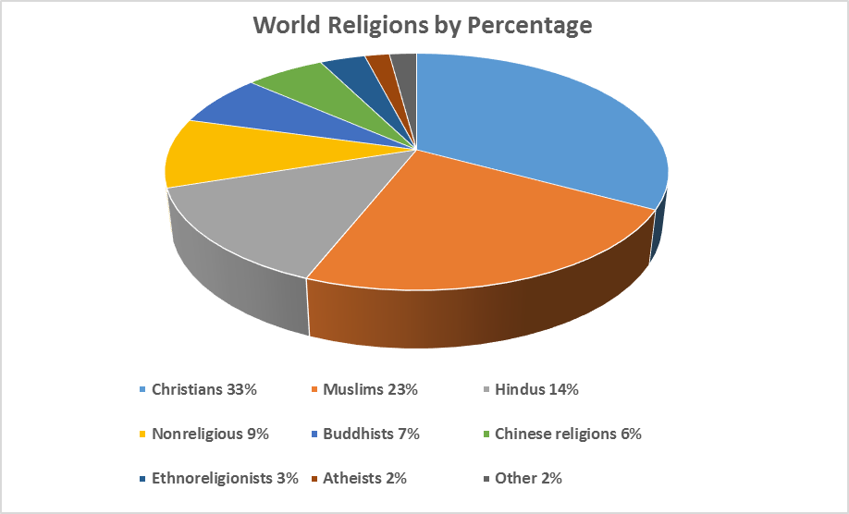
2014
Source: Todd M. Johnson & Peter F. Crossing, “Status of Global Mission, 2014, in the Context of AD 1800-2025”, International Bulletin of Missionary Research, January 2014, p. 29.

Slide 17
World Religions by Population—Mid-2014
Christians | 2,375,619,000
Muslims | 1,660,729,000
Hindus | 1,000,193,000
Nonreligious | 683,000,000
Buddhists | 513,593,000
Chinese folk religionists | 436,413,000
Ethnoreligionists | 250,672,000
Atheists | 136,553,000
Other | 150,688,000
Source: Todd M. Johnson & Peter F. Crossing, “Status of Global Mission, 2014, in the Context of AD 1800-2025”, International Bulletin of Missionary Research, January 2014, p. 29.

Slide 18
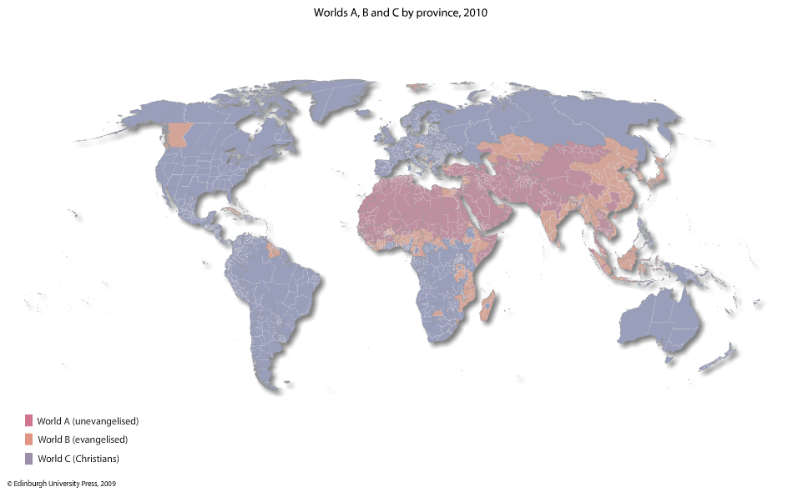
Worlds A, B & C, 2010
Todd M. Johnson, Kenneth R. Ross, eds., Atlas of Global Christianity, 2009, pp. 312-13, ISBN: 9780748632671

Slide 19
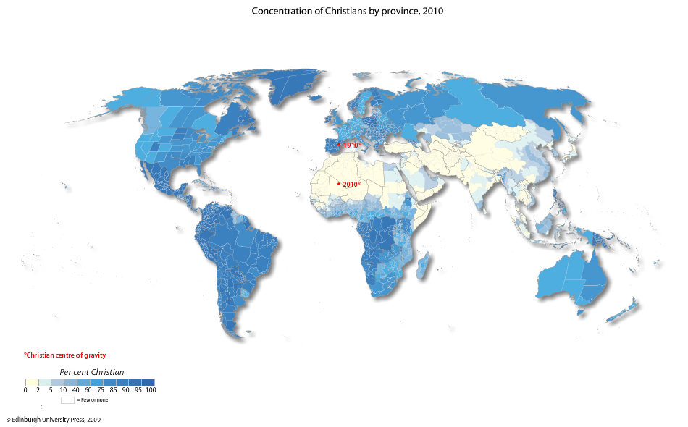
Where Missionaries Are Most Needed
Todd M. Johnson, Kenneth R. Ross, eds., Atlas of Global Christianity, 2009, pp. 56-57, ISBN: 9780748632671

Slide 20
Spectrum of Missionaries
M-1 Frontier missionaries—to World A
M-2 To non-Christians—to World B
M-3 Foreign missionaries—to World C
M-4 Cross-cultural home missionaries
M-5 Home missionaries—near culture
M-6 Pastoral workers--pastors, deacons, preachers, chaplains
M-7 Great Commission Christians-laymen
M-8 Disobedient & nominal Christians
David Barrett & Todd Johnson, World Christian Trends AD 30-AD 2200, p. 31.

Slide 21
Missionary Deployment 2000
Source: http://www.gordonconwell.edu/ockenga/globalchristianity/gd/gd62.pdf

Slide 22
The Harvest Force Has Shifted
An estimated 435,000 foreign missionaries exist in 2014.¹ In 2005, there were 43,899 foreign missionaries from the US and Canada, from 822 North American Protestant mission organizations, representing a 3.8% decline from 2001.² North America provides 9.5% of global missionaries.
There are at least 4,000 Third World mission agencies.³
1 Todd M. Johnson & Peter F. Crossing, “Status of Global Mission, 2014, in the Context of AD 1800-2025”, International Bulletin of Missionary Research, January 2014, p. 29.
2 Mission Handbook, 2007-2009, 20th Ed., Linda Weberd and Dotsey Welliver, eds., p. 12, ISBN: 9781879089402
3 David B. Barrett & Todd M. Johnson, World Christian Trends AD 30-AD 2200, p. 71

Slide 23

Money, comfort, pleasure, reputation, our kingdom, or serving the Lord God?

Slide 24
What does the Lord require of us?
Does hearing “Well done, good and faithful servant” (Matt. 25:21) depend upon how many church services we’ve attended (“pew time” we’ve put in), how many church boards we’ve served on, and how much money we’ve given to the church?
  The context indicates developing the gifts that God has entrusted to us determines God’s verdict upon our service, rather than simply showing up and tithing.

Slide 25
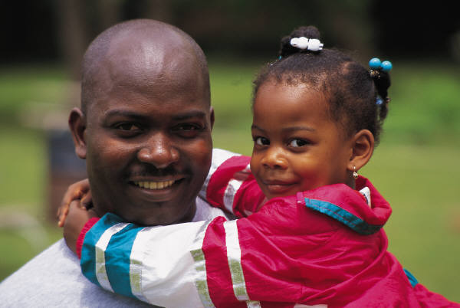
But what about our folk ?
Sinners are born daily among
our own people, and yes, we do have tremendous needs in our neighborhoods. We should try to meet them.
But all ethnic churches are to partner in such a way that every ethnic group is evangelized. Our “Jerusalem” is another Christian’s “uttermost.” The Lord of the Harvest will ensure that every people group will have the Gospel as we obey.
Short-term missionaries can assist national churches and assist home church outreach.

Slide 26
But what about our folk ?
If you protest sending money and people overseas to evangelize and serve, because needs are great at home, do you actually evangelize and go to the housing projects, where needs are greatest?
Can God provide for global missions through your church, and still provide for your local needs?
Is God more likely to bless a church that spreads the Good News of His Son globally, or a church that, in fact, keeps Jesus to herself? Will God bless what is actually a religious club, doing business as a church?

Slide 27
Do We CARE that Pagans are Lost?
Judah was disobedient to God, but thought that as long as they focused upon the Temple, God would not destroy the Temple or them. They said, “We are delivered!” (Jer. 7:10). They were wrong. They should have reformed their actions (7:3).
We focus upon the worship service and each week proclaim God’s deliverance. “Our God is able!” “He is a “Way-maker!”— “He’s an on-time God!”
Isn’t God also interested in making a way for those who haven’t yet heard of Christ? Are we interested only in a way being made for us? If God delivered us, why shouldn’t He use US to deliver others? Maybe God isn’t on time for others because we haven’t shown up yet.

Slide 28
Justice
We want justice for ourselves. Is it just for us to have the Gospel, and do very little to enable others to hear the Gospel?
Many are “doing church,” gettin’ their praise on, while disobedient to the command to go with the gospel (Matt. 28:18-20). Some appear to think that if we have CHURCH, we can forget any consequences for keeping the Gospel among our own people. “God woke us up this morning,” but do we consider those He didn’t wake up, already on their way to Hell?

Slide 29
Do We CARE that Pagans are
REALLY Lost?
God did not wake up thousands this morning who have NEVER HEARD of Jesus Christ. Does this disturb our worship or sleep? Global missions are usually neglected in the black pulpit, and the fulltime cross cultural missionary is an almost invisible church vocation.
We must reform our actions. Having church doesn’t remove responsibility for the nations. Religion is satisfied with security, staying in the Temple, and having church. God isn’t.

Slide 30
Is a slamming choir more important than missions?
Which has higher priority in your church—the choir or global missions?
Whites sometimes think that if they say something needs to be done, they are off the hook.
If our choir sings “Send the Light!” is the church off the hook? Who will actually take the light? Someone else?

Slide 31
Trip to Kenya
A church of 25,000 planned a trip to Kenya in July 2003 to see their bishop “preach to the masses.”
Members were to stay in 5-star hotels, eat at gourmet restaurants, fly in hot-air balloons and go on safari. They could visit their missionaries, at extra charge. They spent more in one night at one of the hotels than they spent on one of their missionaries in 4 years. At the crusade they would attend workshops. They would go to consume and to observe—instead of to serve—encouraged by their own church to do so.

Slide 32
Why Missions Now ?
Global missions is not simply the job of the white church. The African American church is a full partner among the world’s sister churches.
You have a unique role in world mission—especially to people of color, and particularly to the oppressed.
You understand oppression and suffering well, and can easily relate to the oppressed.
As urban-dwellers, you understand the city, where probably the majority of unreached people live.

Slide 33
This is the Time To Engage Missions
Nations open to missionaries are open to African Americans.
Civil rights is (again) law.
White missions welcome African Americans.
Good schools will prepare black missionaries, such as Columbia Int’l University and Moody Bible Institute.
African American mission boards now exist.
The Black community can finance missions.
Short-term missions abound with ease of travel.
It’s globally cool to be African American.

Slide 34
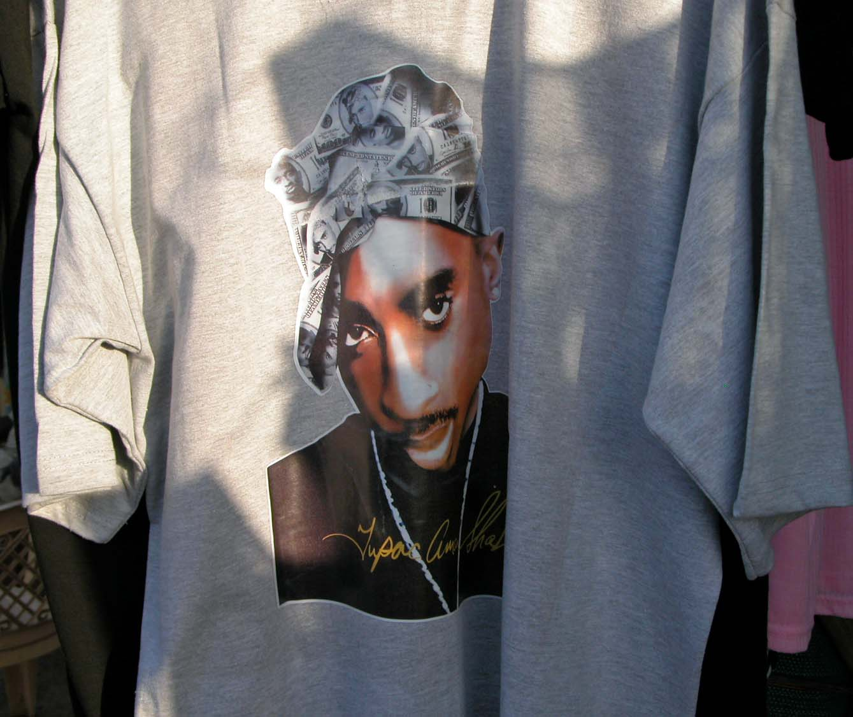
South Sudan market, 2008

Slide 35
Pray
Ask God to show you what He wants of you in ministry. You do want to know that, right? If not, be willing--to be willing.
In 1993 I asked God if He had anything to say to me, after an extended time of prayer. “I want you to go to Africa” was clearly spoken to my spirit. This hadn’t been on my mind for perhaps 17 years. I told God that I was willing to go. Within 10 days I was invited to go to Uganda for several weeks, expenses paid, and within 50 days was on the jet. I’ve gone to Africa many times since.

Slide 36
Every Christian Has a Gift
Every true Christian has at least one spiritual gift (1 Cor. 12:7), both to equip believers for service in the world and to build up the church (Eph. 4: 10-12). This gift cannot be lost, although we’ll be responsible for being a good steward of that gift (Rom. 11:29).

Slide 37
Know your spiritual gifting
As Christians become aware of their gift(s), they will better know for which responsibilities and opportunities they are best equipped, and which work to avoid. If they match work with spiritual gifting, supernatural power will accompany them, and the church will be edified.
  What are your personal spiritual gifts?
  Are you using them diligently?
  A free assessment of your motivational gifting is at www.gifttest.org/

Slide 38
Gifts Overview
Depending upon whether or not the gift of pastor/teacher is reckoned as one or two gifts, there are, by one count, 18 or 19 gifts of the Spirit listed in the New Testament (1 Cor. 12:28-30; Rom. 12:6-8; Eph. 4:7-13).
  (Dispensational and Reformed theology hold to the cessation after the apostolic age of at least some of these gifts.)
More important than knowing which gift we’ve received is using that gift (Rom. 12:6ff.).

Slide 39

Beginning moves
Get involved in some ministry outside the walls of your church. Church is to equip for service, but not simply to other Christians (for example, evangelists should serve those outside the church).
  Consider doing inner city ministry, according to your spiritual gifting.

Slide 40
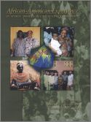

Read mission books
Missionbooks.org is perhaps the best site for current books in Christian missions.
The African-American Experience in World Mission will open your eyes.
A very readable book by African American missionary surgeon, Michael Johnson, MD, is Making the Blind Man Lame (2nd ed.).

