Slide 1

BUDGET
WORKSHOP
BIBLICAL FINANCIAL PRINCIPLES
Jim Sutherland, Ph.D., Director https://rmni.org/financial-ministry.html
Notes:
Stewardship of time add; next week, budgeting, then time stewardship

Slide 2
PLANNING WITH YOUR SURPLUS
God’s plans never fail (Is. 14:27; Ps. 33:11), so we need to try to understand God’s will (Eph. 5:17; Jer. 9:23-24).
Planning is “spiritual” (Prov. 12:5; 16:3)
Get good counsel (Prov. 12:15; 13:10)
God can will in our will (Phil. 2:12-13)
“What has God given you faith to believe Him for ?” Bill Gothard
  Try constructing a financial timeline, using 70 years.

Slide 3
TWO APPROACHES TO SPENDING
From a false assumption
  of what “ought” to be able to spend.
  “I owe it to myself!” “I deserve to be able to ….”—a deductive approach
From actual income/provision
  From within the circle of God’s provision—an inductive approach

Slide 4
Income isn’t the major issue in budgeting
  Here is a list of the nations with the highest percentage of consumers who have no spare cash: 1—America (22%) 1—Portugal (22%) 3—Canada (19%) 4—United Kingdom (17%) 5—France (16%) 6—Netherlands (15%) ACNielson Online Consumer Confidence Survey—Global Survey, 1/11/2005
    But godliness with contentment is great gain--1 Timothy 6:6

Slide 5
HOW TO BUDGET
- 7 STEPS -
1. Pray for wisdom (James 1:5) and for self-control (Galatians 5:23). Habitual overspending is a spiritual issue.
2. BEFORE spending, plan MONTHLY expenses and LONG TERM GOALS (greater than 1 year, requiring savings).
3. Record DAILY expenses in a columnar ledger or software program—keep a running total in each expense category (using the ledger or on the outside of a cash envelope).

Slide 6
HOW TO BUDGET
- 7 STEPS -
4. At month’s end, TOTAL expenses in each category and compare with target figures, and adjust for next month, if needed.
5. Compare ALL expenses and with ALL income.
6. Move any surplus to savings, earmarking it for a particular need.
7. Deduct any shortfall from your next pay before spending it.

Slide 7
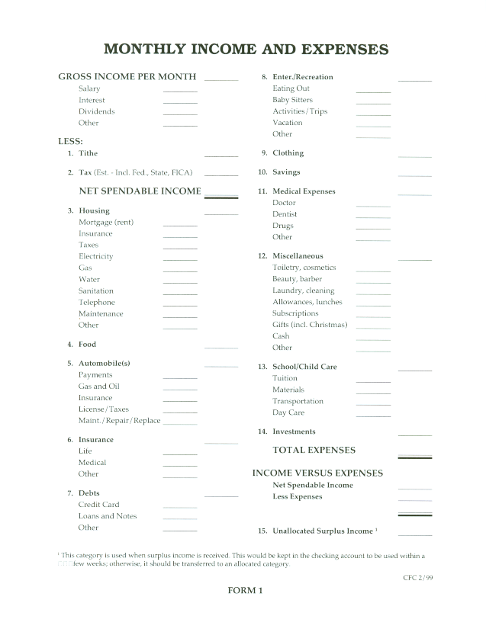
Download this and other helpful financial forms at https://rmni.org/financial-ministry.html
Budget busters
At www.crown.org you’ll find additional budgeting aids

Slide 8
Typical Budget Problems -1
Spending over 40% of net spendable income (gross income, less taxes and giving) for housing & utilities
High cell phone bills, buying expensive smart phones “over time” (which is debt)
Food category out-of-control, including eating out
“Over-recreating,” including cable/streaming services, trips, fitness clubs, and movies (tip: put cash into envelopes and don’t spend until you have sufficient money in the envelope)
Paying too much for auto insurance & having inadequate life insurance

Slide 9
Typical Budget Problems -2
High debt load and failure to even list and total all debt including interest rates (tip: Debt List form can be found at https://rmni.org/financial-ministry.html)
Little or no savings—failure to plan for future needs and goals
“Miscellaneous” spending out-of-control
Unable to pay for private schooling
Putting too much or too little into retirement investments

Slide 10
Typical Budget Problems -3
Too little giving to Christian causes & too much giving to relatives
Inadequate or inordinate tax deductions
High cost of health insurance—consider a good Christian health cooperative: see
www.samaritanministries.org

Slide 11
Budget Balancing
How do Americans try to balance their budgets?
  Cutting down on take-away meals—66%
  Saving on gas and electricity—61%
  Cutting back on out-of-home entertainment—60%
  Spend less on new clothes—54%
  Not driving as much—47%
  Switching to less expensive grocery brands—42% ACNielson Online Consumer Confidence Survey—Global Survey, 11/2005

Slide 12
6 LEVELS OF GIVING
1. Giving little or nothing. Among Baby-busters (18-35), only half gave anything to the church in 2002.¹
2. Inadequate giving. Giving less than 10%.
3. Obedient giving. Giving a tithe.
4. Giving beyond obedience--beyond the tithe.
5. Giving generously, being “willing to share” (2 Cor. 9:6).
6. Surpassing generosity. Giving out of God’s bounty, becoming a conduit of His blessing (2 Cor. 9:8,10-11). In Larry Burkett’s terms, we become a pipeline, instead of a pail.
1 George Barna, “Americans Were More Generous in 2001 Than in 2000,” 4/9/02, accessed at www.barna.org on 2/7/03

Slide 13

BUDGETING TIPS
At year’s end, total all expenses for each category and divide by the number of months included, to refine your monthly budget figures.
You may have to adjust your budget each month, especially if your income varies. Using a spread-sheet helps. Find an MS Excel template here:
https://rmni.org/financial-ministry.html

Slide 14
More BUDGETING TIPS
Expect UNEXPECTED expenses. Satan will try to discourage you. This is the reason for an emergency fund.
The budget may take at least 6 months to begin to work smoothly.
If you use software (e.g., Quicken™) use both a checking account (for checks & debit cards) AND a “cash” account, then combine them when running reports. You may also need a credit card account (you pay them off each month, right?), and again, combine accounts for a report.
Using software makes tax season fairly simple.

Slide 15
FINANCIAL STATEMENT
As of_________________
ASSETS
Liquid Assets[1] LIABILITIES[2]
___________________ $____________ ___________________ $___________
___________________ ____________ ___________________ ___________
___________________ ____________ ___________________ ___________
___________________ ____________ ___________________ ___________
___________________ ____________ ___________________ ___________
___________________ ____________ ___________________ ___________
Total liquid assets $____________ TOTAL LIABILITIES $___________
Invested Assets[3]
___________________ $____________
___________________ ____________
___________________ ____________
___________________ ____________ NET WORTH $__________
___________________ ____________ (Total Assets less Total Liabilities)
___________________ ____________
Total invested $____________
Use Assets[4]
___________________ $____________ TOTAL LIABILITIES
___________________ ____________ AND NET WORTH $___________
___________________ ____________
___________________ ____________
___________________ ____________
___________________ ____________
Total use assets $____________
TOTAL ASSETS $____________
[1] Cash, Savings Accounts, Checking Accounts
[2] Outstanding Real Estate Loans, Credit Cards, Auto Loans, Personal Loans
[3] IRAs, TSAs, 401ks, Investment, Real Estate, CDs, Antiques presented at fair market value.
[4] Residence, Autos, Personal belongings presented at fair market value.
Do your assets exceed your liabilities?
Use this guide to determine the answer. For a download of this form and more Christian stewardship information, see https://rmni.org/financial-ministry.html
END

