Slide 1

China Notes
Jim Sutherland

Slide 2
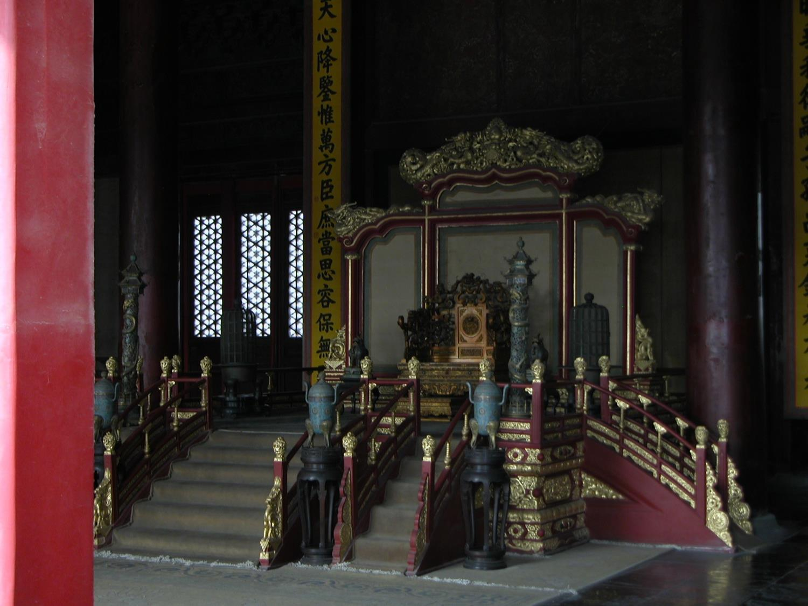
Ancient Kingdom
China was one of the first centers of agriculture and animal domestication, dating from 7500 BC.
China has been essentially unified since the Qin Dynasty in 221 BC and was ruled by monarchs until 1911 (when the Qing Dynasty fell).
  They’re also linguistically unified, as about 2/3 of their 1.3 billion people speak Mandarin, and most of their other 300 languages are closely related.
Jared Diamond, Guns, Germs and Steel, 1999, p. 323, 329, ISBN: 0393317552
CIA World Factbook, https://www.cia.gov/library/publications/the-world-factbook/geos/ch.html accessed 11/26/09

Slide 3
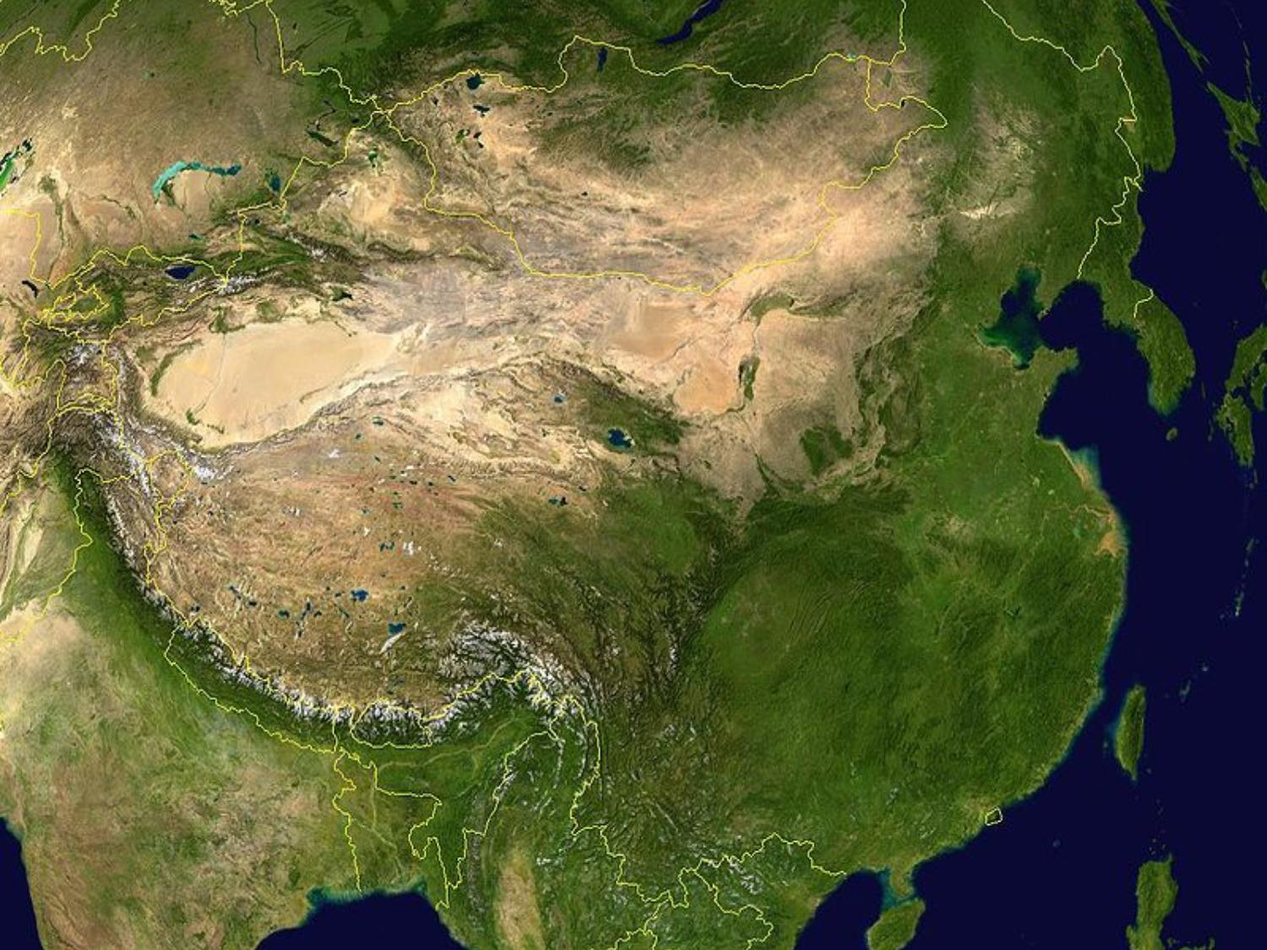
Why Did China Decline?
According to Jared Diamond, China’s political unity, through bad imperial decisions, put China into international backwaters.
Seven treasure fleets sailed from 1405-1433. Due to political infighting, not only were the fleets destroyed, but also the shipyards, and oceanic trade forbidden.
Rulers stopped construction of a water-driven spinning machine, abolished mechanical clocks and machines and technology in general from the late 1400s.

Slide 4
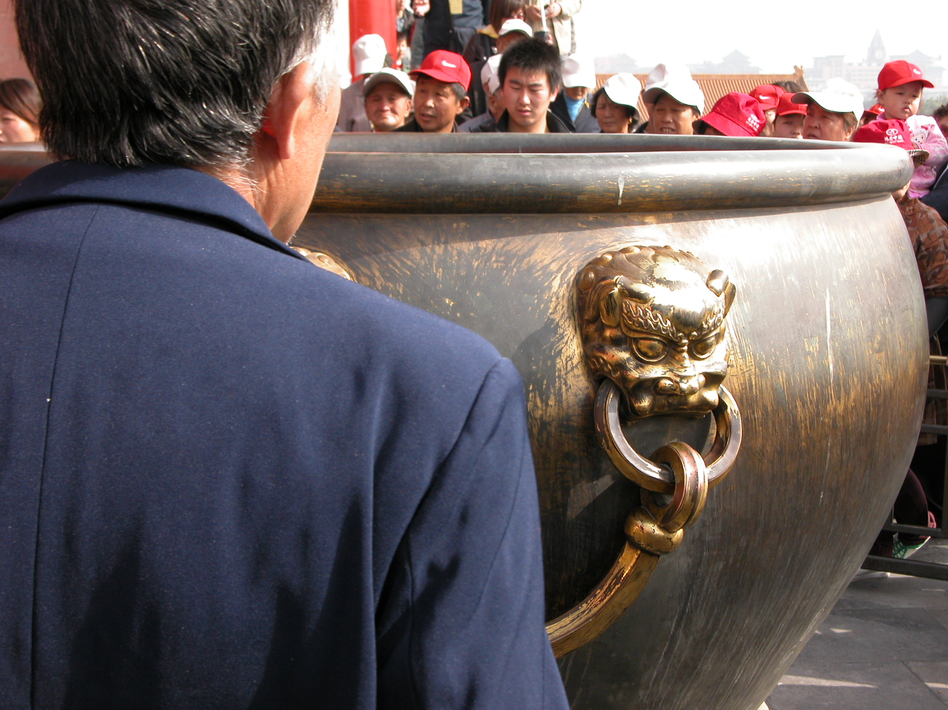
Achievements
China led the globe in technology between 1000 AD and 1450 AD.
  They led in political power, navigation and sea power.
  They developed bronze casting by 3000 BC and invented iron casting by 500 BC. They also invented paper and printing, the wheelbarrow, gunpowder, and the compass by 1500 AD.
Diamond, p. 330, 331, 410-12

Slide 5
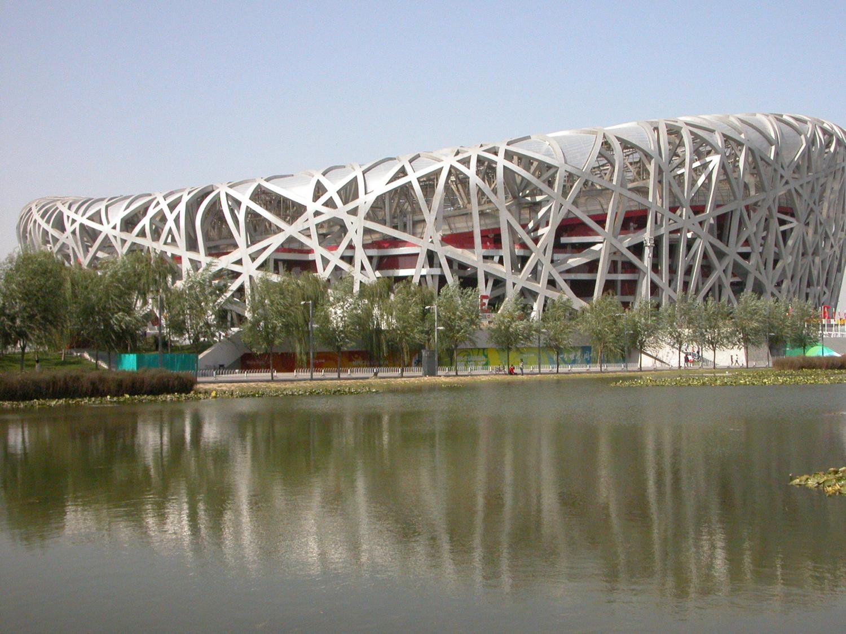
Ethnocentrism
The northern Chinese considered southern Chinese to be inferior, and all non-Chinese to be barbarians from the first millennium BC.
The common name in Chinese for China is the “Middle Kingdom” or the Central State.
Diamond, p. 331;

Slide 6

The Great Wall From Space

Slide 7
First Opium War
Britain incurred a trade deficit with China, which would only accept silver bullion in payment for tea, etc. To reverse this, they created an opium monopoly and a market for addicts within China. By 1838 the British imported over 1,400 tons of opium annually, despite opium use being illegal in China, at least since 1810. The Chinese began a trade embargo against Britain. To force resumption of trade a large British army and several gunships defeated the Chinese during 1840-42 and were forced to open four ports to Britain and pay war reparations.
http://en.wikipedia.org/wiki/Opium_war accessed 11/26/09

Slide 8
Second Opium War
The Second Opium War (1856-60) was fought for similar reasons, and resulted in British and French conquest of China, and opening of 10 new port cities. Christian missionaries were also allowed to travel in China.
Western canon, ships and muskets were clearly superior.
http://en.wikipedia.org/wiki/Opium_war accessed 11/26/09; Shaun Boa, descendant of the Quin Dynasty

Slide 9
The Boxer Rebellion (1898-1901)
Variously described as a war against Christianity or against foreign imperialism and extraterritoriality, the Empress Dowager Cixi used the “Society of Righteous and Harmonious Fists” to expel foreigners from China. They used martial arts, boxer-like.
  In the end, hundreds of missionaries and about 32,000 Chinese Christians were massacred.
  “By June 1900, placards calling for the death of foreigners and Christians covered the walls around Beijing. Armed bands combed the streets of the city, setting fire to homes and "with imperial blessing" killing Chinese Christians and foreigners. --Father Geoffrey Korz, of the Orthodox church”
http://en.wikipedia.org/wiki/Boxer_Rebellion accessed 12/4/09

Slide 10
Reparations and Revenge
Troops from eight countries ended the rebellion, which had expanded to a declared war against Western nations.
  12.9 trillion was paid to Russia, Germany, France, Britain, Japan and the USA (US dollars/12/4/09), bankrupting the Qing Dynasty.
  The China Inland Mission lost 58 adults and 21 children but refused to accept reparations.
  One missionary led US troops through streets showing Boxers, whose property was confiscated and lives sometimes taken.
http://en.wikipedia.org/wiki/Boxer_Rebellion

Slide 11
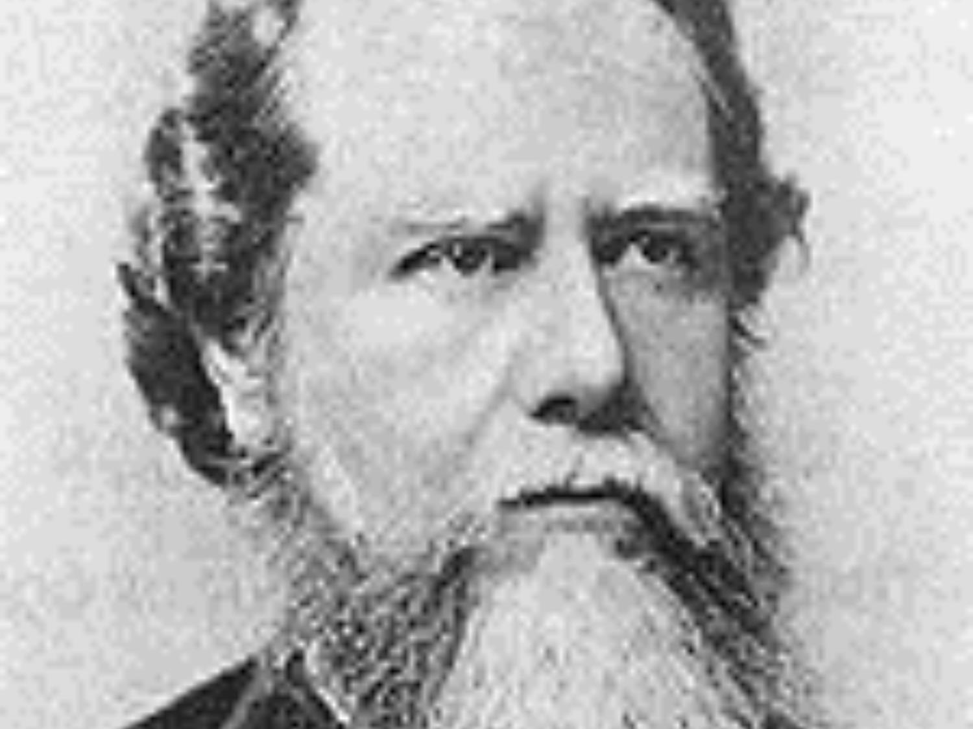
Foreign Missionaries
Hudson Taylor (1832-1905), founder of China Inland Mission, gradually focused upon equipping Chinese to evangelize China. Other missions didn’t.
In the 1890s a non-Christian wrote, “So as long as we only had foreigners to deal with, we were safe, but now that everywhere our own countrymen are enlisted on that side, certainly Christianity will flourish and conquer us.”
The China Centenary Missionary Conference of 1907 reported 3,445 foreign missionaries and 256,779 Chinese Christians. About six Chinese attended out of 1,000 delegates.
By 1925, foreign missionaries numbered 8,000. The Golden Age of Missions lasted about 20 years, until the mid-1920s.
China Centenary Missionary Conference records, p. 782
Daniel Bays, “From Foreign Mission to Chinese Church,” Christian History and Biography, Issue 98, p. 8,9.

Slide 12
Communist China
Mao Zedong’s communist forces
defeated Chiang Kai-shek and established the People’s Republic of China in October 1949.
  To ensure Mao’s rule, between 2-5 million people were killed, often landlords, Kuomintang personnel, those associated with Western businesses and intellectuals.
  Another 4-6 million were shipped to “reform through labor” camps, where many died.
  The attempted eradication of the Church began shortly after Mao took power, in the early 1950s.
http://en.wikipedia.org/wiki/Mao_Zedong accessed 11/26/09; Hattaway, p. 9.

Slide 13
Communist Persecution
“In just one city in China, Wenzhou in
Zhejiang Province, 49 pastors were sent to prison labor camps near the Russian border in 1950. Many were given sentences of up to twenty years for their “crimes” of preaching the gospel. Of those 49 pastors, just one returned home. Forty-eight died in prison.
In my home area of Nanyang believers were crucified on the walls of their churches for not denying Christ. Others were chained to vehicles and horses and dragged to their death.” Bro Yun
Hattaway, p. 10

Slide 14
Persecution of Christians
Moses Xie directed the Chinese
Christian Mission in Shanghai and refused to join the government church (TSPM). He was imprisoned for 23 years (1956-1979). He was handcuffed for 133 days, with the cuffs cutting into his skin. Two years were added to his sentence because he witnessed to another prisoner.
He spent 3 months in jail in 1992 for going to another part of China for ministry. His wife emigrated to the USA in 1993 and died there.
David Aikman, Jesus in Beijing, pp. 65-67, 2003, ISBN: 1596980257.

Slide 15
Li Tianen
Li Tianen was the son of Christian parents. His mother became an itinerant evangelist and taking her son with her. He became an evangelist and house church pastor in the Shanghai area and was arrested in 1960 as someone who would possibly oppose Chairman Mao and sentenced for 10 years.
Two prisoners watched him during the night to make sure he didn’t move his lips to pray. When caught he was forced to stand for 6 hours against a stone wall without a shirt, even in winter, with arms and legs stretched out. He was allowed one 30-minute visit from his wife and family per year. (Aikman, pp. 68-69)

Slide 16
Death of the “church”
John 12:24 I tell you the truth, unless a kernel of wheat falls to the ground and dies, it remains only a single seed. But if it dies, it produces many seeds.
David Paton, missionary in Southern China, wrote in 1953 that “the end of the missionary era was the (judgement and the) will of God” because missionaries were carriers of Western culture, who did not promote self-governing, self-supporting and self-expanding churches.
http://henrymartyn.dns-systems.net/media/documents/HMC%20Lectures/2007%20Lecture%20II%20David%20Paton%20-%20Christainity%20Encounters%20Communism.pdf pp. 1, 3.

Slide 17
Cultural Revolution 1966-76
Mao wanted to purge China of
“liberal bourgeois” people.
  One goal was to remove the “Four Olds”--Old Customs, Old Culture, Old Habits, and Old Ideas.
  Religious buildings and cemeteries were destroyed.
  Those considered anti-revolutionary were sometimes beaten to death, raped, cannibalized and persecuted into suicide. One estimate is that between 750,000 and 1.5 million were killed, and 36 million persecuted.
  Formal education was severely disrupted.
  In Tibet more than 6,000 monasteries were destroyed.
http://en.wikipedia.org/wiki/Cultural_Revolution accessed 11/28/09

Slide 18
God Used the Revolution for Good
Cleared China of religions and Christian denominations.
  The Church was forced underground.
  “Thousands of temples and idols were smashed, creating a spiritual void in the hearts of hundreds of millions of people.”
  A good infrastructure was created, facilitating travel.
  Mandarin was made the official language, facilitating communication.
    Literacy campaigns prepared for Christian literature.
  Chinese believers often have a strong sense of God’s sovereignty.
Hataway, pp. 12-13

Slide 19
God Used the Revolution for Good
God directly revealed Himself. An estimated 80% of house church believers came to Christ as a result of a miracle.
It created a spiritual and moral void which still begs to be filled.
  Wealth creation is the incentive the government uses to keep a covenant of power. As long as prosperity increases, the government is more secure.
  The emptiness of materialism is indicated by the numbers turning to Christ.

Slide 20
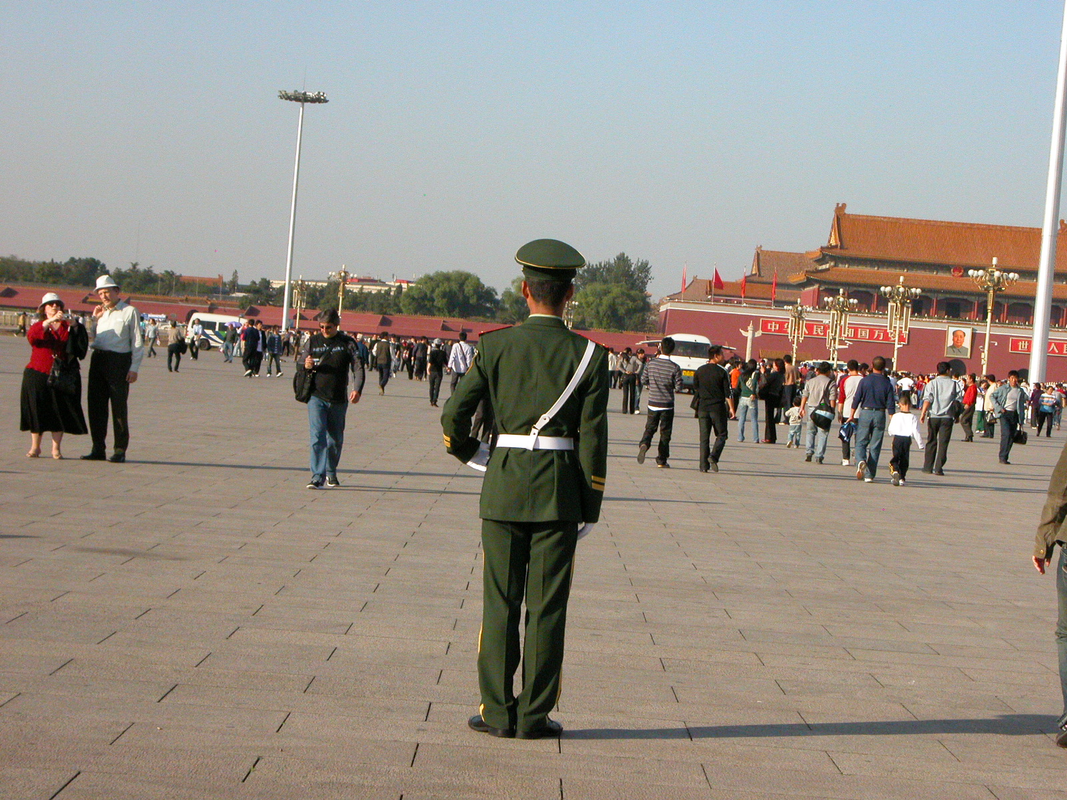
Tiananmen Square 1989
The brutality of the government against her citizens became obvious.
  Many students lost confidence in the government and became open to Christianity.
  “After the country adopted Western science and philosophy, it left a value vacuum. After Tiananmen Square, some scholars lost hope. They wanted to start asking the ultimate questions about the purpose of life. People in China have lost faith in human wisdom. The Cultural Revolution was a disaster, but this spiritual awakening is an unexpected result. The more I knew about the growth of freedom in the West, the more I was captivated by the role of faith in God as the Lord.” Hsu—a Chinese political scientist¹
¹Rob Moll, “Great Leap Forward” http://www.christianitytoday.com/ct/2008/may/19.22.html

Slide 21

Chinese Religions
Instead, the state is attacking Christianity by promoting other religions, such as Buddhism and ethnic religions (animism).
  The Religious Affairs Bureau is emphasizing one religion to deconstruct another.
    It sponsored Buddhist, Taoist and Confucian conferences recently.
  Buddhist temples are full of youths in their 20s and 30s.
In 2005 religious affiliation was estimated to be:
  13.6% Buddhist
  .4% Daoist
  32.1% Chinese folk religion (animist)
  4.2% Ethnoreligionist (animist)
  32.6% Agnostic
  7.6% Atheist
  36.2% Unevangelized (World Christian Database)
  10.0% Christian (common estimate, 140 million)

Slide 22
The Chinese Church Today

Slide 23
Three Basic Chinese Churches
Three-Self Patriotic Movement churches are registered by and controlled by the government. They have church buildings.
Underground churches are largely rural are unregistered—illegal. They are secretive and meet in homes.
Third wave churches are unregistered urban churches but are not as secretive as underground churches. They may invite government officials to visit and aim at transparency.

Slide 24
Underground Churches
These developed from heroic Christian leaders, who often spent many years in prison for preaching the gospel.
  Bro. Yun, the “Heavenly Man,” was one. He was arrested over 20 times and imprisoned three times (his wife once).
  The three authors of the book Back to Jerusalem spent a combined 40 years in prison.
  Most of these turned charismatic/Pentecostal in doctrine since the 1980s. However, Presbyterianism is now becoming popular among them.

Slide 25
Underground Pastors
Pastors of these churches are typically untrained theologically, and they may not appreciate such training. If someone feels a burden to become pastor, that person becomes pastor.
  Sometimes they become authoritarian, “drunk with power”. I’ve seen this kind of issue among some Indian ministry leaders. Churches may not have any by-laws.
  There is more immorality among them than with the TSPM.
  They are thinly stretched. One province has 5,000 churches, but only 30 pastors.

Slide 26
Underground Pastors
Rivalry among house church network (fellowship) leaders has led to division and distrust, especially as non-Chinese have contributed to theological differences among the fellowships.
  The Cultural Revolution was the occasion for some to fall away from Christianity, which has led to mistrust.
  Reconciliation efforts have at times brought fellowship leaders together.

Slide 27
Three-Self Patriotic Movement (TSPM)
TSPM Churches are:
  Self-governing, self-supporting, self-propagating (Nevius’ mission principles)
  Limited in doctrine—cannot preach about the Second Coming of Christ (or the Holy Spirit, one said).
  Limited in place—all ministry must take place within the church walls. This resembles the fall-back mode of many US churches.
  Limited in leadership—seminary student selection and pastoral appointment is controlled by the government.
  The only source of legal Bible purchases and one’s name is recorded with the sale.

Slide 28
Three-Self Patriotic Movement (TSPM)
Seminary students for the TSPM are not of the quality the government wants, we were told.
Some TSPM pastors want to un-register to be able to have more freedom.
A songbook by Canaan, the singer (Chouming), who has composed over 1,000 worship songs, is quite influential in the Three Self church. Canaan has just a middle school education and didn’t study music. (“No Name” network spokesman, 2008)

Slide 29
Third Wave Churches
One such church leader said that the government distrusted underground churches because of their secrecy. What did they have to hide?
These churches try to include governmental officials in activities to show that they are not subversive and can make a solid contribution to Chinese society.
House church leaders, he also said, sometimes criticize third-wave church leaders as compromisers. They haven’t suffered as underground leaders have for their faith.
They meet in apartment buildings.

Slide 30
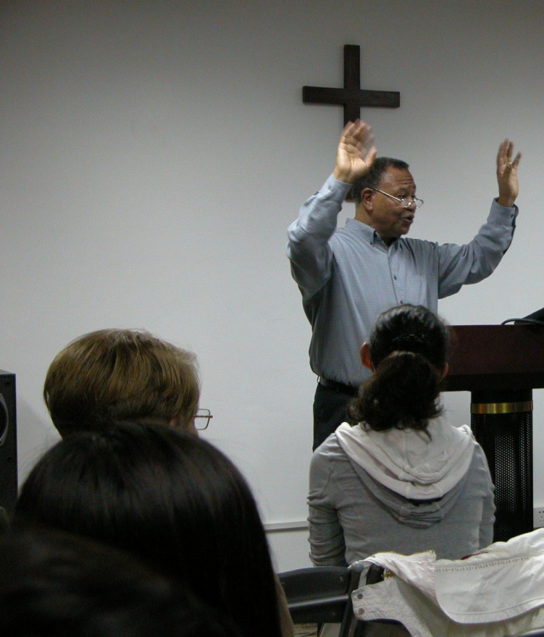
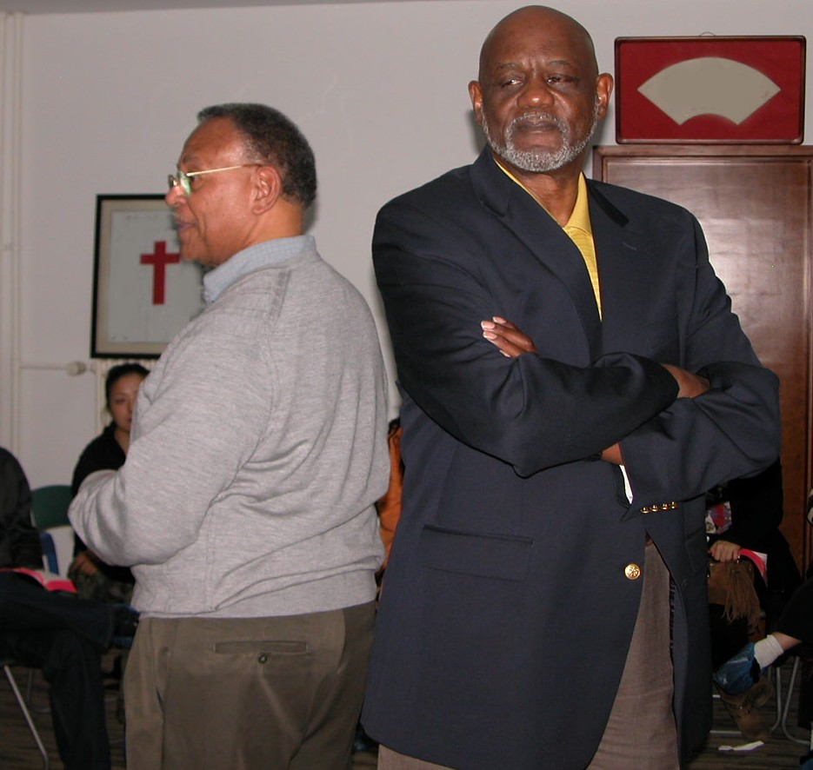
Short-Term Ministry Team of 2009
Jack Gaines is a mission's pastor, who has a ministry of reconciliation. He wrote My Brother’s Keeper, Not My Brother’s Killer.
Missionary and Pastor Brian Johnson heads the Cooperative Mission Network of the African Dispersion (COMINAD).

Slide 31
The Holy Spirit is Working
A Beijing pastor says they’ve led thousands to Christ.
Economist Zhao Xiao believes, “Christian faith provides the backbone of Western economic growth. Everybody wants to make more money, from the ancient time till now. And from history we see that only Christians have a continuous creative spirit and the spirit for innovation.”
Pastor Benjamin noted, “People want to know why Western countries are advanced. Because of Western religious belief, the Chinese are interested in Christianity. That is one reason. Also, I share with people that there are the words “In God We Trust” written on the U.S. dollar….”
Rob Moll, http://www.christianitytoday.com/ct/2008/may/19.22.html

Slide 32
Rapid Church Growth
In 1992 a rural fellowship pastor came to Shanghai as an immigrant worker. In the first 2 years there were six church workers. Each made a plan that in one year they would win a specific number of people to the Lord. Now there are 120 churches and over 4,000 believers since 1992. Each year they baptize 500 people. The vision that the Lord gave their church is to focus on factory evangelism.

Slide 33
Factory Evangelism
One fellowship’s strategy to reach urban workers:
  In every city there are Christians. At first, they fan out where they are working and have meetings, such as Sunday services. Then those [in the church] reach the rest of the workers through these workers. They give a gift to people during holidays. At a construction site, for example, they would buy Band-Aids and give them to the workers when needed, and then share the Gospel. They know some who work in factories, so they send their people to the factory. There is no regularly scheduled break, so after work, they informally share the Gospel with their friends.

Slide 34
7 Core Values of Urban Church Leaders
Seventy urban house church leaders met in 2007:
The Kingdom first—networking within cities and within China—being non-denominational
Bible-based—conservative, evangelical
5-fold ministries of apostles, prophets, evangelists, pastors and teachers
Mentoring leaders, rather than charismatic leadership
The abundant life—material prosperity for the Kingdom
Building the church globally
Demonstrate God’s love to Chinese society (churches may now have orphanages, community centers, youth activities and marriage ministries)
Rob Moll, “Great Leap Forward” http://www.christianitytoday.com/ct/2008/may/19.22.html accessed 11/28/09

Slide 35
Back to Jerusalem Movement
In 1943, Pastor Mark Ma, at Northwest Bible Institute in Shaanxi Province, received a call from the Lord to take the gospel westward to what is now Eastern Turkestan. Nine others shared that burden. The vision soon expanded to take the gospel west through Buddhist, Hindu and Muslim countries, all the way back to Jerusalem.
In 1947 seven of the BTJ Evangelistic Band traveled to the far west of China into the Taklimakan Desert but were stopped by government officials afraid for their safety. Then Communists came to power, the border was closed to them, and the vision seemed to die.
Hattaway, pp. 24-26, 34-35.

Slide 36
Back to Jerusalem Movement
Others say the Chinese have had a vision since the 1920s to take the Gospel back to Jerusalem via the Silk Road, going to the 10/40 Window. This means evangelizing Buddhist, Hindu, and Muslim peoples along the way. They plan to send a minimum of 100,000 missionaries.
I asked the leader of a fellowship of 4.5 million Christians if his people resisted going globally. He didn’t understand the question. They don’t hesitate going even to arch-enemy Japan.
http://ctlibrary.com/ct/2004/april/5.84.html

Slide 37
Secret Missionary Training Schools
One fellowship of 7 million Christians has trained 300 cross-cultural workers in two missionary-training schools, deployed mostly inside China.
Another fellowship of about 7.5 million believers has global missions as their first priority.
A third fellowship of 3 million believers has two missionary training schools and about 45 missionaries distributed in Pakistan, Burma, Yemen, and Cambodia, as well as in every mainland province except one.

Slide 38
Unnamed Christian Fellowship
Their vision came in 1983, when persecution was very severe. They could not have a meeting in their home, so had to go to an isolated place, under a big bridge. At that meeting they got the vision to go back to Jerusalem. Since 1983 they have carried that vision. At that time and for the first generation generally, they could not go to sleep in their homes. They had to sleep in fields and threshing floors. They haven’t given up on the vision. At the meeting when they got the vision, policemen accused them of being against the government.

Slide 39
Unnamed Fellowship, continued
The police said that they cooperated with a foreign god [they thought that was funny]. At that time the police said that they could be shot without a trace left behind. So, the others were crying. One said, “If you die, I’ll take care of your corpse.” Another said, “Don’t cry. In the future you will ride in a car.” [they would be delivered, and prosper, in other words]. None were killed, now they drive a car which belongs to the church. From 1983 to 2003 they have started 2 cross cultural schools. They have already trained over 300 people. The people are ready, but God’s time is not yet. A few have been sent out. Where? A few outside China. Not too many. They could not get a visa. Some of the 300 have been sent to minority tribes and they plan to send more.

Slide 40
Focusing Outside the Walls
“We believe the best way for the Chinese church to remain strong is to keep it motivated to reach out to the nations of the world. When believers focus on serving the Lord and reaching the lost, God blesses them and the church remains sharp. When we become self-centered and critical of each other, Satan has deceived us and the church becomes a blunt, useless instrument.”
  Back to Jerusalem, Chinese house church leaders, p. 95

Slide 41
Expecting To Die
“The Muslim and Buddhist nations can torture us, imprison us, and starve us, but they can do no more than we have already experienced in China for many decades. Thousands of young men and women will go as missionaries, who are not afraid to die for Jesus. They are not afraid to bleed, for they know their bodies are merely temporary tents to be used in the Lord’s service and that one day they will be in paradise where there is no pain and no tears. They are not only ready to die for the gospel, they are expecting it.”
Hattaway, p. 101

Slide 42
Continuing Persecution?
Some Christian expats believe that there will be no more direct persecution of the church by the central government.
  There may be persecution by lower-ranking officials, but not by central government policy.
    Persecution may be related to desires for bribes or for personal reasons.
  However, in Nov. 2009 the 500-member unregistered Shouwang Church in Beijing had to meet outside, even during a snowstorm, and elders have been prevented from attending Sunday services.¹
¹ http://online.wsj.com/article/SB10001424052748704431804574539120649781240.html

Slide 43
Linfen Fushan Church
In December 2009 five members from a Beijing location of this 50,000-member church were sentenced to two years in labor camp after police raided their facility. This came a week after five members of this unregistered church in Shanxi province were given prison terms of up to seven years on charges of illegal assembly, for their part in a protest against hundreds of police raiding a sunrise service.
“China sentences 5 church leaders to labor camp,” Associated Press, 12/2/09
http://www.aol.com.au/news/story/China-house-church-leaders-sentenced/2398549/index.html accessed 12/28/09

Slide 44
The Chinese Underground Church
Needs money for Bibles. They can be purchased, but the fellowships often don’t have money to purchase them. One fellowship could use 200,000 per year. Large print and worn Bibles can be used.
Needs Bible training
Needs Godly leaders
Needs wisdom on how to reach urban centers
Needs funds for missionaries

Slide 45
How to Pray
For God to open the way for them
“Ask God to raise up more leaders after God’s heart.” Also, for the right missionaries
“For unity of the house church” particularly among older members
“Ask God to stop the bondage to the ancestors”
Wisdom to reach urban areas
The ability to pass the faith on to the next generation of Christian leaders

Slide 46
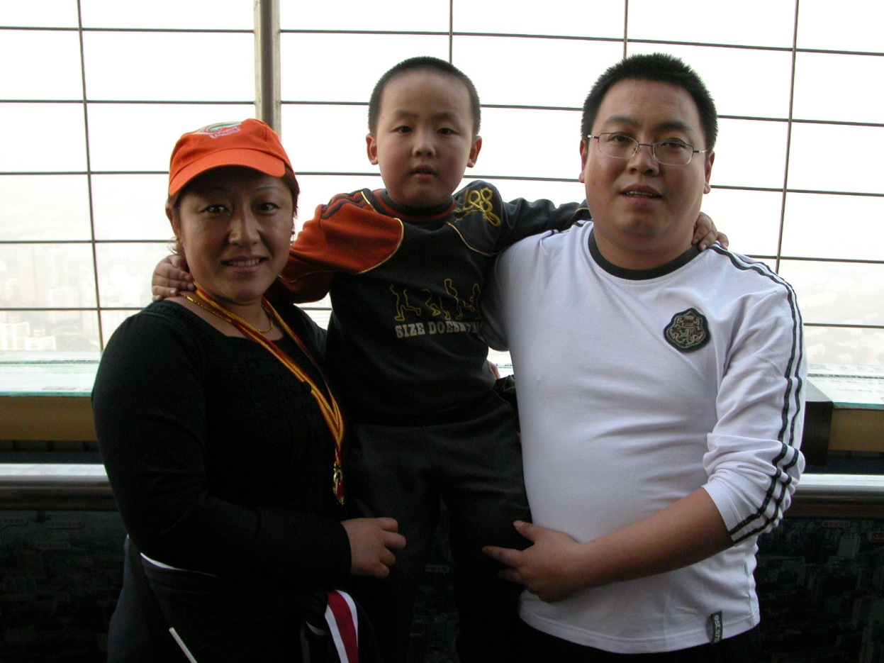
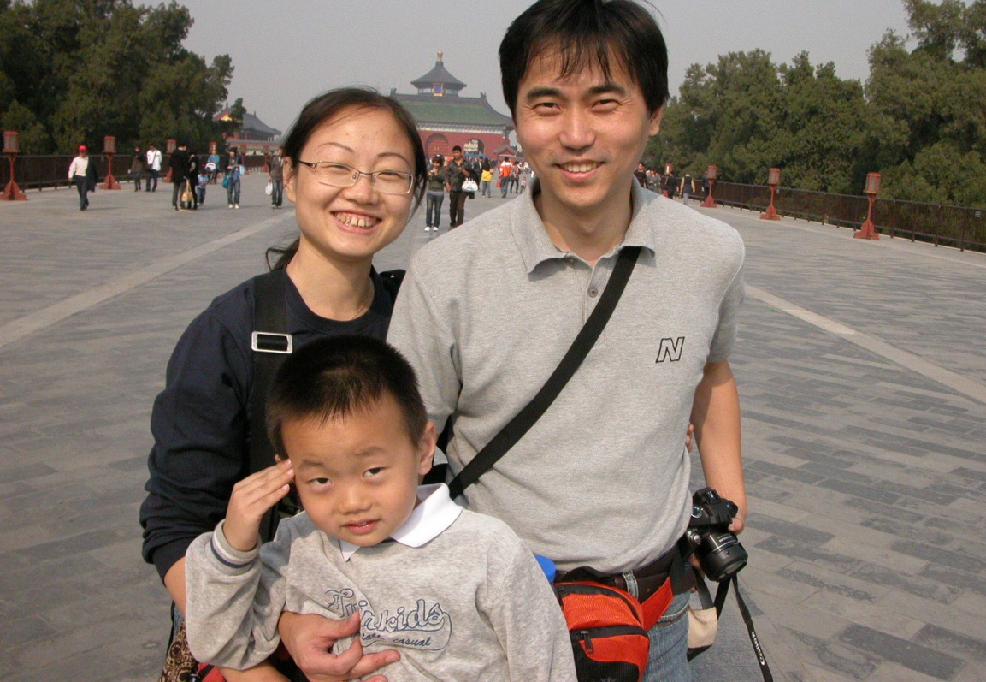
One-Child Families
Fines of up to 2-3 times an annual salary can be assessed against parents having more than one child. Male children are preferred, as they’re considered more able to support parents in their old age. Sometimes women are forcibly sterilized.

Slide 47
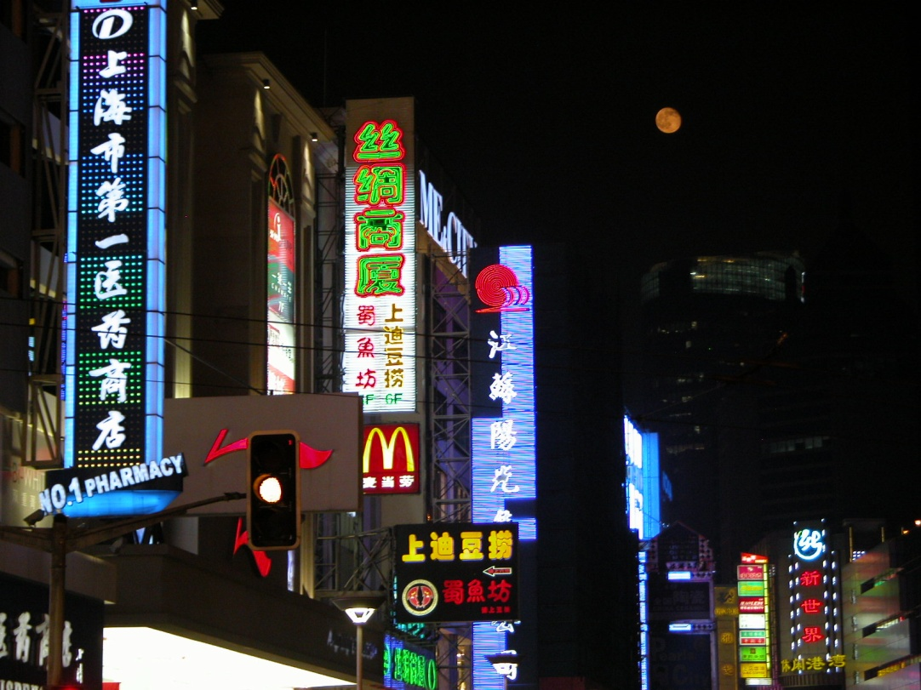
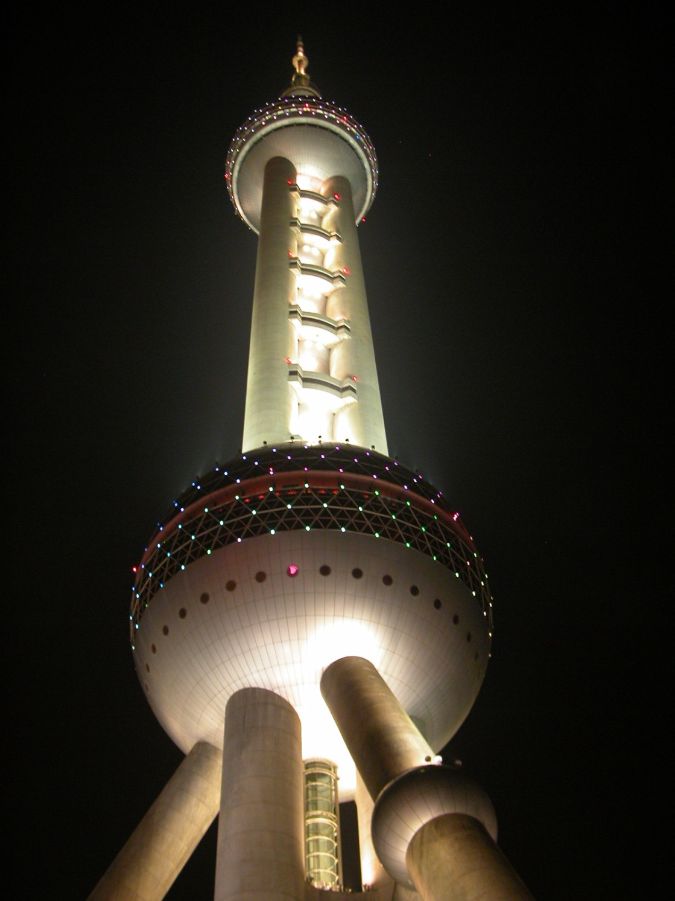
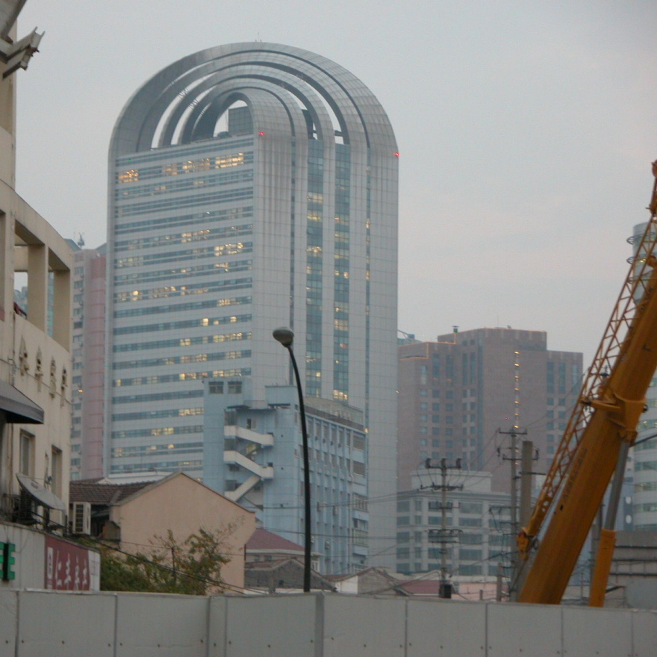
Shanghai

Slide 48
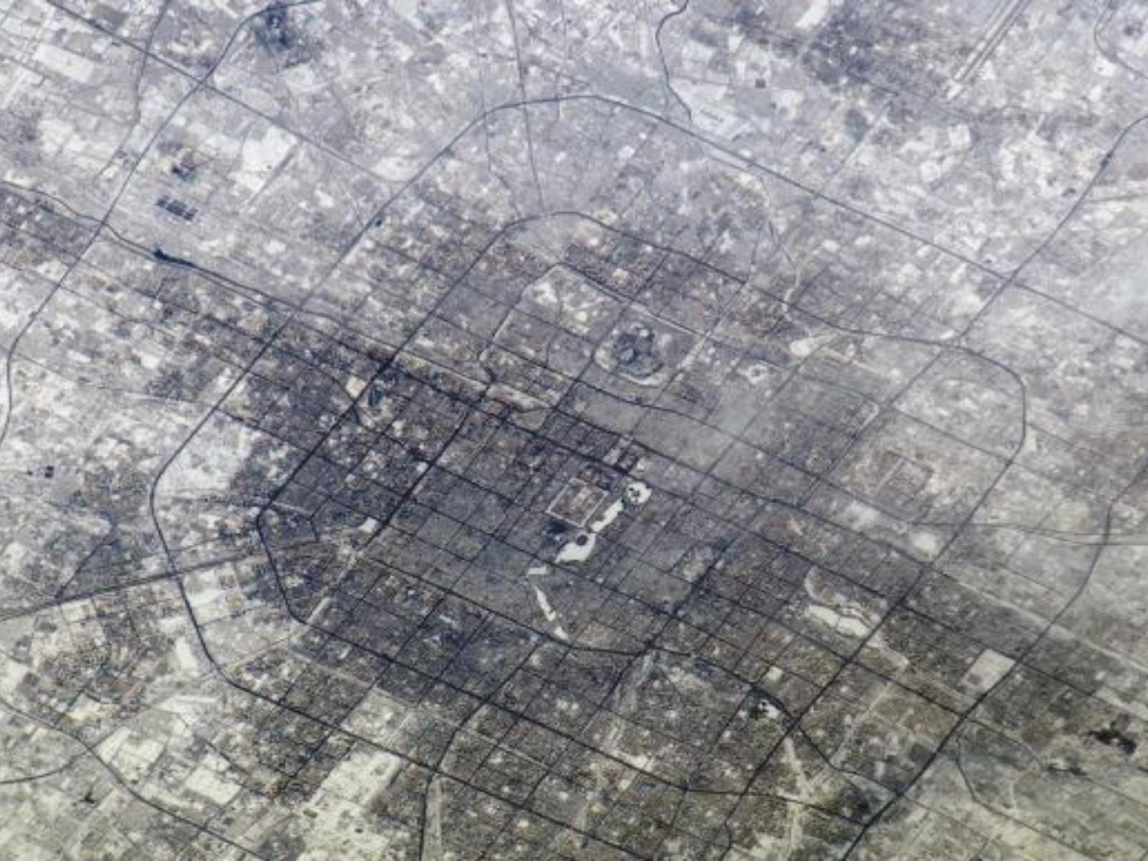
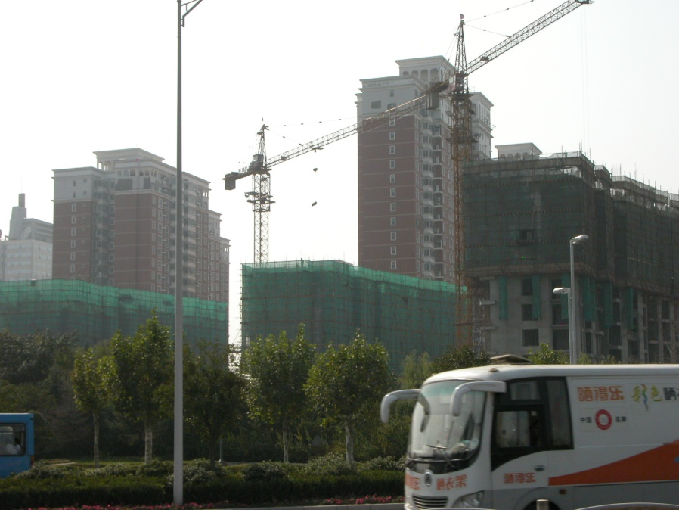
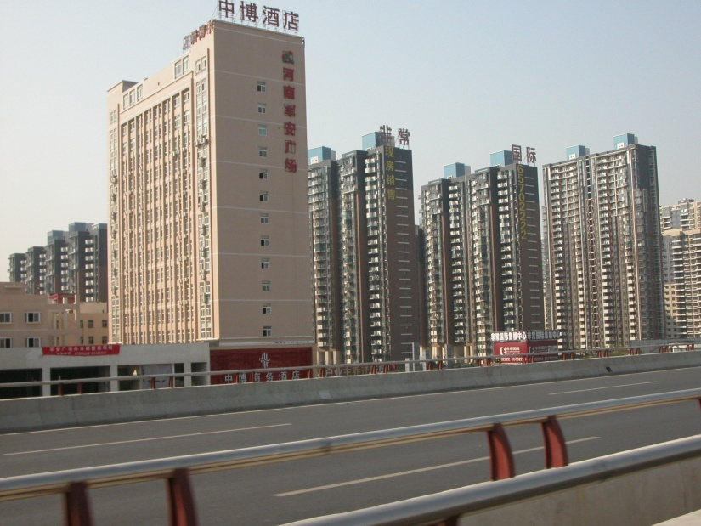
Beijing From Space
The city is the size of the Bahamas

Slide 49

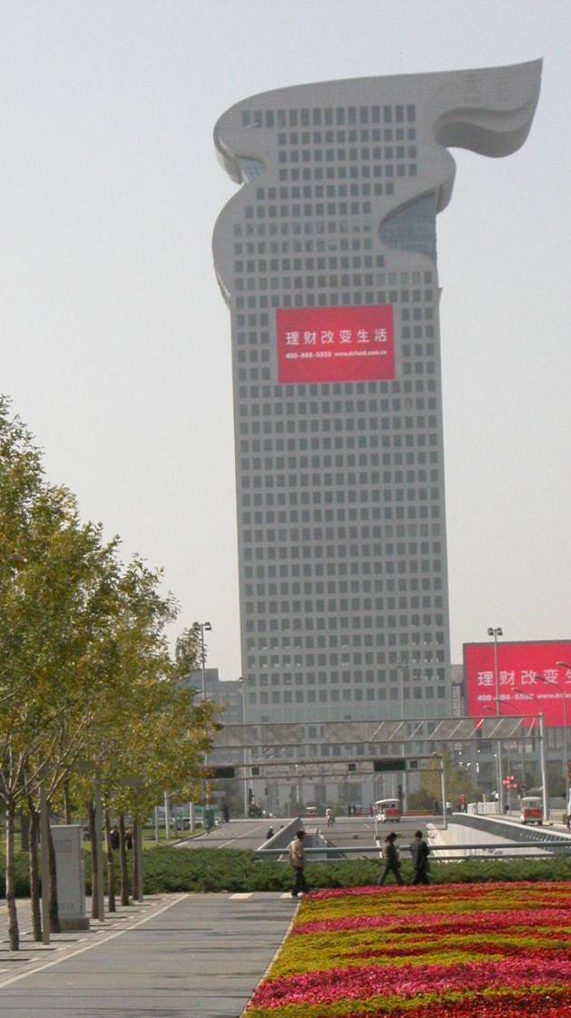
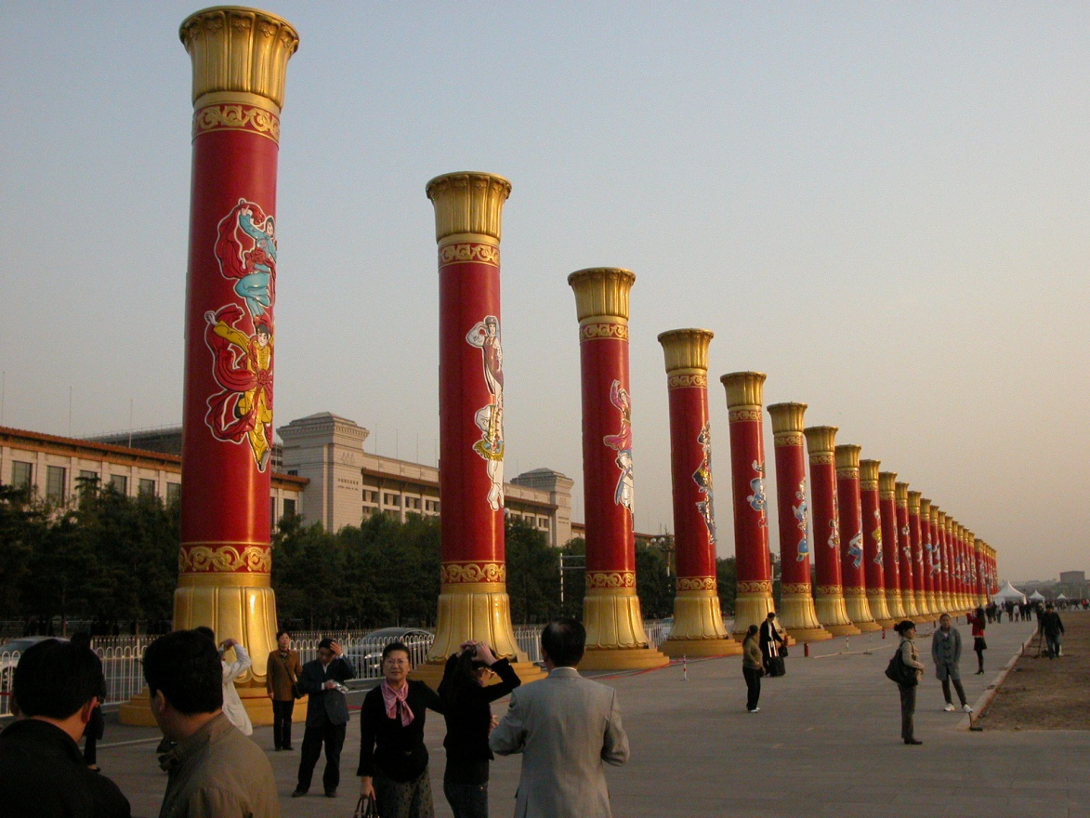
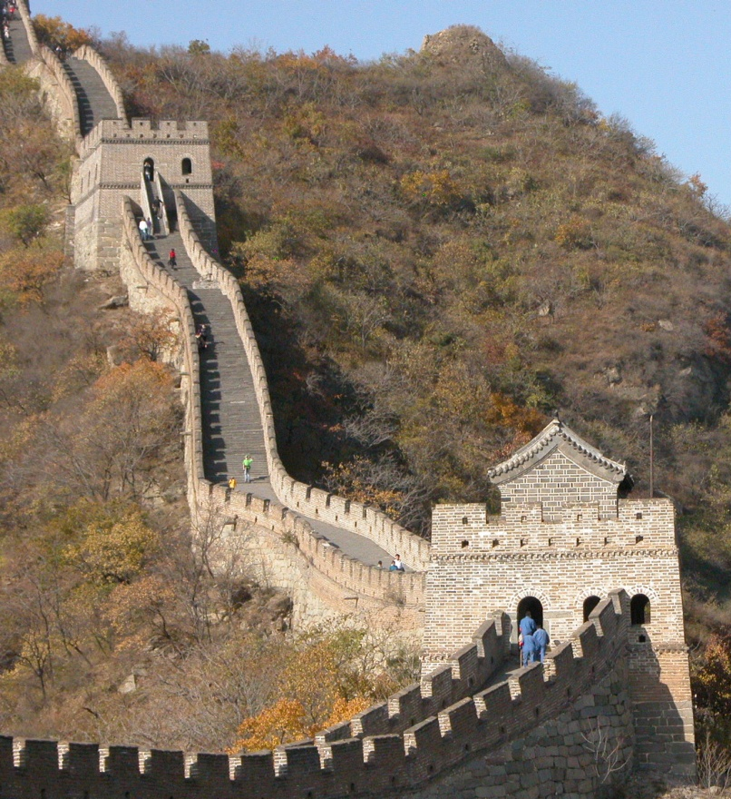
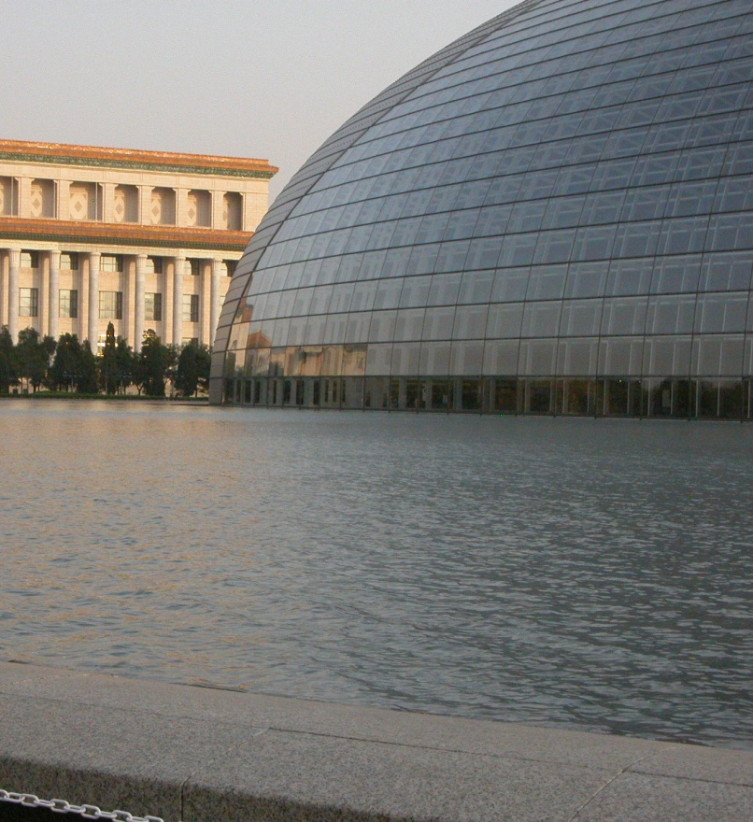
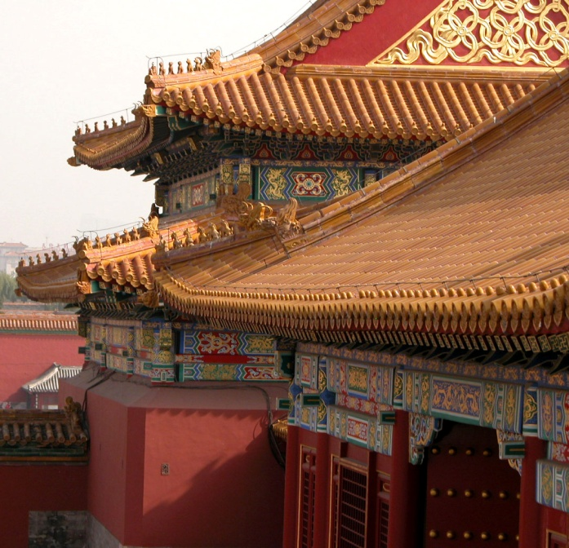

Slide 50
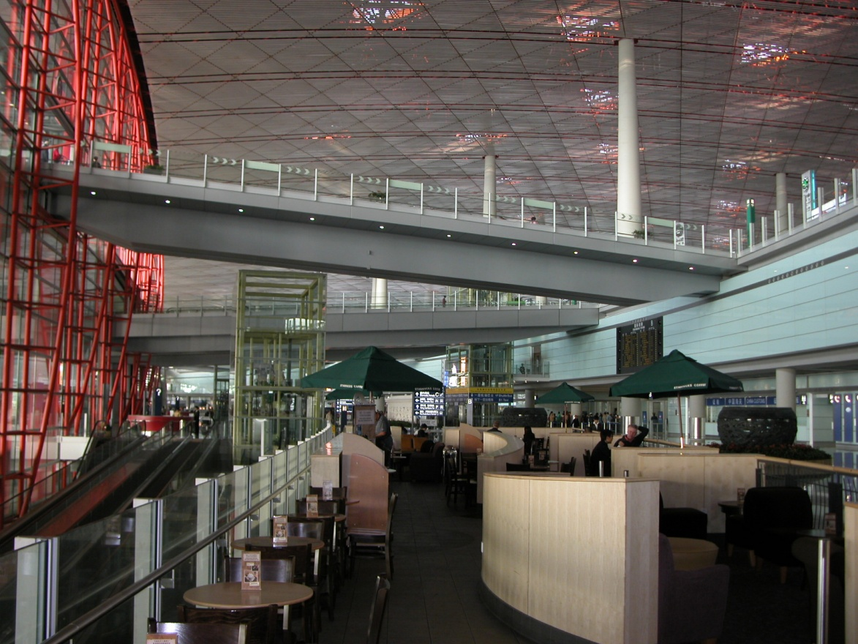

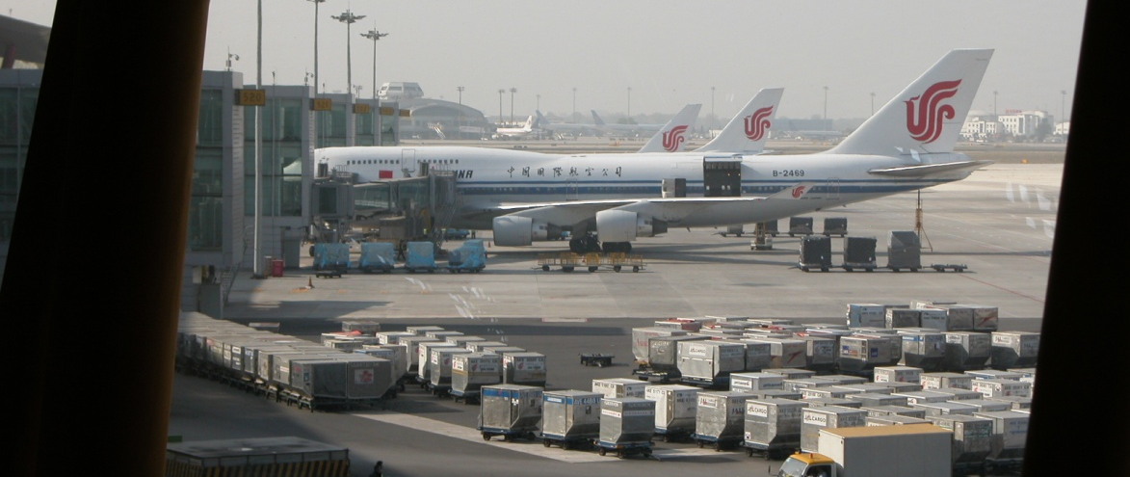
Terminal 3 Beijing Airport
Two miles long,
14 million square feet,
twenty years to create
at a cost of
3.65 billion dollars

Slide 51
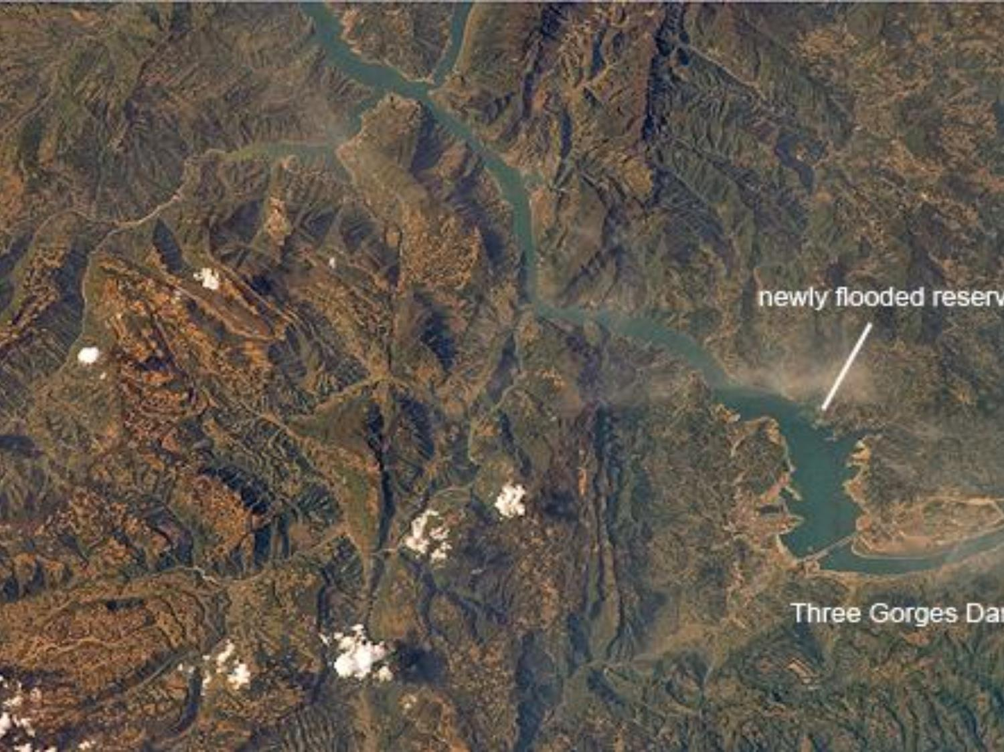
Three Gorges Dam
World’s biggest hydro-electric dam.

Slide 52
Ethnocentrism
Today China, by many estimates, wants to regain their world leadership. Their architecture is designed to make a statement. The 2008 Olympics made a statement, as did their 60th Anniversary military parades in 2009. They have the most people, the largest reserves of foreign currency and gold—almost 2 trillion dollars (2008 estimate) and the best current account balance.
CIA Factbook

Slide 53
China Alliance
While China is rapidly becoming the chief economic and military rival of the USA, as well as its chief lender, Chinese Christians are likewise coming to be perhaps the greatest ally in global evangelism.

