Slide 1
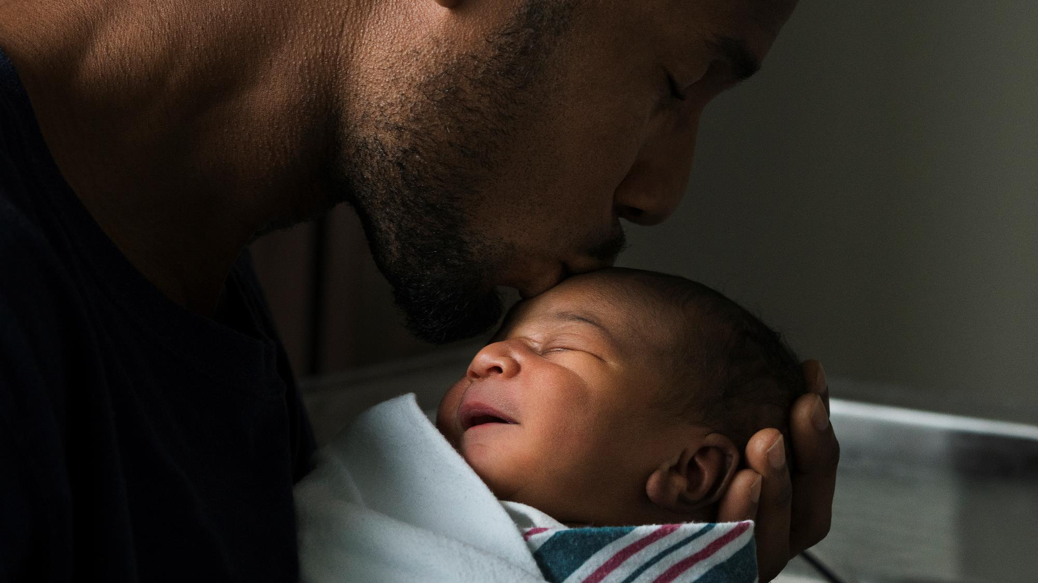

Digging
Deeper as a
Father
Jim Sutherland, PhD
RMNI.org

Slide 2
God Loves Kids
God’s first command to humans was to have children. “God blessed [Adam and Eve] and said to them, ‘Be fruitful and increase in number, fill the earth and subdue it.’” (Genesis 1:28a, NIV-, unless otherwise noted).
He wants “godly” kids (Malachi 2:15).
Notes:
Share where our four are. All in church. One teaches SS. Another recently baptized. Education and jobs that God has provided. Some struggle with who God is, just as their Dad does.

Slide 3
A Father Must “Man up” to Raising His Child
Proverbs 27:8 Like a bird that strays from its nest is a man who strays from his home. (NIV)
  Proverbs 1:8 Listen, my son, to your father's instruction and do not forsake your mother's teaching.
    Both need to be present.
35% of African American children have both parents in the home. 51% live with their mothers.
Among whites, 74% have both parents and 18% live with their mother only, as of 2006.
    http://www.census.gov/population/www/socdemo/hh-fam/cps2006.html

Slide 4
The Marriage Needs to be Stable
Among blacks, 30.5% are married with the spouse present
Among whites 54% is not good, either.
47% of black men and 43% of black women never marry
30.5% of white men and 23% of white women never marry.
  http://www.census.gov/population/www/socdemo/hh-fam/cps2006.html
What implications does this have for children living without benefit of seeing a good marriage?

Slide 5
Love Yo’ Baby
Sons and daughters need to see how a godly man treats his wife. As someone has noted, the best thing you can do for your child is to love your wife.
  The leading cause of death among African American women aged 20-45 is homicide from an intimate partner.
  Wife abuse is about twice as high among African Americans as among other US populations.

Slide 6
We May Need to Mentor Other’s Children
Exodus 3:13 Moses said to God, "Suppose I go to the Israelites and say to them, 'The God of your fathers has sent me to you,' and they ask me, 'What is his name?' Then what shall I tell them?"
  Why wouldn’t they have known God’s name?
  The faith should be transmitted by fathers who tell of their fathers’ God (Gen. 48:15). When patrilineal faith breaks down, we need to start a new line with us. God sees us in continuity with our daddies.

Slide 7
No Perfect Parents
As Larry Crabb has noted, there is no perfect human relationship. Every relationship will disappoint us.
We will sometimes act in ungodly ways, as will our children. They, in turn, will sometimes act ungodly.
  Luke 1:17 And he will go on before the Lord, in the spirit and power of Elijah, to turn the hearts of the fathers to their children and the disobedient to the wisdom of the righteous-- to make ready a people prepared for the Lord.

Slide 8
Our Daddy
We may need to resolve bitterness and anger against our father.
  They may have been highly authoritarian and possibly physically abusive, or just absent.
    This can lead to angry,sullen children.
      Ephesians 6:4 Fathers, do not exasperate [or “provoke to wrath—Marshall] your children; instead, bring them up in the training and instruction of the Lord.
      Failing to keep promises, being largely absent, not really being present mentally or emotionally when around our kids, disciplining angrily or unfairly or autocratically—”Because I said so!”—can lead to exasperation.

Slide 9
Godly Kids
We’ve obeyed the first commandment. The second is more doubtful.
True godliness comes from being regenerated and changed into Christ’s image by the Holy Spirit (2 Cor. 3:18). We cannot be like God without His power.

Slide 10
God Has No Grandkids
Each child must receive Christ individually. We cannot do that for them (John 1:12). Regeneration comes not from a father or mother’s will. Children are in some way “holy,” even if only one parent is a Christian (1 Cor. 7:14), so I believe are set apart, generally, for God.
We can “play the music of the Gospel” for them as we give them the words (Bill Hybels). We can BE good news as we share it.

Slide 11
Commitment to Christ is the Best Apologetic for Christianity
Fathers provide the most credible testimony to God by simply following Him.
  Genesis 48:15 Then he blessed Joseph and said, "May the God before whom my fathers Abraham and Isaac walked, the God who has been my shepherd all my life to this day

Slide 12
Keeping Trust
Children are proud of their fathers (Prov. 17:6b). They naturally respect what you say.
We need to keep their trust by trying to keep our word and by being fair and honest (we will fail sometimes--then confess it), so that when they really need to know, they will trust our answer.
The single best witness will be our love.

Slide 13
Your Children Came With Instructions
Proverbs 22:6 “Train {6 Or Start} a child in the way he should go, and when he is old he will not turn from it.”
  One translator stresses beginning early.
  Another to train according to the level of intellectual and physical development.

Slide 14
Your Children Came With Instructions
“Fathers, do not exasperate your children; instead, bring them up in the training and instruction of the Lord” (Eph. 6:4).
  Dads, not simply Moms, are to take responsibility to “nourish” their children with godly teaching, but not in an overbearing and cruel way. A young child is fairly defenseless.
    A son gets his masculine identity primarily from his father (John Eldridge Wild at Heart, pp. 62-63). ISBN: 0785287965.

Slide 15
Being on their side
Mothers should speak “with wisdom and faithful instruction” Prov. 31:26.
As Dr. James Dobson has noted, children need to know that you are on their “team,” that you are on their side and are cheering for them to win. Then when you correct them, they will know that you love them, even if they think your correction is misplaced.

Slide 16
Fathers are to Provide for their Family
1 Timothy 5:8 “If anyone does not provide for his relatives, and especially for his immediate family, he has denied the faith and is worse than an unbeliever.” NIV
  “Anyone” is masculine in the Greek—the father is the one expected to provide for his family, not the wife.
  Adam was given the job to dig in the garden, not Eve
    Genesis 2:15 “The LORD God took the man and put him in the Garden of Eden to work it and take care of it.” NIV
  Our children are not to support US while we are healthy, WE are to support our children. It is fine for them and for our wife to help, but the responsibility is for the husband and father to provide for his family, not the other way around.

Slide 17
Children Came To Be Taught God’s Laws
God commanded the Israelites to teach their children “so the next generation would know them, even the children yet to be born, and they in turn would tell their children. Then they would put their trust in God and would keep his commands.” Ps. 78:6-7

Slide 18
Evangelize in the Home
The home is the ideal evangelistic context (Joe Novenson)—a ”captive” audience. Only God, not the church, can fully compensate for a child of a disintegrated family.
Train your kids using age-appropriate tools —Bible story books, videos (Hanna Barbera, Veggie Tales), and missionary biographies. Teach the Bible and read to them Christian classics such as Pilgrim’s Progress and the stories of C.S. Lewis and J.R.Tolkien.

Slide 19
Reading to Older Children :
Turn off the TV, or get rid of it. Some book suggestions:
The Little Woman of China (Gladys Alyward)
George Washington Carver--biography
Robinson Crusoe (unabridged edition)
Up From Slavery (Frederick Douglass)
The Cross and the Switchblade (David Wilkerson)
Bruchko –biography of Bruce Olsen

Slide 20
Teach the Book of Proverbs
  Since Proverbs was written largely to sons, carefully teach them over and over to your children.
Proverbs teaches
  the fear of God (1:7)
  self-discipline (24:10)
  how to become financially prosperous (16:20)
  how to become poor (21:17)
  how to speak and how not to speak (10:31-32)
  about alcohol (23:29-35)
  family relationships (17:6)
  to avoid foolish and seductive women (6:20-35)
  to give (3:9-10)
  how to deal with anger (14:17)
  good and bad work ethics (27:23-27; 6:6-11)

Slide 21
Essentials to Teach (Proverbs & Ecclesiastes)
How to fear, love and seek after God
How to handle money
How to prosper and plan
How to be godly and avoid the ungodly
How to select and love a wife or husband
How to raise children
How to control the tongue
To be wise
How to go through the seasons of life

Slide 22
Look for “teachable moments.”
Ask God to help you identify informal times when your child is eager to learn about God.
  “In the days to come, when your son asks you, ‘What does this mean?’ say to him….” Ex. 13:14, cf. Deut. 6:20
Catching such times means investing time. Someone said that love is spelled “time.”
“These commandments that I give to you today are to be upon your hearts. Impress them on your children. Talk about them when you sit at home and when you walk along the road, when you lie down and when you get up. Tie them as symbols on your hands and bind them on your foreheads. Write them on the doorframes of your houses and on your gates” (Deut. 6:6-9). This is whole-life evangelism.

Slide 23
Teachable Moments
The best preparation for such moments is to be parents who are trying (and failing) to love God with all our heart, soul, mind and strength (Mark 12:30), and praying for our children to love Him.
One “teachable moment” came when our son Ethan studied world religions and he needed to know if Christianity was really true. Another came after he listened to a sermon on hell, and Judi asked him if he wanted to talk about it. Judi read to 3-year-old daughter Naomi at bedtime about the Christian life and she wanted it right then.

Slide 24
We Teach “God” To The Kids
Korah—“Our fathers have told us what you did in their days, in days long ago. With your hand you drove out the nations…” (Ps. 44:1). His Daddy took no personal credit, but pointed him to God.
The supreme challenge to parents is not drugs, not school violence or teen pregnancy or a relativistic culture. It is passing along the knowledge of God. We are one generation away from godless barbarism.

Slide 25
Next-Generation Apostasy
“The people served the LORD throughout the lifetime of Joshua and of the elders who outlived him and who had seen all the great things the LORD had done for Israel…After that whole generation had been gathered to their fathers, another generation grew up, who knew neither the LORD nor what he had done for Israel. Then the Israelites did evil in the eyes of God and served the Baals.” Judges 2:7,10

Slide 26
The Curriculum of God
Gideon asked “Where are all his wonders that our fathers told us about….? (Judges 6:13b). Children need to see God for themselves.
Send your children on faith-stretching missions trips (the quickest way to spiritual growth) to see God at work. They are forced to rely upon God.
  The vast majority of Christians become so by the age of 15.

Slide 27
The Curriculum
To fear God —the beginning of wisdom (Prov. 1:7). This is Parenting 101, week one. A child that doesn’t fear God won’t respect authority generally, including yours or society’s. They may have to find God behind bars.
To know God This is a process for us all (1 John 2:3).
To be godly (not sanctimonious). To be like God, given our powers. Protect them from ungodly entertainment, including MTV and BET and most movies and much of TV. Sounds naïve, but such “entertainment” defiles. Take the heat.

Slide 28
Will You Pass It On?
Psalm 78:2-4 ² I will open my mouth in parables, I will utter hidden things, things from of old-- ³ what we have heard and known, what our fathers have told us. ⁴ We will not hide them from their children; we will tell the next generation the praiseworthy deeds of the LORD, his power, and the wonders he has done.

Slide 29
Church
Your selection of a church is very important.
  Is your church vitally interested in ministry to your children, or is your church interested primarily in its older members (stake-holders), being more of a club or co-op?
  Is the character of your pastor that which you want your children to emulate?
  Is your church inward, or outward-looking?
  Which kingdom is being advanced—the Kingdom of God, or a person’s?

Slide 30
How Do We Teach?
Earnestly—death can come for ignoring your counsel (READ Prov. 4:4,20-22)
Gently—don’t embitter (Col. 3:21)
Frequently—finding ways to spend time with the kids.

Slide 31

Mom At Home?
If a mother of young children works to increase the standard of living, she may gain little net increase.
She may end up with work both at home and the office.
Daycare means someone else raises the child and extra sickness (1 & 2-year-olds, especially).
  13 million children are in daycare in the US and 2/3 of mothers with children under 6 are working (Katha Pollitt, “Happy Mother’s Day,” The Nation, 5/28/01)

Slide 32
Discipline and Correction
Relationship should come before discipline (James Dobson).
You pay now or you will pay with interest later. Spare yourself the emotional pain and trouble of discipling now, and you will reap far greater pain.
  A foolish son brings grief and ruin (Prov. 17:21,25; 19:13
Western cultures have largely abandoned corporal discipline.

Slide 33
Physical Discipline
“He who spares the rod hates his son…” Prov. 13:24
“Punish him with the rod and save his soul from death.” (Prov. 23:14)
“Folly is bound up in the heart of a child, but the rod of discipline will drive it far from him.” (Prov. 22:15)
The world’s wisdom is wiser than God.

Slide 34
Rewards of Discipline
“Discipline your son, and he will give you peace; he will bring delight to your soul.” Prov. 29:17
  Discipline each child according to the child’s nature. Some are easily corrected, others are hard-headed.
“The father of a righteous man has great joy; he who has a wise son delights in him.” Prov. 23:24

Slide 35
Stepchildren
If you show genuine love and don’t refer to the child as a stepchild, the experience of several African American Christian dads is that the child will think of you as “Daddy,” even when the biological father is in the picture.
  Being “Dad” seems to be more important to the child than biological descent.

Slide 36
Parenting Adult Children
Parenting does not completely end when the child marries or leaves your home.
  Genesis 2:24 “For this reason a man will leave his father and mother and be united to his wife, and they will become one flesh.”
  It probably is not a good idea to bring a son’s new wife into the home of the son’s parents. Who is the wife’s authority—the husband or the husband’s father?
  The son needs to establish his own home and relationship with his wife and then his children.

Slide 37
Parenting Adult Children
We then become a counselor, coach, prayer warrior, and cheerleader.
  Events such as a lost job, a job gained, a promotion, melanoma, pregnancy and delivery, studying for a professional designation, fixing up a home, dealing with other in-laws, challenges of moving to a new state, are opportunities to come alongside.
  Our children contact us to ask to pray for particular personal and other needs.
We can also learn from our children. My sons can advise me about cars and many technical areas, such as metal-working. I’m moving from being an authority figure to being a close colleague.
Children can also show us our faults, if we are willing to listen.

Slide 38
Role Reversals
As we parents age, our children normally take a larger and larger place in our lives.
  At some point they may want to take us into THEIR homes or provide care for US.
  The normal direction of provision is from the parent down.
    2 Corinthians 12:14 Now I am ready to visit you for the third time, and I will not be a burden to you, because what I want is not your possessions but you. After all, children should not have to save up for their parents, but parents for their children.
    Parents usually provide for their children until they leave the home or, in America, until they complete high school or college.
  However, 1 Timothy 5:4 But if a widow has children or grandchildren, these should learn first of all to put their religion into practice by caring for their own family and so repaying their parents and grandparents, for this is pleasing to God.
Notes:
If can’t control children, can’t be a church leader.

Slide 39
Caring for Aged Parents
We cared for my wife’s widowed mother, born in 1920, for about a year and a half.
The husband/wife relationship must come before the child/parent relationship as a prior understanding.
Find regular times away from care-giving.
At some point a parent’s care may require more intensive supervision or medical help than a child can reasonably provide. No guilt should be attached to providing that care outside the home.

