Slide 1
The False
“Prosperity Gospel”
$
Jim Sutherland, PhD
RMNI.org

Slide 2
God’s Next Level is Down, Not Up
⁵Have this attitude in yourselves which was also in Christ Jesus, ⁶ who, although He existed in the form of God, did not regard equality with God a thing to be grasped, ⁷ but emptied Himself, taking the form of a bond-servant, and being made in the likeness of men. ⁸ Being found in appearance as a man, He humbled Himself by becoming obedient to the point of death, even death on a cross. ⁹ For this reason also, God highly exalted Him, and bestowed on Him the name which is above every name, (Phi 2:5-9 NAU)
A focus upon fulfilling one’s destiny and going ever higher meant death and preaching in hell for Jesus (1 Pet. 3:19).
For even the Son of Man did not come to be served, but to serve, and to give his life as a ransom for many." (Mar 10:45 NIV) Jesus didn’t come to receive, but to give.
His focus was not to make life better for Himself. …Christ suffered for you, leaving you an example, that you should follow in his steps. (1Pe 2:21 NIV)

Slide 3
“Manipulating” God
A certain Black preacher once said that when we say “Jehovah Jireh,” this puts “pressure on God” to be our Provider. So, by invoking this name of God, can we exercise a power over this God, putting a “move” on Him, which induces His blessing upon us? This ignores Rom 11:36, “Who has ever given to God, that God should repay him?”
Is God so paranoid of His reputation and character that He jumps to justify Himself? It is amazing that God doesn’t jump to preserve His glory. He chose to use Cyrus, for example, despite Cyrus not acknowledging Him.
Our God is too small when we think we can put pressure on the One who builds galaxies. God does whatever He pleases (Ps. 115:3). The shaman by spell or mantra tries to manipulate the spirit world. If you CAN manipulate God, then YOU are God.

Slide 4
Miracle Centers
This “gospel” requires ongoing “miracles.” A miracle is a suspension of the laws of nature. It is not a special donation, or unusual timing particularly. Healing a man blind from birth without a medical procedure or raising a dead person would be miracles. Hitting the lottery or finding a wife would not usually be miracles.
God does not run the world by a succession of millions of miracles [per second] (C.S. Lewis’ thought). God runs the world by laws that He established, which He began to reveal clearly to us in the book of Genesis.

Slide 5
This Teaching Works Against Prosperity
This “theology” doesn’t require hard work.
“Several scholars have highlighted the negative social implications of this prosperity gospel. Gifford (2015: 85) believes it to inhibit development in Africa because success is a supernatural gift of God and therefore not to be labored for. Writing from South Africa, Eric Gbote and Selaelo Kgatla (2014: 9) also see a minimization of personal responsibility, with morality subordinate to greed and consumerism.”
  Tamie Davis, “The contribution of Luphurise Mawere's ‘Things to do so you are able to succeed financially’ to African prosperity theology” Missiology, 51:4 (Oct. 2023), p. 335.

Slide 6
God Uses Suffering
God is more interested in our conformity to the character of Jesus, who learned obedience by what He suffered. We learn more from suffering than from material prosperity.
  Heb. 5:8 Son though he was, he learned obedience from what he suffered.
“We can ignore even pleasure. But pain insists upon being attended to. God whispers to us in our pleasures, speaks in our conscience, but shouts in our pains: it is his megaphone to rouse a deaf world.” (CS Lewis, The Problem of Pain

Slide 7
Self-centeredness
Mark 10:45 For even the Son of Man did not come to be served, but to serve, and to give his life as a ransom for many.”
A theology of Prosperity can sidestep the call to godliness and service. This may play to upwardly mobile “Christianity,” but is not biblical Christianity.
We hear near zero of the horizontal responsibilities of the Christian—only talk of blessing, wholeness, deliverance, prosperity and freedom. There is nothing wrong with being whole, just in being wholly absorbed in personal “wholeness,” which in fact is incomplete. Prosperity theology plays well to African-American churches already permeated with a profound sense of having received God’s goodness, as well as to lower-income persons.
GOD
GOD
ME
ME
OTHERS

Slide 8
African Wealth Disparity
This teaching is widely embraced in Africa via TV, radio, and conferences. Africa lags behind many other nations in individual wealth.
Among the top 39 nations with the highest average and median wealth per adult, South Africa is the only African country listed, which has average wealth of $24,000, according to the USB Global Wealth Report 2023. Average global per-person adult wealth is $84,700.
  www.ubs.com/global/en/family-office-uhnw/reports/global-wealth-report-2023.html#executive

Slide 9
Comfort and the Kingdom
Can we focus upon being blessed to the neglect of biblical Christian responsibilities and to the detriment of His Kingdom? Absolutely. Many Christians spend most of their lives inside local church activities instead of serving outside church walls, where it is uncomfortable.
Dietrich Bonhoeffer is quoted from Letters and Papers from Prison, “Whoever insists upon security and comfort as primary conditions of life cannot have faith.”

Slide 10
Finances Test Commitment to God
There are two masters—Luke 16:9-13
  The “Rich Young Ruler” illustrates—Luke 18:18-23
  Money is stronger than blood and friendship—Prov. 19:7
  Money offers pleasure, prestige, power
  We can’t love God and the world—1 John 2:15; Demas tried--2 Tim. 4:10
Notes:
Too much on this slide

Slide 11
Finances Test Commitment to God
Honestly, do you want to be rich?
If we “go for the gold” and choose to pursue money and affluence, here are the consequences:
  Temptation, traps, grief, destruction—1 Tim. 6:9-10
  Dissatisfaction—Ecclesiastes 5:10
  Chokes the Word of God—Matthew 13:22
  Riches take wings—Prov. 23:4-5

Slide 12
Where Is Your Treasure?
The “prosperity gospel” preaches materialism and greed in the name of super-spirituality.
Some teach that Jesus was rich, “justifying” a Rolls Royce, for example.
  Jesus had nowhere to lay his head: Matt. 8:20 Jesus replied, “Foxes have dens and birds have nests, but the Son of Man has no place to lay his head.”
  He had to go fishing for a shekel tax: Matt. 17:27 “But so that we may not cause offense, go to the lake and throw out your line. Take the first fish you catch; open its mouth and you will find a four-drachma coin. Take it and give it to them for my tax and yours.”
According to the NT, riches can be a spiritual liability, making it harder to enter heaven (Matt: 19:23-24). Riches tend to choke the Word of God (Matt. 13:22).

Slide 13
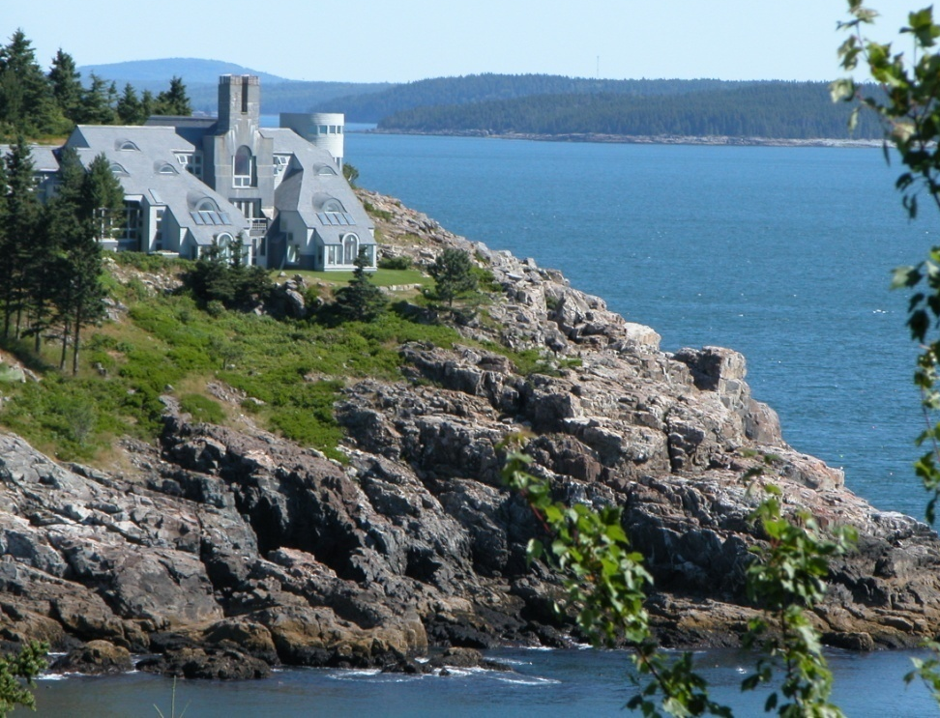
Where Is Your Treasure?
Are we trying to build heaven on earth?
We cannot manipulate God by giving, or by praise or by claiming something. God is too smart for that. He knows our heart.
Beware of greedy teachers who exploit you with false words (2 Pet. 2:3). If these greedy teachers really believed in “seed money,” they would send you the money so that they would have more.

Slide 14
The Creator and The Creation
Material riches are not to be our goal, but things material are not evil in themselves. The good God created very good things out of matter—stars and people and butterflies and whales (Gen. 1:31).
  The focus is to be on the Creator, instead of upon His creation.
    Matthew 6:21 “For where your treasure is, there your heart will be also.” NIV
    If God is our treasure, He can entrust to us the good things of His creation, knowing that they will not become idols—i.e. become more important to us than is God.
  Psalm 37:4 “Delight yourself in the LORD and he will give you the desires of your heart.” See also Ps. 16:11; 84:11b; Rom. 8:32. The more we love God, the more He is free to bless us, and I suspect we place less and less intrinsic value upon those gifts.
There is no creation mandate from God to us to become wealthy, but to be good stewards of God’s creation.

Slide 15
Wealth and Christians
God blessed Abraham, Job, David, Solomon, Hezekiah, etc. with much wealth. (Gen. 24:35; Job 1:3; I Chron. 29:3-5; 2 Chron. 1:12; 2 Chron. 32:27)
The fact that stealing remains a sin (Rom. 13:9) implies that private property is approved by God.
The “rich” are not told to divest of wealth, but to be richly generous (1 Tim. 6:18). If you made $10,000 in 2022, you are richer than approximately 53% the planet’s population.
  www.ubs.com/global/en/family-office-uhnw/reports/global-wealth-report-2023.html#executive
Riches are deceitful. They quietly entrap us, unless we are generous. It remains harder for the rich to enter heaven—Matt. 19:23.

Slide 16
Seek First God’s Kingdom
The more we love God, the more He is able to bless us materially, since we won’t make idols or let His blessings distract us from the Kingdom.
  He who did not spare his own Son, but gave him up for us all—how will he not also, along with him, graciously give us all things?
  Rom. 8:32 NIV
He also provides our wants--Ps. 37:4 “Take delight in the LORD, and he will give you the desires of your heart.” NIV
You make known to me the path of life; in your presence there is fullness of joy; at your right hand are pleasures forevermore.
Ps. 16:11 ESV

Slide 17
Real Prosperity is when …
Your name is written in heaven, Luke 10:20
You are content, and godly, 1 Tim. 6:6
  Without contentment, you’ll never have enough.
God meets all your needs, Phil. 4:19
  How much more than that do you need?
  Proverbs 30:7-9 "Two things I ask of you, O LORD; do not refuse me before I die: Keep falsehood and lies far from me; give me neither poverty nor riches but give me only my daily bread. Otherwise, I may have too much and disown you and say, 'Who is the LORD?' Or I may become poor and steal, and so dishonor the name of my God.”
Notes:
The more we love God, the more He is able to bless us materially, since we won’t make idols or let His blessings distract us from the Kingdom. God gives us more than our needs, He also provides our wants—in Thy right hand are pleasures forevermore. He who did not spare His own Son…Ps. 37 delight in the Lord and He will

Slide 18
Real Prosperity is when …
You have all the funds you need to accomplish all the work that God has given you to do in life, Eph. 2:10.
  (Preparation for ministry and ministry itself cost money)
You have the world—all things are the Christian’s
(1 Cor. 3:21-23; Rom. 4:13—JRW Stott).

Slide 19
Finances Test Commitment
If you go for the crown and the Lord:
  All your basic needs will be met—Matt. 6:25-34 (sometimes these will be met by others, James 2:14-17).
  All other needs will be met—Phil. 4:19, Rom. 8:32’
  We’ll have enough to share.
  Our lives will find balance between work and rest—Eccles. 4:5-8.
Is my trust in my Master, or in trying to make God make me rich through “miracles” and some twisted form of faith?
Notes:
The more we love God, the more He is able to bless us materially, since we won’t make idols or let His blessings distract us from the Kingdom. God gives us more than our needs, He also provides our wants—in Thy right hand are pleasures forevermore. He who did not spare His own Son…Ps. 37 delight in the Lord and He will

Slide 20
Contentment
Are you content right now ? 1 Tim. 6:6
  Debt often indicates lack of contentment.
What are the minimums? 1 Tim. 6:8
Will Christians always have them? (2 Cor. 11:27; Matt. 8:20; 2 Pet. 1:3). How was Paul content? Phil. 4:13
What would it take to make you content, if you’re not ?
Do you experience Jesus’ abundant life? (John 10:10)
Notes:
The more we love God, the more He is able to bless us materially, since we won’t make idols or let His blessings distract us from the Kingdom. God gives us more than our needs, He also provides our wants—in Thy right hand are pleasures forevermore. He who did not spare His own Son…Ps. 37 delight in the Lord and He will

