Slide 1

Forgiveness, reconciliation, peace
Jim Sutherland, Reconciliation Ministries Network, Inc., www.RMNI.org

Slide 2
forgiveness
The Vertical and the Horizontal

Slide 3
Disclaimer
The Bible was written by inspiration of God, to people who at various times knew war, racial hatred, bribery, armies and absolute rulers. They knew injustice, corrupt officials, sin and death. The Bible speaks to us today.

Slide 4
Present darkness
You have a unique opportunity to be light. You are here to demonstrate the supernatural power of God by His Spirit within you.
  No other people have the supernatural power to forgive, reconcile and live in peace together that the Church has. We have the Spirit to motivate and empower us to love and to live in peace with one another (Galatians 5:22).
  If the Church cannot show an inclusive love in this nation, none can in their own strength.
Through God’s power the Church is a foretaste of heaven, which will bring “people from every tribe, and language and people and nation” together in the worship of God (Revelation 5:9).

Slide 5
Personal Sin in Islam and Hinduism
Islam—as long as our sin is no more than 49% and our goodness 51%, Muslims believe that they will make it to paradise. They do not believe that Adam’s sin was transmitted (Sura 20:122), so do not have as pessimistic view of human nature as do Christians. “Honor killings” are legal under sharia law, generally, as are wife-beating, amputation and stoning. Idolaters are to be slain (Sura 4:89).
  In honor-based societies, vengeance is not left to God, but to family and friends.
Hinduism—bad karma does not affect one’s relationship with God. There is no forgiveness, but there must be payment for sin in the next life¹. Sin is ignorance of the truth (avidya).
        1 Dean Halverson, Ed. The Compact Guide to World Religions, ISBN: 1556617046, p. 88; Hindu Scriptures, R.C. Zaehner, translator, Everyman’s Library, 1966, p. v-vi; Nichols, “Hinduism, p. 90.

Slide 6
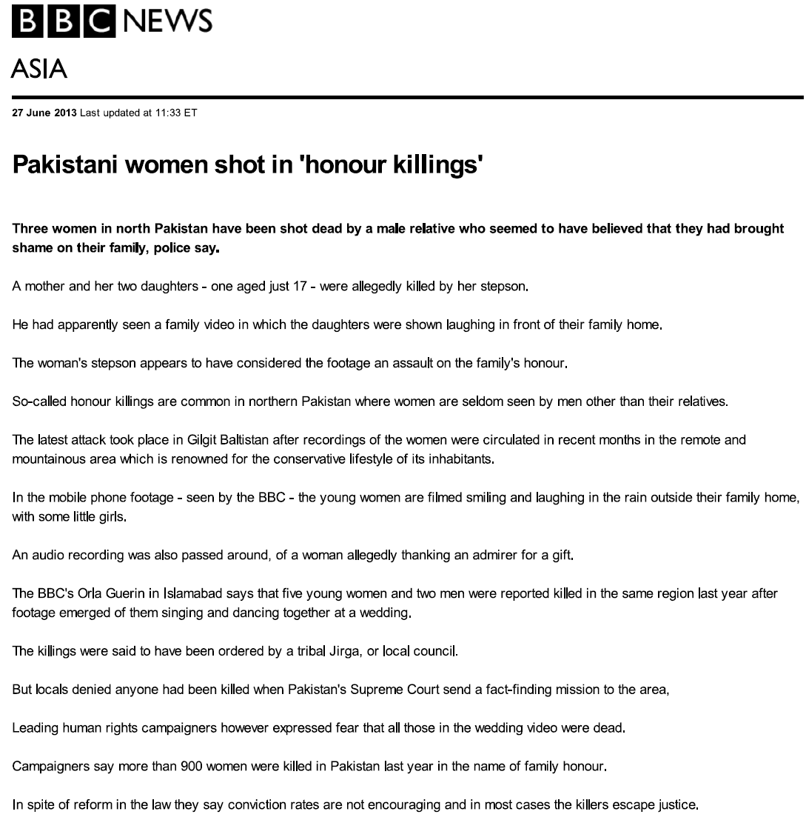
“honor” killings for laughing

Slide 7
Buddhism and Animism
Buddhism—sin and evil are to be overcome by supreme human effort—the Eightfold Path. However, there is still the law of karma, that must be paid for in the next life. Whatever evil we experience, we are presumed to deserve, due to past life. Bodhisattvas are those who have achieved such great merit that they delay their deliverance to share their merit with others. This indicates a very low view of personal sin.
  In Zen Buddhism there is no sense of personal sin.
In animistic societies, the creator God is so distant, that He cannot be relied upon to settle scores. Animists try to get spirits on their side through sacrifice, and people take vengeance into their own hands. Sin must be atoned for. This creates a cycle of vengeance, where people cannot easily keep score, so they simply try to hurt members of the other tribe, including women and children and their homes.

Slide 8
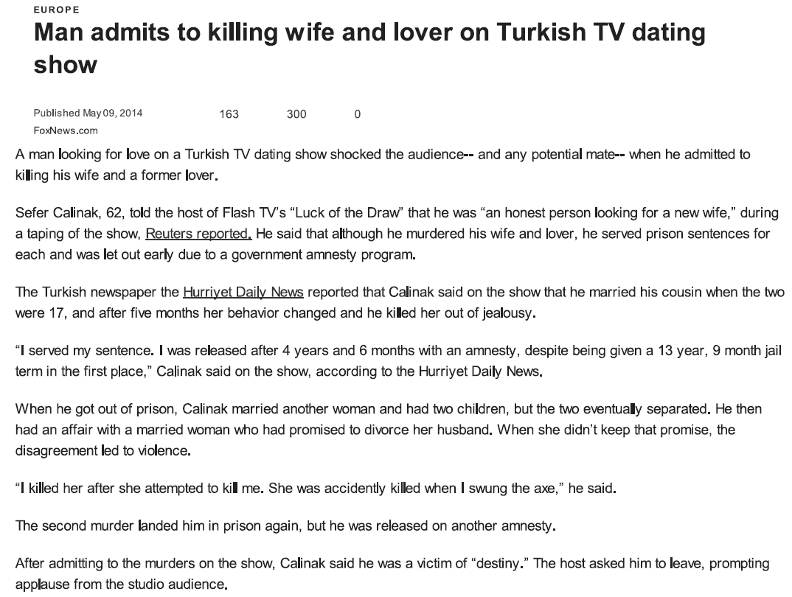
We tend to minimize our sins

Slide 9

We redefine sin
We call sin mental illness, or a mistake, or the normal result of environment, and a sickness. We have almost lost the category of “sin” outside of the church.
  An aid worker in Darfur did not believe that perpetrators there had a sin nature. The rapes and killings were a logical expression of their environment. They were not to blame, their environment was to blame.
Karl Pierson, 18, brought a shotgun, 125 rounds of ammunition, three Molotov cocktails and a machete to school and shot a girl who knew him, Claire Davis, age 17. Why? Because Pierson didn’t get on the school debate team.
    Her parents forgave Karl because “He didn’t know what he was doing.”
    “it’s no longer our responsibility to pass judgment.”
    Yet Karl’s actions were premeditated, and he had read a bomb-making manual.
    NBC News, Jan. 2, 2014, “Family of slain Colorado student Claire Davis forgive killer.”

Slide 10
We can forgive for various reasons
We can forgive because bitterness will harm us.
  “Each time someone does something bad to us, it’s as if they are throwing a rock into our well. If we leave the rocks, we won’t be able to draw water. We must go down into the well. We must pick up each rock, one at a time, and put it into the bucket. Then we must lift the rocks out of the well and throw them aside. It’s hard work, and it takes time. Our wells might have many rocks or just a few. When we have taken them out, we can draw sweet water from the well again.” “Kate McCord”, In the Land of the Blue Burka. ISBN: 139780802408143.
We can forgive because it will help us. Forgiveness “works”. It’s how God created us to live. The alternative is to live in bitterness.

Slide 11
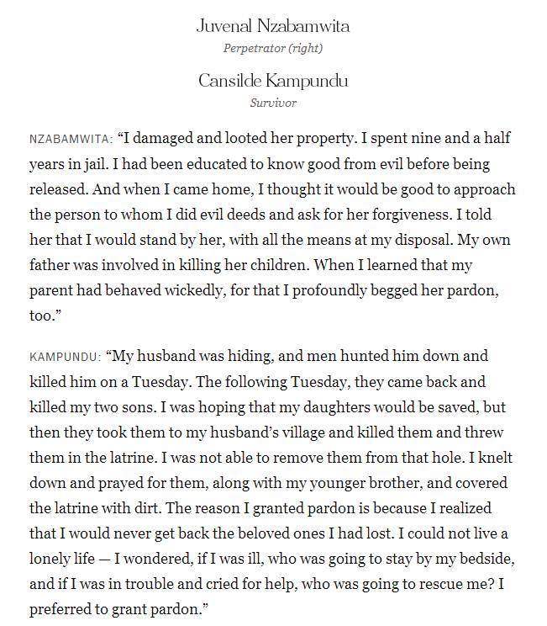
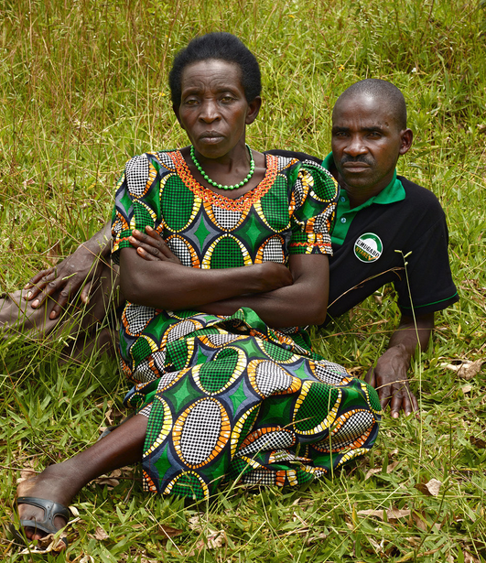
In the Rwandan genocide of 1994, up to 1 million people were killed, and up to 250,000 women were raped. 120,000 people were detained for crimes, according to the UN.
“Portraits of Reconciliation,” Photos: Pieter Hugo, text: Susan Dominus www.nytimes.com/interactive/2014/04/06/magazine/06-pieter-hugo-rwanda-portraits.html?_r=0

Slide 12
How sin against god is dealt with in Christianity
First, we recognize universal sin, transmitted through Adam (1 Corinthians 15:21-22).
All sin is first sin against God (Psalms 51:4), by breaking God’s laws.
Sin deserves death (Romans 6:23). Life is in the blood, so blood must be shed for sin (Leviticus 17:11).
Either the sinner must pay for sin (Matthew 13:41-42), or a sinless substitute. Jesus Christ is the only sinless substitute (Hebrews 4:15; 1 Peter 2:22), who specifically came to earth to pay for our sin, by shedding His blood on a cross (Luke 19:10; 1 Peter 2:24). That payment is applied to a sinner by faith in Christ’s deity and sacrifice for us (Romans 10:6-13), so that the sinner is justified (made righteous) and saved from his sin.

Slide 13
God goes looking for sinners
The payment to God for sin is through our intermediary, Jesus (1 Timothy 2:5). The redeemed (Christians) do not need to pay for their sins personally, since they have been taken away through the blood of the cross (Colossians 1:20).
  God forgives us only due to Christ’s sacrifice (Matthew 26:28; 2 Corinthians 5:21; Ephesians. 1:7; Colossians. 1:14; Hebrews 9:22).
  Some people think that it’s God’s job to forgive—that is simply what He does.
Justice is getting what we deserve, mercy is not getting what we deserve, and grace is getting what we don’t deserve.
  Sin is an offense against an omnipotent, just God.
  Offenders would normally expect to go to God to petition for forgiveness. On the contrary, God has always gone looking for those who have offended Him.
  When Eve and Adam and Eve sinned, they hid, but God looked for them (Genesis 3:9-10).
  God established a sacrificial system for Adam’s sons, Cain and Abel to atone for their sin (Genesis 4;4-7). He then, through Moses, entered into the Mosaic Covenant with the Israelites, again so that sinners could come before a holy God (although it was impossible for the death of animals to wipe away human sin, Hebrews 10:4).

Slide 14
God’s forgiveness is proactive
Jesus came to seek and save those who are apart from God (Luk 19:10). Jesus fulfilled the just demands of the Mosaic covenant, but went further. He satisfied God’s anger against humanity by the just One dying a horrible death for the unjust (1John 2:2; 4:10).
God is no longer angry at those whose sins have been cleansed by the blood of His son Jesus. Those whose sins remain are actually enemies of God (Romans 5:10).
God goes looking for even the one person who is lost (Matthew 18:12-14), no matter how many are saved.
Our forgiveness must be proactive, just as our seeking the lost must extend to the ends of the earth (Matthew 28:19).

Slide 15
How sin against another person is dealt with
God established human government to punish wrongdoing (Romans 13:1-5). Governmental authority represents God’s authority.
When the government does not carry out justice when a person breaks a law affecting another person, a Christian still must not take vengeance. As Christ is our intermediary before the Father, the Father is the intermediary between the transgressor and the victim, and God says that He will repay (Romans 12:19; Hebrews 10:30). That repayment may be on earth, or in God’s court above, within our lifetime--or after death.
  Therefore, no one truly gets away with anything, ever. This is how the Bible describes the way in which God orders His world.
  We do not have to pay back those who kill and steal and rape. Either the government will do this in courts of law, and God will deal with the sinner, or simply God will deal with the sinner in His time.

Slide 16
forgiveness
Christians may believe all this, yet fail to forgive a transgressor, make no attempt to reconcile with a transgressor, and fail to live in peace with a transgressor. We may harbor ill will or hatred against those who have sinned (or those we think have sinned) against us.
  We may not be living in the “grace of God.”
¹⁴ Strive for peace with everyone, and for the holiness without which no one will see the Lord. ¹⁵ See to it that no one fails to obtain the grace of God; that no "root of bitterness" springs up and causes trouble, and by it many become defiled; (Hebrews 12:14-15 ESV)
A person must be born again to really understand forgiveness and have the power to overcome sin by the Spirit. We must be those who face our own sin, realize that we cannot pay for it, and that we must have the grace of God in Christ.

Slide 17
Broken down world
Since all sin (Rom 3:23), all of us cannot live without sinning (1 John 1:8-10).
Therefore even Christians cannot live without needing to be continually forgiven. The people around us also constantly need to be forgiven. When we think too highly of our self (that we sin very little), it is more difficult to forgive others (who we think should be more like us) or even to associate with others we consider are worse sinners (Pharisees).
  We forget that a Christian’s sin-debt to God (that Christ paid for) is astronomical (because all sin is first against God), and the debt of another to us is small by comparison.

Slide 18
Parable of 10,000 talents
²¹ Then Peter came up and said to him, "Lord, how often will my brother sin against me, and I forgive him? As many as seven times?" ²² Jesus said to him, "I do not say to you seven times, but seventy-seven times. ²³ "Therefore the kingdom of heaven may be compared to a king who wished to settle accounts with his servants.²⁴ When he began to settle, one was brought to him who owed him ten thousand talents. ²⁵ And since he could not pay, his master ordered him to be sold, with his wife and children and all that he had, and payment to be made. ²⁶ So the servant fell on his knees, imploring him, 'Have patience with me, and I will pay you everything.'²⁷ And out of pity for him, the master of that servant released him and forgave him the debt.
²⁸ But when that same servant went out, he found one of his fellow servants who owed him a hundred denarii, and seizing him, he began to choke him, saying, 'Pay what you owe.‘ ²⁹ So his fellow servant fell down and pleaded with him, 'Have patience with me, and I will pay you.'³⁰ He refused and went and put him in prison until he should pay the debt.
³¹ When his fellow servants saw what had taken place, they were greatly distressed, and they went and reported to their master all that had taken place. ³² Then his master summoned him and said to him, 'You wicked servant! I forgave you all that debt because you pleaded with me. ³³ And should not you have had mercy on your fellow servant, as I had mercy on you?'³⁴ And in anger his master delivered him to the jailers, until he should pay all his debt. ³⁵ So also my heavenly Father will do to every one of you, if you do not forgive your brother from your heart." (Matthew 18:21-35 ESV)

Slide 19
Parable
The rabbis suggested that forgiving someone three times was sufficient. Peter doubled that and added one, since seven was a “perfect” number.
Jesus replied with an amazing number (77 times), which could be interpreted as forgiving without limit.
The “kingdom of heaven,” or life under God’s rule, is like a king (God) who was settling accounts with His servants. One owed Him 10,000 talents, which is about 4.06 billion US dollars (July 2014). That gives an indication how much in debt we are to God—we cannot pay it, and could not settle the debt if we spent eternity in hell paying on it.
The debtor thought so highly of himself that he thought he could actually repay this debt, just as people today think that if they obey sometimes or do some good, that this will pay their huge sin debt.
  We have all become like one who is unclean, and all our righteous deeds are like a polluted garment. We all fade like a leaf, and our iniquities, like the wind, take us away. (Isaiah 64:6 ESV)
  The King understood that the servant could not repay, and threw him in jail.

Slide 20
The servant begged for mercy, and the King, out of pity, not only released him, but wiped out the whole debt!
God graciously extended mercy and forgave the debt. This is what “forgive” means in Greek (ἀφῆτε), to let go or release a person—the person no longer owes anything. Sin is removed as far as east is from west (Psalms 103:12). All sins are forgiven (Psalms 103:3; 1 John 1:9; Colossians 2:13).
It is one thing to ask for mercy, and another to understand how desperately we need mercy.
The newly released servant then apparently went looking for someone who owed him the equivalent of $5,800 USD, or .000001% of his forgiven debt.
  That is equivalent to how much another owes us who has sinned against us, compared to what we owe God.

Slide 21
The servant showed his debtor no mercy, and in fact used severe violence, which his King did not use on him. He extended no patience and threw his debtor into prison.
When the King heard of this, he called the man “wicked.” It is actually wicked not to forgive, in light of what we have had forgiven of our sin. He should have showed mercy (not throwing his debtor into jail).
Then the King reassessed the original debt and delivered him (not his family) to jail until all was repaid. Like suffering in hell, the debt cannot be repaid no matter how much time is given.
Then Jesus applied the parable-- v35 “So also my heavenly Father will do to every one of you, if you do not forgive your brother from your heart."
  We cannot expect forgiveness if we don’t extend it.
  Forgiveness must be genuine, not formal.

Slide 22
Forgiveness is not optional
Ephesians 4:32 Be kind to one another, tenderhearted, forgiving one another, as God in Christ forgave you.
Colossians 3:12-13 Put on then, as God's chosen ones, holy and beloved, compassionate hearts, kindness, humility, meekness, and patience, bearing with one another and, if one has a complaint against another, forgiving each other; as the Lord has forgiven you, so you also must forgive.
  This word for “forgive” (χαρίζομαι) means to “bestow a favor unconditionally” (Vine). It is forgiveness graciously given, not reluctantly offered.
And whenever you stand praying, forgive, if you have anything against anyone, so that your Father also who is in heaven may forgive you your trespasses." (Mark 11:25 ESV)
Forgiveness is expected of us—we forgive because God has forgiven us.

Slide 23
Who “owes you”?
Who “owes you” right now? Whom have you not yet released, or whom have you superficially forgiven, but secretly still hold a grudge against?
  From time to time, I search my heart for those I may not have released and declare that their debt was paid at the cross of Christ. No one owes me anything. And, I am not locked into “victimhood” and self-pity.
  We may need to forgive the same person’s sin, or sin pattern, or the same exact sin, “77” times, because it has hurt us so deeply.
  We ask for daily food and for daily forgiveness, and should offer forgiveness daily (Luke 11:4).
No rule or guideline is given here, simply “forgive.” Freely have we received, freely give (Matthew 10:8, NIV).
Perhaps we lack joy or peace because we refuse to release someone?
This is a major reason why marriage can be so difficult. We don’t release sin, then keep score of the spouse’s sins, and when we’re provoked, we give the score. When we don’t keep score, It is part of dying daily.
  “Husbands, love your wives, and do not be embittered against them.” (Colossians 3:19 NAS)

Slide 24
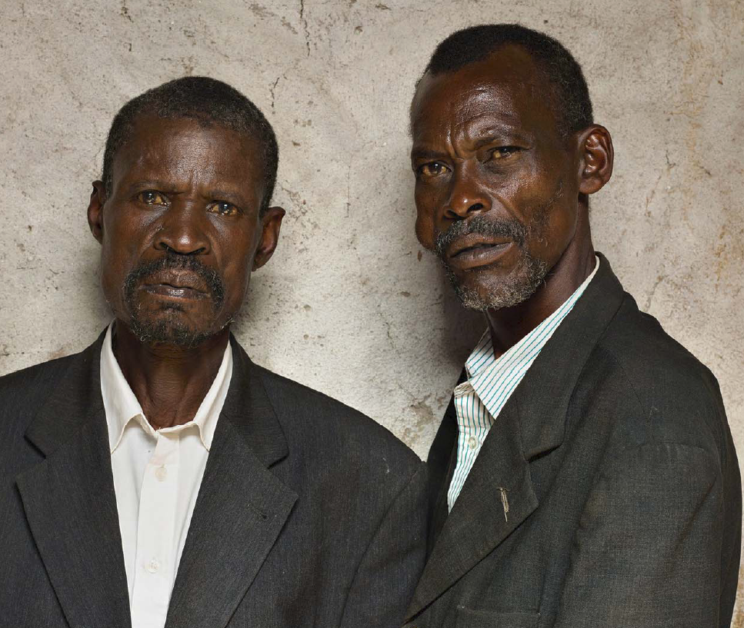
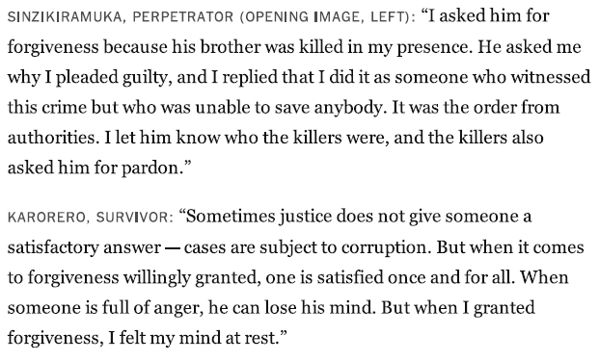
Forgiveness gives peace
“Portraits of Reconciliation,” Photos: Pieter Hugo, text: Susan Dominus www.nytimes.com/interactive/2014/04/06/magazine/06-pieter-hugo-rwanda-portraits.html?_r=0

Slide 25
“If [your brother] repents…forgive”
Luke 17:4 and if he sins against you seven times in the day, and turns to you seven times, saying, I repent, you must forgive him.”
  This repentance would seem insincere. The point is that we should keep forgiving.
What if my brother does not repent of minor offenses? Should we still forgive?
  Do we remember to ask God to forgive us for every sin we have committed?
  If we confess what sins we are conscious of, God will forgive all sin (1 John 1:9).
  Above all, keep loving one another earnestly, since love covers a multitude of sins. (1Peter 4:8 ESV). Our love should cover many smaller offenses that we do not need to mention. If we find that after trying we simply are unable to forgive, then we need to go and share that offense. In other words, we don’t need to make a habit of confronting people over their sin. This can be simply a cover for faultfinding.

Slide 26
If s/he does not repent of major offenses
¹⁵ "If your brother sins against you, go and tell him his fault, between you and him alone. If he listens to you, you have gained your brother.
¹⁶ But if he does not listen, take one or two others along with you, that every charge may be established by the evidence of two or three witnesses.
¹⁷ If he refuses to listen to them, tell it to the church. And if he refuses to listen even to the church, let him be to you as a Gentile and a tax collector. (Matthew 18:17 ESV)
This is church discipline. Some major offenses must be addressed formally and publically, even if costly, or not popular, or if the person still does not repent.

Slide 27
“People of the lie”
Some people simply will not, or cannot, see their sin. “No one is so blind as he who will not see,” (Dale Linebaugh).
People can live in a pattern of denial, and refuse to acknowledge their sin even when given clear evidence of it, time after time.
A “blind spot” is a sin that we simply do not see. Sometimes a person will acknowledge it if confronted with it, but sometimes not. King David seduced Bathsheba, Uriah’s wife, then murdered her husband Uriah to cover it. For months David didn’t see his sin for what it was until confronted by the prophet Nathan. Immediately he confessed, “I have sinned against the Lord.” (2 Samuel 12:13; Psalm 51).
  But “people of the lie” find no repentance nor any sin of which to repent. Their blind spot seems to be without remedy.

Slide 28
Forgiveness and boundaries
  Dr. M. Scott Peck wrote a book, People of the Lie. They transgress boundaries, but deny that they do. Further, they do not expect any consequences for their behavior, or believe that they deserve any consequences.
  When we are around people who will not honor normal human boundaries, we must establish boundaries. Transgressing normal human boundaries may be in the form of acting overly familiar, taking too much of another person’s time, flirting while married, having emotional affairs (not guarding one’s heart), frequently asking for money or favors, etc. It is trespassing.
  We are not to simply let someone sin against us, or take advantage of us as they wish. We may have tried to get the person to stop through rebuke, but without success.
  We may forgive a person, but still must establish boundaries for their behavior.

Slide 29
Biblical examples of boundaries
  Rebuke is a form of boundary. A person will know that if they sin against us, s/he will be confronted—there will be a consequence.
Divorce for sexual sin is a boundary. If the boundary of no sexual uncleanness is crossed, divorce is allowed, but not required.
The process of excommunication sets a boundary if there is no repentance.
God not forgiving blasphemy against the Holy Spirit is a boundary—there is no forgiveness if crossed (Mark 3:29).
God set boundaries in the Old Testament Law that must not be crossed. Deuteronomy 28:15-68 outlines extensive curses for disobeying those laws.

Slide 30
Vicarious or representative repentance
The Bible provides examples of leaders who confessed the sins of their people.
  Moses interceded before God on behalf of the Israelites for forgiveness (Exodus 32:31-32) and to keep God from wiping them out (Numbers 14:11-19.
  Nehemiah confessed his people’s sins (Nehemiah 1:4-11).
  Daniel confessed the sins of his people Israel (Daniel 9:1-23).

Slide 31
Forgiveness and capital punishment
God initiated capital punishment—a life for a life (Exodus 21:23; Deuteronomy 19:21). This is the penalty for killing a person in God’s image.
God defined the difference between murder (premeditated with malice) and manslaughter (accidental, with no malice, Deuteronomy 19:4-5).
The government bears the sword for the Lord to punish evildoers (Romans 13:4). This is not “murder” but is killing for the sake of justice. Vengeance is God’s and He uses the government’s sword to avenge.
  What if there is injustice and the innocent are condemned? In this broken world, every human institution is open to corruption. But government is better than lawlessness, and God knew that government would not be perfect. The thief on the cross was forgiven by Jesus, but still died, justly, through the justice system.

Slide 32
reconciliation
The Vertical and the Horizontal

Slide 33
Reconciliation defined
Various lexicons indicate that in popular Greek the word (διαλλάσσω) meant to change someone’s mind, to make friends. A stronger form of the word (ἀποκαταλλάσσω) means to “reconcile completely,” to bring back to a former state of harmony” (Thayer).

Slide 34
Why reconcile ?
The secular world—those living without reference to things spiritual, have practical or personal reasons to reconcile people, just as they have to forgive.
  Reconciliation can prevent divorce, which creates problems for children of the marriage, and often creates financial hardship on those divorcing.
  Out of concern for a weaker party, reconciliation might protect from abuse, such as an abusive husband or father.
  Humanitarian concerns enter in when groups are threatened due to tribal warfare, the desire for spoils, the desire for power or for religious dominance.
  War makes life hard, peace makes life easier.
  But why are humans of any value? Why not allow the powerful to abuse the weak? What is wrong with violence? What is the basis for what is right and wrong? These are foundational (metaphysical) questions.

Slide 35
Why care ?
For those who do not believe that people are made in the image of God, but evolved due to time plus chance plus nothing (or plus eternal matter), we are simply higher life forms on the food chain. People have ascribed value, but it is arbitrary and often temporary.
  Human value may decrease as people age or otherwise become a burden to society.

Slide 36
Why Christians should care
For Christians people have value because God gives us value. We are part of the creation which God called “very good” (Genesis 1:31).
We are made in God’s image (Genesis 1:27). Because of this, murder is wrong, and violence against the innocent is wrong.
God cares for the weak—particularly the poor, the alien and the orphan. These are created during strife, and these suffer during conflicts. They have few resources to protect themselves.
  Thus says the LORD: Do justice and righteousness, and deliver from the hand of the oppressor him who has been robbed. And do no wrong or violence to the resident alien, the fatherless, and the widow, nor shed innocent blood in this place. (Jeremiah 22:3 ESV)

Slide 37
Wars between civilizations
Wars and rumors of wars will continue to the end (Matthew 24:6). Victors will continue to define the terms of peace, and the defeated will continue to feel unjustly treated.
“For [Samuel] Huntington, this new phase [in global politics] is marked not so much by the end of history, the return of traditional rivalries among nation-states, or the decline of the nation-state in the face of tribalism and globalism—as many would have it—but rather by a new source of conflict in the world, neither economic nor ideological but cultural. As such, nation-states will neither disappear nor go into a period of decline; to the contrary, they shall continue to function as the most powerful actors in world affairs. At the same time, however, global conflict will be increasingly defined not by conflicts among nation-states…but rather by conflicts between nations and groups of different civilizations….” In Ethnicity and the Bible, Mark G. Brett, ed., p. 473.

Slide 38
Clashing Civilizations
A global divide is developing between radical Islam and everyone else. These Muslims are working for a global Dar Al Islam—House of Islam, or a global caliphate, and will use any means to get it. One was announced by ISIS in July 2014 in northern Iraq.
  On the other side are moderate and nominal Muslims, Western and westernized nations, and any government that opposes them.
At the same time China is rising as the next global superpower, probably. China is radically materialistic. Chinese, more than any others, value themselves by how much they own. www.ipsos-na.com/news-polls/pressrelease.aspx?id=6359 accessed 9/9/14
Hinduism is being radicalized by the BJP Party, which backed recently elected Prime Minister Morsi. India is a very religious civilization.
Christianity also wins the hearts and souls of the world for the worship and service of God. But the kingdom we seek is of the heart.

Slide 39
God’s work to reconcile
God’s aim is nothing less than to reconcile the world to Himself. The Bible describes God’s reaching out to rebellious humanity in the Garden, continuing through those He elected. He chose Abraham and made of his offspring a special nation Israel for the purpose of making that nation a light to the nations and bearer of God’s written revelation of Himself (Exodus 19:6; Isaiah 49:6).
When Israel rejected God’s Son and Redeemer Jesus, God turned to reach out to seek and save Gentiles (non-Jews, Romans 11:11-12).
  For if their [Jews] rejection means the reconciliation of the world, what will their acceptance mean but life from the dead? (Romans 11:15 ESV)
God reconciled Jews and Gentiles through Jesus Christ and has given us the mission to seek and to reconcile the rest of humanity to God, as His now-integrated kingdom of priests (1 Peter 2:5,9; Revelation 1:6).

Slide 40
God’s global plan to reconcile
¹³ But now in Christ Jesus you who once were far off have been brought near by the blood of Christ. ¹⁴ For he himself is our peace, who has made us both one and has broken down in his flesh the dividing wall of hostility ¹⁵ by abolishing the law of commandments expressed in ordinances, that he might create in himself one new man in place of the two, so making peace,
¹⁶ and might reconcile [reconcile completely] us both to God in one body through the cross, thereby killing the hostility.
¹⁷ And he came and preached peace to you who were far off and peace to those who were near. ¹⁸ For through him we both have access in one Spirit to the Father. ¹⁹ So then you are no longer strangers and aliens, but you are fellow citizens with the saints and members of the household of God, (Eph 2:13-19 ESV)

Slide 41
Horizontal and vertical reconciliation
Observe that God has now brought Gentiles to Himself through Christ’s blood.
Jesus is our peace.
The Law is no longer the special mark of God’s people, the Jews (Deuteronomy 4:8). It has been fulfilled by Christ and is now “obsolete” (Hebrews 8:13).
God reconciled Jew and Gentile by the cross, making one category instead of two—the follower of Christ.
God “preached peace” to both Jew and Gentile—peace with God and peace between them.
Now anyone can become a child of the Father.

Slide 42
Reconciliation: universal, personal
Paul put it this way in Colossians: ¹⁹ For in him [Jesus] all the fullness of God was pleased to dwell, ²⁰ and through him to reconcile to himself all things, whether on earth or in heaven, making peace by the blood of his cross.
²¹ And you, who once were alienated and hostile in mind, doing evil deeds, ²² he has now reconciled [completely] in his body of flesh by his death, in order to present you holy and blameless and above reproach before him, (Colossians 1:19-22 ESV)
Reconciliation is global in scope, but personal in application. Our job is to go into all the world to preach the Good News and reconcile people to God. This is done one person at a time.
Our vision for reconciliation should not be smaller than God’s.

Slide 43
The church is a global family
Islam has a global “house,” Hinduism has a national civilization, and Buddhism a spiritual philosophy, but our Father has a family.
Those redeemed are adopted, as sons and daughters, into God’s family (Galatians 4:5; Ephesians 1:5). All in the family have the urge to worship the same Father.
Through Jesus Christ, all true Christians are brothers and sisters. The only stronger union is marriage.
  This comes home when traveling the globe. It is nothing to trust your life to believers you have barely met. They are family. In fact they possibly are safer than one’s biological family, who may be alienated from you due to Jesus (Matthew 10:35-36).

Slide 44
God’s reconciliation is working
Christianity is the best-distributed religion on the planet. Christians are found in all 238 countries and Christians are found in at least 11,500 of earth’s 12,600 ethnic language groups. Christianity is the largest religion in 5 of the 6 continents (Asia is the exception).
    Michael Jaffarian, “the demographics of world religions entering the 21st century,” in Between Past and Future, J. Bonk ed. 2003. pp. 261-62.
There should be unity with essentials of the faith and liberty with non-essentials.

Slide 45
We have the ministry of reconciliation
¹⁸ All this is from God, who through Christ reconciled us to himself and gave us the ministry of reconciliation;
¹⁹ that is, in Christ God was reconciling the world to himself, not counting their trespasses against them, and entrusting to us the message of reconciliation.
²⁰ Therefore, we are ambassadors for Christ, God making his appeal through us. We implore you on behalf of Christ, be reconciled to God.
²¹ For our sake he made him to be sin who knew no sin, so that in him we might become the righteousness of God.
(2 Corinthians 5:18-21 ESV)
Vertical reconciliation (person to God) will eventually bring about horizontal reconciliation (person to person), as we become brothers and sisters in Christ.

Slide 46
Reconciliation has limits
Matthew 7:14 indicates that only a few will be saved. Even at the church’s best, everyone will not be saved: ¹³ "Enter by the narrow gate. For the gate is wide and the way is easy that leads to destruction, and those who enter by it are many. ¹⁴ For the gate is narrow and the way is hard that leads to life, and those who find it are few. (Matthew 7:13-14 ESV)
The parable of the sower (Matthew 13:3-8) shows that perhaps only a quarter of the truth of God’s Word will bear any fruit.
The truth of God’s election also indicates that not everyone will be saved (Romans 9) . However, people from every tribe, tongue and people and nation will be found in heaven (Revelation 5:9; 13:7; 14:6). The fact that even one person is saved demonstrates the grace of God toward sinners.

Slide 47
How are you doing?
The “church” is vague. You and I are the church. When was the last time you informally shared your faith in Christ with a stranger to reconcile that person to Christ?
When was the last time you intentionally planned or prayed for the opportunity to share your faith in Christ with an unbeliever?
When was the last time you shared your faith with someone from a very different culture?
Is your church supporting cross-cultural gospel missionaries?

Slide 48
The church impartial
The church should display to the world how God reconciles people from every imaginable background, making them one body.
  The church does not always accept people of different backgrounds as equals.
  The Bible speaks against showing partiality – “But if you show partiality, you are committing sin and are convicted by the law as transgressors.” (James 2:9 ESV). Favoring people for church or other offices or for assistance from a certain tribe, economic or social status, for no other reason than those distinctions, is showing partiality and is a sin.

Slide 49
Vicarious repentance
We may have to confess the sins of our fathers not simply to God (vertically), but to people affected by our fathers’ and mothers’ sins.
I work among African Americans. One man I know hates white people. He gives some of the reasons—slavery, whites taking sexual advantage of black slaves, trying to deceive blacks by keeping them down with the Gospel, prejudice in current society, etc.
  He sells bad movies that have been illegally reproduced. It also appears that he is selling drugs to them, since he recently purchased three cars.
I have had to agree with many of his charges against whites. I’ve had to ask for forgiveness many times in my life for sins I didn’t personally commit against blacks, although I have shown racial prejudice at times. Simply recognizing past sins can help to heal.
The US Southern Baptist Convention publically repented of her sins of being racist toward African Americans. I can’t prove a connection, but the SBC now has 5,000 African America congregations.

Slide 50
Reconciliation among Christians—our move
Luke 17:3 “Pay attention to yourselves! If your brother sins, rebuke him, and if he repents, forgive him, [ἀφῆτε—release him]
  We are to take the initiative—we act first, when sinned against.
”So if you are offering your gift at the altar and there remember that your brother has something against you, ²⁴ leave your gift there before the altar and go. First be reconciled to your brother, and then come and offer your gift.” (Matthew 5:23-24 ESV).
  When we sin, we should be the first one to act, and go to the one offended.
  In certain situations, going would make matters worse, perhaps by exposing someone else.
“We should be a quick ‘repenter’” (Joe Novenson). A father should repent before his wife and his child. When we see our sin, confess it.
  A man should not confess lust to the woman he lusted for, of course.
  Some “secret sins” should only be confessed to God.

Slide 51
Going to the pain
Racial reconciliation should go to the great point of rupture, in contrast to reconciliation with God, generated from the great point of healing—the cross.
For Jews we need to acknowledge the Holocaust, in my limited experience, in witnessing to them.
For some Muslims, the Crusades are one issue. Christians killed to keep access to the Holy Land.
For African Americans, slavery is a real gateway for dialogue. I was on a Christian talk program focusing upon racial reconciliation and when I mentioned slavery as the “first base” for building relationships. The host moved quickly on. We need to say that enormous wrongs were committed by whites upon blacks for over 220 years.

Slide 52
Reconciling with a non-christian
²⁵ Come to terms quickly with your accuser while you are going with him to court, lest your accuser hand you over to the judge, and the judge to the guard, and you be put in prison. ²⁶ Truly, I say to you, you will never get out until you have paid the last penny. (Matthew 5:25-26 ESV)
  This suggests that we are to make concessions with an accuser, for the simple reason that it may go very badly for us in court. And truth may not prevail.
³⁸ "You have heard that it was said, 'An eye for an eye and a tooth for a tooth.' ³⁹ But I say to you, Do not resist the one who is evil. But if anyone slaps you on the right cheek, turn to him the other also. ⁴⁰ And if anyone would sue you and take your tunic, let him have your cloak as well. ⁴¹ And if anyone forces you to go one mile, go with him two miles. (Matthew 5:38-41 ESV) 48 You therefore must be perfect, as your heavenly Father is perfect. (Matthew 5:48 ESV)
  Again, this prevents more conflict, and is sacrificial.

Slide 53
Justice & reconciliation: rwanda
This process was through courts and education.
Three levels of courts: 1) The Int’l Criminal Tribunal for Rwanda tried the worst offenders, 2) the National Court system tried serious genocide cases and 3) the 12,000 Gacaca (GA-CHA_CHA) community court system, where 1.2 million were tried who did not plan the genocide.
The Gacaca courts gave lighter sentences to those who confessed their crimes, who asked for forgiveness and who tried to reconcile with the community. These courts also provided information about those who died.
The National Unity and Reconciliation Commission conducted peace education dealing with Rwanda’s history, held leadership academies, conducted seminars in trauma counseling and conflict resolution, held national summits and published reports on matters concerning the genocide. These seem to have been horizontal in nature.

Slide 54
peace
The Vertical and the Horizontal

Slide 55
Peace defined
The famous Hebrew word “shalom” means “being whole, intact; prosperity, peace” (Holladay Lexicon).
The Greek word for “peace” (εἰρήνη) has the meanings of freedom from war, harmony between people and, like shalom, “security, safety, prosperity” (Thayer’s Greek Lexicon).

Slide 56
No christ, no peace
²² "There is no peace," says the LORD, "for the wicked." (Isaiah 48:22 ESV)
¹⁴ "Their mouth is full of curses and bitterness."
¹⁵ "Their feet are swift to shed blood;
¹⁶ in their paths are ruin and misery,
¹⁷ and the way of peace they have not known."
¹⁸ "There is no fear of God before their eyes." (Romans 3:14-18 ESV)
We must make peace with God, before we can have the peace of God.

Slide 57
Know christ, know peace with god
For in him all the fullness of God was pleased to dwell, and through him to reconcile to himself all things, whether on earth or in heaven, making peace by the blood of his cross. (Colossians 1:19-20 ESV)
Isaiah 53:5 But he was pierced for our transgressions; he was crushed for our iniquities; upon him was the chastisement that brought us peace, and with his wounds we are healed.
ESV Romans 5:1 Therefore, since we have been justified by faith, we have peace with God through our Lord Jesus Christ

Slide 58
Preaching peace when there is none
Some pastors in the USA rarely if ever speak of sin. They want to preach positive, soothing messages. They preach prosperity, health and wholeness.
¹⁰ To whom shall I speak and give warning, that they may hear? Behold, their ears are uncircumcised, they cannot listen; behold, the word of the LORD is to them an object of scorn; they take no pleasure in it.
¹¹ Therefore I am full of the wrath of the LORD; I am weary of holding it in. "Pour it out upon the children in the street, and upon the gatherings of young men, also; both husband and wife shall be taken, the elderly and the very aged.
¹² Their houses shall be turned over to others, their fields and wives together, for I will stretch out my hand against the inhabitants of the land," declares the LORD.
¹³ "For from the least to the greatest of them, everyone is greedy for unjust gain; and from prophet to priest, everyone deals falsely.
¹⁴ They have healed the wound of my people lightly, saying, 'Peace, peace,' when there is no peace.
Jeremiah 6:10-14 ESV

Slide 59
The peace of god
There is much to cause us anxiety in our life, but we can live with our minds and spirits in peace.
ESV Psalm 4:8 In peace I will both lie down and sleep; for you alone, O LORD, make me dwell in safety.
Peace from God comes with trusting God ESV Isaiah 26:3 You keep him in perfect peace whose mind is stayed on you, because he trusts in you.
ESV John 14:27 Peace I leave with you; my peace I give to you. Not as the world gives do I give to you. Let not your hearts be troubled, neither let them be afraid.
ESV John 16:33 I have said these things to you, that in me you may have peace. In the world you will have tribulation. But take heart; I have overcome the world."

Slide 60
Try to live in peace on earth
¹⁶ Live in harmony with one another. Do not be haughty, but associate with the lowly. Never be wise in your own sight. ¹⁷ Repay no one evil for evil, but give thought to do what is honorable in the sight of all. ¹⁸ If possible, so far as it depends on you, live peaceably with all. ¹⁹ Beloved, never avenge yourselves, but leave it to the wrath of God, for it is written, "Vengeance is mine, I will repay, says the Lord." ²⁰ To the contrary, "if your enemy is hungry, feed him; if he is thirsty, give him something to drink; for by so doing you will heap burning coals on his head." ²¹ Do not be overcome by evil, but overcome evil with good. (Rom 12:16-1 ESV)
We are to try to live in peace; “Strive for peace with everyone, and for the holiness without which no one will see the Lord.” ESV Hebrews 12:14
"Blessed are the peacemakers, for they shall be called sons of God. (Matthew 5:9 ESV)

Slide 61
Oneness in the church
Complete peace and harmony will only be found in heaven.
The closest to peace on earth should be within the church:
  ¹¹ And I am no longer in the world, but they are in the world, and I am coming to you. Holy Father, keep them in your name, which you have given me, that they may be one, even as we are one. (John 17:11 ESV)
²⁰ "I do not ask for these only, but also for those who will believe in me through their word,
²¹ that they may all be one, just as you, Father, are in me, and I in you, that they also may be in us, so that the world may believe that you have sent me.
(John 17:20-21 ESV)
If the church is divided, people are less likely to believe in Christ.

Slide 62
Peace within the church is not easy
ESV Mark 9:50 Salt is good, but if the salt has lost its saltiness, how will you make it salty again? Have salt in yourselves, and be at peace with one another."
ESV Romans 14:19 So then let us pursue what makes for peace and for mutual upbuilding.
ESV 2 Corinthians 13:11 Finally, brothers, rejoice. Aim for restoration, comfort one another, agree with one another, live in peace; and the God of love and peace will be with you.
ESV Ephesians 4:3 eager to maintain the unity of the Spirit in the bond of peace.
ESV 1 Thessalonians 5:13 Be at peace among yourselves. [Even in the early church there was conflict.]

Slide 63
⁸ Finally, all of you, live in harmony with one another; be sympathetic, love as brothers, be compassionate and humble. ⁹ Do not repay evil with evil or insult with insult, but with blessing, because to this you were called so that you may inherit a blessing. ¹⁰ For, "Whoever would love life and see good days must keep his tongue from evil and his lips from deceitful speech. ¹¹ He must turn from evil and do good; he must seek peace and pursue it. 1 Peter 3:8-11
So many admonitions to live in peace mean that due to sin we are still, even as Christians, prone to strife.

Slide 64
Christ offers conflict to followers
Christians cannot expect peace with unbelievers.
34 "Do not think that I have come to bring peace to the earth. I have not come to bring peace, but a sword.
35 For I have come to set a man against his father, and a daughter against her mother, and a daughter-in-law against her mother-in-law.
36 And a person's enemies will be those of his own household.
37 Whoever loves father or mother more than me is not worthy of me, and whoever loves son or daughter more than me is not worthy of me.
38 And whoever does not take his cross and follow me is not worthy of me. 39 Whoever finds his life will lose it, and whoever loses his life for my sake will find it.
(Matthew 10:34-39 ESV)

Slide 65
Pray for the government
Due to increasing lawlessness, people globally are falling back to people like themselves for protection. These groups may be religious (Sunni, Shia, conservative, liberal, denominational), tribal, gang-related, regional, cultural, professional (unions, intellectuals), political organizations or nations. Government should bring stability.
We should pray for our leaders.
¹ First of all, then, I urge that supplications, prayers, intercessions, and thanksgivings be made for all people,
² for kings and all who are in high positions, that we may lead a peaceful and quiet life, godly and dignified in every way.
(1Timothy 2:1-2 ESV)

Slide 66
Church and government
The church has sometimes taken a prophetic role in government, as God’s prophets spoke to government corruption in Israel and Judah.
Christians should run for office to provide honest government leaders. The church is the best hope of a nation, through the work of the Holy Spirit to purify God’s people.

Slide 67
Christ’s two comings telescoped
Christ’s first coming was to lay the foundation for peace with God.
His second coming will establish peace on earth.
⁹ Rejoice greatly, O daughter of Zion! Shout aloud, O daughter of Jerusalem! Behold, your king is coming to you; righteous and having salvation is he, humble and mounted on a donkey, on a colt, the foal of a donkey. ¹⁰ I will cut off the chariot from Ephraim and the war horse from Jerusalem; and the battle bow shall be cut off, and he shall speak peace to the nations; his rule shall be from sea to sea, and from the River to the ends of the earth. (Zechariah 9:9-10 ESV)

Slide 68
Everlasting peace coming
⁶ For to us a child is born, to us a son is given; and the government shall be upon his shoulder, and his name shall be called Wonderful Counselor, Mighty God, Everlasting Father, Prince of Peace.
⁷ Of the increase of his government and of peace there will be no end, on the throne of David and over his kingdom, to establish it and to uphold it with justice and with righteousness from this time forth and forevermore. The zeal of the LORD of hosts will do this.
Isaiah 9:6-7 ESV

Slide 69
News of peace !
We always have good news of peace--with God, and of God.
Stand therefore, having fastened on the belt of truth, and having put on the breastplate of righteousness, ¹⁵ and, as shoes for your feet, having put on the readiness given by the gospel of peace. (Ephesians 6:14-15 ESV)
¹³ For "everyone who calls on the name of the Lord will be saved."
¹⁴ How then will they call on him in whom they have not believed? And how are they to believe in him of whom they have never heard? And how are they to hear without someone preaching?
¹⁵ And how are they to preach unless they are sent? As it is written, "How beautiful are the feet of those who preach the good news!"
(Romans 10:13-15 ESV)

