Slide 1

Global Mission Trends 2013
RMNI.org
Jim Sutherland, PhD, Director

Slide 2
What is “Missions”?

Slide 3
Basic Definition of Missions
Christian mission brings the message of salvation in Christ alone to all ethnic groups so that they have the undisputed opportunity to become new persons in Christ (2 Cor. 5:17).
  Matthew 24:14 And this gospel of the kingdom will be preached in the whole world as a testimony to all nations, and then the end will come. (The NIV is used, unless noted.)
  Luke 24:47 repentance and forgiveness of sins will be preached in his name to all nations, beginning at Jerusalem. (References are from the New International Version.)

Slide 4
Broad Definition of Missions
More generally, mission is continuing to do Jesus’ work.
  “As the Father has sent me, I am sending you.”--John 20:21 (out of our comfort).
  “The Son of Man came to seek and to save what was lost.”—Luke 19:10
  To destroy the Devil’s work—1 John 3:8
  “preach Good News to the poor…free the prisoners…release the oppressed”—Luke 4:18
  Mission glorifies God by bringing new worshippers to Him “from every nation, tribe, people and language”—Rev. 7:9-10.

Slide 5
WHAT IS A CHRISTIAN
MISSIONARY ?
A Christian missionary is God’s ambassador bringing the message of salvation in Christ alone to another people, so that members will have the opportunity to be born from above.
  John 3:3 In reply Jesus declared, "I tell you the truth, no one can see the kingdom of God unless he is born again."
  This is a narrow definition of classic mission. Certainly Christian support personnel and those in mercy ministries in cross-cultural ministries are missionaries.

Slide 6
Distinguishing Traits of a Missionary
A missionary is sent by God on a task. The word “missionary” is the Latin equivalent of the Greek “apostle,” or “sent one.”
A missionary usually goes to a different culture and ethnic group. Paul went to Gentiles and Peter to Jews (Gal. 2:8).
  This distinguishes them from “witnesses,” the work of every Christian, and from local evangelists (although “witness” is used in Acts 1:8).
Missionaries are sent by God, through the Spirit, usually by local churches (Acts 13:3).

Slide 7
Missionaries are Called by God
Missionaries are distinguished by a “call” from God (Acts 13:2), although some believe Matt. 28:18-20 (“the Great Commission”) suffices for a call to everyone.
  This call may not come in the form of an unusual revelation. It could be simply a conviction or burden that God gives.
  The call may be to a specific people—however defined, to a country, or to a kind of ministry, such as teaching or medicine. The ministry focus may also change over time.

Slide 8
A Missionary is Not:
Someone who simply does the work of a deacon:
  Comforting the grieving
  Taking food to the hungry (Acts 6:1-4), etc.
Someone who does the work of an evangelist among his or her own people.
“If everyone is a missionary, then no one is a missionary.” It has been defined away.

Slide 9
Missionary to Non-missionary
M-1 Frontier missionaries—World A
M-2 To non-Christians—World B
M-3 Foreign missionaries--World C
M-4 Cross-cultural home missionaries
M-5 Home missionaries—near culture
M-6 Pastoral workers, as pastors, deacons, preachers, chaplains
M-7 Great Commission Christians-laymen
M-8 Disobedient & nominal Christians
David Barrett & Todd Johnson, World Christian Trends AD 30-AD 2200, p. 31.

Slide 10
Four Mega-trends in Missions

Slide 11
These are:
1. The long-term growth of Christianity— the Kingdom
2 Globalization—the inter-connectedness of planet Earth
3 Urbanization
4 (Consequent) Mission force shifts

Slide 12
Mega-trend #1: Steady Global Christian Growth

Slide 13
The Global Kingdom Is Growing
It grows from a mustard seed to a tree-- Matthew 13:31-33
The Kingdom grows mysteriously toward a final harvest--Mark 4:26-29.
Christianity is the best-distributed religion on the planet. Christians are found in all 238 countries and Christians are found in at least 11,500 of Earth’s 12,600 ethnic language groups. Christianity is the largest religion in 5 of the 6 continents (Asia is the exception).
  Michael Jaffarian, “The demographics of world religions entering the 21st century,” in Between past & future, J. Bonk ed. 2003, pp. 261-62.

Slide 14
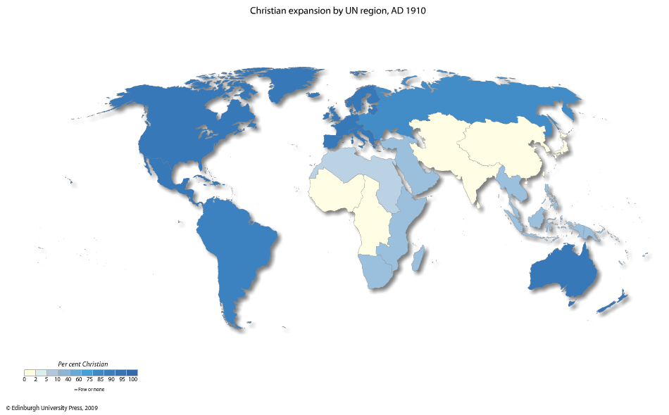
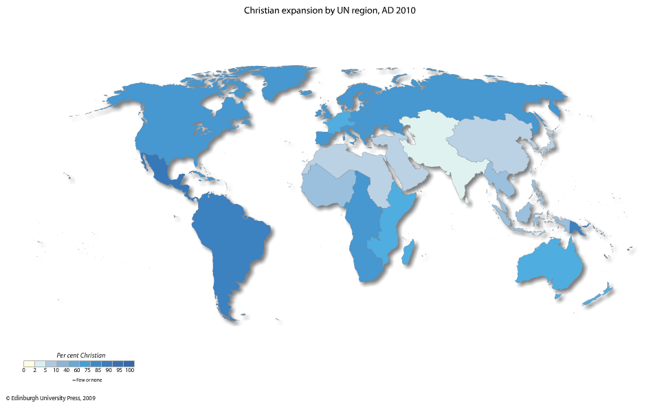
100 Years of Christian Growth, 2010
1910
Todd M. Johnson, Kenneth R. Ross, eds., Atlas of Global Christianity, 2009, pp. 52-53, ISBN: 9780748632671
2010

Slide 15
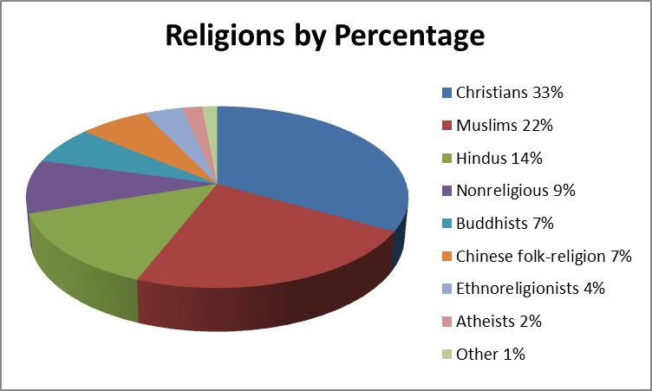
World Religions by Percentage and Size of World Population--2013
World Religions by Population
Christians | 2,354,523,000
Muslims | 1,635,314,000
Hindus | 982,329,000
Nonreligious | 684,193,000
Buddhists | 433,144,000
Chinese folk religionists | 433,144,000
Ethnoreligionists | 242,745,000
Atheists | 132,036,000
Other | 156,062,000
Source: Todd Johnson & Peter Crossing, “Status of Global Mission, 2013, in the Context of AD 1800-2025,” Int’l Bulletin of Missionary Research, Jan. 2013, p. 33.
.

Slide 16
A. Sub-trend: Christianity is Headed South by Southeast

Slide 17
A. The Church is going South & East
The Four-fifths World (Asia, Africa, Latin America) contains 58% of all Christians, versus 42% in the West¹
In 1900 9.2% of Africa was Christian. In 2000, 45.9% were. Population grew 626% in that period, while Christianity grew by 3,500%.²
  Yet ethnoreligionists (tribal religions) were 117,537,000 in 1900 and 242,745,000 in 2013.³
1 Michael Jaffarian, “The demographics of world religions entering the 21st century,” in Between past & future, J. Bonk ed. 2003, pp. 257-258.
2 Michael Jaffarian, “The demographics of world religions entering the 21st century,” in Between past & future, J. Bonk ed. 2003, pp. 255, 260-261.
3 Todd Johnson & Peter Crossing, “Status of Global Mission, 2013, in the Context of AD 1800-2025,” Int’l Bulletin of Missionary Research, Jan. 2013, p. 33.

Slide 18
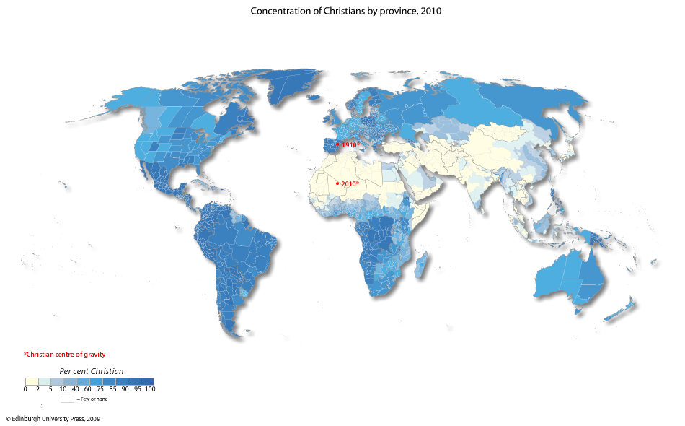
Christian Concentration By Province
Todd M. Johnson, Kenneth R. Ross, eds., Atlas of Global Christianity, 2009, pp. 56-57, ISBN: 9780748632671

Slide 19
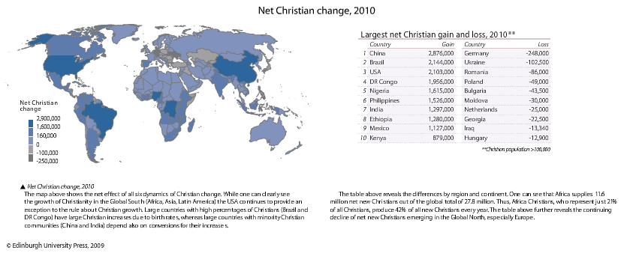
Global Net Christian Change
Todd M. Johnson, Kenneth R. Ross, eds., Atlas of Global Christianity, 2009, pp. 60-61, ISBN: 9780748632671
By 2050 Europe will have an estimated 2.3% evangelical population, while Muslims may be 11%.
  Patrick Johnstone, “Look at the Fields: Survey of the Task,” ch. 1 in From Seed to Fruit: Global trends, fruitful practices, and emerging issues among Muslims, 2008, ISBN: 9780878080038, p.10.

Slide 20
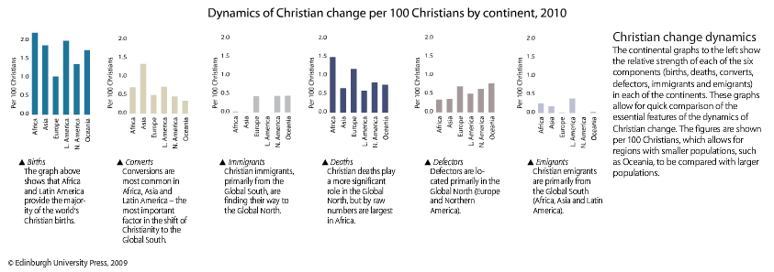
Components of Christian Population Change
Todd M. Johnson, Kenneth R. Ross, eds., Atlas of Global Christianity, 2009, pp. 62-63, ISBN: 9780748632671

Slide 21
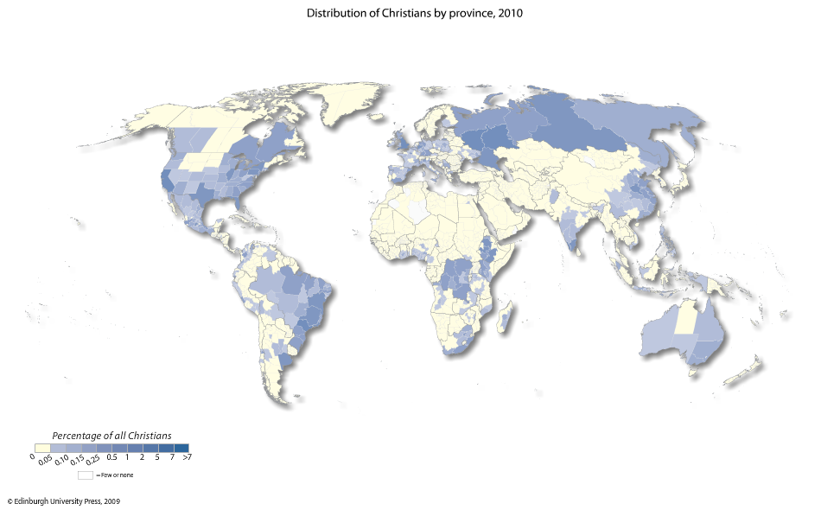
Distribution of Christians by Province, 2010
Todd M. Johnson, Kenneth R. Ross, eds., Atlas of Global Christianity, 2009, pp. 58-59, ISBN: 9780748632671

Slide 22
Massive Relative Population Decline of Advanced Nations
“One central fact in the changing religious picture is a massive relative decline in the proportion of the world’s people who live in the traditionally advanced nations.” [Europe, North America, former Soviet Union]
In 1900= 32% of world population
2000= 18% and by 2050= 10-12%
Philip Jenkins, The Next Christendom, p. 79 ISBN: 0195168917

Slide 23
Most Christians are now Southern and Eastern
In 1960 about 58% of the world’s Christians were western. In 1990, 38% were. (Guthrie, p. 134)
The Christian center of gravity has shifted southward to the Third World (now having 58% of all Christians). David B. Barrett & Todd M. Johnson, World Christian Trends AD30-AD 2200, p. 71
Christianity is shifting east. China has over 106 million Christians. India has over 57 million Christ followers Todd M. Johnson, ed. World Christian Database (Leiden/Boston: Brill, 2007)
70,000 of the average 77,000 new Christians per day (91%) come from Africa, Asia and Latin America. David Barrett, Todd M. Johnson & Peter Crossing, “Missiometrics 2008: Reality Checks for Christian World Communions,” Int’l Bulletin of Missionary Research, Jan. 2008, p. 28.

Slide 24
The Rise of Southern Christendom
By 2025, only 3 of the 10 nations with the largest Christian population will be advanced nations.
  USA, Brazil, Mexico, Philippines, Nigeria, Dem. Rep. of Congo, Ethiopia, Russia, China, Germany (in rank order)
Philip Jenkins, The Next Christendom, p. 90, based upon US government statistics, ISBN: 0195168917

Slide 25
B. Sub-trend: Independent Churches are Growing the Fastest within Christianity
Independent churches are distinct from historical denominations and the major Christian blocs of Protestantism, Catholicism, Orthodoxy and Anglicanism. They have grown from 1.3% of Christians in 1900 to 16% in 2013. They are second only to Roman Catholicism as a bloc. Source: Todd Johnson & Peter Crossing, “Status of Global Mission, 2013, in the Context of AD 1800-2025,” Int’l Bulletin of Missionary Research, Jan. 2013, p. 33.
Independent churches include Third Wave (after Pentecostal and Charismatic), charismatic churches, Pentecostal, African Independent Churches, ethnic churches, community and Fundamentalist churches.
Michael Jaffarian, “The demographics of world religions entering the 21st century,” in Between past & future, J. Bonk ed. 2003, pp. 264-5.

Slide 26
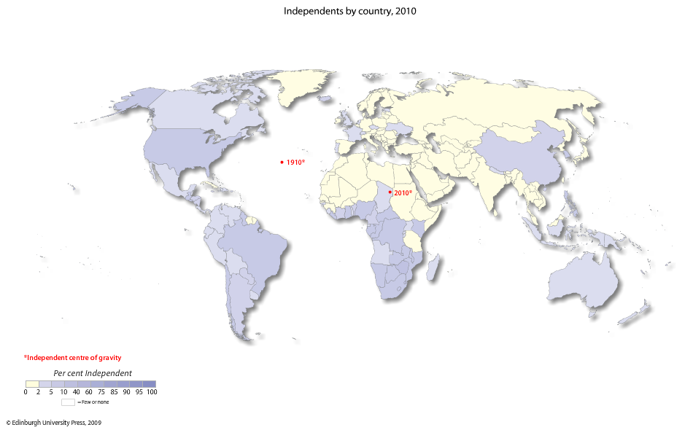
Independent Christians, 2010
Todd M. Johnson, Kenneth R. Ross, eds., Atlas of Global Christianity, 2009, pp. 78-79, ISBN: 9780748632671

Slide 27
C. Sub-trend: Charismatic/Pentecostal Groups are among the fastest-growing Independents
The proportion of Pentecostals/Charismatics/Neocharismatics to all Christians in 2013 is 27%, or 628,186,000, up from .2% in 1900. Todd Johnson & Peter Crossing, “Status of Global Mission, 2013, in the Context of AD 1800-2025,” Int’l Bulletin of Missionary Research, Jan. 2013, p. 33.
One-half to one-third of Chinese house churches have become Charismatic since 1988, primarily through the ministry of Pentecostal pastor Dennis Balcomb.¹ There may be 100 million underground Christians in China as of 2008.² 1David Aikman, Jesus in Beijing, 2006, ISBN: 139781596980259, pp. 81, 276. 2 Michelle A Vu, “China cracks down on Christians during Christmas week,” 12/27/08 at www.christiantoday.com/article/china.cracks.down.on.christians.during.christmas.week/22205.htm accessed 9/6/13

Slide 28
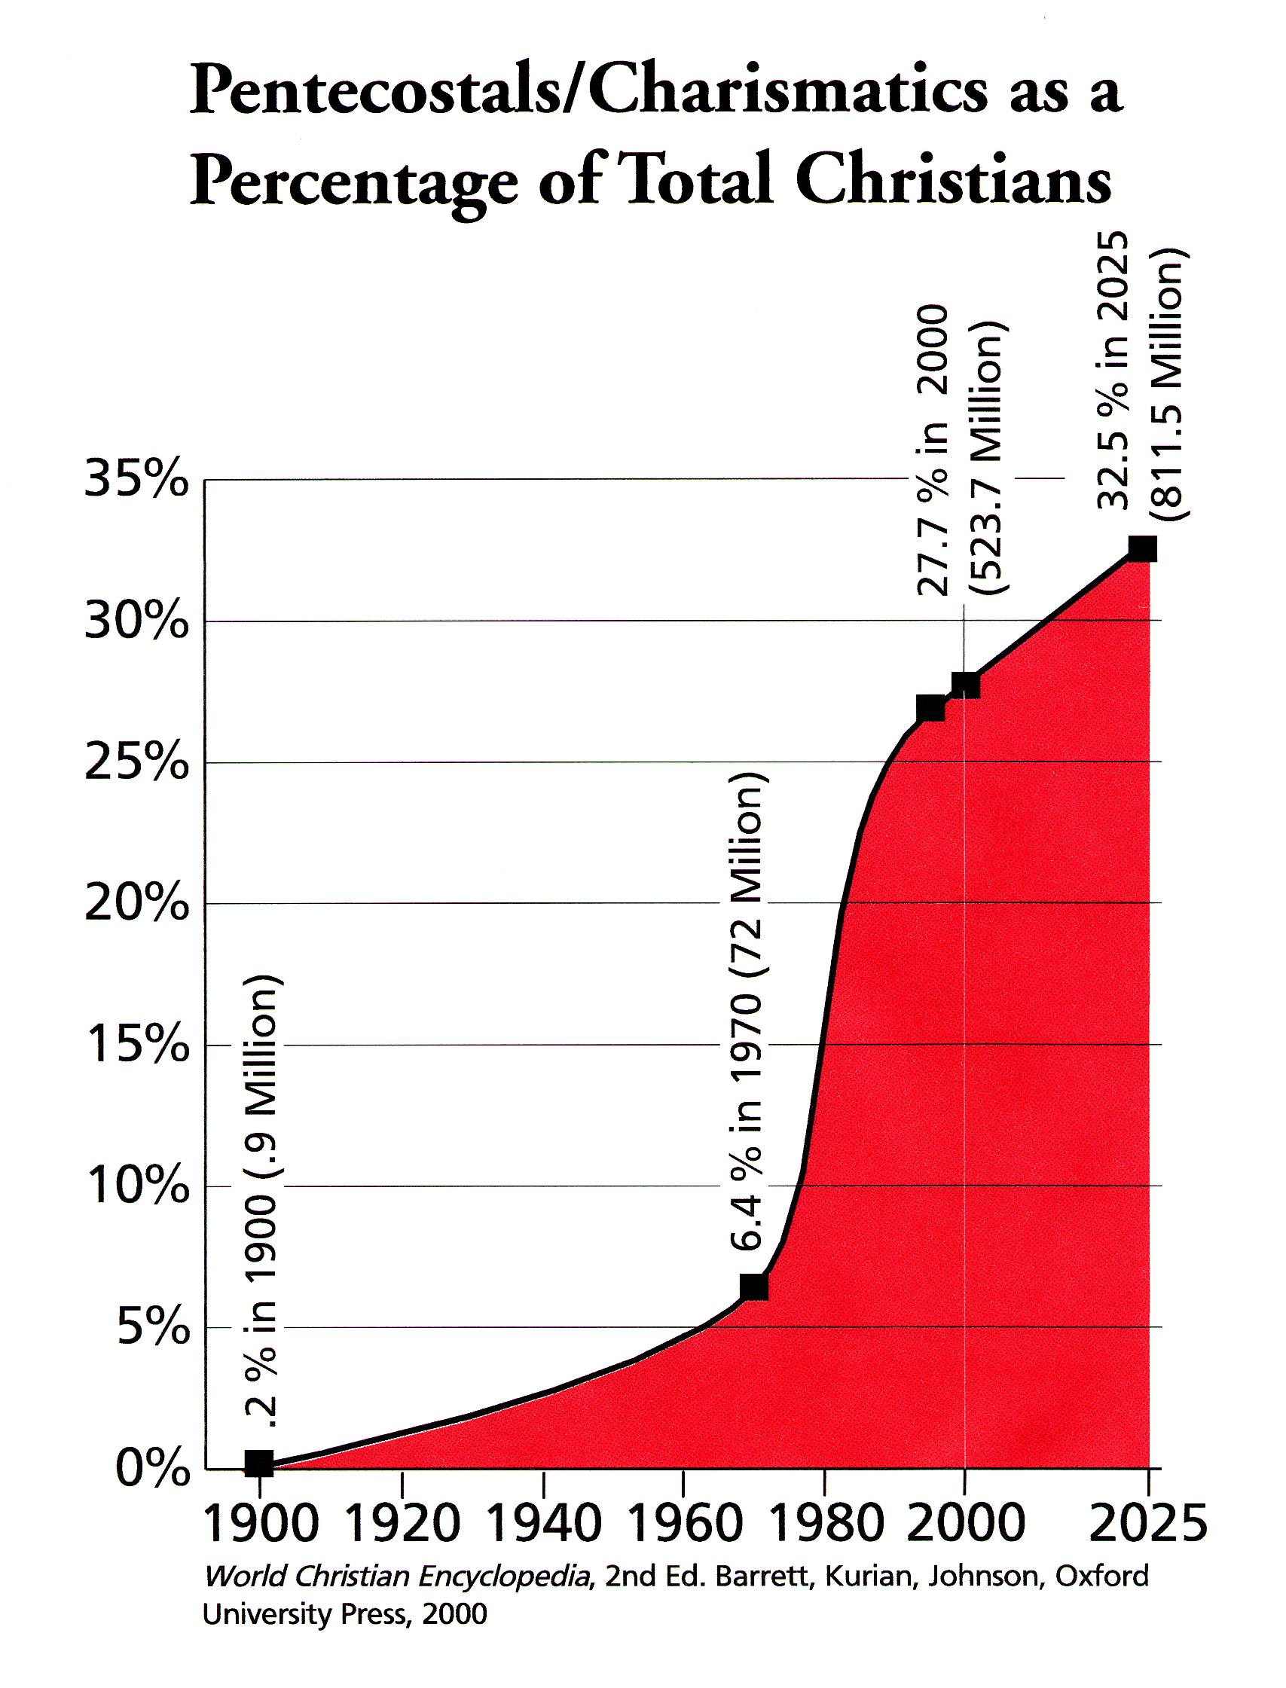
Spectacular Pentecostal Growth
An estimate on 1/2013 of the Pentecostal/Charismatic/Neocharismatic population for 2025 is 828,027,000, or 30% of all kinds of Christians.¹
Twenty-nine percent of their growth in the 1990s was by conversion. ²
1 Source: Todd Johnson & Peter Crossing, “Status of Global Mission, 2013, in the Context of AD 1800-2025,” Int’l Bulletin of Missionary Research, Jan. 2013, p. 33.
2 Michael Jaffarian, “The demographics of world religions entering the 21st century,” in Between past & future, J. Bonk ed. 2003, pp. 267.
This chart is taken from “Where Are We Now?” by Luis Bush, from the Mission Frontiers June 2000 edition. © 2000. Reprinted with permission. www.missionfrontiers.org

Slide 29
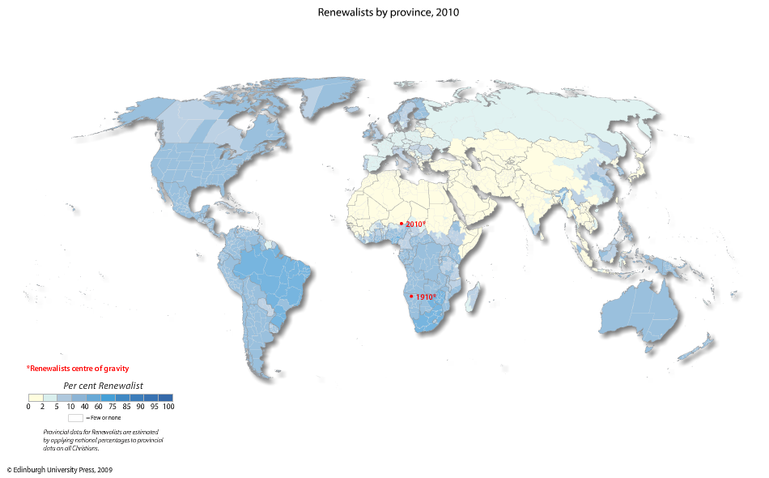
Pentecostal/Charismatic/Renewalists, 2010
Todd M. Johnson, Kenneth R. Ross, eds., Atlas of Global Christianity, 2009, pp. 102-103, ISBN: 9780748632671

Slide 30
Christian Sub-group Annual Growth Rates, 2013
All Christians 1.3%
Great Commission Christians: 1.2%
Pentecostals/Charismatics: 2.4%
Evangelicals: 2.3%
Independents overall: 2.4%
Source: Todd Johnson & Peter Crossing, “Status of Global Mission, 2013, in the Context of AD 1800-2025,” Int’l Bulletin of Missionary Research, Jan. 2013, p. 33.

Slide 31
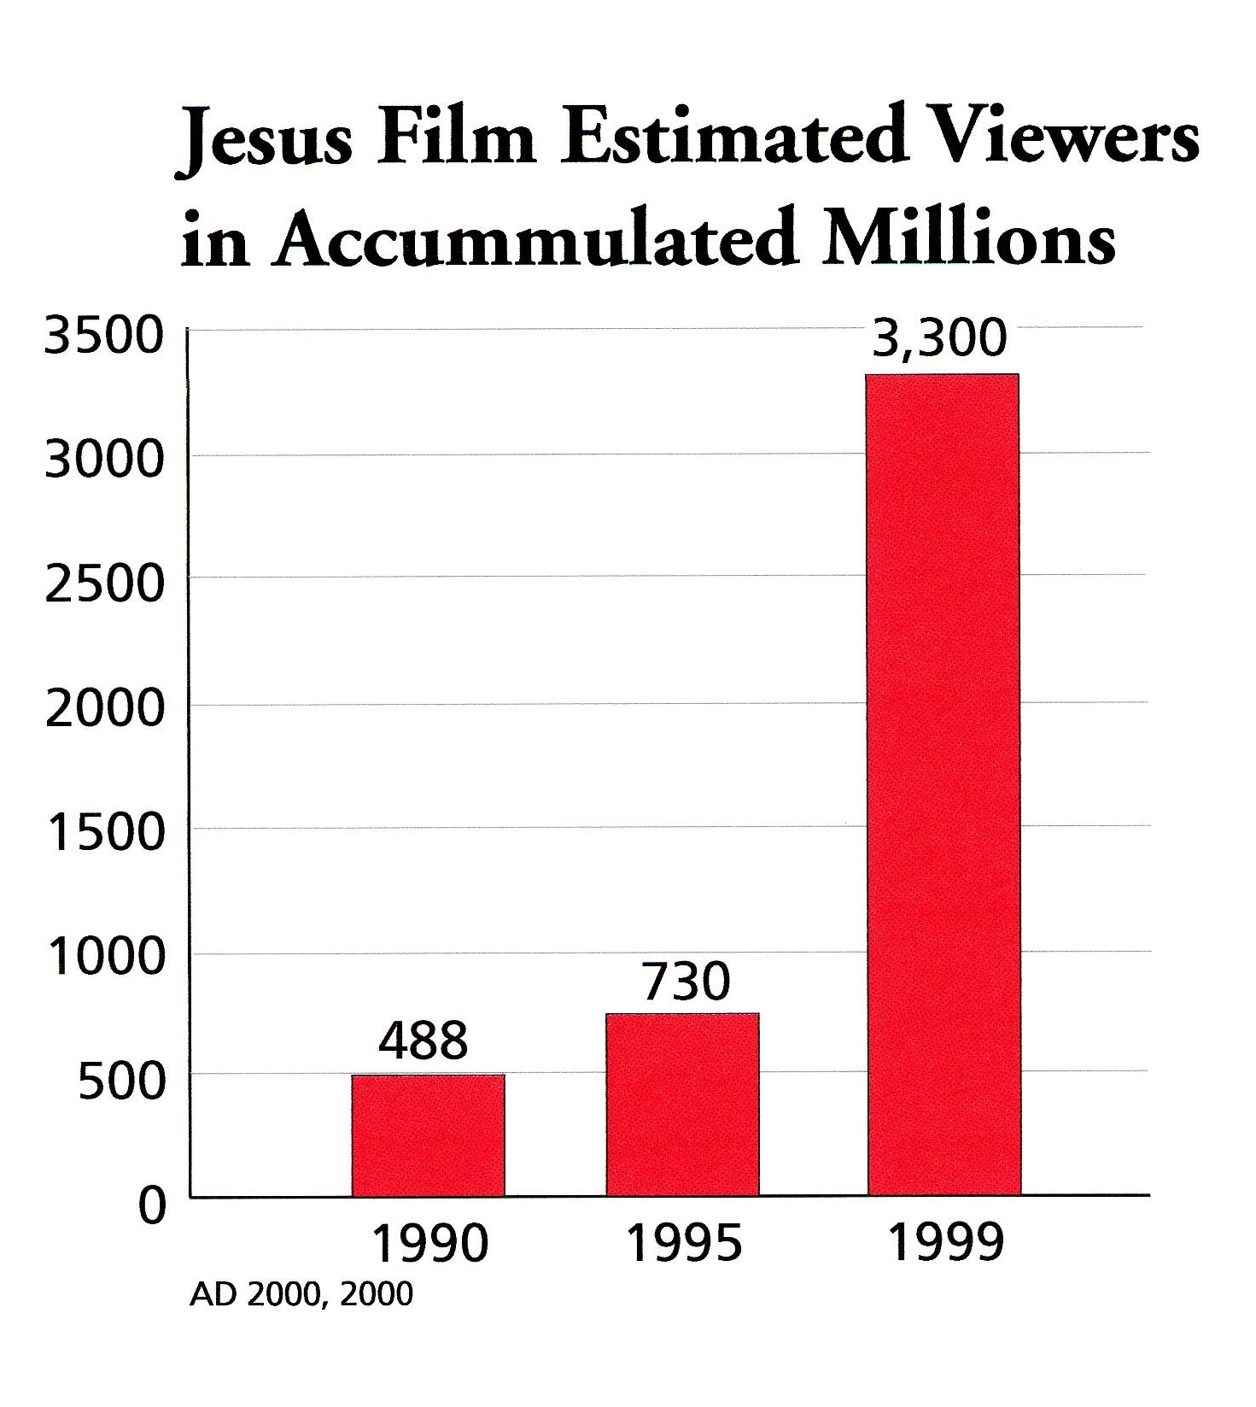
The Jesus Film phenomena- by 2013 more than 200 million had professed Christ after seeing it. It’s translated in more than 1,100 languages.
This material is taken from “Where Are We Now?” by Luis Bush, from the Mission Frontiers June 2000 edition. © 2000. Reprinted with permission. www.missionfrontiers.org
www.jesusfilm.org accessed 9/4/2013

Slide 32
D. Sub-trend: Going for Closure of the Great Commission
There were 250 global evangelization plans in 1900, 510 in 1970, and approximately 2,200 in 2013.
If the church had been really serious about completing the Great Commission, it would have been done by now (David Platt, Upside Down House).
Source: Todd Johnson & Peter Crossing, “Status of Global Mission, 2013, in the Context of AD 1800-2025,” Int’l Bulletin of Missionary Research, Jan. 2013, p. 33.

Slide 33
The Last Bastion: Cultural Religions
“In our Evangelical missionary efforts we made it our goal to proclaim the Gospel to every nation on earth. Then we made it our goal to proclaim the Gospel to every people on earth, and that is still very much a strategy in action. Let us now also consider how to bring the Gospel to every religion on earth.”
Michael Jaffarian, “The demographics of world religions entering the 21st century,” in Between past & future, J. Bonk ed. 2003, p. 268.

Slide 34
The Harvest Force is Specializing
The movement is toward specialization. Each is seeking its own niche.
  Examples: Ministry to Muslims, street children, HIV/AIDS, intellectuals, farmers, poor women, handicapped, etc.
  Development (holistic) ministries: medical, community, economic (Micro-economic development, etc.)
  Non-resident missionaries, tent-makers, second-career missionaries, warfare prayers, etc.
  Business as Mission (BAM) in various forms and for various purposes (reaching employees, reaching suppliers, supporting missionaries, providing a visa, gaining contact with nationals, helping local Christians develop businesses, etc.).

Slide 35
Orality
There are about 939,909,000 nonliterate people as of 2013. Source: Todd Johnson & Peter Crossing, “Status of Global Mission, 2013, in the Context of AD 1800-2025,” Int’l Bulletin of Missionary Research, Jan. 2013, p. 33.
Approximately 66% of people globally live by orality (non print-based communication), resulting in an “oral majority who cannot or will not learn well through print-based instruction.”
  See www.orality.net for information
Barrett & Johnson provide the figure of 13% of those over age 15 as being nonliterate in 2013. Source: Todd Johnson & Peter Crossing, “Status of Global Mission, 2013, in the Context of AD 1800-2025,” Int’l Bulletin of Missionary Research, Jan. 2013, p. 33.
  .
Various case studies indicate that otherwise resistant peoples may be reached through worldview-sensitive storying. See www.orality.net for more information
This approach bypasses the immediate need for literacy and may open the hearts of some peoples far more quickly than a literacy-based strategy.

Slide 36
The Literacy Movement
Total living languages in the World: 7,105
Wycliffe translations in progress: more than 1,500
Languages needing translation: less than 2,000
Ethnologue 16th Ed. 2009, http://www.ethnologue.com/ethno_docs/distribution.asp?by=area accessed 9/4/2013
http://www.wycliffe.org/about/statistics.aspx accessed 9/4/2013

Slide 37
Hindrances to Great Commission Closure

Slide 38
Most of the 426,000² foreign missionaries go where invited, not where most needed
 | % of Christian Missionaries (2005)¹ | # of Christian Missionaries¹ (2005)=443,525 | Global pop. in mid-2013² 7,130,014,000
World A non-Christian | 3.1% | 13,750 | 2,080,397,000
World B evangelized | 25.2% | 112,020 | 2,695,094,000
World C Christians | 71.6% | 317,755 | 2,354,523,000
1 David Barrett, Todd M. Johnson & Peter Crossing, “Christian World Communions: Five Overviews of Global Christianity, AD 1800-2025,” Int’l Bulletin of Missionary Research, Jan. 2009, Global Table 5, p. 25.
2 Todd M. Johnson, ed. World Christian Database (Leiden/Boston: Brill, 2007) 2 Todd Johnson & Peter Crossing, “Status of Global Mission, 2013, in the Context of AD 1800-2025,” Int’l Bulletin of Missionary Research, Jan. 2013, p. 33.
Notes:
P 80 WCTrends

Slide 39
Missionary Deployment 2000
Source: http://www.gordonconwell.edu/resources/documents/gd62.pdf

Slide 40
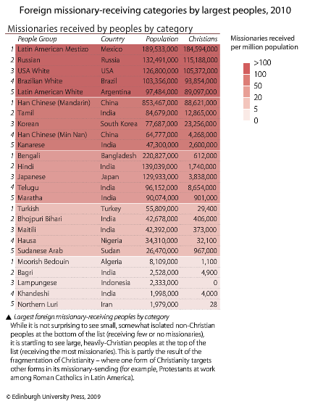
Peoples Receiving the Most Missionaries
Todd M. Johnson, Kenneth R. Ross, eds., Atlas of Global Christianity, 2009, pp. 288-289, ISBN: 9780748632671

Slide 41
Where Missionaries Are Most Needed
Todd M. Johnson, Kenneth R. Ross, eds., Atlas of Global Christianity, 2009, pp. 56-57, ISBN: 9780748632671

Slide 42
The Unfinished Task: 29%
While 71% of the world is adequately evangelized, 2,080,397,000 are left out in 2013 (29%).
With population growth, 2,261,576,000 will need to be evangelized by 2025 (28%). Todd Johnson notes the irony that while the percentage of the unevangelized goes steadily down, the actual number of unevangelized people steadily rises. Source: Todd Johnson & Peter Crossing, “Status of Global Mission, 2013, in the Context of AD 1800-2025,” Int’l Bulletin of Missionary Research, Jan. 2013, p. 33.

Slide 43
Global Evangelistic Resources
“40% of the church’s global foreign mission resources are being deployed to just 10 oversaturated countries with strong citizen-run home ministries.”
“91% of all Christian outreach/evangelism does not target non-Christians but targets other Christians, many in wealthy World C countries and cities.”
“Measures of personal evangelism by Christians indicate that 86% of all Buddhists, Hindus, and Muslims do not personally know a Christian.”
David Barrett, Todd M. Johnson & Peter Crossing, “Missiometrics 2008: Reality Checks for Christian World Communions,” Int’l Bulletin of Missionary Research, Jan. 2008, p. 29.

Slide 44
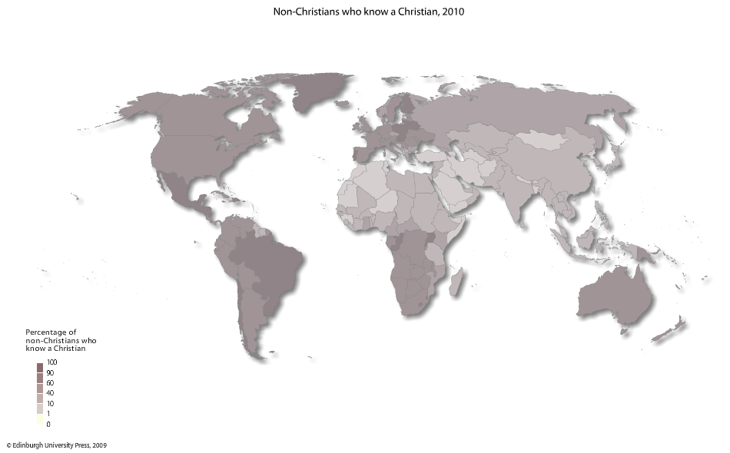
Non-Christian Contact With Christians
Todd M. Johnson, Kenneth R. Ross, eds., Atlas of Global Christianity, 2009, pp. 316-17, ISBN: 9780748632671

Slide 45
Islam and Hinduism Are Also Growing

Slide 46
Percentages of World Population: Hindu, Muslim & Christian--2013
Annual percentage growth rates in 2013 | Percent of world population 2013 | Percent of world population 2025 (est.)
Hindu 1.4 per annum | 14 | 13.8
Muslim 1.8 per annum | 23 | 24.6
Christian (all groups) 1.3 per annum | 33 | 33.8
1 Todd M. Johnson, ed. World Christian Database (Leiden/Boston: Brill, 2007) 2 Todd Johnson & Peter Crossing, “Status of Global Mission, 2013, in the Context of AD 1800-2025,” Int’l Bulletin of Missionary Research, Jan. 2013, p. 33.

Slide 47
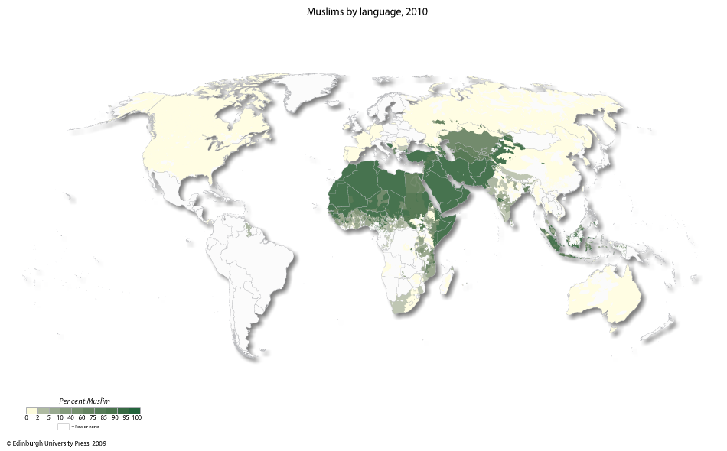
Muslims by Language
Todd M. Johnson, Kenneth R. Ross, eds., Atlas of Global Christianity, 2009, pp. 214-15, ISBN: 9780748632671

Slide 48
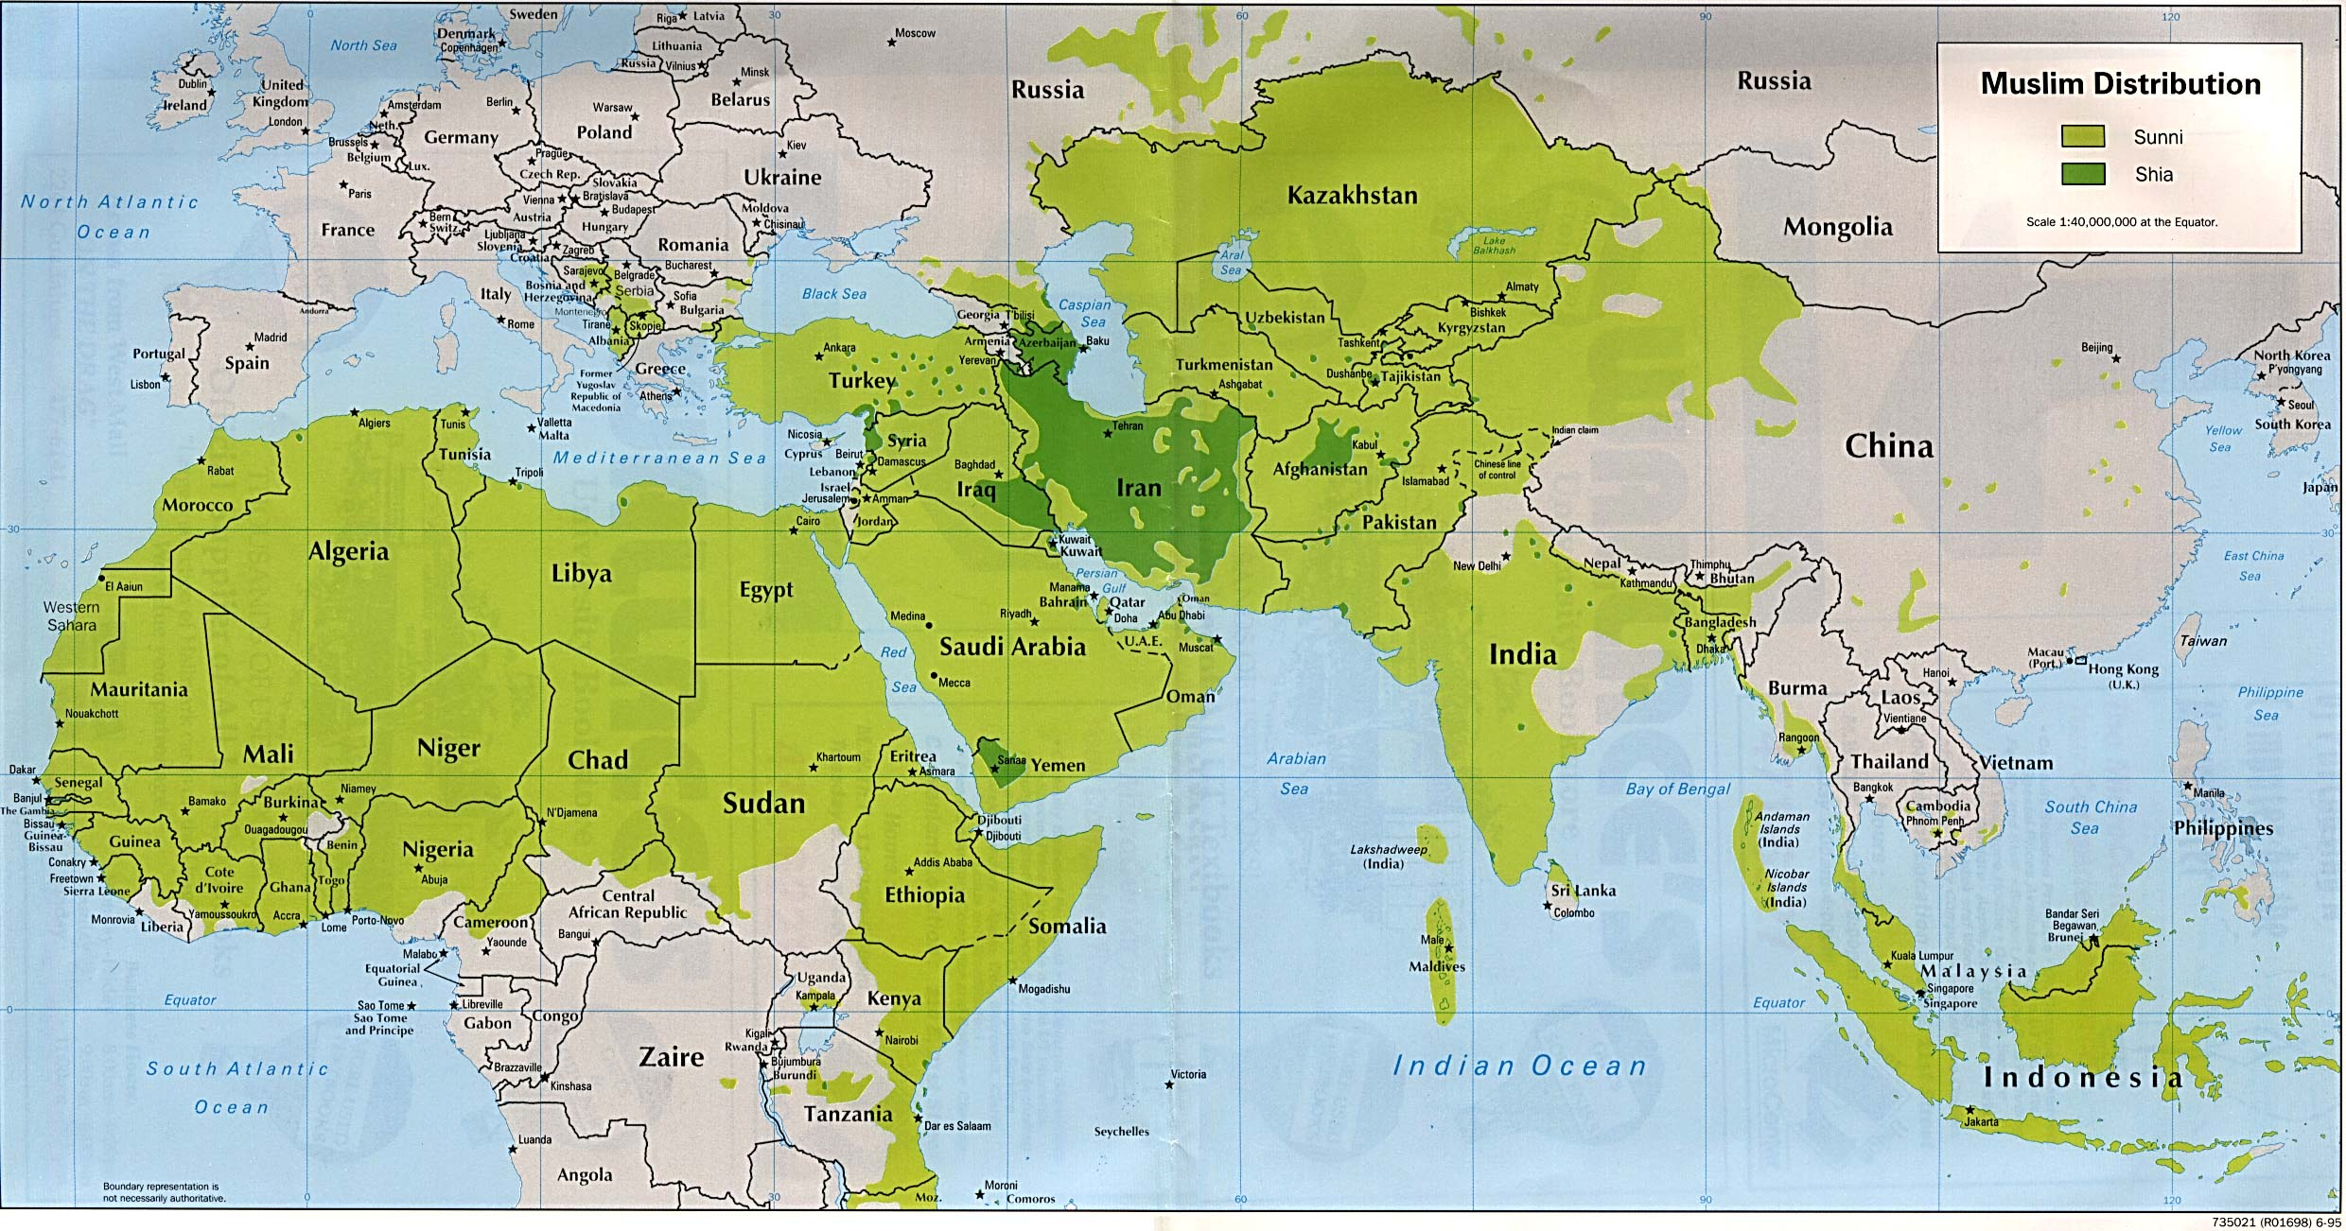
Sunni and Shia Muslim Distribution

Slide 49
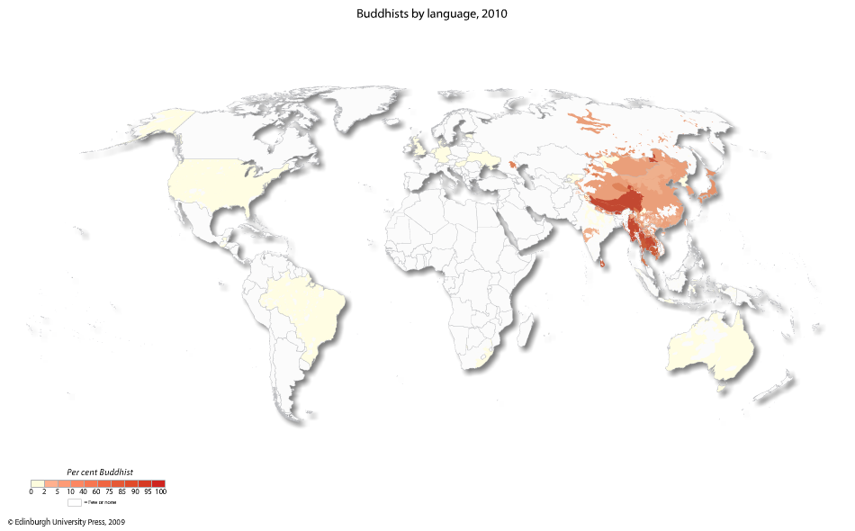
Buddhists by Language
Todd M. Johnson, Kenneth R. Ross, eds., Atlas of Global Christianity, 2009, pp. 218-19, ISBN: 9780748632671

Slide 50
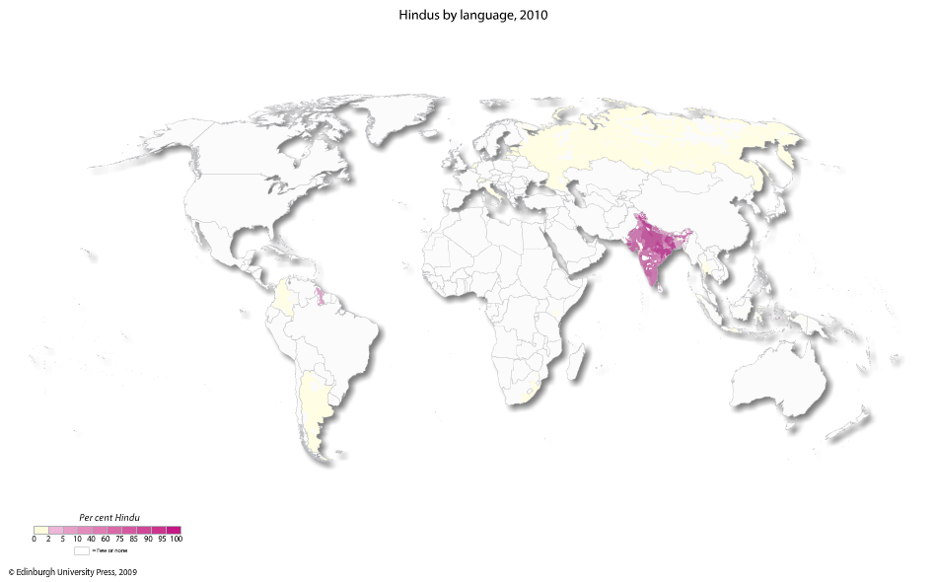
Hindus by Language
Todd M. Johnson, Kenneth R. Ross, eds., Atlas of Global Christianity, 2009, pp. 216-217, ISBN: 9780748632671

Slide 51
Mega-trend #2: Globalization

Slide 52
Rapid Knowledge Access
“The world’s dominant activity is rapidly becoming the deepening and spreading of information and knowledge.” David Barrett, George Kurian, Todd Johnson, “The Status of Christianity and Religions in the Modern World,” World Christian Encyclopedia, 2nd ed., p. 1:5; p. 2:535
Daily there are 93,000 new computers in Christian use. The number of these computers increases 5.3% per year (by 2013, 640,000,000 were in Christian use). Todd Johnson & Peter Crossing, “Status of Global Mission, 2013, in the Context of AD 1800-2025,” Int’l Bulletin of Missionary Research, Jan. 2013, p. 33.

Slide 53
The Web and Arabs
The Internet allows access to Christian teaching, preaching, chat rooms and to Christians in otherwise “closed” nations.
  There were approximately 90 million Middle Eastern Internet users at the end of 2012, with Iran having by far the largest percentage.¹
  The Al Hayat satellite network reaches many in Iran, where sat dishes are officially forbidden.
    However, as many as 70% of the population has one.²
1 www.internetworldstats.com/stats5.htm accessed 9/6/13
2 http://www.ncr-iran.org/en/news/human-rights/14149-iran-regime-forces-seize-satellite-dishes-in-shiraz accessed 9/6/13

Slide 54
English-language Ministry
The ascendency of English globally allows English-speaking Christian teachers to share their faith on the side.
  There are perhaps 2,000-3,000 Christian English teachers currently in China who otherwise probably would not be there.¹
  An estimated 10% of Chinese college students are Christian.
  1 David Aikman, Jesus in Beijing, 2006, ISBN: 139781596980259, pp. 81, 276.

Slide 55
Global Competition For Funding
When Indian and Chinese nationals can be fielded for about $150 per month, it’s harder to justify a Western missionary salary of $8,300 per month, unless the Western missionary has expertise that justifies it.

Slide 56
The Urban Challenge

Slide 57
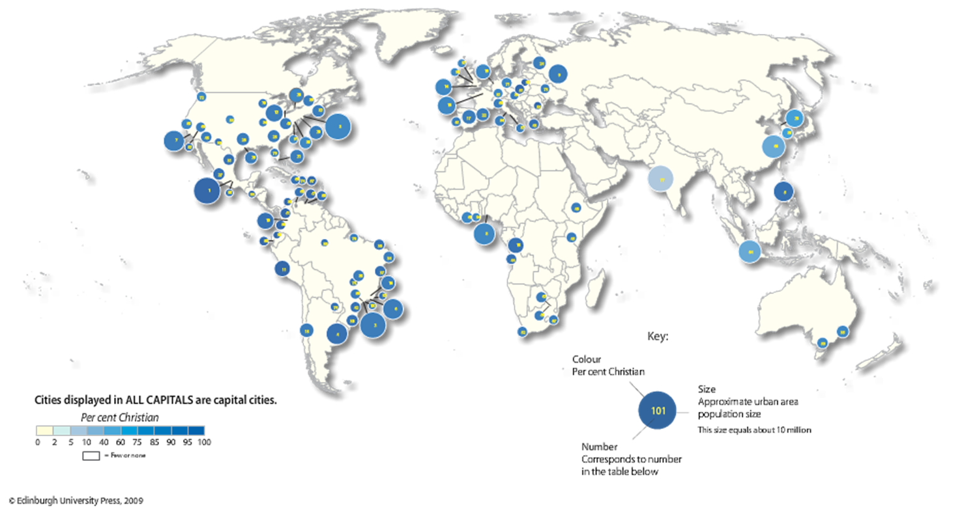
100 Cities With the Most Christians
Todd M. Johnson, Kenneth R. Ross, eds., Atlas of Global Christianity, 2009, pp. 242-43, ISBN: 9780748632671

Slide 58
Christian Urban Penetration, 2013
123,000 non-Christian urbanites are added per day.
Christians are 41% of the urban population, while 33% of world population.
Todd Johnson & Peter Crossing, “Status of Global Mission, 2013, in the Context of AD 1800-2025,” Int’l Bulletin of Missionary Research, Jan. 2013, p. 33.

Slide 59
Increasing Global Urbanization
2013-- 52% of Earth’s population is urban¹
2025-- 57% are estimated to live in cities¹
2050-- 66% are estimated to live in cities²
By 2015 only one city in an advanced nation will be among the 10 largest cities. In rank order:
Tokyo, Bombay (Mumbai), Lagos, Shanghai, Jakarta, São Paulo, Karachi, Beijing, Dhaka, México²
1 Todd Johnson & Peter Crossing, “Status of Global Mission, 2013, in the Context of AD 1800-2025,” Int’l Bulletin of Missionary Research, Jan. 2013, p. 33.
2 Philip Jenkins, The Next Christendom, 2002, p. 93, based upon UN statistics, ISBN: 0195168917

Slide 60
Largest Cities Becoming Non-Christian
In 1900 there were 5 non-Christian megacities
By 2000, 14 of the top 25 cities were non-Christian
In 2000 there were 226 non-Christian cities of over 1 million population.¹
In 2013 there were 265 such cities.²
From the World Christian Encyclopedia, David Barrett, George Kurian, Todd Johnson, Eds. 2001, ISBN:0195079639, p. 2: 536, 538; 1:8; World Christian Trends AD 30-AD 2200, Barrett & Johnson, 2001, p. 59.
2 Todd Johnson & Peter Crossing, “Status of Global Mission, 2013, in
the Context of AD 1800-2025,” Int’l Bulletin of Missionary Research,
Jan. 2013, p. 33.

Slide 61
How to Reach the Cities?
Rurally based Chinese house churches send missionaries to factories, then develop friendships and begin house churches.
  One group provided bandages to construction workers as a way of getting to know them.
  Economically it’s difficult for rural workers to live in the cities.
Ministries in India are making headway through missionaries from the south penetrating the north. One leader in Vananasi, the Hindu capital of India, said that all he lacked was workers. Missionaries leave families behind for perhaps 4-6 months of labor.

Slide 62
Mega-trend #4: Mission Force Changes

Slide 63
The Harvest Force Has Shifted
An estimated 426,000 foreign missionaries existed in 2013.¹
The US sent 126,650 missionaries abroad in 2010, making it approximately 30% of the total.²
There are at least 4,000 Third World mission agencies.³
1 Todd Johnson & Peter Crossing, “Status of Global Mission, 2013, in the Context of AD 1800-2025,” Int’l Bulletin of Missionary
Research, Jan. 2013, p. 33.
2 Todd M. Johnson, ed. World Christian Database (Leiden/Boston: Brill, 2007) 3 David B. Barrett & Todd M. Johnson, World Christian Trends AD 30-AD 2200, p. 71

Slide 64
Back to Jerusalem
Since at least 1942, Chinese Christians have felt called by God to take the Gospel West, through Buddhist and Muslim nations, completing the circling of the globe, all the way back to Jerusalem. Most, if not all, Chinese house church fellowships (which may number 100 million Christians) are behind this movement, the goal of which is to field at least 100,000 foreign missionaries.
  There are underground missionary training schools. Some have several campuses, so they can shift as the police find and close down a location.
Brother Yun, Peter Yongze, Enoch Wang, Paul Hattaway, Back to Jerusalem, 2003, p. 97, ISBN: 139781884543890.

Slide 65
Missionary Sending Shifts
More local churches are bypassing traditional mission agencies, becoming direct senders. Stan Guthrie, Mission in the 3rd Millennium, p. 5
  This is true of some African American mega-churches, for example.
Churches and individuals are supporting more indigenous, national ministries, instead of more costly western missionaries. As of 2005, 88,500 non-North American missionaries were supported by North American agencies.
Michael Jaffarian, “The statistical state of the North American Protestant missions movement…” Int’l Bulletin of Missionary
Research, Jan. 2008, p. 35,37.
Notes:
Korean plans for 100,000 ;

Slide 66
Short-term Missions Have Increased in Number
Due to affordable jet travel, early retirement, world exposure via TV, and mission organization facilitation, such trips have proliferated within the last 20 years.
By 2006, about 1.5 million US Christians went on short-term mission trips (2 weeks or less) each year.
Michael Jaffarian, “The statistical state of the North American Protestant missions movement…” Int’l Bulletin of Missionary Research, Jan. 2008, p. 36.
The Southern Baptists alone average 20,000 trips annually.
29% of US 13-17 year olds have been on a religious service or mission trip as of 2005 Robert Priest & Alvaro Nieves, eds., This side of heaven: Race, ethnicity and Christian faith, p.331, ISBN: 0195310578.

Slide 67
Going Versus Sending
Nationals know the culture and are more efficient evangelists within their own culture. They can serve for far less money than do North American missionaries.
However, if nationals alone are used to reach nationals, 4,000 socio-linguistic groups would not be reached. Stan Guthrie, Mission in the 3rd Millennium, p. 15
But Jesus’ command to go into all the world (Matt. 28:19) means that simply sending others and staying home (“missions by proxy”¹), isn’t obedient. 1 Term used by Brian Johnson, COMINAD.com

Slide 68
Funding Away from Evangelism to Relief Work
North American agencies centering upon evangelism/discipleship received 45.1% of the North American total giving, whereas those focusing upon relief/development received 49.1% of funds in 2005.
Between 2001 and 2005 income to evangelism/discipleship ministries based in North America increased 2.7%, while income to relief/development agencies increased 74.3%. Michael Jaffarian, “The statistical state of the North American Protestant missions movement…” Int’l Bulletin of Missionary Research, Jan. 2008, p. 37.

Slide 69
The Body and/or the Soul?
While Jesus met physical/emotional needs, preaching good news took the higher priority—it has eternal consequences.
  Luke 4:40-44 When the sun was setting, the people brought to Jesus all who had various kinds of sickness, and laying his hands on each one, he healed them. 41 Moreover, demons came out of many people…. 42 At daybreak Jesus went out to a solitary place. The people were looking for him and when they came to where he was, they tried to keep him from leaving them. 43 But he said, "I must preach the good news of the kingdom of God to the other towns also, because that is why I was sent." 44 And he kept on preaching in the synagogues of Judea.

Slide 70
In the end, will we all be saved anyway?

Slide 71
Are the unevangelized really lost ? Yes.
Those who do reject Jesus will not have eternal life in heaven (John 3:36; 12:48). Jesus said that none come to the Father apart from Him (John 14:6).
Everyone sins, but sinners don’t normally seek God (Rom. 3:23, 11-12; John 6:44). Pagans even suppress the knowledge of God obvious to them in nature (Rom. 1:18-20). They don’t accept the light already given.

Slide 72
Other reasons
Pagans also violate their own moral standards– thus condemning themselves (Rom. 2:14-16).
Everyone comes into this world condemned by Adam’s sin (Romans 5:18). Each of us also sins individually and sin results in spiritual death (Romans 3:23; 6:23). Forgiveness comes by repentance and faith in Christ (Acts 2:38; 10:43; Romans 10:9-10). Forgiveness doesn’t come automatically to all people by Christ’s death.
  However, if even one of the parents is a Christian, their children are in some way “holy” or set apart (1 Corinthians 7:14).

Slide 73
No Person Left Behind?
Theological drift, even among evangelicals, is toward believing that those who haven’t heard the Gospel will not go to hell.
  A third of evangelical college and seminary students believed that people can be saved without specifically turning to Christ in a 1987 poll. Stan Guthrie, Mission in the 3rd Millennium, p. 39

Slide 74
No Person Left Behind?
“Theologian Ronald Nash, in his 1994 book Is Jesus the only savior?, estimates that more than half of the evangelical leaders in denominational or missions leadership and of missions professors at evangelical colleges and seminaries may believe that people can be saved by Christ without specifically turning to him for forgiveness of their sins.” Stan Guthrie, Mission in the 3rd Millennium, p. 39

Slide 75

If all are saved who don’t hear of Christ, the best strategy is to immediately withdraw all missionaries, so that none will hear, and all will be saved.
D. James Kennedy

Slide 76
Certainties
The world will hear. Matthew 24:14 And this gospel of the kingdom will be preached in the whole world as a testimony to all nations, and then the end will come. But God will use people to preach (means).
Christ is returning 2 Peter 3:9-12 The Lord is not slow in keeping his promise, as some understand slowness. He is patient with you, not wanting anyone to perish, but everyone to come to repentance. 10 But the day of the Lord will come like a thief. The heavens will disappear with a roar; the elements will be destroyed by fire, and the earth and everything in it will be laid bare. 11 Since everything will be destroyed in this way, what kind of people ought you to be? You ought to live holy and godly lives 12 as you look forward to the day of God and speed its coming. That day will bring about the destruction of the heavens by fire, and the elements will melt in the heat. (NIV)

Slide 77
Christian Giving

Slide 78
Giving To MISSIONS Remains LOW
Globally, Christians in 2013 gave 1.8% of income to Christian causes, including 0.1% of their income to global foreign missions. There has been almost no change in recent years. Todd Johnson & Peter Crossing, “Status of Global Mission, 2013, in the Context of AD 1800-2025,” Int’l Bulletin of Missionary Research, Jan. 2013, p. 33.
In the USA, as of April 2013, 5% of Americans actually donate 10% of income to a church or non-profit organization. Among born-again believers, 12% tithe. [These figures were not subdivided into giving to missions.]
  https://www.barna.org/barna-update/culture/606-american-donor-trends accessed 9/6/13

Slide 79
Wealth and Global Averages
Very Poor: 18%--0 to $100 (per capita)
Needy: 28%--$100- $1,000
Coping: 10%--$1,000- $5,000
Well-off: 35%--$5,000-$10,000
Affluent: 9%--$10,000 + Where are YOU?
“Command those who are rich in this present world not to be arrogant nor to put their hope in wealth…Command them to do good, to be rich in good deeds and to be generous and willing to share.” 1 Tim. 6:17a-18, NIV
From the World Christian Encyclopedia, David Barrett, George Kurian, Todd Johnson, Eds. 2001, ISBN:0195079639, p. 1:6

Slide 80
Other Resources and Some Definitions

Slide 81
Further research:
www.worldchristiandatabase.org/wcd/
  Probably the premiere site for mission stats, by subscription.
www.uscwm.org/ Their magazine Mission Frontiers is available at https://www.uscwm.org/our-work/publishing/mission-frontiers
www.mislinks.org/ For research and missions topics
www.ethnologue.com/ Language database
www.joshuaproject.net/ Unreached people info
www.gmi.org Global Mapping links
  www.gmi.org/research/websites.htm Global Mapping research links
https://www.cia.gov/library/publications/the-world-factbook/ Country information from the US—CIA
http://www.thequran.com/
Locate this presentation at http://www.rmni.org

Slide 82
Further research:
www.4kworldmap.com Global human needs mapping
www.Missioninfobank.org
“Reseach resources from and for Christian leaders”
www.peoplegroups.org Realtime info to help engage with unreached people groups
www.worldmap.org 237 country profiles and various maps

Slide 83
Definitions of Major Religions
Christians followers of Christ--all kinds & levels of commitment
Muslims followers of Muhammad emphasizing monotheism and 5 Pillars
1- Profession of Faith, Shahadah, "There is no God but Allah, and
Muhammad is his prophet".
2 .Prayer, five times a day & on Fridays-- The "Salat"
3. Give alms, "Zakat“
4. Fasting, "Sawm," on the month of "Ramadan“
5. Pilgrimage to Mecca
Hindus Indian religious philosophy with goal of finding Brahman, or reality
(The World’s Religions by Norman Anderson, p. 140)—having
at times one (differing) pervasive god with many lower gods
Non-religious no interest in religion, secularists, agnostics, materialists)

Slide 84
Definitions of Major Religions
Buddhists Philosophy of Gautama Buddha (b. 563 BC) • “The Buddha taught
        Four Noble Truths: (1) suffering is real; (2) suffering is caused by selfish desire; (3) suffering will cease when selfish desire is eliminated; and (4) selfish desire will cease through following the Noble Eightfold Path.” James Beverly at http://www.apologeticsindex.org/2647-buddhism#articles
Chinese folk religionists “Followers of traditional Chinese religion (local deities including Taoist ones, ancestor veneration, Confucian ethics, Chinese
universism, divination and magic, some Buddhist elements).” Todd M. Johnson, ed. World Christian Database (Leiden/Boston: Brill, 2007)
Ethnorelgionists animists, polytheists, shamanists tied to an ethnic group
Atheists those disbelieving in God, including Communists

Slide 85
Definitions of Major Religions
New Religionists New Religious movements, or radical new crisis religions including
the Japanese neo-Buddhist and neo-Shinto new religious
movements, and Korean, Chinese, Vietnamese and Indonesian
syncretistic religions, et alia.
Todd M. Johnson, ed. World Christian Database (Leiden/Boston: Brill, 2007)
Sikhs monotheistic blend of Islam/Hinduism
Jews followers of the God of the Old Testament Bible

Slide 86
“People Group”
  “A significantly large grouping of individuals who perceive themselves to have a common affinity for one another because of their shared language, religion, ethnicity, residence, occupation, class or caste, situation, etc., or combinations of these.” Lausanne Strategy Working Group, 1982
  For evangelistic purposes: “The largest group within which the gospel can spread as a church planting movement without encountering barriers of understanding or acceptance.” This is also the definition of a “unimax” people. Lausanne Strategy Working Group, 1982

Slide 87
“Great Commission Christians”
Definition: “Believers in Jesus Christ who are aware of the implications of Christ’s Great Commission, who have accepted its personal challenge in their lives and ministries, and who are seeking to influence the Body of Christ to implement it.” Todd M. Johnson, ed. World Christian Database (Leiden/Boston: Brill, 2007)
In 1900, Great Commission Christians were 14% of all Christians. By mid-2013, they are estimated to be 30% of all Christians. Todd Johnson & Peter Crossing, “Status of Global Mission, 2013, in the Context of AD 1800-2025,” Int’l Bulletin of Missionary Research, Jan. 2013, p. 33

Slide 88
Evangelicals
“Evangelicals” are “a subdivision mainly of Protestants consisting of all affiliated church members calling themselves Evangelicals, or all persons belonging to Evangelical congregations, churches or denominations; characterized by commitment to personal religion.”
  Todd M. Johnson, ed. World Christian Database (Leiden/Boston: Brill, 2007)

Slide 89
Ethnolinguistic Peoples
An ethnolinguistic people is “A distinct homogeneous ethnic or racial group within a single country, speaking its own language.”
Of the estimated 13,300 ethnolinguistic peoples, 4,300 were less than 50% evangelized by 2005. Center for the Study of Global Christianity “All Humanity in Mission Perspective in mid-2005” © 2004 globalchristianity.org

