Slide 1
Presented by
Bishop L. Foday Farrar
Senior Pastor of Solid Rock Ministry International
Bishop of Global Ministry of Full Gospel Baptist Church Fellowship International

Slide 2
THE TWENTY-FIRST CENTURY CHURCH
IS
A MISSION Church
A MOBILIZED Church
A church that FOLLOWS the model of Jesus Christ, sharing in bringing closure to the Great Commission!

Slide 3
GOD’S HEART (YOUR HEART)
“God so loved the world that He gave His only begotten Son that whosoever believeth on Him will not perish but have everlasting life.”
John 3:16
From Genesis to Revelation, God Is a God of Mission.
He Is Building His Kingdom.

Slide 4
THE BIBLICAL BASIS OF MISSIONS
Promises of God – Genesis 12:1-3
Top Line Promises
      I will make you a great nation
      I will bless you
      I will make your name great
      You will be a blessing
      I will bless those who bless you
      Whoever curses you, I will curse

Slide 5
THE BIBLICAL BASIS OF MISSIONS
Blessing of God – Galatians 3:8, Matthew 21:43
Bottom Line Blessing
    All the peoples of the earth will be blessed
    through you!

Slide 6
THE BIBLICAL BASIS OF MISSIONS
God’s Prophecies – Prophecy of Fulfillment
Matthew 24:14
And this gospel of the kingdom will be preached in the whole world as a testimony to all nations, and then the end will come.
2 Peter 3:11-12
Since everything will be destroyed in this way, what kind of people ought you to be? You ought to live holy and godly lives 12 as you look forward to the day of God and speed its coming. That day will bring about the destruction of the heavens by fire, and the elements will melt in the heat.

Slide 7
THE BIBLICAL BASIS OF MISSIONS
God’s Promises – Acts 1:8
The POWER is in the GOING!
Jerusalem – immediate area, same culture (E1)
Judea – outlying area, same culture (E2)
Samaria – outlying area, different culture (E3)
Ends of the earth, distant area, different culture (E4)

Slide 8
The Local Church is a Mission Church…
God is a God of Missions
The Bible is a Book of Missions
Jesus was a Missionary
The Holy Spirit is a Mission Spirit, therefore
WE ARE A PEOPLE OF MISSIONS!
Twenty-First Century local churches must move from a COMMUNITY view to a GLOBAL view:

Slide 9
The Local Church is a Mission Church…
God chooses to work through the local church to expand His kingdom and it is central to His plan.
In the twenty first century local churches must become equipped in the work of the Great Commission.

Slide 10
The Local Church is a Mission Church…
To evangelize the world the vibrancy of the early church must be restored.
This requires a transformation God’s transformation.
A transformation of love, power and the first principles of Jesus Christ.

Slide 11
The Local Church is a Mission Church…
GOD is raising up a church that is true to the Great Commission.
This church is PREPARED AND MOBILIZED to GO!

Slide 12
The Local Church is a Mission Church…
The Twenty-First Century Church makes, matures and mobilizes disciples AND disciple makers.
Abandon and break traditions of the past.
Yield to be forged into a Great Commission church.
Commit to reach the millions of unsaved people all over the world.

Slide 13
A MOBILIZED CHURCH
What is a Mobilized Church?
A church where God’s people are awakened, kept moving and growing until they find their strategic involvement to complete world evangelism.
(Mission Mobilizers Handbook )

Slide 14
A MOBILIZED CHURCH
Prays:
  Commits to faithful and obedient intercession for the lost world
  adopts at least one unreached people group
Gives:
  10% or more of total church revenue to cross-cultural missions. This is recommended entry level giving. Some Churches give 60%. Long range goal - at least 33%.
  25% or more of total missions budget to reaching unreached peoples.

Slide 15
A MOBILIZED CHURCH
Mobilization: Personalizing the Great Commission
1. Praying
2. Learning
3. Giving
Bon Voyage
4. Sending
5. Going

Slide 16
A MOBILIZED CHURCH
Ministers:
  Engages 10% or more of all adults in church physically in cross-cultural ministry (short-term missions, international student ministry, etc....)
Sends:
1% or more of adults as career missionaries
1% or more of adults as tentmakers,
either in training or deployed to the field.

Slide 17
A MOBILIZED CHURCH
A MOBILIZED church PERSONALIZES the Great Commission through Kingdom Expansion!
“Therefore go and make disciples of all nations, baptizing them in the name of the Father and of the Son and of the Holy Spirit, and teaching them to obey everything I have commanded you. And surely I am with you always, to the very end of the age.” Matt 28:19-20

Slide 18
KINGDOM EXPANSION
The Mission of Discipleship
Matthew 28:18-20
Go, “having gone”
Assignment
Make disciples - (Imperative)
Task
Of all nations, ethne
Target
Baptize
Tasks
To obey everything commanded
Teach
I am with you always
Promise

Slide 19
KINGDOM EXPANSION
Model of a Great Commission Church
Spirit - Filled Leadership
Mono-Cultural
Fellowship
Redemption Power
Revelation
Mission
Cross-Cultural
Worship & Intercession
Edification

Slide 20
KINGDOM EXPANSION
Changing
A Generation
of Leaders

Slide 21

CHANGING A GENERATION OF LEADERS
The Master Plan of Jesus
  “When morning came, he called his disciples to him and chose twelve of them, whom he also designated apostles…” (Luke 6:13)
  In ordinary men, Jesus saw the
  potential of leadership for the Kingdom.

Slide 22

CHANGING A GENERATION OF LEADERS
The Master Plan of Jesus
TRAIN -Give knowledge
IMPART -Lay hands
EMPOWER -Give authority
SEND -Apostolic Teams (mobilized)
Sending forth equipped nationals and leaders from the LOCAL CHURCH who are ready to destroy the kingdom of the enemy!

Slide 23
CHANGING A GENERATION OF LEADERS
Global Alliance
Global Alliance is a strategic plan that will coordinate the mission efforts of local churches, prevent duplication and wasted resources.
God is bringing together ministries, para-churches, mission organizations and others for the purpose of working together with one common cause:
Bringing Closure to the Great Commission.

Slide 24


CHANGING A GENERATION OF LEADERS
Global Alliance
Pastoral and Leadership Training
Library
Fellowship
Alliance Meetings
Short-term Missionary Housing
Media Centre

Slide 25
CHANGING A GENERATION OF LEADERS
The Local Church is the Twenty-First Century Church!
The Local Church MUST change its worldview in order to TURN THE HEARTS OF NATIONS TO GOD!

Slide 26

TURN THE HEARTS OF NATIONS TO GOD
Train to Reign
The devil now reigns in so many nations and he has placed a barrier – a wall – that prevents the gospel of Jesus Christ from reaching every nation, tribe and tongue.

Slide 27
TURN THE HEARTS OF NATIONS TO GOD
Train to Reign
The Global Village
“Reached” People groups
“Unreached” People groups
Muslim
Committed Christian
Non-religious
10%
Hindu
“Other” Christians
Buddhist/ Eastern religions
20%
Tribal/Folk religion
Non-Christians Within “Reach”
Sikh
30%
Jews / Others

Slide 28
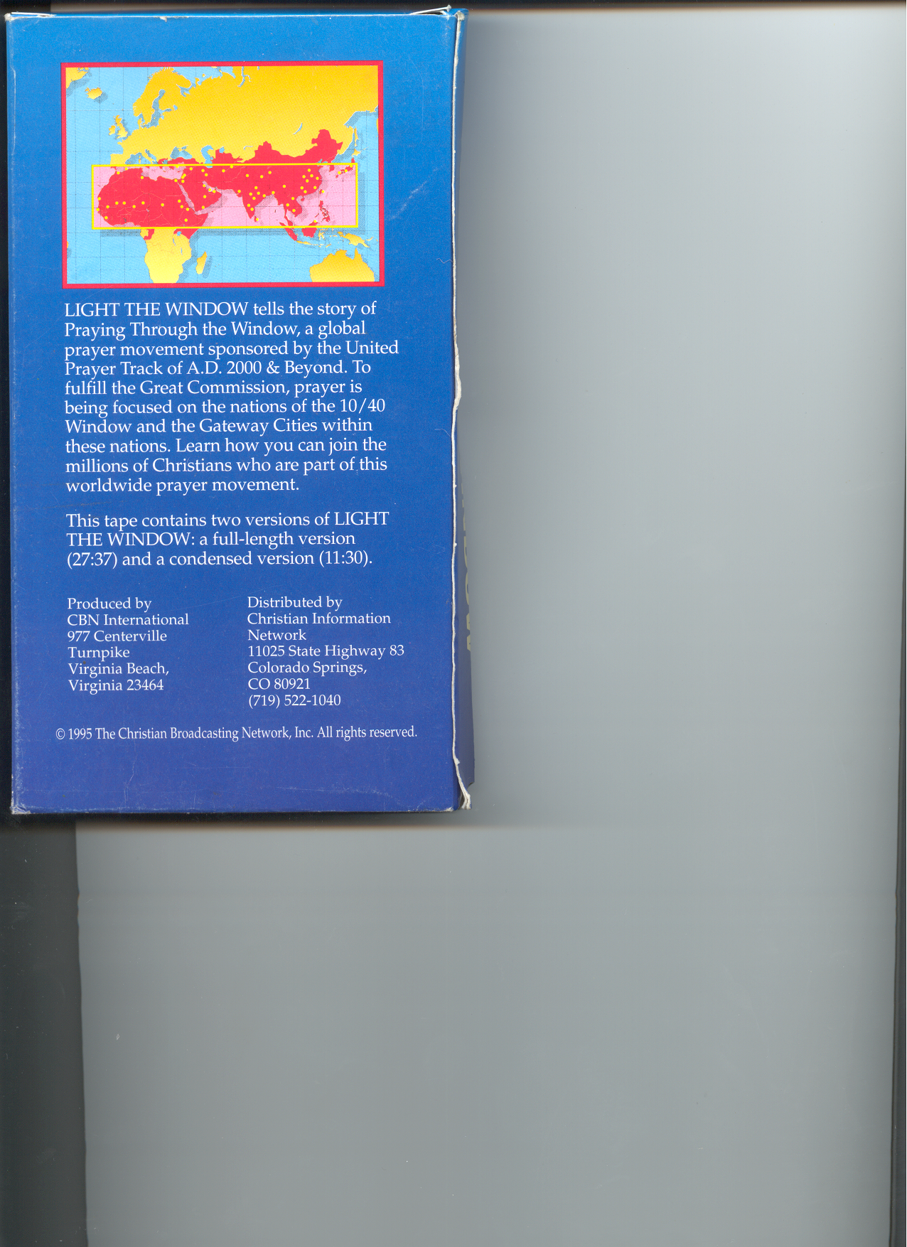
TURN THE HEARTS OF NATIONS TO GOD
Train to Reign
This world is a battlefield. The greatest battle goes on inside nations: the battle between God and Satan.
Unreached People Groups

Slide 29
TURN THE HEARTS OF NATIONS TO GOD
Congregations of Christian Believers per Unreached People Group
100
1500
1950
2000
1 to 12
1 to 1
33 to 1
1980
1000
1900
1 to 5
10 to 1
= 6 congregations
162 to 1
900 to 1
Source: U.S.C.W.M

Slide 30
TURN THE HEARTS OF NATIONS TO GOD
Non-Believers per Believer
AD 100 - 360 to 1
AD 1000 - 270 to 1
AD 1500 - 85 to 1
AD 1900 - 40 to 1
AD 1950 - 30 to 1
AD 1980 - 15 to 1
AD 1999 - 7 to 1
(Source: U.S.C.W.M.)

Slide 31
TURN THE HEARTS OF NATIONS TO GOD
Daily Bread
BILLIONS ARE WITHOUT PHYSICAL OR SPIRITUAL FOOD.
About 1.8 Billion people are undernourished physically.
Full Bible
Of 6,528 Language Groups:
NT
Less than 1/3 have a completed Bible.
Portions
70% of the world’s languages have not yet been served the Bread of Life!
No Scriptures

Slide 32
TURN THE HEARTS OF NATIONS TO GOD
IMPACT: 31.1 million dying annually all over the world going to a Christ-less hell!!!

Slide 33
TURN THE HEARTS OF NATIONS TO GOD
IS THERE A CAUSE?
  Democratic Republic of Congo
  Kenya
  Darfur
  Rwanda

Slide 34
HARVEST CONNECTION
GOD + YOU + Holy Spirit = REACHED NATIONS!
Are you willing to accept God’s plan for His church in the twenty-first century?
NOW is the time to commit to becoming an equipped mission-mobilized church and reach, teach and send forth spirit-filled disciples to Jerusalem, Judea, Samaria and the uttermost.

