Slide 1


Introduction to Hinduism
RMNI.org
Jim Sutherland, PhD, Director

Slide 2
Why focus upon Hinduism?
  Ethnic religions are the last major frontier in World A—the unevangelized world.

Slide 3
World Religions by Percentage and Size of World Population--2009
World Religions by Population
Christians | 2,271,727,000
Muslims | 1,449,614,000
Hindus | 913,455,000
Nonreligious | 773,947,000
Chinese universists | 388,609,000
Buddhists | 387,872,000
Ethnoreligionists | 266,281,000
Atheists | 148,346,000
Other | 228,306,000
David Barrett, Todd M. Johnson & Peter Crossing, “Christian World Communions: Five Overviews of Global Christianity, AD 1800-2025,” Int’l Bulletin of Missionary Research, Jan. 2009, Global Table 5, p. 25.

Slide 4
Major Religion Numerical Growth: by Birth and by Conversion, 2005
 | Natural Increase per year (sum) | Conversion increase per year (sum) | Total increase per year (sum)
Hindus | 13,120,170 | -510,255 | 12,609,915
Buddhists | 3,166,543 | 3,048,352 | 6,214,895
Christians | 22,843,921 | 5,907,725 | 28,751,647
Significant conversion growth
World Christian Database, 2005

Slide 5
Percentages of World Population: Hindu, Buddhist & Christian--2009
Annual percentage growth rates as of 2009 | Percent of world population 2009 | Percent of world population 2025 (est.)
Hindu 1.35 per annum | 13.4 | 13.6
Buddhist .73 per annum | 5.7 | 5.5
Christian (all groups) 1.32 per annum | 33.3 | 33.9
David Barrett, Todd M. Johnson & Peter Crossing, “Christian World Communions: Five Overviews of Global Christianity, AD 1800-2025,” Int’l Bulletin of Missionary Research, Jan. 2009, Global Table 5, p. 25.

Slide 6
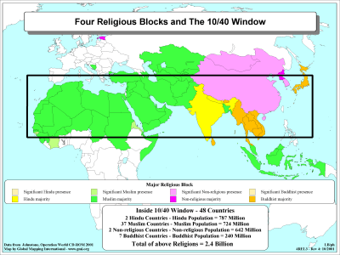
Hindu majority
Buddhist majority

Slide 7
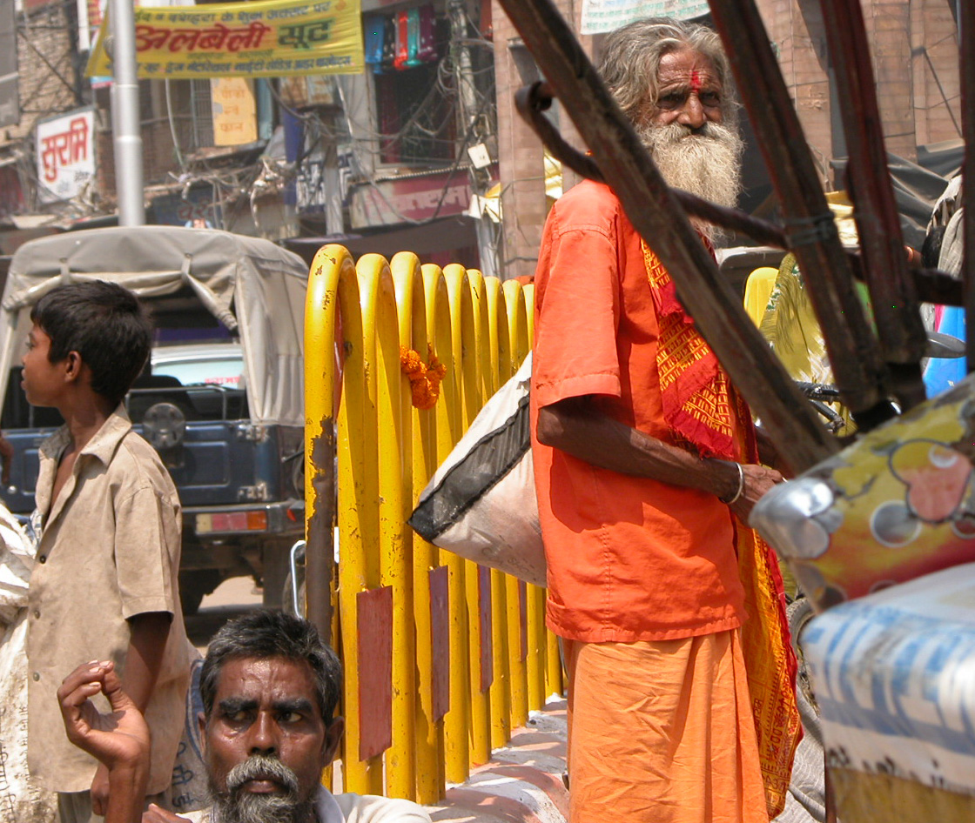
HINDUISM
Notes:
Discuss Hath Yoga and yoga generally—what place and function does it have in Hinduism? In Buddhism? Also add castes.

Slide 8
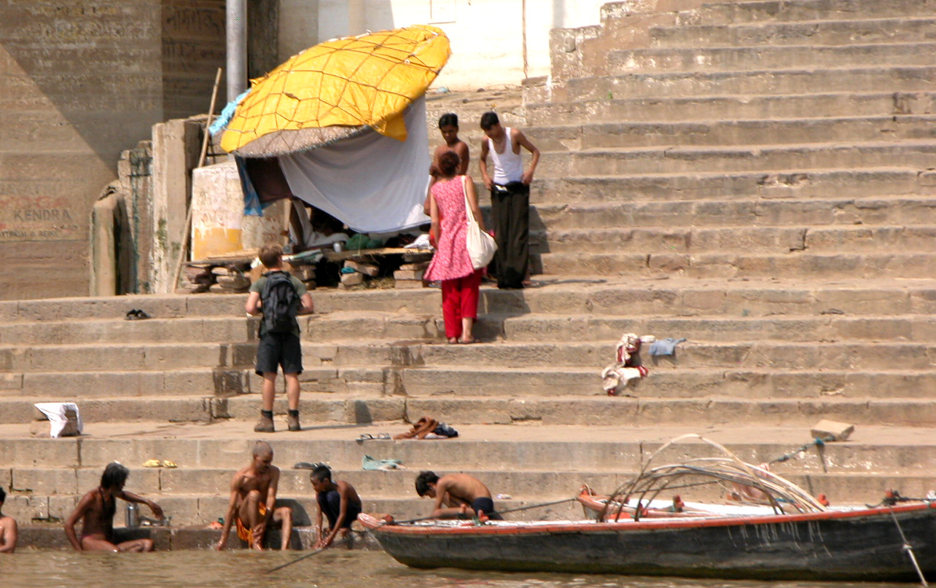
The West Still Inquiring of the East

Slide 9
Indians Are Prominent in East Africa
Cross-cultural ministry is not simply to Africans of other tribes.
There is at least one Hindu temple in Kampala. We visited in the late 1990’s and the priest was quite willing to help us understand Hinduism.
Consider evangelizing Ugandan Hindus of Indian background, who have a disproportionately large influence in East Africa.

Slide 10
Who is a Hindu?
Hindus can be polytheists, monotheists, pantheists, dualists, monists, agnostics or atheists. How do these differ?
  “Of all the world’s great religions, Hinduism is the most difficult to define. It did not have any one founder….It has many scriptures which are authoritative but none that is exclusively so.” Bruce J. Nichols, “Hinduism,” in The World’s Religions, Norman Anderson, ed., ISBN 0851113141, p. 136.)
  The only general obligation is to abide by the rules of their caste, so as to gain a better reincarnation. (Noss, p. 72-73)
Notes:
Approach a Hindu using diagnostic questions, like a doctor treating a patient for the first time.
“Do you believe in god?” “What god do you worship?”
“Have you ever done something wrong?” “How do you deal with that?” “Christians believe that….”

Slide 11
Hinduism as Philosophy
Indo-European tribes conquered India from the northwest from about 1800-1500 BC. They produced the Vedas (“knowledge”) which are the oldest of Hindu sacred books. (Noss & Noss, p. 73-74).
  The Greeks are another branch of these tribes. (Noss, p. 73).
  “Only Indo-Europeans have continually returned to the fundamental problems of metaphysics, the Aryans in India (giving rise to Hindu Philosophy), the Greeks in Greece….” Arthur A. Custance, Noah’s Three Sons, Zondervan, 1975, p. 31.

Slide 12
Religion Philosophy
Founded upon revelation
Concerned with morals
  Morals are absolute.
  Have to do with person- to-God
Concerned with “supranature”
Miracles are a part
Goal is to find God
Arthur A. Custance, p. 29.
Founded upon reason
Concerned with ethics
  Ethics are relative. (School of Morals?)
  Are person-to-person
Not concerned with nature, but with “metanature” (science concerned with nature)
Miracles are irrelevant
Goal is to find truth

Slide 13
Hinduism as Philosophy
“The gods of the early Indo-Europeans were gods of light, but this light was not moral light but rather the illumination of the mind or understanding.”
Philosophy can be defined as “strictly rational speculation, concerned with the ultimate nature and meaning of reality, apart from revelation, to satisfy a purely intellectual need…” Custance, p. 30.

Slide 14
Hinduism as Philosophy
The Greek and Hindu pantheons are alike, including worship of heavenly bodies.
  Some gods are the same: Dyaus is Zeus (rules earth), Varuna is Ouranos (sky), Usas is Eos (dew). Godchecker.com
  Orphism (from oracles), Pythagoras (c.580-500 BC) and Plato (c.428-348 BC) all taught transmigration of souls.
    Here Greek philosophy shifts from the “physical to the spiritual, from the temporal to the eternal. Reality is not now what is perceived by the senses but what lies beyond them. The soul lives an independent life and is in itself the only true reality.” A.N. Marlow, “Hinduism and Buddhism in Greek Philosophy,” Philosophy East and West, #1, April 1954, p. 36, 39.

Slide 15
Hindu Scriptures
  The two classes of sacred text are shruti—that which was seen or heard by rishis (seers), and smriti—what is remembered, outside the Vedas--of lesser authority.
  The Vedas (2000 BC- 600 BC) were earliest, being mostly instructions to priests concerning sacrifices. They are four:
    Rig-Veda (“veda of hymns”); Sama-Veda (“veda of chants”), Yajur-Veda (“veda of sacrifice”) and Atharva-Veda (“magic charms”)
      These four vedas are in turn each divided into three parts: samhita (collections of hymns), brahmana (details of sacrifices) and upanishad (moving from ritual to philosophic treatises).
    (Dean Halverson, Ed. The Compact Guide to World Religions, ISBN: 1556617046, p. 88; Hindu Scriptures, R.C. Zaehner, translator, Everyman’s Library, 1966, p. v-vi; Nichols, “Hinduism, p. 138).
Notes:
Eventually Brahmin developed personal attributes ----saguna Brahman (Dean Halverson, Ed. The Compact Guide to World Religions, ISBN: 1556617046, p. 88).

Slide 16
Hindu Scriptures
  Of enduring interest, in 800-300 BC came the Upanishads (or Vedantas)—the end of the Vedas. These focus upon the union of Brahman (“the changeless essence that upholds the universe”) with Atman (“the same changeless essence that indwells the human spirit”). This earlier concept of Brahman is called Nirguna Brahman—or Brahman without attributes.
    Other smriti are the Ramayana (Rama’s way); the Mahabharata epics (“the great story”)—within which is the Bhagavad-Gita (stories of Krishna); the Vedangas (law codes; the Puranas (genealogies of gods); Darshanas (philosophy); Sutras (codes of conduct) and Tantras (to attain demonic power). (Dean Halverson, Ed. The Compact Guide to World Religions, ISBN: 1556617046, p. 88, 91; Zaehner, viii; Nichols, “Hinduism, p. 138).
Notes:
Eventually Brahmin developed personal attributes ----saguna Brahman (Dean Halverson, Ed. The Compact Guide to World Religions, ISBN: 1556617046, p. 88).

Slide 17
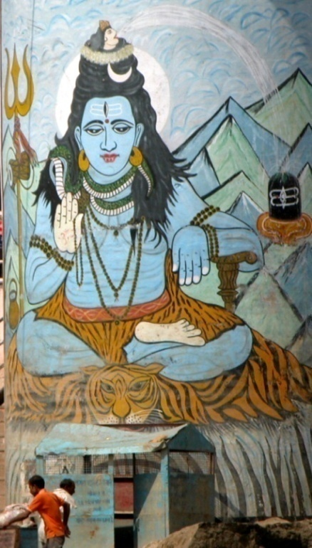
Primary Gods
Shiva
Nirguna Brahman (without attributes)
evolved into Saguna Brahman (with
attributes), or Ishvara.
  Brahman manifested in the trimuri (three manifestations): Brahma (creator), Vishnu (preserver) and Shiva (destroyer). Shiva is most worshipped today, with Vishnu second. These all have at least one divine consort (devi or goddess). (Halverson, p. 88-89; sacredsites.com/asia/india/shiva/_shrines.html)
  Additionally, there are supposed to be ten avatars, or earthly manifestations, of Vishnu, among them Rama, Krishna and Buddha.
  The pantheon of Hindu gods is estimated to be around 330 million in all.

Slide 18
The Ten Avatars of Vishnu
Matsya, the fish.
Kurma, the tortoise.
Varaha, the boar.
Narasimha, the half-man/half-lion.
Vamana, the dwarf.
Parashurama, Rama with the axe.
Rama, Ramachandra, the prince and king of Ayodhya.
Krishna (meaning "dark coloured" or "all attractive“).
Gautama Buddha (meaning "the enlightened one“) (specifically as Siddhartha Gautama).
Kalki ("Eternity", or "time", or "The Destroyer of foulness“)… is expected to appear…in the year 428899 CE. (cf. Mahdi, Messiah) http://en.wikipedia.org/wiki/Avatar

Slide 19
God
“In Hindu philosophy there is no contradiction between belief in an all-embracing, all-pervading, omnipresent God and the puja (worship) of a variety of gods and goddesses in the Hindu pantheon…in theory they represent nothing more than imaginative pictures of the infinite aspects of one all-pervading God.”
  Nicholls, p. 141.
Notes:
Eventually Brahmin developed personal attributes ----saguna Brahman (Dean Halverson, Ed. The Compact Guide to World Religions, ISBN: 1556617046, p. 88).

Slide 20
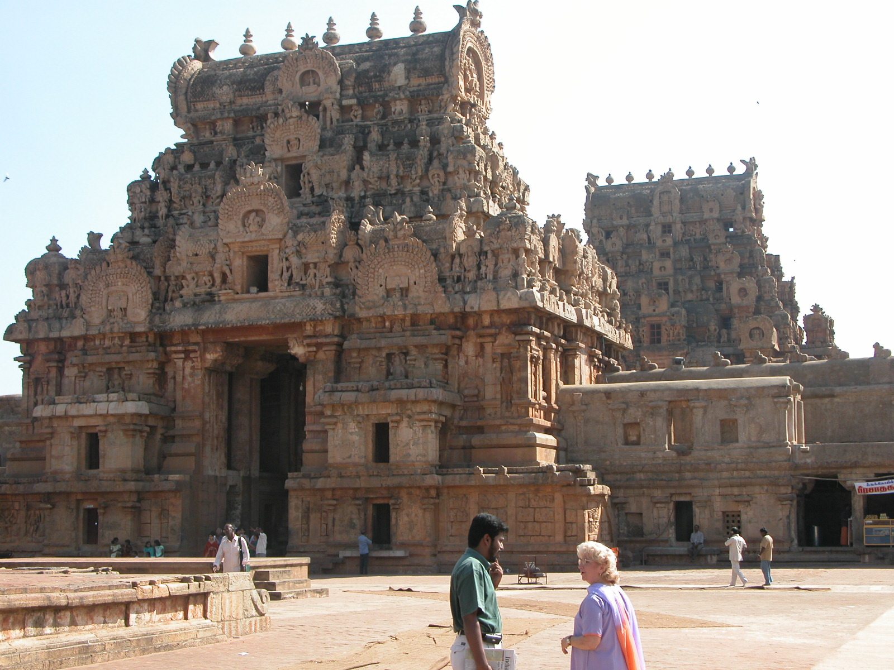
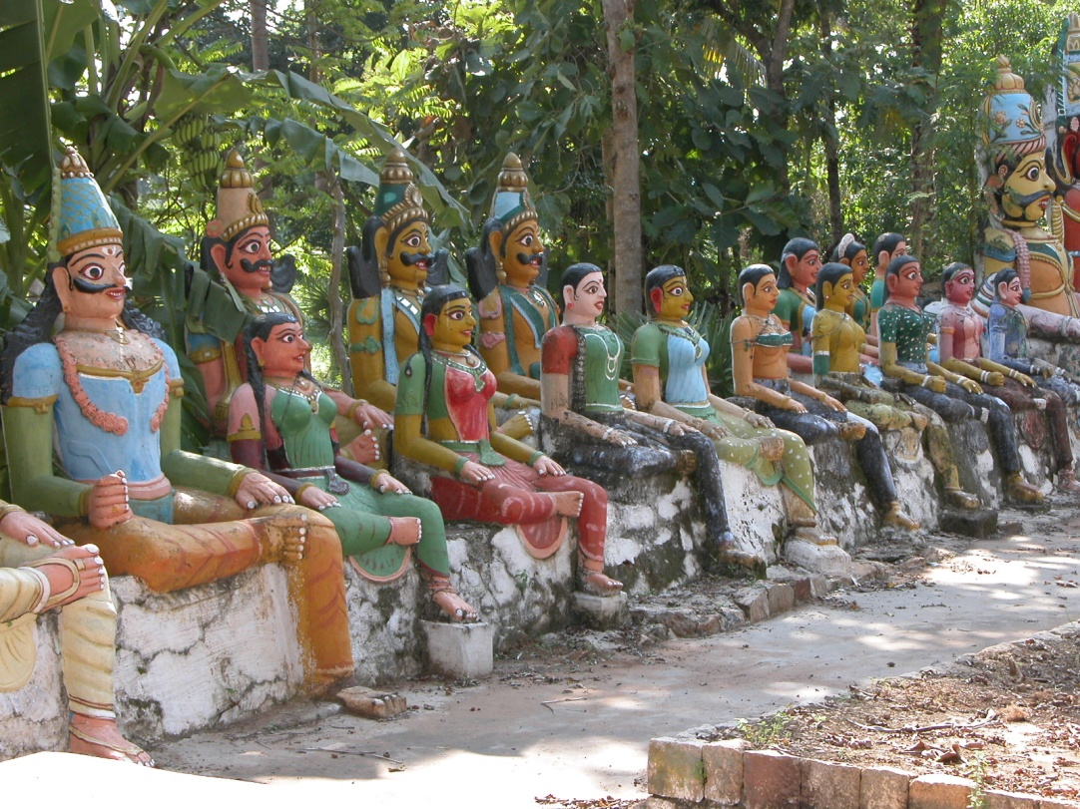
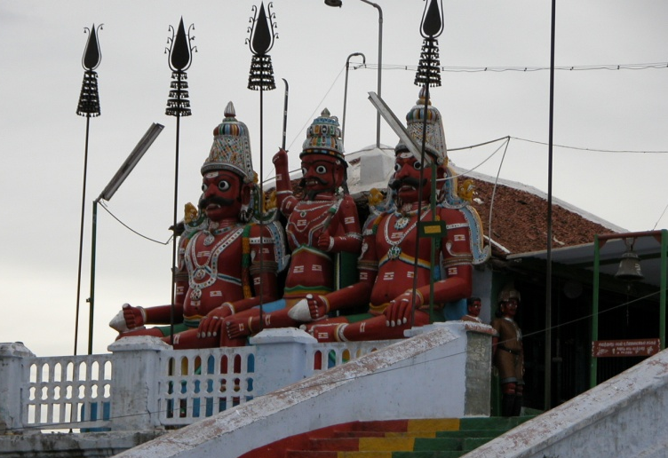
Indian Temples—Old and New

Slide 21
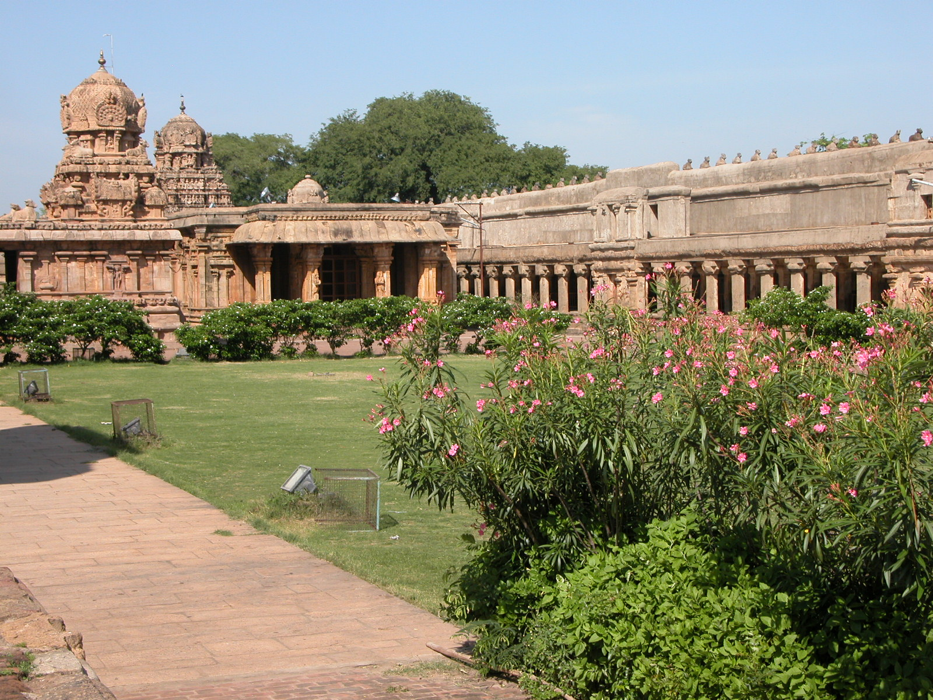
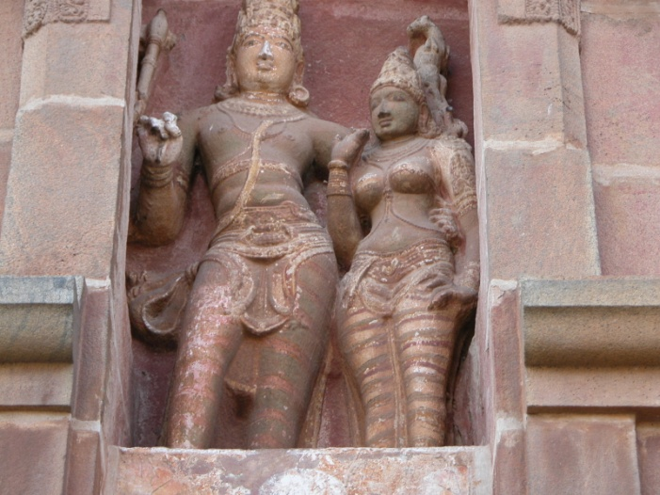
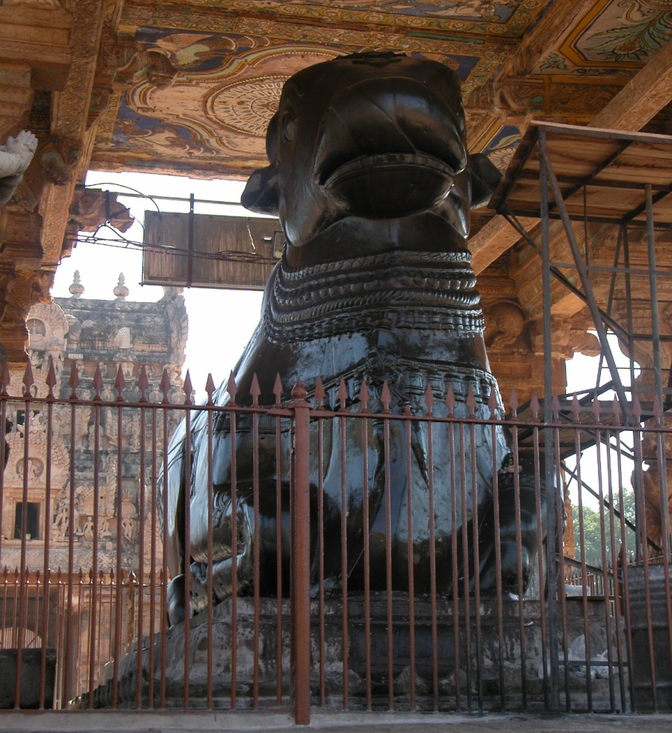
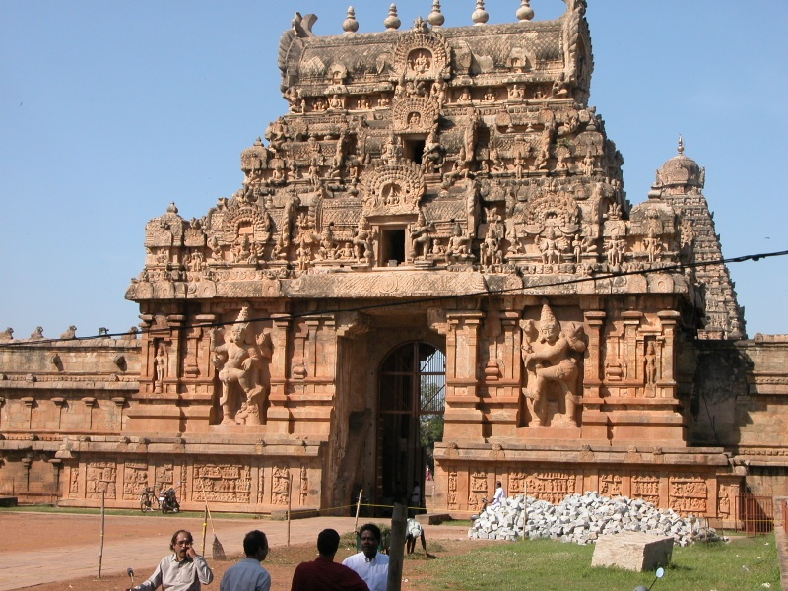
817,112,705 Hindus were in India in 2005, about 72% of the population, and about 1.34 million in the USA. WorldChristianDatabase
Brihadisvara Temple, Thanjavur, Tamil Nadu, 1010 AD--dedicated to Shiva
Nandi—the bull Shiva rides

Slide 22
“Salvation” in Hinduism
For Hindus the problem is ignorance. We (Atman) are a part of God (Brahman), but we fail to unite with Brahman due to our bondage to earthly desires.
  “Immortal in very truth is Brahman. East, west, north and south, below, above Brahman projects Itself; Brahman is this whole universe, most to be desired!” Mundaka Upanishad II.12
  “Hence the man who thus knows will be at peace, tamed, quietly contented, long-suffering, recollected, for he will see the Self in self: he will see all things as the Self. Evil does not touch him: all evil he shrugs off. Evil does not torment him: all evil he burns out. Free from evil, free from doubt, immaculate, he becomes a Brahman (in very truth, for Brahman now indwells him).” Brihadaranyaka Upanishad IV, iv, 23

Slide 23
Bondage to Desire
Subjects to Karma
“As a man acts (karma), as he behaves, so does he become. Whoso does good, becomes good: whoso does evil, becomes evil. By good (punya) works (karma) a man becomes holy (punya), by evil he becomes evil.
  “But some have said: ‘This ‘person’ consists of desire alone. As is his desire, so will his will (kratu) be; as is his will, so will he act (karma); as he acts, so will he attain.”
  “To what his mind [and] character are attached, to that attached a man goes with his works. Whatever deeds he does on earth, their rewards he reaps. From the other world he comes back here,--to the world of deed and work.”
  Brihadaranyaka Upanishad IV. 5

Slide 24
Karma and Sin
Halverson points out two basic differences:
  While both are moral acts in nature, karma does not affect one’s relationship with Brahman, since we are one with Brahman.
  The law of karma is inexorable. There is no forgiveness, only payment for one’s wrongdoing in the next life. (Halverson, p. 90)
Sin is ignorance of truth (avidya), attributing reality to what is not real (maya), and mala, the sense of being an individual self. It is more metaphysical than moral. (Nicholls, p. 145)

Slide 25
Samsara
The cycle of rebirth is called samsara. It is like a wheel—we reap in this life the karma of our former life, and we sow in this life what we reap in the next.
  This has led to lack of compassion for those in difficult circumstances, since they are deserved.
  Hinduism is a “works” religion, second only to Buddhism, potentially stretching thousands of lifetimes before good works enable to reach release (moksha).

Slide 26
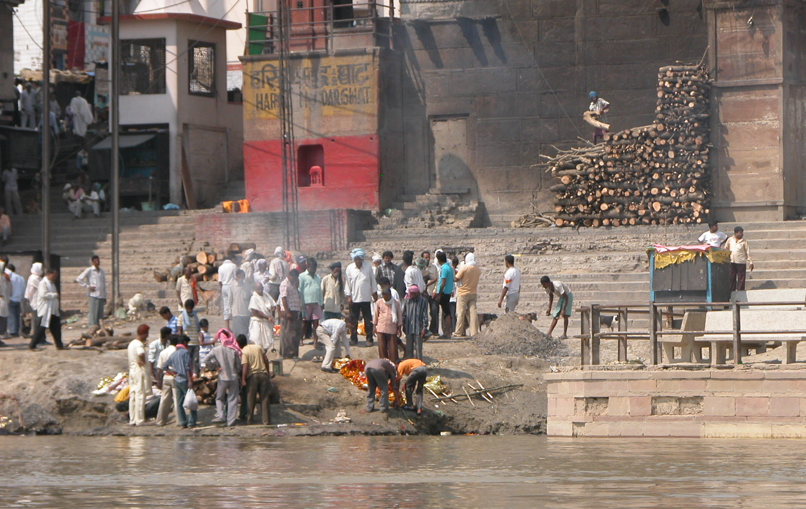
Cremation on the Ganges is Believed to Undo the Bad Karma of 1,000 Lives
Bodies being cremated

Slide 27
Four Ways (Yoga) to Moksha
(Release from Samsara)
1. Karma marga (karma yoga) is the way of “selfless or disinterested action.” Karma for reward keeps us in samsara, however.
2. Karma bhakti (bhakti yoga) is the way of love and devotion to God via ritual or attempts to directly commune with God.
  “Bhakti is devotion for its own sake rather than for the glory of God. It has value in itself; it is a method to merit the grace of God.” Nicholls, p. 146-147

Slide 28
Four Ways (Yoga) to Moksha
(Release from Samsara)
3. Jnana marga (jnana yoga) is the path of knowledge, or meditation for intellectuals.
  The Gita recognizes all three ways, but emphasizes bhakti. (Nichols, p. 147)
4. Raja yoga is considered by some to be the highest way. It’s practiced by mendicant monks. Steven Cory, “The Spirit of Truth and the Spirit of Error 2” ISBN: 0802482406
  “Rising above their desire for sons, their desire for riches, their desire for [exalted] states of being, they wander forth to lead a beggar’s life. For there is no difference between a desire for sons and a desire for riches and a desire for [exalted] states of being: all of them are nothing more than desire.” Brihadaranyaka Upanishad IV, iv.22

Slide 29
How To Evangelize Hindus
It’s crucial to determine where this person is heading in Hinduism. How strongly does this person believe? What is the goal? In what is trust? How does the person hope to attain the goal? What is the person looking for in life? What god(s) is worshipped?
  Ask how well the person is doing in the chosen path. Are there any failures? How will the person deal with those failures? Usually those failures will be moral, not philosophical or intellectual.
  Instead of confronting eons of weary rebirth, we offer complete forgiveness of sins through the grace of God, rather than through personal effort, be it intellectual, devotional or praiseworthy.

Slide 30
Relevant Scriptures
  Hebrews 9:27-28 Just as man is destined to die once, and after that to face judgment, ²⁸ so Christ was sacrificed once to take away the sins of many people; and he will appear a second time, not to bear sin, but to bring salvation to those who are waiting for him.
  Titus 3:4-7 But when the kindness and love of God our Savior appeared, ⁵ he saved us, not because of righteous things we had done, but because of his mercy. He saved us through the washing of rebirth and renewal by the Holy Spirit, ⁶ whom he poured out on us generously through Jesus Christ our Savior, ⁷ so that, having been justified by his grace, we might become heirs having the hope of eternal life.

Slide 31
Adding to the Pantheon
It’s not unusual for Hindus to be very receptive to Christ. As with Muslims, Christ himself is often very attractive in His person and life. So we stress Him, not doctrinal truth or “Christianity.” Ghandi admired Christ, but did not become a Christian. He allegedly didn’t see Christ in Christians.
A Hindu may simply add Christ to those revered. The uniqueness of Christ must be stressed:
  Acts 4:12 Salvation is found in no one else, for there is no other name under heaven given to men by which we must be saved."
  John 14:6 ⁶ Jesus answered, "I am the way [yoga] and the truth and the life. No one comes to the Father except through me.

Slide 32
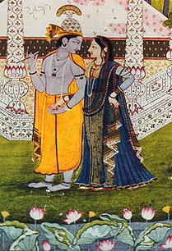
The Holiness of God
Hindus gods are sometimes quite erotic, such as Krishna. Both the male and female phallus symbols are worshipped in Shivite temples.
  1 John 1:5 This is the message we have heard from him and declare to you: God is light; in him there is no darkness at all.
Krishna with a consort
From Wikipedia

Slide 33
Union With God
Advaita Vedanta teaches the complete union of Atman and Brahman and is the most common form of Hinduism in the West. (Cory)
  John 14:17 the Spirit of truth. The world cannot accept him, because it neither sees him nor knows him. But you know him, for he lives with you and will be in you.
  John 14:23 Jesus replied, "If anyone loves me, he will obey my teaching. My Father will love him, and we will come to him and make our home with him.

Slide 34
God and Creation Differentiated
Genesis 1:1 “In the beginning God created the heavens and the earth.” There is no creation out of nothing in Hinduism. Creation either from the body of God or pre-exists as an egg. The creator and the creation are all of one essence, without differentiation. All is not identical with of God.
  One creation account reads: “In the beginning this [universe] was the Self alone—in the likeness of a man.” “He was afraid,” and lonely, so he created a woman. Self split into man and woman and then had intercourse, creating human beings. Further relations produced the animals. “He knew that he was [the whole of] creation, for he had brought it all forth. Hence he became [all] creation.” Brihadaranyaka Upanishad I, iv:1-5

Slide 35
Not Focusing Upon the Transitory
Matt. 6:25-34 shows our Father’s intimate provision for us.
  We should not over-focus upon the desires and pleasures of this life, since we are pilgrims and strangers: 1 Peter 1:17 Since you call on a Father who judges each man's work impartially, live your lives as strangers here in reverent fear.
  Luke 12:15 ¹⁵ Then he said to them, "Watch out! Be on your guard against all kinds of greed; a man's life does not consist in the abundance of his possessions."

Slide 36
Enjoy Life, Mindful of the Next
  1 Timothy 6:17-19 NAS ¹⁷ Instruct those who are rich in this present world not to be conceited or to fix their hope on the uncertainty of riches, but on God, who richly supplies us with all things to enjoy. ¹⁸ Instruct them to do good, to be rich in good works, to be generous and ready to share, ¹⁹ storing up for themselves the treasure of a good foundation for the future, so that they may take hold of that which is life indeed.
    We can earn rewards in heaven.
    Christians are not told to be ascetics. That may be a special calling. We are to focus upon God, while enjoying His gifts.

Slide 37

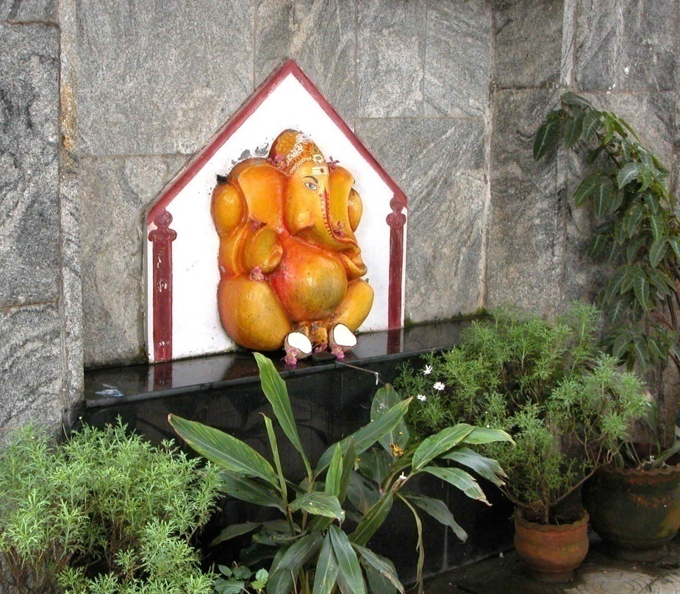
1 John 5:21 Dear children, keep yourselves from idols.

