Slide 1

Introduction to Islam
RMNI.org
Jim Sutherland, PhD, Director
Notes:
Character of Mohammed; errors in the Koran; radical Islam; better apologetics; global domination; basic beliefs –expanded?;

Slide 2
World Religions by Percentage and Size of World Population--2009
World Religions by Population
Christians | 2,271,727,000
Muslims | 1,449,614,000
Hindus | 913,455,000
Nonreligious | 773,947,000
Chinese universists | 388,609,000
Buddhists | 387,872,000
Ethnoreligionists | 266,281,000
Atheists | 148,346,000
Other | 228,306,000
David Barrett, Todd M. Johnson & Peter Crossing, “Christian World Communions: Five Overviews of Global Christianity, AD 1800-2025,” Int’l Bulletin of Missionary Research, Jan. 2009, Global Table 5, p. 25.

Slide 3
Percentages of World Population: Hindu, Muslim & Christian--2009
Annual percentage growth rates as of 2009 | Percent of world population 2009 | Percent of world population 2025 (est.)
Hindu 1.35 per annum | 13.4 | 13.6
Muslim 1.75 per annum | 21.2 | 23.5
Christian (all groups) 1.32 per annum | 33.3 | 33.9
David Barrett, Todd M. Johnson & Peter Crossing, “Christian World Communions: Five Overviews of Global Christianity, AD 1800-2025,” Int’l Bulletin of Missionary Research, Jan. 2009, Global Table 5, p. 25.

Slide 4
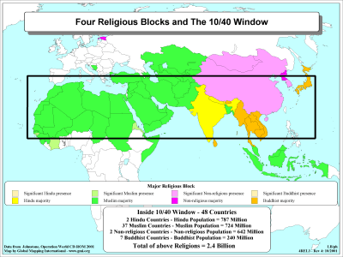
Muslim majority

Slide 5
Islam

Slide 6
Islam
(In Arabic, “Islam” means submission to the will of God). The religious faith of Muslims who profess belief in Allah as the sole deity and in Muhammad as the prophet of Allah.
  As of 2005, there were 4,750,000 Muslims in the USA, or about 1.6% of the population. World Christian Database

Slide 7
Muhammed’s Early Years
Born around 570 AD, he was raised after age 6 by relatives.
  During his youth he came into contact with Jews and Christians of various persuasions (including Nestorians), very probably leading him to a belief in one God, in contrast to the polytheism of his tribe.
  At 25 he married a rich widow named Khadija, with whom he lived until she died twenty-five years later. Of the 5-6 children they had, only Fatima survived her father.
  Now 40, he thought much about the coming judgment day and hell, meditating in the wilderness. Tradition provides that after several days in a cave near Mt. Hira and Mecca, an angelic vision compelled him to recite a revelation. Norman Anderson, “Islam,” ch. 3 in The World’s Religions, ISBN: 0851113141, re: 1989, p. 93; J. Noss & D. Noss, Man’s Religions, 7th Ed., p. 501-502.

Slide 8
Coming Into Power
He at first doubted that the visions were from God through the angel Gabriel, but Khadija, together with others, encouraged him, and he came to confidence that he was both prophet and apostle of the God of the Jews and Christians, but to the Arabs. Noss, p. 503; Anderson, p. 96.
  Early Suras seem to emphasize divine judgment, while later ones the unity and otherness of God. Anderson, p. 94
  After being largely rejected in his own city of Mecca, he migrated (hijra) eventually to Medina in 622, and there was given full authority as prophet and virtual king. Nine years later he conquered Mecca and became the leading Arab of their peninsula. Anderson, pp. 94-96.

Slide 9
Method of Revelations
His revelations appeared to some as his being seized, or similar to seizures, with cold sweats. He claimed that an angel in the form of a man talked with him, although none around him could see this person. Noss, p. 505
  “To work (these stories) up into the form of rhymed Suras…must have required time, thought and labour. It is not possible that a man who had done this could have forgotten all about it, and believed that these legends had been brought to him ready prepared by an angelic visitor.” R. Osborne, quoted by N. Anderson, p. 97
  Some sections are very similar to the Talmud and the OT.
  He claimed that his account of OT history was accurate and the Hebrew OT corrupted, when they disagreed.

Slide 10
Revelations Concerning Muhammed’s Wives
He received special dispensation from God that only he could have more than 4 wives (Sura 33:50), and he had 15. Anis Shorrosh, Islam Revealed, ISBN: 0840730152, p. 56.
He had another special revelation exempting him from the taboo against marrying a beautiful daughter-in-law, who had divorced his adoptive son Ali (Sura 33:36-38).
Muhammed’s surviving wives could not remarry (Sura 33:53).
After the age of 50 he married ‘Ayisha, a girl 6, and consummated that marriage when she was 9. Stuart Robinson, Mosques and Miracles, 2004, ISBN: 0957790554, p. 133.

Slide 11
Imitation of the Prophet
Followers of no other religion try to imitate their founder in as minute detail as those of Muhammed. D. G. Hogarth, cited by N. Anderson, p. 99
  Ahmad ibn Hanbal, a Traditionalist, did not eat watermelons because he didn’t know the exact way by which Muhammed ate them. Anderson, p. 99
  The Koran dictates in immense detail responsibilities for the whole range of human life. Anderson, p. 114
    Conversely, Christians have freedom in the Spirit: 2 Corinthians 3:17 “Now the Lord is the Spirit, and where the Spirit of the Lord is, there is freedom.”

Slide 12
Muslims
Followers of Islam, in its 2 main branches (with schools of law, rites or sects):
  Sunnis or Sunnites (Hanafite, Hanbalite, Malikite, Shafiite)
  Shias or Shiites (Ithna- Ashari, Ismaili, Alawite and Zaydi versions)
Also:
  Kharijite and other orthodox sects
  Reform movements (Wahhabi, Sanusi, Mahdiya), also heterodox sects (Ahmadiya, Druzes, Yazidis)
Excluding syncretistic religions with Muslim elements, and partially-islamized tribal religionists
  World Christian Database

Slide 13
Sunnis and Shias Defined
Sunnis: “Followers of the larger of the major branches of Islam, that adheres to the orthodox tradition of the sunna, acknowledges the first 4 caliphs, and recognizes 4 schools of jurisprudence: Hanafite, Hanbalite, Malikite, Shafiite.”
  Sunna: “The body of hadith, traditions of Muhammed, i.e. of Islamic custom and practice.”
(Shi’is). “Followers of the smaller of the 2 great divisions of Islam, rejecting the Sunna and holding that Mohammed’s son-in-law Ali was the Prophet’s successor and itself divided into the Ithna-Ashari Ismaili, Alawite and Zaydi sects.”
World Christian Database

Slide 14
Sunni Authorities
The four school of jurisprudence accept these as authoritative:
  The Koran
  The Sunna or Traditions of the Prophet
  The “Ijma,” or what the Muslim community agrees upon
  The Qiyas, which are deduced from the above three authorities. Anderson, p. 108
Muslims today, in general, do not feel that they have the right to interpret the Koran for themselves (“ijtihad”). Rather, Muslims must submit to previous commentary on the Koran. Anderson, p. 108

Slide 15
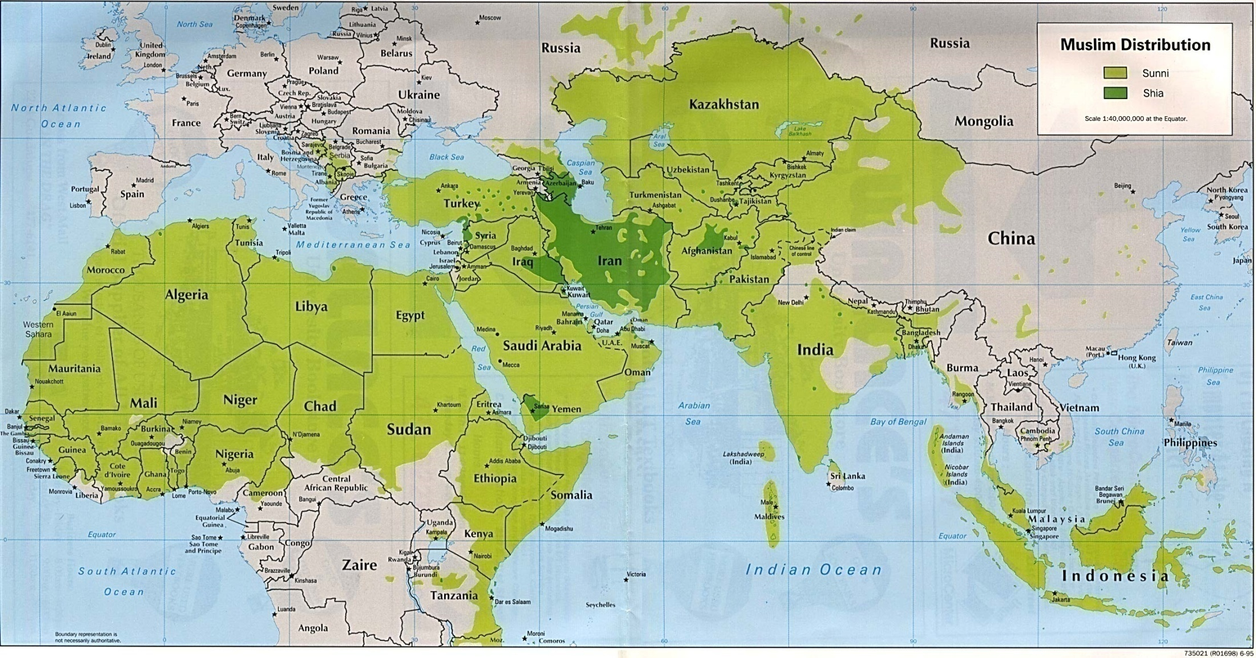
Muslim Distribution
http://www.lib.utexas.edu/Libs/PCL/Map_collection/world_maps/Muslim_Distribution.jpg 1995

Slide 16
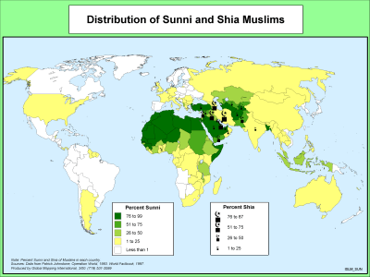

Slide 17
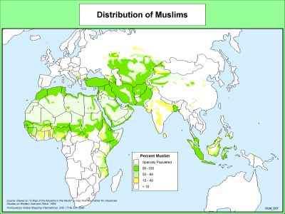

Slide 18
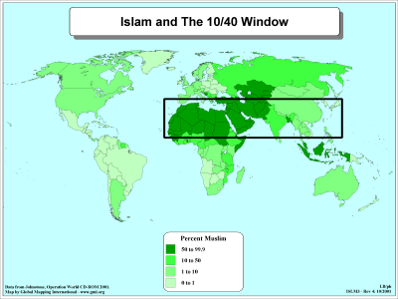

Slide 19
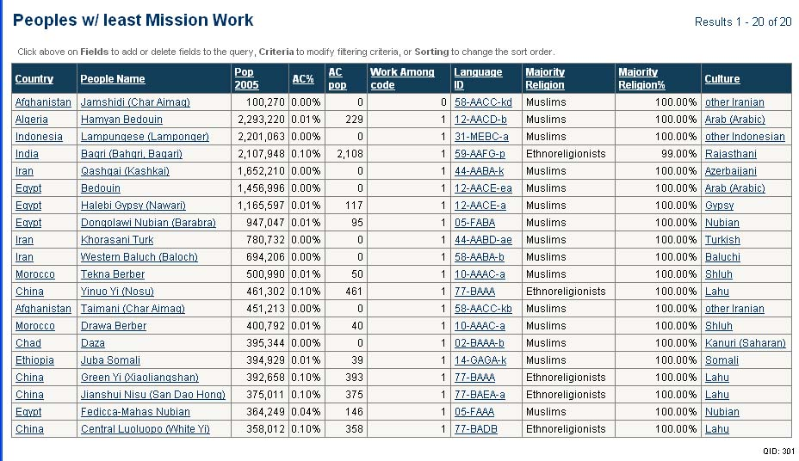
15 of the 20 Least-reached Peoples are 100% Muslim
World Christian Database

Slide 20
The European Church
2,224,800 In 1900 94.5% of Europe was Christian, but in 2000 only 76.8% was.
  The 1990s saw a reversal of the decline of Christianity in Europe. In 1990 76.2% were Christian, while in 2000 the number is 76.6%. The conversion gain was 34%, compared to 10% globally. North America, Latin America and Oceania saw a net loss of Christians in the 1990s.
  Michael Jaffarian, “The demographics of world religions entering the 21st century,” in Between past & future, J. Bonk ed. 2003, pp. 261-262.

Slide 21
Europe’s Future
By 2050 Europe will have an estimated 2.3% evangelical population, while Muslims may be 11%.
  Patrick Johnstone, “Look at the Fields: Survey of the Task,” ch. 1 in From Seed to Fruit: Global trends, fruitful practices, and emerging issues among Muslims, 2008, ISBN: 9780878080038, p.10.
With very low birth rates of Europeans, some Muslims expect to be able to turn European countries into Muslim states simply by voting.

Slide 22

Comparison of Scriptures
Bible
  Without error in autographs
  Given by God via the Spirit
    2 Peter 1:20-21 ²⁰ Above all, you must understand that no prophecy of Scripture came about by the prophet's own interpretation. ²¹ For prophecy never had its origin in the will of man, but men spoke from God as they were carried along by the Holy Spirit.
    2 Timothy 3:16 “All Scripture is God-breathed…”
    God used the personalities of the writers—mediated, not dictated. www.answering-islam.org/Intro/comparison.html
Quran (Muslim’s view)
  Believed accurately preserved by Allah (15:9)
  Dictated to illiterate Muhammad by the angel Gabriel.
    Sura 2.97 “Say: Whoever is an enemy to Gabriel-for he brings down the (revelation) to thy heart by Allah’s will, a confirmation of what went before, and guidance and glad tidings for those who believe”
    Prescriptive, rather than descriptive (Dr. Ergun Caner).

Slide 23
Comparison of Scriptures
Bible
  Contains thousands of prophecies, many of which have been fulfilled.
    Jer. 51:35-40; 49:17-18; Micah 5:2; Ps. 22:14-18; Is. 53:1-10
  In the Quran Muslims are told that Allah revealed the Torah and the Gospel
    Sura 3:3 It is He Who sent down to thee, in truth, the Book, confirming what went before it; and He sent down the Law (of Moses) and the Gospel (of Jesus) before this, as a guide to mankind cf.4:136
Quran
  Contains no actual predictive prophecy. www.geocities.com/worldview_3/quranvbible.html R. Totten
  Given to Muhammad during approximately 20 years in “ecstatic states.” (J. Noss & D. Noss, Man’s Religions, 7th Ed., p. 506)
  Sura 10:94 “If thou wert in doubt as to what We have revealed unto thee, then ask those who have been reading the Book from before thee”
  [ask Christians]

Slide 24
Comparison of Scriptures
Bible
  Is not eternal, but the
  product of prophetic and apostolic authority. Jesus is the eternal Word of God (John 1:1-5, 14).
  We don’t consider only the Hebrew and Greek (& Aramaic) copies to be truly authoritative, but encourage translations. For Islam, the Quran in Arabic is authoritative, superseding the Bible.
  Translations from Arabic are interpretations. www.answering-islam.org/Intro/comparison.html
Quran
  Considered eternal, descended from heaven, the actual words of God. Noss, p. 94.
  (W)hat the Qur'an is to the Muslim, 'Christ himself' is to the Christian. We are not 'book'-centered; we are 'Person'-centered (that is, 'Christ'-centered)! www.answering-islam.org/Intro/comparison.html
  Muslims consider the Bible to be corrupted.
    “But the transgressors changed the word from that which had been given them” Sura 2:59

Slide 25
Understanding of God
“There is no god but God.” (Shahadah)
  Say not "Trinity" : desist: it will be better for you: for Allah is one Allah. Surah 4:171; cf. 5:76 www.answering-islam.org/Intro/comparison.html
God is not Father to His followers, but more a merciful Judge.
  Of the 99 names for God, not one shows a personal relationship (Ergun Caner). http://en.wikipedia.org/wiki/Ninety-nine_names_of_Allah
God is a Tri-unity
  Matt. 3:16-17; 1 Cor. 12:4-6; Eph. 4:4-6; Heb. 9:14; 1 Pet. 1:2; 4:14; Gen. 1:2,26 +John 1:1-3; Matt. 28:19
God is Father to Christians (Matt. 6:9)—an intimate Father (Rom. 8:15; Gal. 4:6).
God is not only just, but gracious. He gives what we don’t deserve in the death of Jesus (Eph. 2:8-9).

Slide 26
Understanding of God
God is love (I John 4:8--agape). God’s love is based upon His own character more than the merit of the beloved.
  God loves even the prodigals (Luke 15) and the transgressors (Rom. 5:8-10).
God is also sovereign in His mercy and compassion (Rom. 9:15-16).
Allah is characterized primarily by justice and mercy. Allah loves those who do what is right (Surah 2:195, 222, 276; 3:31, 134, etc.),but not unconditionally (agape love).
He does not love the prodigals (7:31) or transgressors (5:87).
God forgives or chastens according to his will (5:18).

Slide 27
Understanding of God
God is singular: “apart from Me there is no God,” Is. 44:6; 45:5, or Savior (Is. 45:21).
No one comes to the Father except through Jesus (John 14:6).
Jesus claims to be one with the Father (John 10:30). If we see Jesus, we see the Father (John 14:9). If we don’t believe in Jesus, we are condemned (John 3:18).
The Koran teaches that Allah is the same God as the God of Jews and Christians. “We believe in the Revelation which has come down to us and in that which came down to you; Our God and your God is One; And it is to Him we bow.” Sura 29:46

Slide 28
Discrepancies Between
The Bible & The Koran
The Koran emerged to correct the Bible, due to supposed corruption in transmission. http://en.wikipedia.org/wiki/Biblical_narratives_and_the_Qur’an, accessed 3/5/09
  All sons of Noah are saved from the Flood: Gen. 8:18; One of Noah’s sons rejects him and is drowned: Sura 11:43.
    Noah wife is labeled as being untrue to him—Sura 66:10.
  Lot’s wife is turned into a pillar of salt: Gen. 19:26; she does not leave Sodom: Sura 11:81.
  The Queen of Sheba inquires of Solomon’s wisdom: 1 Kings 10:1-3; she becomes a monotheist: Sura 27:43

Slide 29
Discrepancies Between
The Bible & The Koran
Haman served under Persian King Xerxes: Esther 3:1; Haman served a Pharaoh (“Firaun”), Sura 28:6.
Aaron made the golden calf that was worshipped when Moses was on Mt. Sinai, and “had let them get out of control,” Ex. 32:24-25; Aaron professed innocence and had almost died from abuse by the Israelites, Sura 7:150.
The Bible does not mention the infant Jesus speaking intelligible sentences; The Koran does: Sura19:30-33.
Mary, mother of Jesus was said to have Aaron for a brother—Sura 19:28. Some Muslims say this [suddenly] refers to the Miriam of Ex. 15:20 (their names are the same in Arabic).
Muhammed believed the Christian Trinity was composed of the Father, Mary and their offspring, Jesus (Sura 4:171; 5:72).

Slide 30
Sin and Salvation
Adam’s sin is transmitted to all, and all individually sin (Rom. 5:12; 1 Cor. 15:22; Rom. 3:10-12).
  The wages of sin is death, resulting in Hell (Rom. 6:23; Matt. 25:46; Rev. 20:14-15).
  Salvation is by God’s grace and mercy (Rom. 6:23; Titus 3:5; Eph. 2:8-9), through the sacrificial, substitutionary sacrifice of Jesus Christ (1 Pet. 2:24).
Adam was forgiven (Sura 20:122), and sin was not transmitted to all.
  It hasn’t been easy to convince Muslims I’ve met that they sin.
  A Muslim must have at least 51% good deeds in life, or face roasting in Hell (Sura 23:103).
    Angel on the right shoulder records good, on left, evil.
  Sura 56 describes Hell as black smoke and drinking boiling water.

Slide 31
Sin and Salvation
Christians can have assurance of salvation before death (1 John 5:11-13), because our trust is in the finished sacrifice of Christ on the cross, and the love of the Father, not in our performance (John 19:30; 1 John 4:16-17; Col. 1:19-20).
Muslims cannot be sure of their salvation, unless they die in a jihad that has been legitimized by a fatwah. (Ergun Caner).
  Those whose scales are heavy with good deeds can enjoy a garden of paradise with feasting and perpetual virgins serving them (Sura 56.21-22;36).

Slide 32
Christ
Christians believe that He was a prophet, lived a sinless life, died on the cross for sin and is God incarnate and the Messiah (Mk. 6:4; 2 Cor. 5:21; Phil. 2:6-8).
  Muhammad was told to ask for forgiveness for his sin (Sura 40:55; 47:19).
Muslims believe that He was a prophet and Messiah (Sura 2.136; 3.45). He was not crucified (Sura 4:57). He did miracles but is not God’s son (Sura 5:110; 4.171).
Prophets are considered sinless (isma). www.answering-islam.org/Intro/comparison.html
To call Jesus “Allah,” being son of Mary, is blasphemous. (5:72-73)

Slide 33
Sharia Law
“There is no strictly static set of laws of sharia. Sharia is more of a system of law, a consensus of the unified spirit, based on the Koran (the religious test of Islam), hadith (sayings and doings of Muhammad and his companions), lima (consensus), Qivas (reasoning by analogy) and centuries of debate, interpretation and precedent.” Wikipedia

Slide 34
Sharia Law
Sharia law is established in separate courts in England and is one of the major aims of Muslims as they gain a majority in nations such as Nigeria.
  These practices are legal: amputation, stoning, honor killing, killing of apostates, wife-beating, female genital mutilation, punishment for blasphemy.
Cinnamon Stillwell, “Sharia Law: Coming to a Western Nation near you,” FrontPage Magazine, 9/25/08

Slide 35
Basic Doctrines
Belief in God—oneness
Belief in angels
Belief in God’s prophets (Muhammad is the final prophet)
Belief in the holy books
Belief in the Day of Judgment
Belief in predestination (God’s divine decrees)
  Sam Elisha; Anderson, p. 115

Slide 36
Basic Practices
1. Profession of Faith, Shahadah, "There is no God but Allah, and Muhammad is his prophet".
2. Prayer, five times a day & on Fridays--The "Salat"
3. Giving of alms, “Zakat” 2.5% to Dar Islam
4. Fasting, "Sawm," on the month of “Ramadan”
Pilgrimage to Mecca—The Hajj http://religion-cults.com/Islam/islam3.html
Christianity is concerned with orthodoxy—Islam with orthopraxy. www.answering-islam.org/Intro/comparison.html

Slide 37
Witnessing to a Muslim
Be patient. A Muslim convert will be rejected by that family—it’s momentous.
Don’t offend a Muslim by eating shellfish, pork or lard-based foods. Men speak to men and women to women.
Focus upon God’s finished work of atonement and upon God’s grace.
  Ergun Caner, “What Do Muslims Believe?, Ankerberg Theological Research Institute DVD.
Don’t assume the person is a theologically trained Muslim—s/he may be a cultural Muslim.

Slide 38
Dreams and Visions
Due perhaps to the few missionaries, and the extraordinary insulation of many Muslims, God is using dreams and visions to bring many Muslims to Himself.
  Rajab Ali Nozad, formerly a Shiite Iranian, was given a vision of two “spiritual forms” who told him, “God is and Jesus is true. Of that rest assured and come.” He then had joy and began to understand the Bible, coming to Christ. His account is at: http://www.born-again-christian.info/nozad.htm
  “More Than Dreams,” a DVD, dramatizes the accounts of Muslims from Egypt, Nigeria, Indonesia, Iran and Turkey who found Christ through visions. www.morethandreams.org (no longer available)

Slide 39
Muslim Distribution
As of 2008, Muslims were in the majority in 50 nations.
  Globally, only about 20% of Muslims are of Arabic background. Patrick Johnstone, “Look at the Fields: Survey of the Task,” ch. 1 in From Seed to Fruit: Global trends, fruitful practices, and emerging issues among Muslims, 2008, ISBN: 9780878080038, p.10.
There are approximately 8.3 million Evangelicals inside Muslim nations, which is about .57% of the Muslim population.
As of 2008, there exist an estimated 229 unengaged, unreached Muslim groups of at least 100,000. Jim Haney, “First Fruits and Future Harvests,” Ch. 6 in From Seed to Fruit: Global trends, fruitful practices, and emerging issues among Muslims, 2008, ISBN: 9780878080038, p. 87.

Slide 40
Jihad Is Supported by Quran
Sura 4.89: They desire that you should disbelieve as they have disbelieved, so that you might be (all) alike; therefore take not from among them friends until they fly (their homes) in Allah's way; but if they turn back, then seize them and kill them wherever you find them, and take not from among them a friend or a helper. (Shakir trans.)
So when the sacred months have passed away, then slay the idolaters wherever you find them, and take them captives and besiege them and lie in wait for them in every ambush, then if they repent and keep up prayer and pay the poor-rate, leave their way free to them; surely Allah is Forgiving, Merciful.

Slide 41
Global Domination
Muslim extremists want domination of the world by Islam.
The founder and board chairman of the Council for American-Islamic Relations (CAIR), Omar Ahmed, told Muslims in Freemont, California in 1998, “Islam isn’t in America to be equal to any other faith, but to become dominant. The Koran should be the highest authority in America, and Islam the only accepted religion on Earth.”
Brigitte Gabriel, Because They Hate, 2006, ISBN: 9780312358389, p. 138. See www.cair.com and www.anti-cair-net.org

Slide 42
Muslim Persecution of MBBs
A MBB pastor and family in Kiegestan must move about every 6 months, due to community and government pressure on landlords, due to the “shame” he brings on the community.
  A sister-in-law of this pastor who is single faces much pressure from her family for following Christ and not Islam.

Slide 43
US Prison Muslim Recruitment
  The National Islamic Prison Foundation, funded by the American Muslim Foundation with Saudi Arabian funds, aims to convert to Islam American prisoners, two-thirds of whom are nonwhite. Being already at odds with US society, they are natural targets. An estimated one in six US prisoners are Muslims. Chuck Colson, “Evangelizing for Evil in Our Prisons: Radical Islamists seek to turn criminals into terrorists,” June 24, 2002, www.opinionjournal.com/editorial/feature.html?id=110001885 , accessed 3/24/09
  “Responsible for indoctrinating the inmates in NIPF’s program are Saudi-trained Islamic clerics, who generally preach Wahhabism, an extreme form of Islam embraced by the Taliban and al Qaeda, and associated with virulent anti-Semetic and anti-Western worldviews.” www.discoverthenetworks.org/groupProfile.asp?grpid=6387, accessed 3/24/09

Slide 44
New Media and Muslims
“In the Middle East, there are an estimated 41,939,200 Internet users, and between 2000 and 2008 the region witnessed an impressive Internet usage growth rate of 1,176.8 %.” www.internetworldstats.com/middle.htm, accessed 2/23/09
  “197,090,443 population estimate for the Middle East in 2008”
  “41,939,200 Internet users as of Mar.31/08, 21.3% of population” www.internetworldstats.com/middle.htm, accessed 2/23/09

Slide 45
Christianity and the Internet
56 global ministry networks have developed, with 350 million computers. (David B. Barrett & Todd M. Johnson, World Christian Trends AD30-AD 2200, p. 71)
How well are we evangelizing on the Web? Are we providing Christian knowledge-seekers with solid teaching?
  Father Zakaria Boutros “Father Z” has 300 million annual hits to his websites, exposing Islam. His TV programs (260 of them) are watched by 20 million people and are downloaded by the hundreds of thousands on the Internet. http://islameyat.com/english/english.htm
Presentation by Father Z and Haroum Ibraham at Maclellan Global
  Briefing, 8/8/07

Slide 46
Why Do Muslims Follow “Isa”?
J. Dudley Woodberry and Russell G. Shubin, in their article “Why I Chose Jesus,” document these reasons:
  Muslims are drawn to Jesus, to the Bible and particularly to the Sermon on the Mount.
  Muslims usually do not have an assurance of their salvation. Christ offers this (cf. 1 John 5:11-13).
  The character of Christ attracts Muslims.
  The Bible provides satisfying answers.
  Over 25% of a survey of 120 Muslim Background Believers (MBB) indicated that a dream or vision “were key in drawing them to Christ and sustaining them through difficult times.”
    Mission Frontiers, March 2001, www.missionfrontiers.org/pdf/2001/01/200101.htm, accessed 2/26/09
Notes:
www.missionfrontiers.org/pdf/2001/01/200101.htm

Slide 47
Other Factors Leading to Christ
The “power of love” was named by half as the greatest reason for becoming a follower of Christ.
  This was both the love of Believers and that of God.
A personal relationship with God was cited by 10% of the survey as the main reason they followed Christ. God is Father (Rom. 8:15: Gal. 4:6) www.missionfrontiers.org/pdf/2001/01/200101.htm, accessed 2/26/09

Slide 48
Why Do Muslims Follow “Isa”?
Woodberry and Shubin note concerning dreams and visions:
  Christ is often seen in a white robe.
  There are often “preparatory” visions to salvation. A person may be directed to visit a particular follower of Christ.
  A second type of vision is “empowering,” to sustain through torture, for example.
  A third is some kind of supernatural event pointing people to Christ.
  Mission Frontiers, March 2001, www.missionfrontiers.org/pdf/2001/01/200101.htm, accessed 2/26/09
Notes:
www.missionfrontiers.org/pdf/2001/01/200101.htm

Slide 49
Three “Fruitful Practices” in Reaching Muslims
From responses by 300 workers who attempt to establish fellowships among Muslims (representing more than 30 organizations) some fruitful practices emerged.
  Use the heart language of the people--99% considered this important and 94% practiced it.
  Use storying in oral cultures to share the Gospel—98% believed this important, and 74% practiced it.
  Use local methods to develop leaders--such as informal apprenticeships—98% believed it important, and 80% did it.
  Don Allen, “Eyes to See, Ears to Hear,” Ch. 7 in From Seed to Fruit: Global trends, fruitful practices, and emerging issues among Muslims, 2008, ISBN: 9780878080038, pp. 101-105.

Slide 50
Nine “Fruitful Practices” in Witnessing
  Witness through social networks, such as families, as a means to form fellowships.
  Communicate the Gospel in ways that make the most sense in the local culture. “Use scripture that addresses worldview issues and creates spiritual hunger.”
  Witness in the heart language. Since women know trade languages less than men, the heart language is more important to them.
  Adapt to the local culture in dress, language and patterns of behavior—more important in rural areas.

Slide 51
Nine “Fruitful Practices” in Witnessing
  Proclaim the Gospel boldly.
  Offer to pray for people’s friends, while the friends are there, in the name of “Isa al-Masih”.
  Utilize the personal testimonies of Muslim Background Believers.
  Use evangelistic methods that can be reproduced.
  Use a variety of methods to share the Gospel, rather than a single approach.
  David Greenlee and Pam Wilson, “The Sowing of Witnessing,”, Ch. 8 in From Seed to Fruit: Global trends, fruitful practices, and emerging issues among Muslims, 2008, ISBN: 9780878080038, pp. 113- 121.

Slide 52
John Travis’ “C1-C6 Spectrum” of Muslim Background Believer Christ-centeredness
C1--a church that is culturally alien to the Muslim community in language, music and other forms
C2—a church that uses the local Muslim language, but in other regards is alien to the Muslim community.
C3—a C2 church that uses non-Islamic local cultural forms, such as clothing and art
C4– a C3 church that uses Muslim cultural forms that do not violate the Bible. Muslims consider them Christians. They may use Muslim prayer posture and a Muslim diet. Most missionaries try to plant this kind of fellowship.

Slide 53
John Travis’ “C1-C6 Spectrum” of Muslim Background Believer Christ-centeredness
C5– a C4 church, with the distinctions that members consider themselves to be Muslims, but followers of “Isa”, and that Muslims consider them to be basically Muslims. Their theology is biblical, however.
C6—secret believers in Christ, considered to be Muslims. They consider themselves to be either Christians or followers of Isa, but are considered by Muslims to be Muslims.
Joshua Massey, “God’s Amazing Diversity in Drawing Muslims to Christ,” International Journal of Frontier Missions, 17:1, Spring 2000, pp. 5-13.

Slide 54
Useful Websites for
Islamic Study
http://www.thespiritofislam.com/books/imk/index.html#chap0301
http://www.fatherzakaria.net/
http://www.truthnet.org/islam/
http://www.arabicbible.com/christian/missions.htm
http://www.christianitytoday.com/ct/2003/aprilweb-only/4-28-31.0.html (differences between Shi’ah and Sunni)
http://www.thequran.com/
http://www.islam.tc/main.php Koran online

