Slide 1
Mission Seminar
RMNi.org
Jim Sutherland, PhD, Director

Slide 2
Christian Mission Shares the Gospel
Christian mission brings the message of salvation in Christ alone to all ethnic groups so that they have the undisputed opportunity to become new persons in Christ (2 Cor. 5:17).
Matthew 24:(3)14 And this gospel of the kingdom will be preached in the whole world as a testimony to all nations, and then the end will come. (The NIV is used, unless noted.)
Romans 15:20 It has always been my ambition to preach the gospel where Christ was not known, so that I would not be building on someone else's foundation.
Luke 24:46 He told them, "This is what is written: The Christ will suffer and rise from the dead on the third day, 47 and repentance and forgiveness of sins will be preached in his name to all nations, beginning at Jerusalem.
Mission glorifies God by bringing new worshippers to Him “from every nation, tribe, people and language”—Rev. 7:9-10.

Slide 3
Which is more important, the spiritual or the physical need?
While Jesus met physical/emotional needs, preaching good news took the higher priority—it has eternal consequences.
Luke 4:40-44 When the sun was setting, the people brought to Jesus all who had various kinds of sickness, and laying his hands on each one, he healed them. 41 Moreover, demons came out of many people…. 42 At daybreak Jesus went out to a solitary place. The people were looking for him and when they came to where he was, they tried to keep him from leaving them. 43 But he said, "I must preach the good news of the kingdom of God to the other towns also, because that is why I was sent." 44 And he kept on preaching in the synagogues of Judea. (References are from the New International Version)

Slide 4
Church planting is essential.
A good strategy to disciple the nations is for frontier missionaries to plant viable ethnic churches, which will continue to evangelize and disciple their own people, first.
“St. Paul’s theory of evangelizing a province was not to preach in every place in it himself, but to establish centres of Christian life in two or three important places from which the knowledge might spread into the country round.” Roland Allen, Missionary Methods: St. Paul’s or Ours? 1930. p. 18.

Slide 5
What is Christian discipleship?
Discipleship--Christians becoming more and more like Christ--is more the responsibility of the established church, than of missions.
Matthew 28:19-20 Therefore go and make disciples of all nations, baptizing them in the name of the Father and of the Son and of the Holy Spirit, 20 and teaching them to obey everything I have commanded you…."
Colossians 1:28 We proclaim him, admonishing and teaching everyone with all wisdom, so that we may present everyone perfect in Christ.
Missionaries assist the national church in fulfilling her mission in ways such as providing evangelistic tools, education and medical and community ministry.

Slide 6
MISSION is Doing Jesus’ Work Cross-culturally
More generally, mission is continuing to do Jesus’ work.
“As the Father has sent me, I am sending you.”--John 20:21 (out of our comfort).
“The Son of Man came to seek and to save what was lost.”—Luke 19:10
To destroy the Devil’s work—1 John 3:8
“preach Good News to the poor…free the prisoners…release the oppressed”—Luke 4:18

Slide 7
Who is a Christian missionary (narrow definition)?
A Christian missionary is God’s ambassador bringing the message of salvation in Christ alone to another people, so that members will have the opportunity to be born from above.
John 3:3 In reply Jesus declared, "I tell you the truth, no one can see the kingdom of God unless he is born again."
This is a narrow definition of classic mission. Certainly Christian support personnel and those in mercy ministries in cross-cultural ministries are missionaries.

Slide 8
Distinguishing Traits of a Missionary
A missionary is sent by God on a task. The word “missionary” is the Latin equivalent of the Greek “apostle,” or “sent one.”
A missionary usually goes to a different culture and ethnic group. Paul went to Gentiles and Peter to Jews (Gal. 2:8).
This distinguishes them from “witnesses,” the work of every Christian, and from local evangelists.
Missionaries are sent by God, through the Spirit, usually by local churches (Acts 13:3).

Slide 9
Missionaries are Called by God
Missionaries are distinguished by a “call” from God (Acts 13:2), although some believe Matt. 28:18-20 (“the Great Commission”) suffices for a call to everyone.
The call may be to a specific people—however defined, to a country, or to a kind of ministry, such as teaching or medicine.

Slide 10
Worlds A, B & C
World A
The unevangelized world
=2,026,696,000 as of mid-2010, or 29% of Earth’s population
World B
The evangelized non-Christian world
= 2,587,410,000 in mid-2010, or 38%
World C
The Christian world
=2,292,454,000 in mid-2010 or 33%
Source: David Barrett, Todd Johnson & Peter Crossing, “Status of Global Mission, 2010, in Context of 20th and 21st Centuries,” Int’l Bulletin of Missionary Research, Jan. 2010, p. 36.

Slide 11
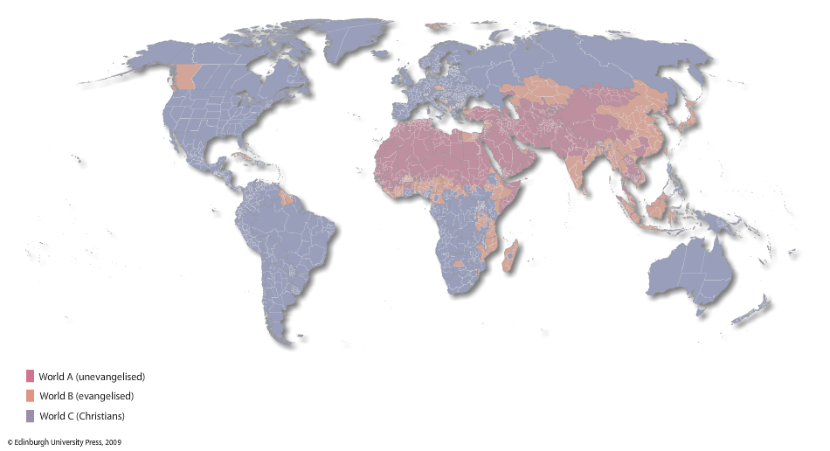
Worlds A, B & C, 2010
Todd M. Johnson, Kenneth R. Ross, eds., Atlas of Global Christianity, 2009, pp. 312-13, ISBN: 9780748632671

Slide 12
World Religions by Percentage and Size of World Population--2010
World Religions by Population
Christians | 2,292,454,000
Muslims | 1,549,444,000
Hindus | 948,507,000
Nonreligious | 639,852,000
Buddhists | 468,736,000
Chinese folk religionists | 458,316,000
Ethnoreligionists | 261,429,000
Atheists | 138,532,000
Other | 149,290,000
Source: David Barrett, Todd Johnson & Peter Crossing, “Status of Global Mission, 2010, in Context of 20th and 21st Centuries,” Int’l Bulletin of Missionary Research, Jan. 2010, p. 36.
.

Slide 13
Spectrum of Missionaries
M-1 Frontier missionaries—to World A
M-2 To non-Christians—to World B
M-3 Foreign missionaries—to World C
M-4 Cross-cultural home missionaries
M-5 Home missionaries—near culture
M-6 Pastoral workers--pastors, deacons, preachers, chaplains
M-7 Great Commission Christians-laymen
M-8 Disobedient & nominal Christians
David Barrett & Todd Johnson, World Christian Trends AD 30-AD 2200, p. 31.

Slide 14
“Great Commission Christians”
Definition: “Believers in Jesus Christ who are aware of the implications of Christ’s Great Commission, who have accepted its personal challenge in their lives and ministries, and who are seeking to influence the Body of Christ to implement it.” World Christian Database www.worldchristiandatabase.org
In 1900, Great Commission Christians were 14% of all Christians
By mid-2010, they are estimated to be 31% of all Christians. Source: David Barrett, Todd Johnson & Peter Crossing, “Status of Global Mission, 2010, in Context of 20th and 21st Centuries,” Int’l Bulletin of Missionary Research, Jan. 2010, p. 36.
to be also 32%

Slide 15
Being a classic missionary does not equal being a deacon or evangelist.
Someone who does the work of a deacon—important, but not equivalent:
Comforting the grieving
Taking food to the hungry (Acts 6:1-4), etc.
Someone who does the work of an evangelist among his or her own people.
“If everyone is a missionary, then no one is a missionary.” It has been defined away.
Should everyone who helps a sick person be called a “nurse” or “doctor”?

Slide 16
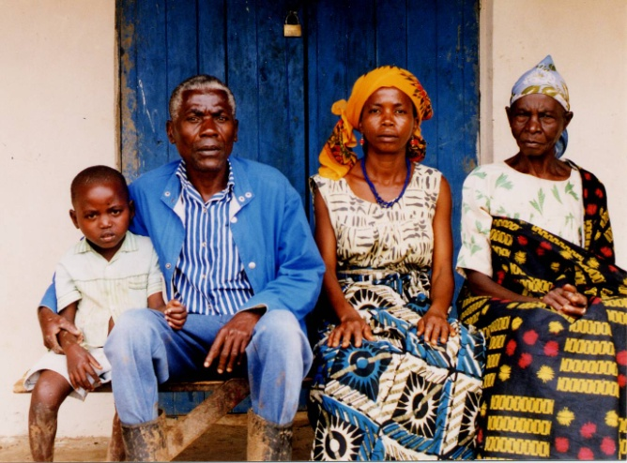
Why Support Global Missions ? --Because God cares
God wants no one to be lost (go to hell), but all to repent (2 Pet. 3:9). Missions is God’s work, not the responsibility of any one sending nation or people.
We see this in the Old Testament:
God sought out Adam after he sinned.
God called Abraham in order to bless “all peoples” through Jesus (Gen. 12:3; 18:18)

Slide 17
Why Engage Global Missions ?: Jesus cares
The “Servant of the Lord,” meaning both Jesus and Israel, was to bring God’s salvation “to the ends of the earth” (Isaiah 49:3-6; Acts 13:46-47).
Jesus’ earthly ministry was to Jews (Matt. 15:24), but He also served the Samaritan (John 4).
His death was a ministry for all the lost (2 Cor. 5:14-15).
The Jews were ethnocentric—focused upon themselves--content to keep salvation among themselves.

Slide 18
Why Engage Global Missions? We engage to be obedient.
In the New Testament the Son of Man came to seek and save the lost (Luke 19:10). We are now His “feet” to reach the lost, wherever they are (Rom. 10:14-15).
Christians are now mediators (priests) between God and unbelievers (Rom. 15:16).
Christ told the 11 apostles to witness not only in Jerusalem, but even to the uttermost parts of the earth (Acts 1:8). Those 11 could not possibly go everywhere—it is the work of the global Church until all are evangelized.

Slide 19
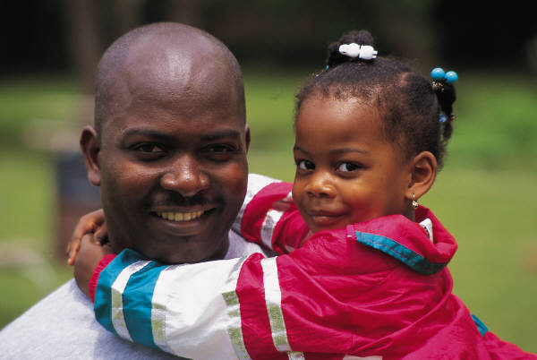
But what about our folk ?
Sinners are born daily among
our own people, and yes, we do have tremendous needs in our neighborhoods. We should try to meet them.
But all the ethnic churches are to partner in such a way that every ethnic group is evangelized. Our “Jerusalem” is another Christian’s “uttermost.” The Lord of the Harvest will ensure that every people group will have the Gospel as we obey.
Short-term missionaries can assist national churches and assist home church outreach.

Slide 20
But what about our folk ?
If you protest sending money and people overseas to evangelize and serve, because needs are great at home, do you actually evangelize and serve well in your neighborhood?
Can God provide for global missions through your church, and still provide for local needs?
Is God more likely to bless a church that spreads the Good News of His Son globally, or a church that, in fact, keeps Jesus to herself? Will God bless a religious club, masquerading as a church?

Slide 21
Are Those Who Don’t Hear Of Jesus Really Lost ?
Those who do reject Jesus will not have eternal life in heaven (John 3:36; 12:48). JESUS said that none come to the Father apart from Him (John 14:6).
Everyone sins, but sinners don’t normally seek God (Rom. 3:23, 11-12; John 6:44). Pagans even suppress the knowledge of God obvious to them in nature (Rom. 1:18-20). They don’t accept the light already given.

Slide 22
Are Those Who Don’t Hear Of Jesus Really Lost ?
Pagans also violate their own moral standards– thus condemning themselves (Rom. 2:14-16).
Everyone comes into this world condemned by Adam’s sin (Romans 5:18). Each of us also sins individually and sin results in spiritual death (Romans 3:23; 6:23). Forgiveness comes by repentance and faith in Christ (Acts 2:38; 10:43; Romans 10:9-10). Forgiveness doesn’t come automatically by Christ’s death, or by baptism.
If even one of the parents is a Christian, his or her child is in some sense “holy” or set apart (1 Corinthians 7:14).

Slide 23
Missionary, come home?
If all are saved who don’t hear of Christ, the best strategy is to immediately withdraw all missionaries, so that all will be saved
D. James Kennedy

Slide 24
Do We CARE that Pagans are REALLY Lost?
Judah was disobedient to God, but thought that as long as they focused upon the Temple, God would not destroy the Temple or them. They said, “We are delivered!” (Jer. 7:10). They were wrong. They should have reformed their actions (7:3).
African American churches magnify the worship service and each week proclaim God’s deliverance. “Our God is able!” “He is a “Way-maker!”— “He’s an on-time God!”
Isn’t God also interested in making a way for those who haven’t yet heard of Christ? Are we interested only in a way being made for us? If God delivered us, why can’t He use US to deliver others?
We want justice for ourselves. Is it just for us to have the Gospel, and do nothing to enable others to hear the Gospel?

Slide 25
Do We CARE that Pagans are REALLY Lost?
Many are “doing church” while disobedient to the command to go with the gospel (Matt. 28:18-20). Some appear to think that if we have CHURCH, we can forget any consequences for keeping the Gospel among our own people. “God woke us up this morning,” but do we ask about those He didn’t wake up?
God didn’t wake up perhaps 42,000 this morning who have NEVER HEARD of Jesus Christ. Does this disturb our worship or sleep? Global missions are usually neglected in the black pulpit, and the fulltime cross cultural missionary is an almost invisible church vocation.
We must reform our actions. Having church doesn’t remove responsibility for the nations. Religion is satisfied with security, staying in the Temple, and having church. God isn’t.

Slide 26
Trip to Kenya
A church of 25,000 planned a trip to Kenya in July 2003 to see their bishop “preach to the masses.”
Members were to stay in 5-star hotels, eat at gourmet restaurants, fly in hot-air balloons and go on safari. They could visit their missionaries, at extra charge. They would spend more in 1 night at one of the hotels than they would spend on one of their missionaries in 4 years. At the crusade they would attend workshops. They would go to consume and to observe—instead of to serve—encouraged by their own church to do so.

Slide 27
Is a slamming choir more important than missions?
Which has higher priority in your church—the choir or global missions?
Whites sometimes think that if they say something needs to be done, they are off the hook.
If our choir sings “Send the Light!” is the church off the hook?

Slide 28
What is God doing in the world?
And how can I join Him?

Slide 29
Most of the 400,000* foreign missionaries go where invited, not where most needed
 | Percentage of Christian Missionaries (2005) | Number of Christian Missionaries (2005)=443,525 | Population in 2010
World A (non-Christian) | 3.1% | 13,750 | 2,026,696,000
World B (evangelized) | 25.2% | 112,020 | 2,587,410,000
World C (Christians) | 71.6% | 317,755 | 2,292,454,000
*David Barrett, Todd Johnson & Peter Crossing, “Status of Global Mission, 2010, in Context of 20th and 21st Centuries,” Int’l Bulletin of Missionary Research, Jan. 2010, p. 36.
Notes:
P 80 WCTrends

Slide 30
Christian Urban Penetration
118,000 non-Christian urbanites are added per day
Christians are 21% of the urban population, while 33% of world population.
David Barrett, Todd Johnson & Peter Crossing, “Status of Global Mission, 2010, in Context of 20th and 21st Centuries,” Int’l Bulletin of Missionary Research, Jan. 2010, p. 36.

Slide 31
Increasing Global Urbanization
2010-- 50.7% of Earth’s population is urban¹
2025-- 57% will live in cities¹
2050-- 66% are estimated to live in cities²
By 2015 only one city in an advanced nation will be among the 10 largest cities. In rank order: Tokyo, Bombay (Mumbai), Lagos, Shanghai, Jakarta, São Paulo, Karachi, Beijing, Dhaka, México²
1 David Barrett, Todd Johnson & Peter Crossing, “Status of Global Mission, 2010, in Context of 20th and 21st Centuries,” Int’l Bulletin of Missionary Research, Jan. 2010, p. 36.
2 Philip Jenkins, The Next Christendom, 2002, p. 93, based upon UN statistics, ISBN: 0195168917

Slide 32
Largest Cities Becoming Non-Christian
By 1950--7 of the top 25 cities were non-Christian
By 2000, 14 of the top 25 cities were non-Christian
In 2000 there were 226 non-Christian cities of over 1 million population.¹
In 2010 there were 266 such cities.²
From the World Christian Encyclopedia, David Barrett, George Kurian, Todd Johnson, Eds. 2001, ISBN:0195079639, p. 2: 536, 538; 1:8; World Christian Trends AD 30-AD 2200, Barrett & Johnson, 2001, p. 59.
David Barrett, Todd Johnson & Peter Crossing, “Status of Global Mission,
2010, in Context of 20th and 21st Centuries,” Int’l Bulletin of Missionary
Research, Jan. 2010, p. 36.
% Urbanites Adequately Evangelized

Slide 33
Blacks and Urban Missions
50.7% of the world are urban dwellers by mid-2010. A majority of African Americans know the city.
David Barrett, Todd Johnson & Peter Crossing, “Status of Global Mission, 2010, in Context of 20th and 21st Centuries,” Int’l Bulletin of Missionary Research, Jan. 2010, p. 36.

Slide 34
Overview of Black Missions
Perhaps 70 African American global
missionaries served between 1790
and 1820¹.
Perhaps another 600 served in Africa
between 1820 and 1980².
About 155 were identified in 1998³. Possibly 400-500 serve today, far less than 1 percent of the 118,600 US foreign missionaries⁴. African Americans are about 13 percent of the US population.
1 Marilyn Lewis, www.urbana.org/_articles.dfm?Recordid=230
2 Sylvia Jacobs, “African Missions and the Af-Am Christian Churches,” p. 22, Encyclopedia of Af-Am Religions, 1993.
3 Jim Sutherland, Ph.D. dissertation, www.RMNI.org/dissertation, p. 5
4 World Christian Database, 2005

Slide 35
AME AMEZ CME Nat. Bapt. Conv.
Reconstruction
Sources: Lerone Bennett, Jr., Before the Mayflower, 5th ed., 1982; Sylvia Jacobs, “African Missions and the African American Christian Churches,” 1983; U.S. Census Bureau http://www.census.gov/hhes/income/income00/incxrace.html

Slide 36
Sources: Wilbur Harr, “The Negro as an American Protestant missionary in Africa,” 1945. Sylvia Jacobs, “African Missions and the African American Christian churches,” 1993; Marilyn Lewis, “Overcoming obstacles: The broad sweep of the African American and Missions,” 2001; Wm. Seraile, “Black American Missionaries,” 1972; U.S. Census Bureau, “Historical income tables—households, Table H-5, 1967-2000”

Slide 37
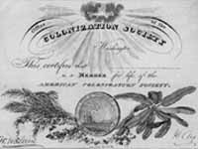
Outstanding AfAm Missionaries
John Marrant by 1775 had somehow preached the Gospel to the Cherokee, Creek, Catawar and Housaw Indians.
George Liele by 1791 had established a church of 350 in Jamaica, despite persecutions.
Prince Williams established a church in the Bahamas in 1790 that spawned 164 other Baptist churches. He pastored from age 70 to 104.
Lott Carey in 1821 was the first African American missionary to Africa. He went to escape racism and to serve his motherland. He was sent by Baptists and the American Colonization Society, established to return Blacks to Africa.
Sources: Sylvia Jacobs, Marilyn Lewis, Alan Neely, Wm. Sereile, Wycliffe Translators

Slide 38
Dr. William Sheppard
Dr. Wm. Sheppard went to the Congo in 1821, becoming head of the American Presbyterian Congo Mission among the Bakuba tribe, going 1200 miles inland.
He build churches, day schools and homes for children rescued from slavery.
His wife published the first book and hymnal in the Bakuba language.
Sources: Wilbur Harr, Sylvia Jacobs, John Hendrick and Winifred Vass

Slide 39
Dr. Aaron McMillan
Dr. Aaron McMillan was a physician and Nebraska legislator before going with the American Board of Commissioners in 1929 to head an Angolan hospital.
He trained assistants, treated over 80,000 patients and performed over 3,000 surgeries during his medical ministry¹.
1 Wilbur Harr, 1945. “The Negro as an American Protestant missionary in Africa”. Ph.D. dissertation, microfilm, University of Chicago, pp 54-55.

Slide 40
Dr. Michael & Kay Johnson
Dr. Michael Johnson serves with World Gospel Mission in Kenya, East Africa. He operates at St. Mary’s hospital and, with his wife, serves street children in the Kibera slums of Nairobi. He also trains Kenyan surgical residents.
They have a street ministry (The Least of These) to care for abandoned and orphaned children of Nairobi.
Kay, his wife, runs development projects in rural Kenya and places orphans.

Slide 41
African American Personal Finances
As of 2008, African Americans had an annual buying power of 803 billion dollars, ranking 17th among world economies in gross national income. Contributions were 1.4% of income¹. Buying power was expected to reach $981 billion by 2010².
This is the first generation with a great chance to have a “piece of the rock.”
1 http://www.targetmarketnews.com/storyid01201001.htm accessed 7/21/10
2“The US African American Market” MarketResearch.com http://www.allheadlinenews.com/articles/7002523834 accessed 1/8/07

Slide 42
African American Mission Power
Ghana sent 500 missionaries per year in 2005. Her population in 2008 was 23.4 million and her Gross National Income is 15.1 billion. African Americans spent 17.2 billion on telephone services in 2008.
Sources:
World Christian Database,
The World Bank: http://web.worldbank.org/WBSITE/EXTERNAL/COUNTRIES/AFRICAEXT/GHANAEXTN/0,,menuPK:351978~pagePK:141132~piPK:141109~theSitePK:351952,00.html
Target Market News http://www.targetmarketnews.com/storyid01201001.htm

Slide 43
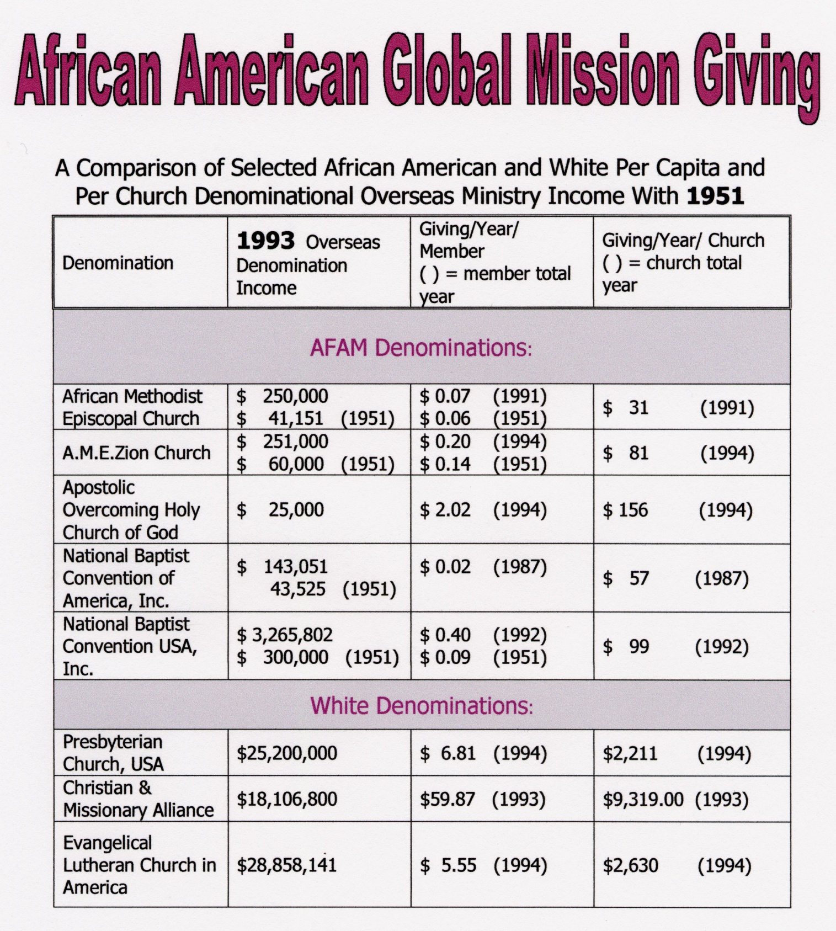

Slide 44
A Traditional Black Church and Global Missions
One traditional church in Chattanooga with a budget of $120,000 spent .4 % on evangelistic home missions (to Blacks).
This church spent NOTHING on global missions. More was spent on the annual men’s breakfast and on the copy machine than on missions.
What percentage of your church budget goes to cross-cultural/global ministry?

Slide 45
Is Christianity mostly about God serving ME ?
Some evangelical churches focus upon personal peace, wholeness and prosperity.
“Many/most AFAM are 1st generation ‘haves.’ Those who are ‘have nots’ are usually unwilling to leave all for Christ. Until 2nd generation ‘haves’ are born again few if any will leave their community to serve others. Once 2nd generation ‘haves’ move out of AFAM stereotypes of success, a typical service can be affirmed.”
Kyshia Whitlock—African American missionary to Honduras

Slide 46
Materialism Leading to Little Cross-Cultural (CC) Mission Support Partially Explaining Other Factors in the Black Church
Source: Jim Sutherland, “African American Underrepresentation in Intercultural Missions,” 1998, available at www.rmni.org/dissertation, p. 238

Slide 47
Outstanding African American Missions Churches
Particularly among newer independent churches, some give substantially.
Rosedale Park Baptist in Detroit gave 1 million to missions over 10 years www.rpbc.net
Christian Stronghold Church in Philadelphia gives at least $110,000 /year for global missions, and supports 6 foreign missionaries They sent short-term teams to Kenya (10 people), Alabama (13 people) and Liberia (6 people) in 2010.

Slide 48
Why Missions Now ?
Global missions is not simply the job of the white church. The African American church is a full partner among the world’s sister churches.
Blacks have a unique role in world mission—especially to people of color, and particularly to the oppressed.
Blacks understand oppression and suffering well, and can easily relate to the oppressed.
As urban-dwellers, they understand the city, where probably the majority of unreached people live.

Slide 49
This is the Time To Engage Missions
Nations open to missionaries are open to African Americans.
Civil rights is (again) law.
White missions welcome African Americans.
Good schools will prepare black missionaries, such as Columbia Int’l University and Moody Bible Institute.
African American mission boards now exist.
Black income steadily rises.
Short-term missions abound with ease of travel.

Slide 50
FEARS
Jesus does send us as sheep among wolves (Matthew 10:16). He doesn’t promise safety.
But the Great Commission to go into all the world closes with Jesus saying “I am with you always, to the very end of the age.” (Matt. 28:20, NIV). He promises to go with us.
The absolutely safest place in the world is in the center of God’s will for you.
The most dangerous place is out of His will.

Slide 51
FEARS
God doesn’t give us a spirit of “timidity,” but of “power” (2 Tim. 1:7-NIV).
Money? The great missionary to China, Hudson Taylor, wrote “God’s work, done in God’s way, will never lack God’s supply.”
Losing things? “And everyone who has left houses or brothers or sisters or father or mother or children or fields for my sake will receive a hundred times as much and will inherit eternal life.” (Matt. 19:29-NIV).

Slide 52
How Can I Get Involved?
Ask God what He wants of YOU.
Go on a short-term mission trip.
Read about missions—see www.calebproject.org bookstore
Develop and JOIN the world missions team at your church.
Invite missionaries to speak in your church.
Financially support cross-cultural missionaries and find out what your church spends for global missions.
Evangelize locally.
Join in praying that God will send out 5,000 workers into the harvest (Luke 10:2).

Slide 53
What Can I Do To Serve ?
God has already given at least one spiritual gift to every Christian (1 Corinthians 12:7). It’s there to help other Christians. That spiritual gift can also be used to lead people to Christ.¹
Missions help you to discover God’s equipping and to learn dependence upon Him for ministry success.
Today any skill can be used somewhere on the mission field.
If you can’t personally go, you can finance generously and regularly those who do go. Missionaries have continuous expenses. We can then send prayers after the funds.
1 Contagious Christians by Bill Hybels and Mittelberg p123

Slide 54
African American Mission Organizations
Ambassadors Fellowship http://ambassadorsfellowship.org/ 719-495-8180
Carver International Mission
carverfm@aol.com 770-484-0610
COMINAD is an African American missions mobilizing network.
IAAMM@aol.com 404-343-4172
Have Christ Will Travel Ministries
215-438-6308

Slide 55
Some of the Mission Organizations Eager to Accept African Americans
Advancing Church in Missions Commitment http://pioneers.org/
Africa Inland Mission www.aim-us.org
Campus Crusade for Christ’s Impact Movement www.impactmovement.com
International Teams www.iteams.org
Middle East Christian Outreach www.gospelcom.net/meco

Slide 56
More Mission Organizations Eager to Accept African Americans
Operation Mobilization www.om.org
SIM (Serving in Mission) www.sim.org
TEAM www.Teamworld.org
United World Mission http://umn.org
Wycliffe (Bible translation) www.wycliffe.org

Slide 57
Short-term Missions
Each year 400,000 go to mission fields for a few weeks to a few years¹.
Some Short-term Opportunities:
-- Reconciliation Ministries Network, Inc. https://www.rmni.org/global-and-short-term-missions.html
SIM www.sim.org/short-term.asp
Southern Baptists www.imb.org/vim
TEAM www.teamworld.org/opportunities
1 Barrett and Johnson, World Christian Trends, AD 30-AD 2200, c. 2001, p. 40. NOTE: RMNI CANNOT ENDORSE ALL TRIPS

Slide 58
Mission Trips
Please visit www.RMNI.org for the latest information on short-term mission trips to countries such as Uganda and South Sudan

Slide 59
Please pray for 5,000 African American missionaries
RMNi.org
Jim Sutherland, PhD, Director

