Slide 1
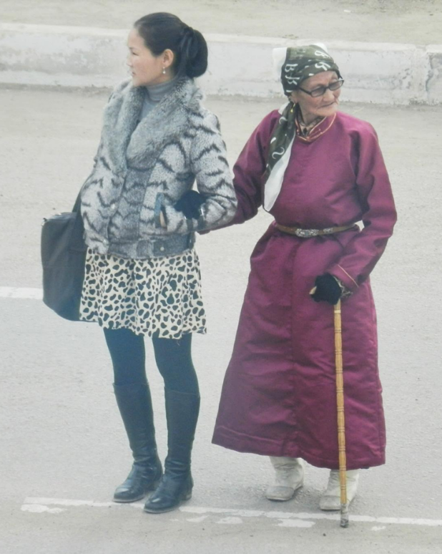
Mongolia
Jim Sutherland

Slide 2

Mongolian Flag
On the left panel are represented fire, the sun and the moon. The sun and moon are symbols of Tengriism—the worship of “father sky.” Oktyabri Dash, Mongolia: Photo Album ISBN: 978999297950X
The blue panel also represents the sky, of which there is much.

Slide 3
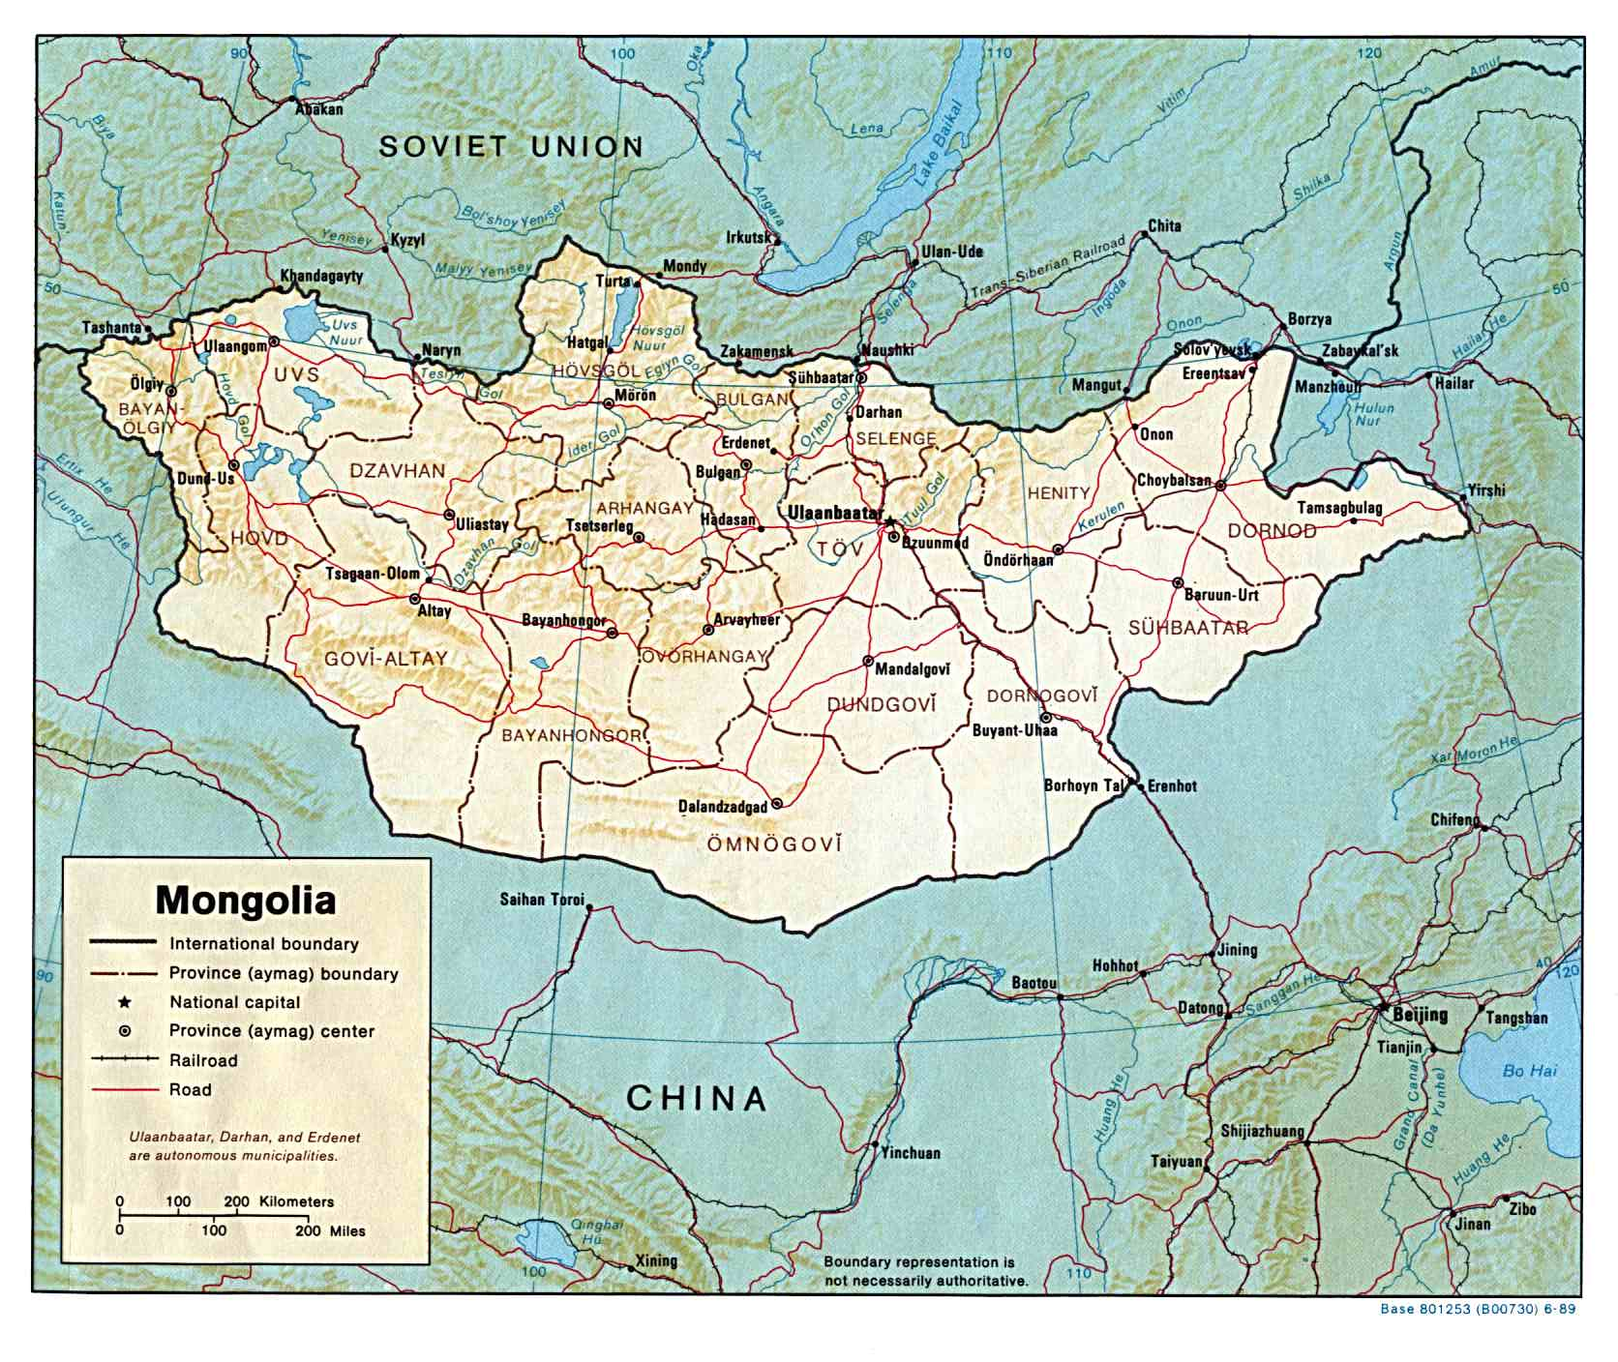
Khentii Province
Mongolia has an estimated 3.1 million persons, and is the least densely populated independent nation. About 62% live in cities. (CIA World Factbook)

Slide 4
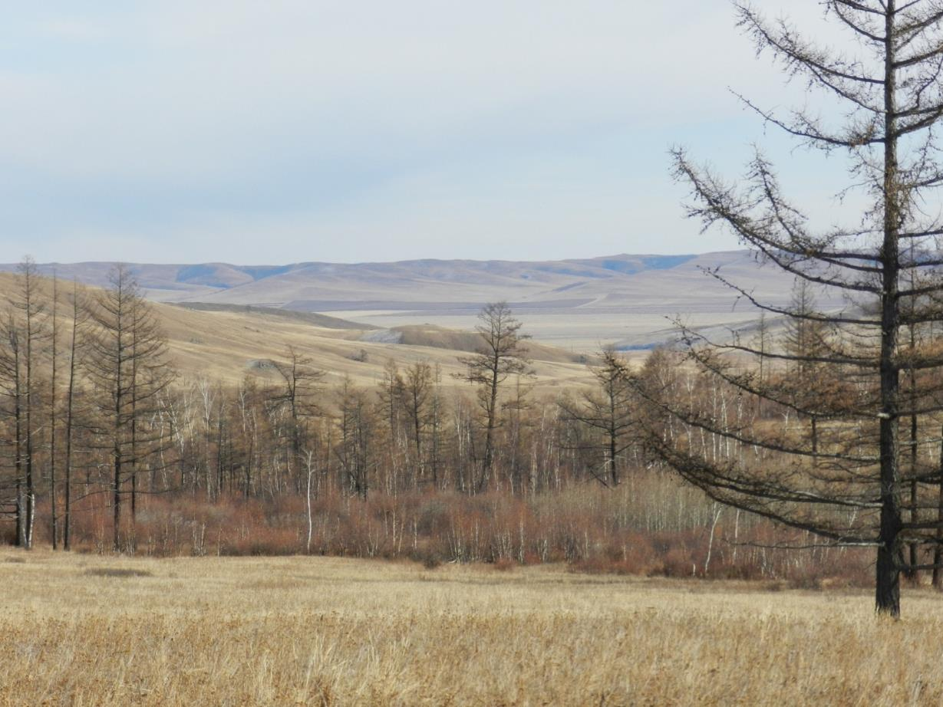

Slide 5
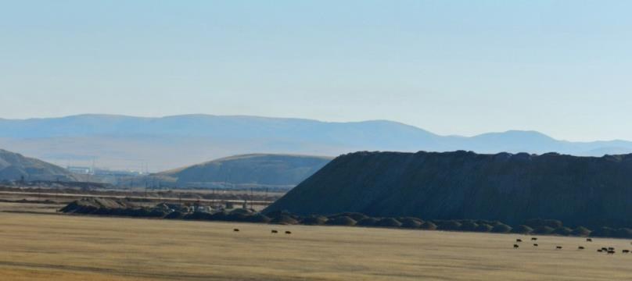
Natural Resources
Mongolia has significant deposits of coal, gold, uranium and other minerals. However, cashmire from goats and camels accounts for 80% of her exports.
160,000 herders herd 43 million head of livestock, primarily sheep, goats, horses and cattle (some camels and yaks). (The UB Post, 11/2/11, p. 7)

Slide 6
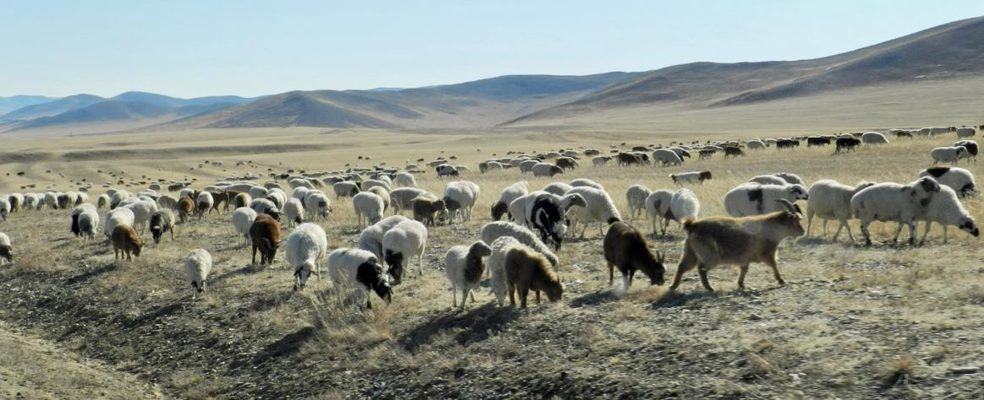
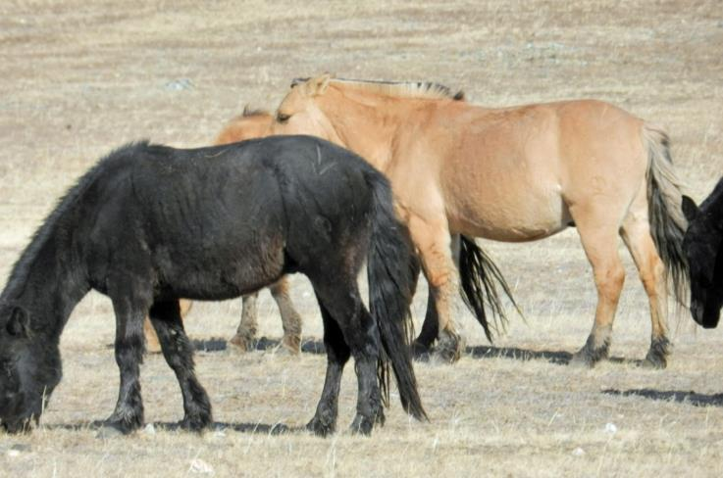

Slide 7
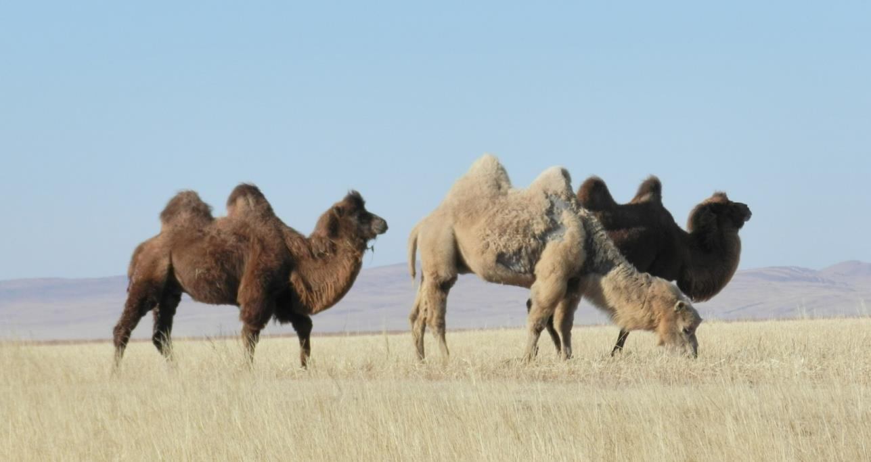
Bactrian Camels

Slide 8
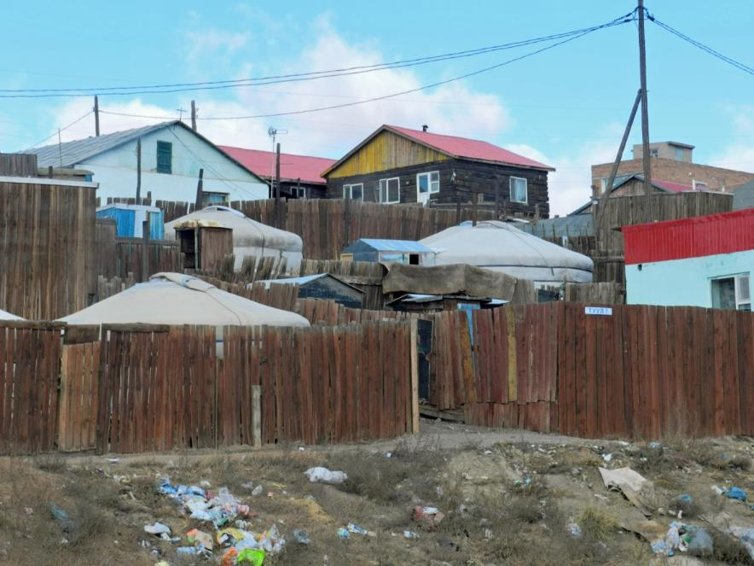
Urbanization
  A severe winter in 2000-2002 and another in 2009-2010¹ caused the loss of much livestock, forcing some herders to move to urban areas around UlaanBaatar, ger and all.
¹Don Belt, “The Urban Clan of Genghis Khan,” National Geographic, Oct. 2011.

Slide 9
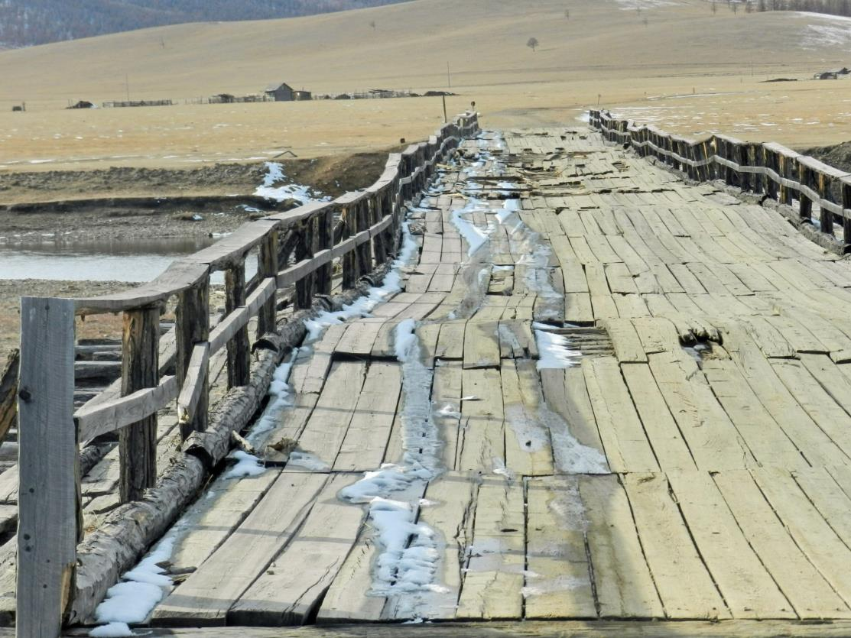
Poor infrastructure in rural areas

Slide 10
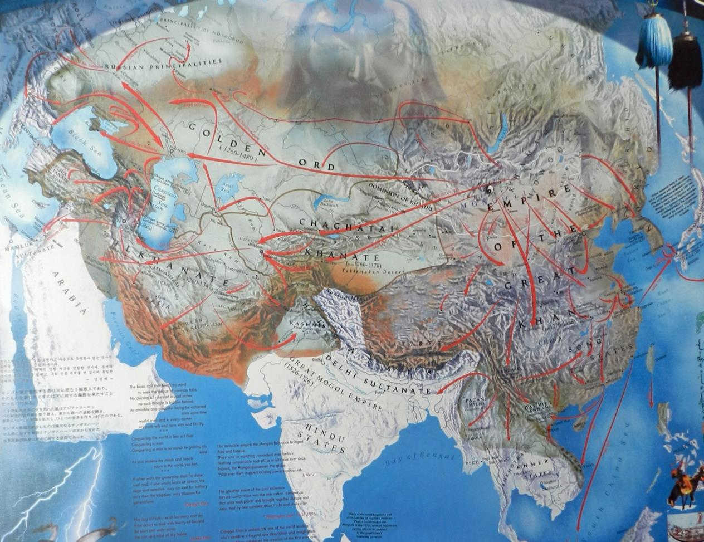
The Mongol empire lasted from 1206 AD until 1368 and was the largest land empire in history. http://en.wikipedia.org/wiki/Mongol_Empire

Slide 11
Chinggis Khaan
“First, Chinggis Khaan, the correct spelling for Genghis Khan, is Mongolia’s beloved hero and the founding father of our nation. He is beloved and respected above anything else in Mongolia. To us, he is like Abraham Lincoln, God, and Chuck Norris put together.” 8/3/2009
  Mergen http://mergenchuluun.com/genghis-khan-and-hitler-not-the-same-thing
“As an apostle of the extremes of the last thousand years, there exists no better candidate [for man of the millennium] than Genghis Khan, who embodied the half-civilized, half savage duality of the human race.” Washington Post, Joel Achenbach, 12/31/1995

Slide 12
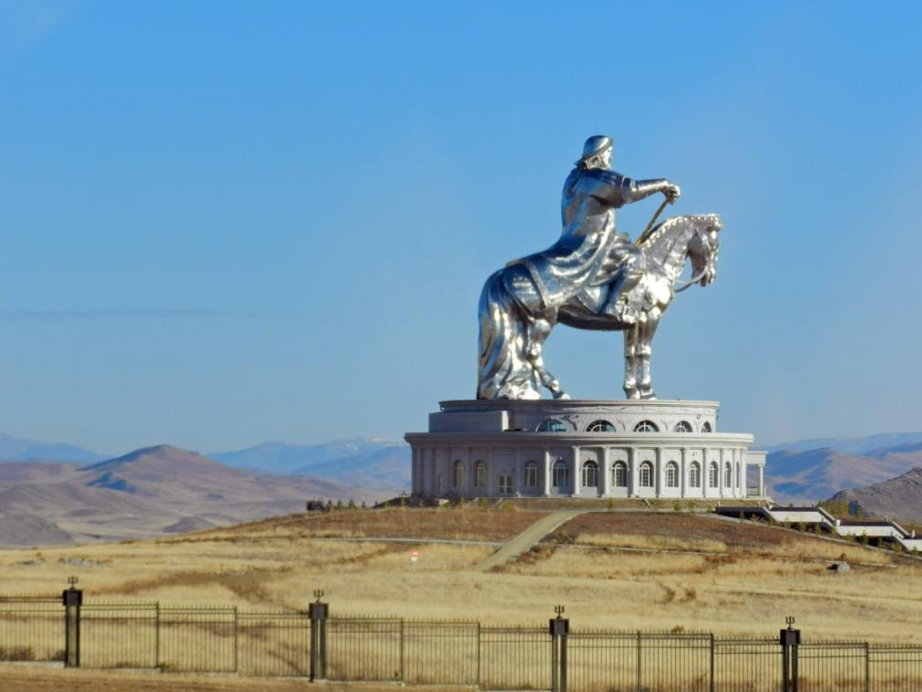
Chinggis Monument

Slide 13
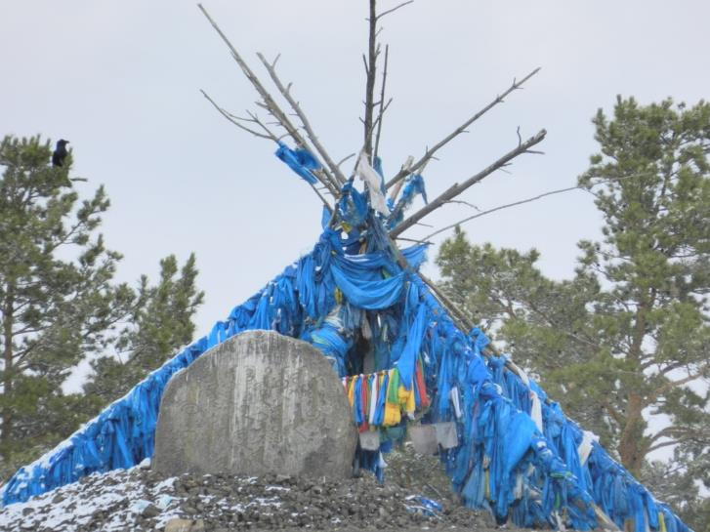
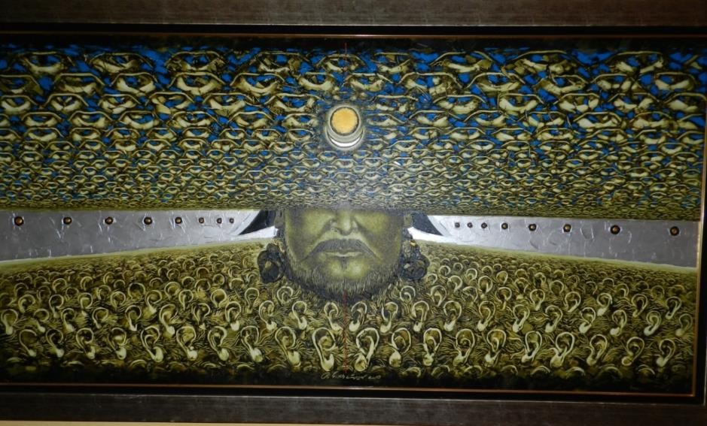
(top) Ghenghis Khan’s birthplace, monument, and artist’s conception of an all-seeing and all-hearing Ghenghis, with a blood line supposed from heaven.

Slide 14
More Recent History
Between 1368 and 1691 Mongols ruled Mongolia amidst much in-fighting among khans.
By 1691, the (Manchu) Qing Dynasty conquered Mongolia and ruled until it dissolved in 1911.
With Russian help, Mongolia established independence from China in 1921 and became a Communist state in 1924.
  In 1928 Buddhist monasteries were destroyed and monks and shamans killed. About a third of Mongol males were Buddhist monks in the 1920s. Russia successfully defended Mongolia from Japanese aggression in 1939 and later induced China to recognize Mongolian independence in 1949. http://en.wikipedia.org/wiki/Mongolia

Slide 15
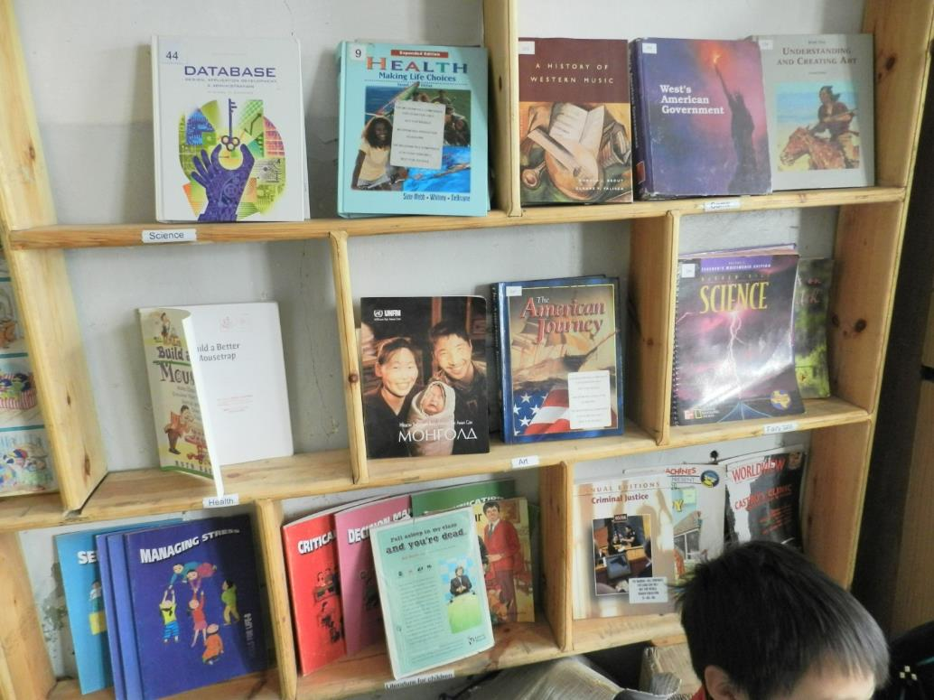
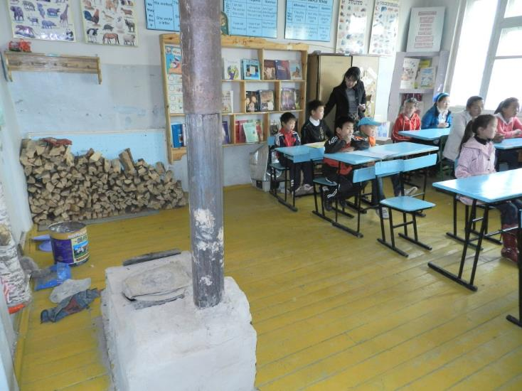
democracy

Slide 16
Religions
After Communist rule, by 1989 there may have been only four Mongolian Christians. By 2000, Christians numbered about 9,000, and today are over 40,000 in a nation of 2.9 million. http://www.operationworld.org/mong
By 2005, an estimated 38% of Mongolians were evangelized. (World Christian Database)
The CIA estimates that in 2004 (Tibetan) Buddhists were 50%, non-religious were 40% and Shamanist and Christians were 6%. https://www.cia.gov/library/publications/the-world-factbook/geos/mg.html
Operation World estimates Buddhists to be 35%, Shamanists to be about 35%, non religious 20% and Christians 2%. http://www.operationworld.org/mong

Slide 17
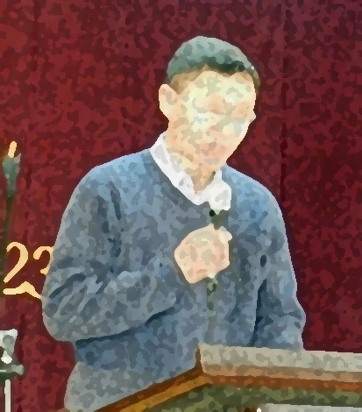
Rise of Shamanism
This Mongolian Pastor told me of a resurgence of shamanism, as did our team members. This ties into national pride and a return to the religious roots of their glory days, which was animism, or worship of parts of creation as gods.

Slide 18
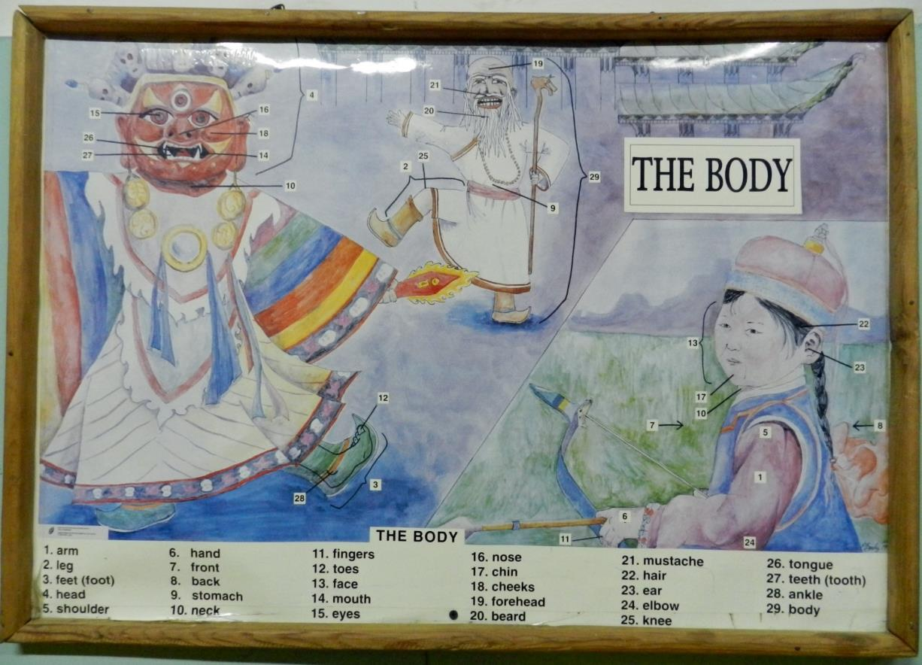
Shaman figures used to teach english

Slide 19
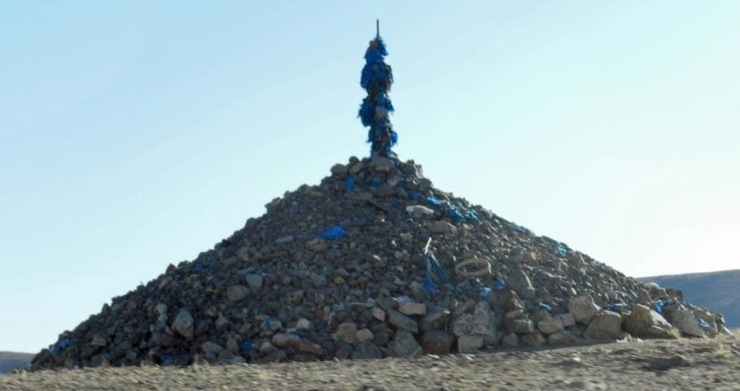
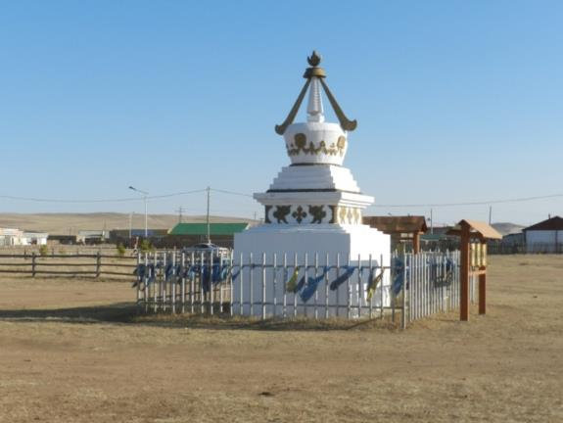
Ovoo
These are located on mountain tops and other prominent locations, for the worship of the sky and mountains, and are also used in Buddhism.
Travelers circle them 3 times clockwise, for a safer trip, and add a rock to the pile.

Slide 20
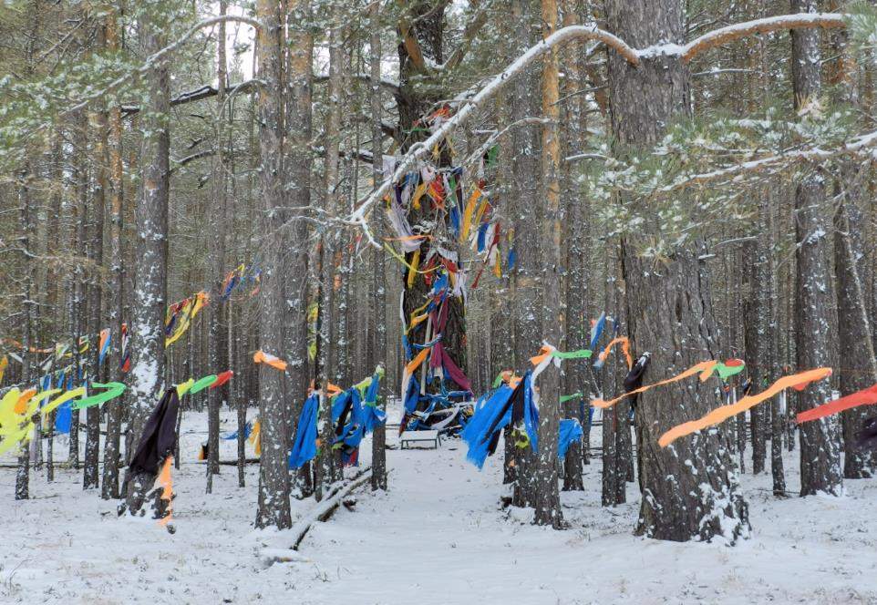
Shaman Holy Place
Here shamans gather. It’s located within sight of Chinggis’ birthplace. Note the blue khadag scarves, a symbol of the sky.

Slide 21
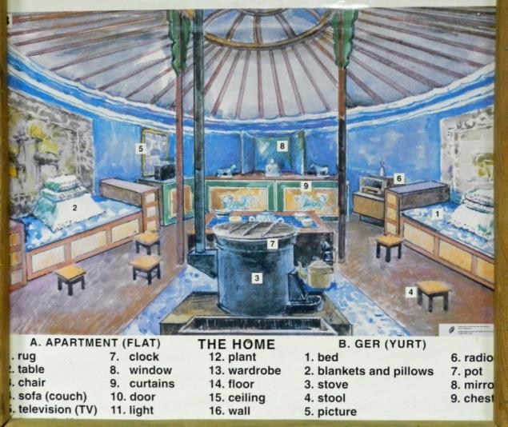
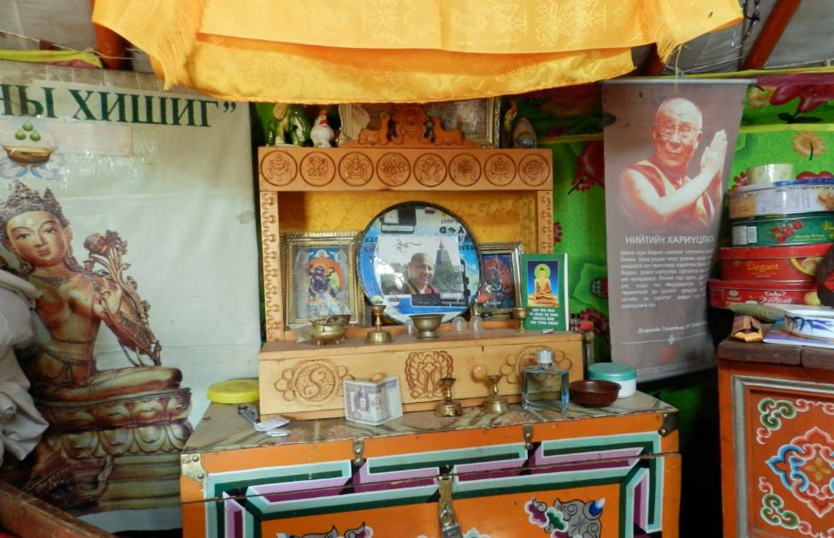
Buddhism (Tibetan)

Slide 22
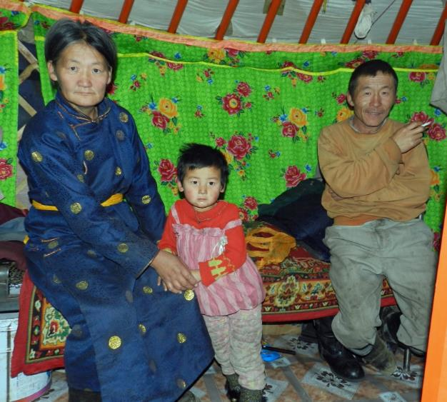
Vet Net
Founded by Dr. Gerald and Frances Mitchum in the around 1996, VetNet has trained Mongolian vets in 20 provinces.
  These have a natural connection to semi-nomadic herders, who live relatively isolated lives, and who are often Buddhist or shamanist.
  Herders are often poor.
  VetNet provides annual vet
  trainings in Mongolian.

Slide 23
VetNet Teachers
Frances Mitchem, seeing the need, began to provide school buildings, supplies, solar energy, medical care and teacher training, as well as summer programs for herder children.

Slide 24
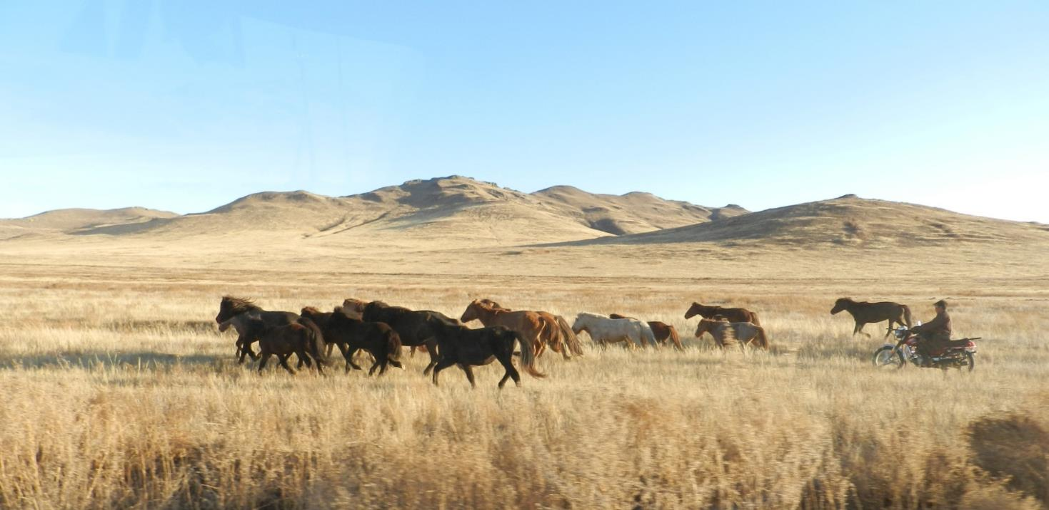
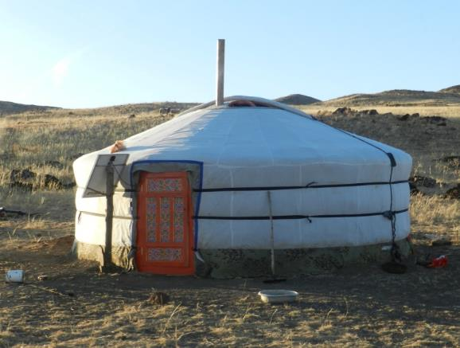

Slide 25
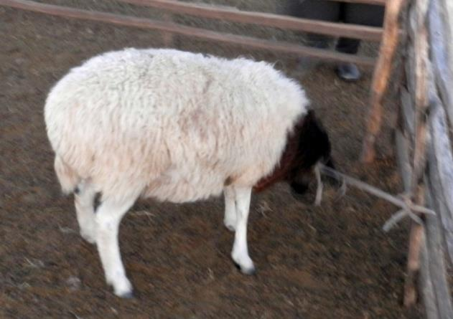
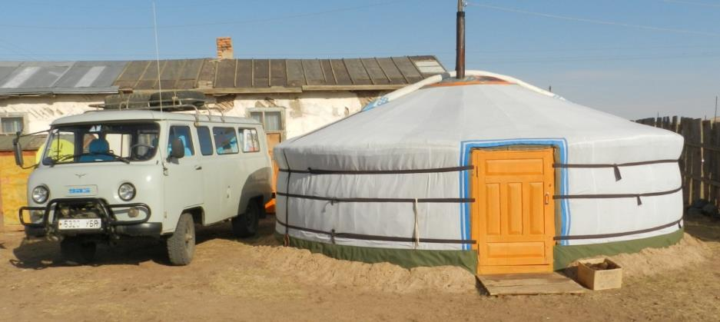
What’s For Dinner, & Night One

Slide 26
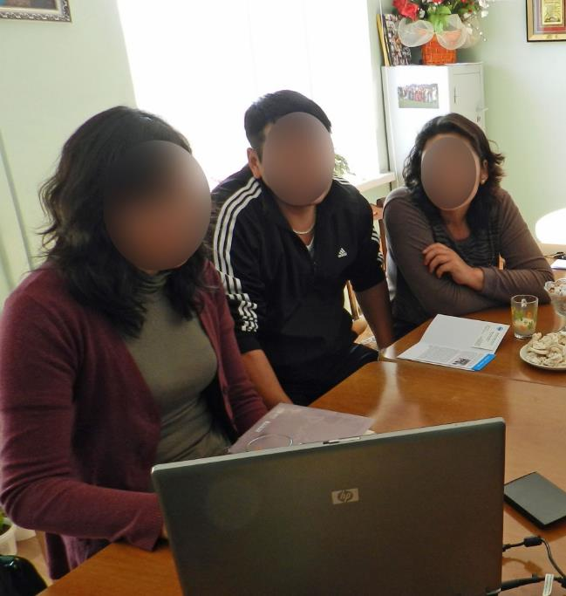
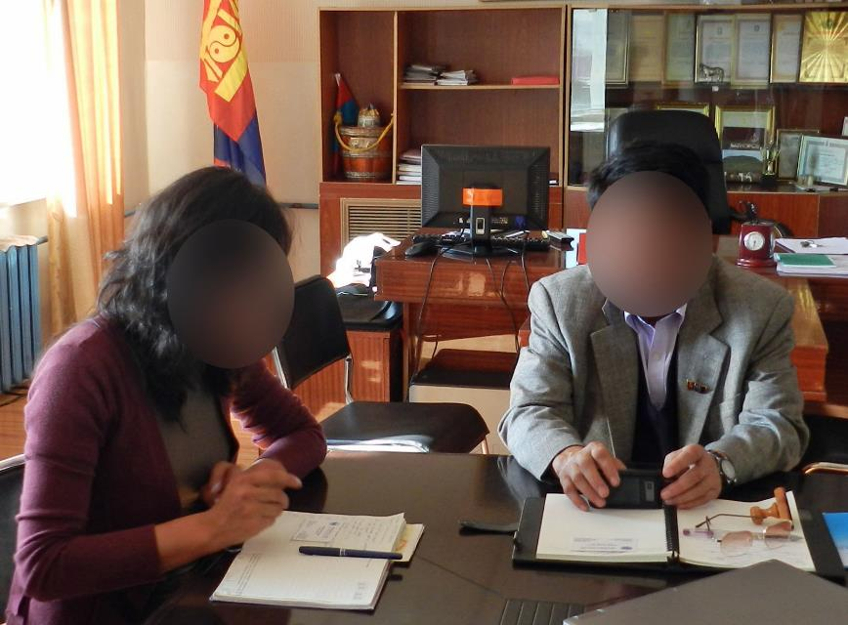
Meeting Officials
Notes:
Resize from here

Slide 27
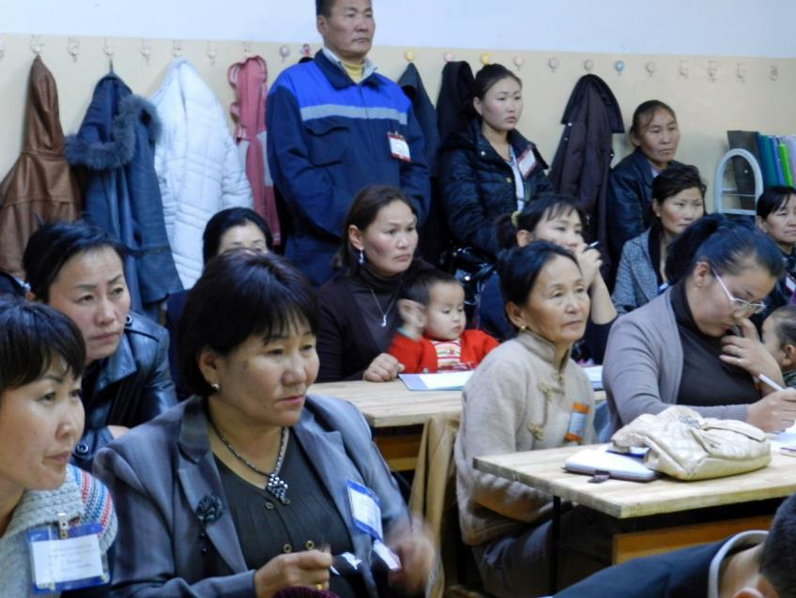
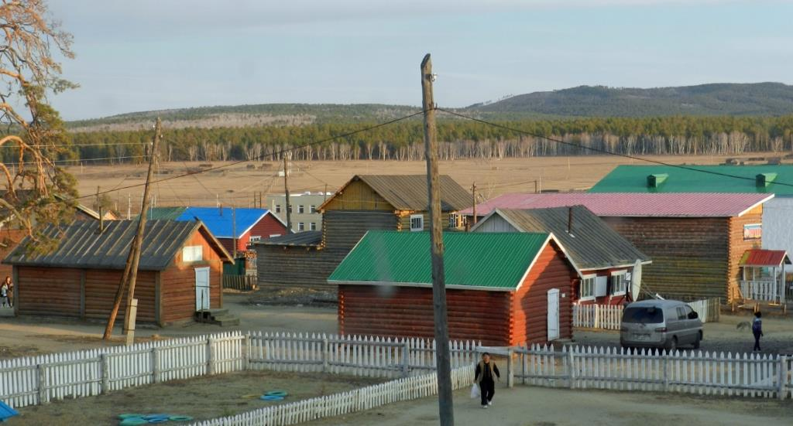
Training for teachers

Slide 28
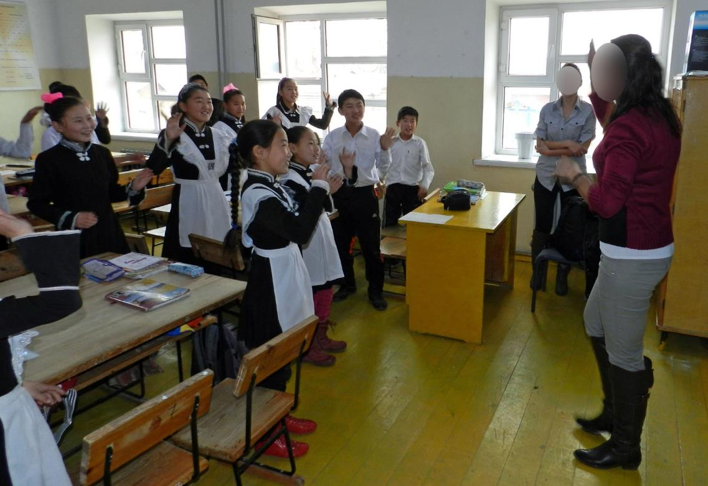
Teaching ENglish

Slide 29
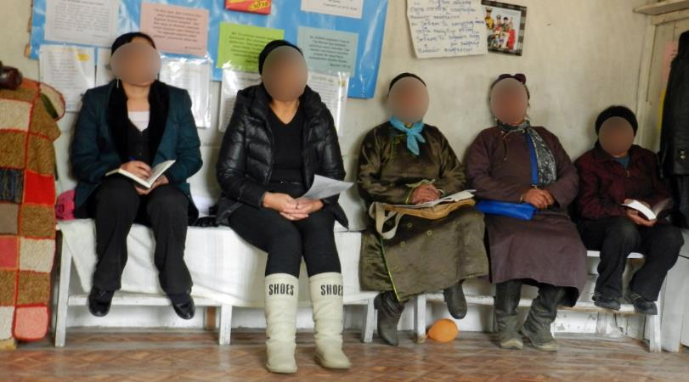
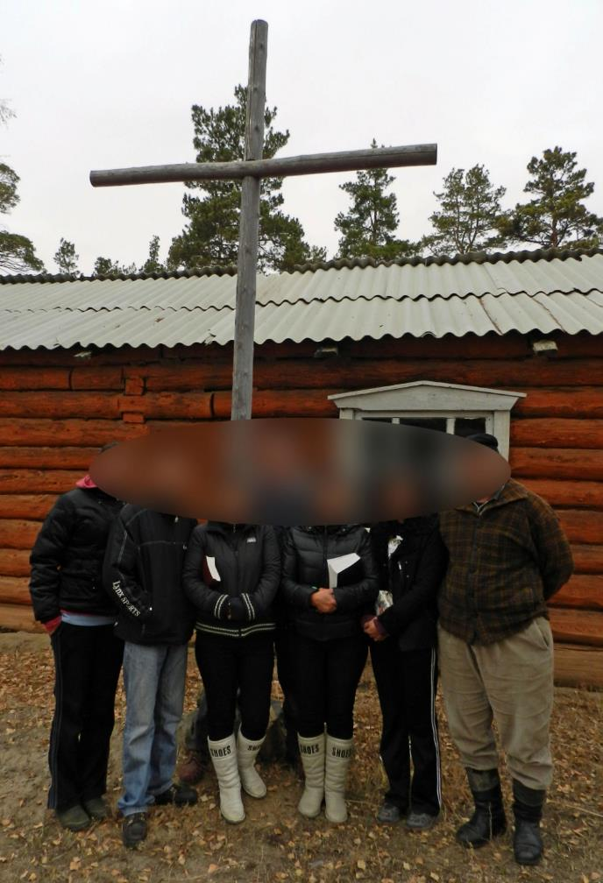
Church
Churches must register each year , and this is good for only 12 months. Approval must be gained from up to six government agencies each time. Depending upon local authorities, churches can be harassed or denied official status. There are reports of harassment of Christian converts. Some areas will not register any Christian churches. There is no official state religion, but “proper respect” is given to Buddhism, on the claim that it unifies the nation. According to the (Mongolian) Evangelical Alliance, there are approximately 500 evangelical Mongolian churches . See http://www.state.gov/documents/organization/171660.pdf

Slide 30
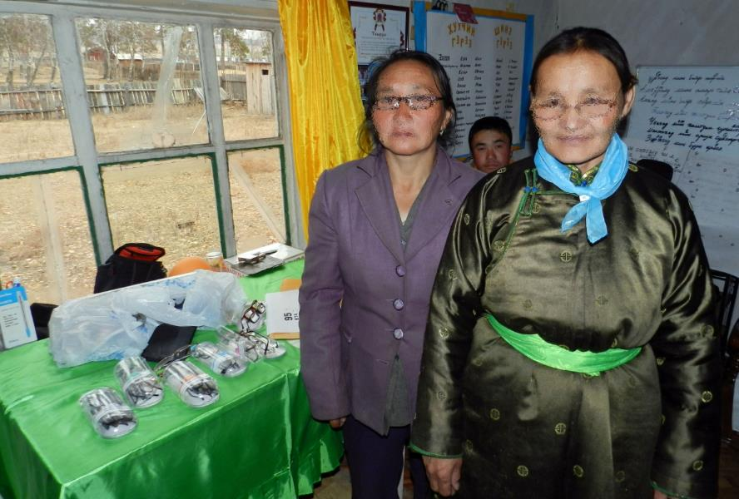
Reading glasses
Nara attended a morning prayer meeting at a church in Binder, Khentii Province. She’d gone to the hospital a day earlier because of a strained eye. The doctor told her that she needed to get reading glasses, and gave her the prescription. From Binder it’s a 9-10 hour one-way ride to the capital, where she could get them, so she wondered how that would be possible. We showed up the next morning with her exact prescription, and she was most happy.
Ladies, newly fitted.

Slide 31
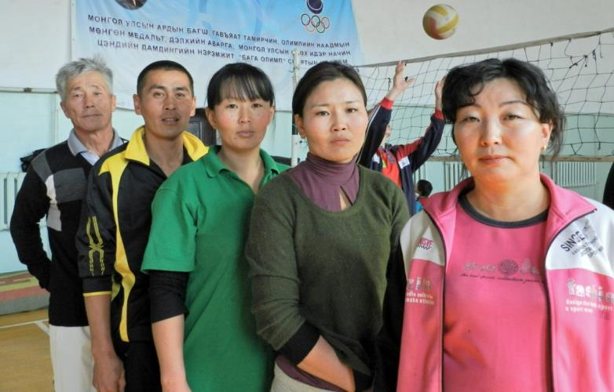
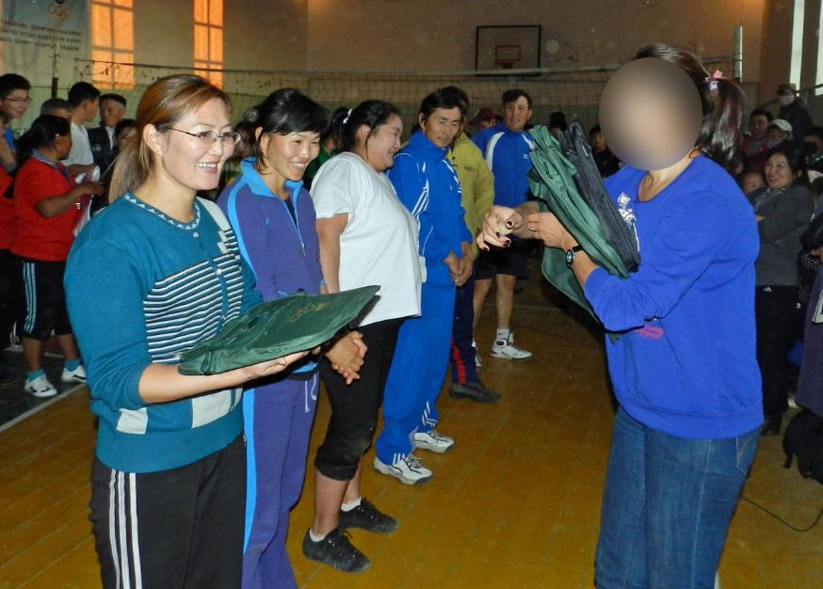
Sports

Slide 32
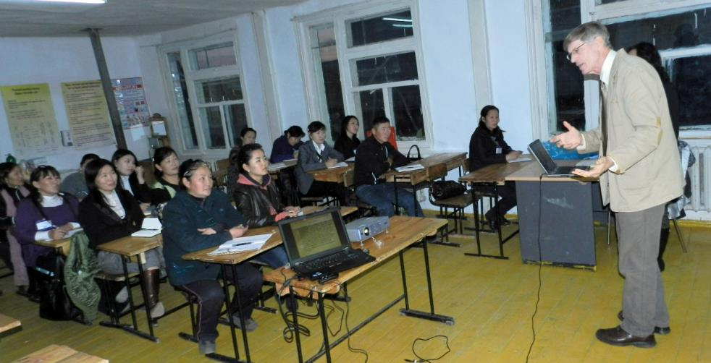
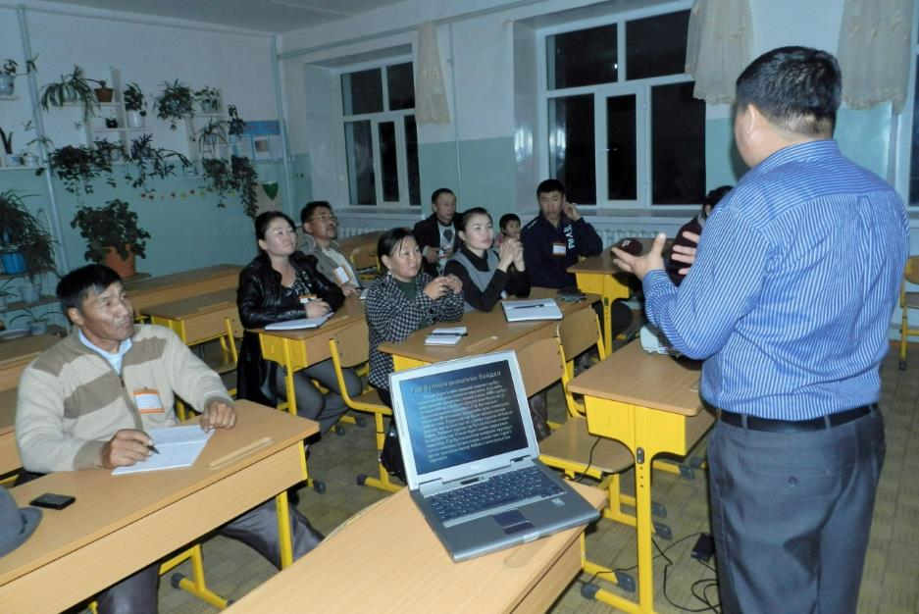
Training—Finances, Reconciliation

Slide 33
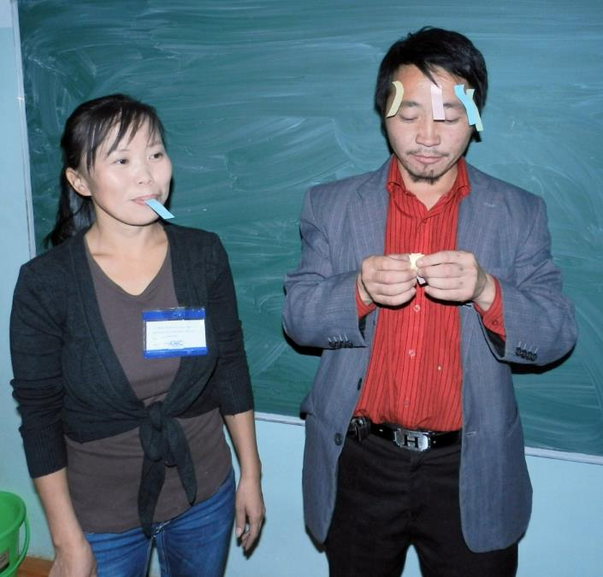
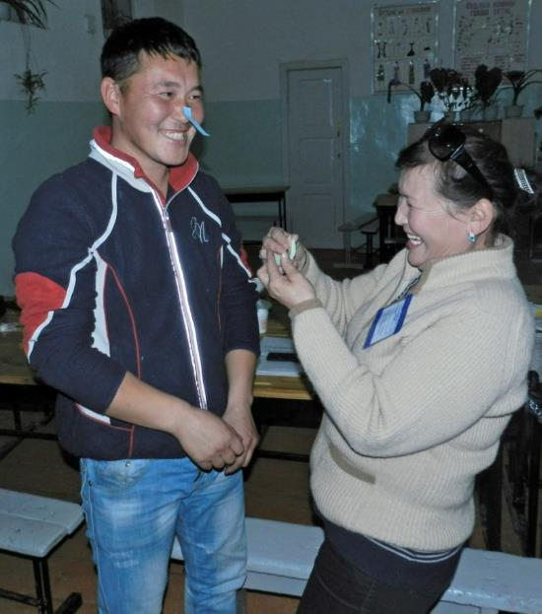
Rock, Paper, Scissors

Slide 34
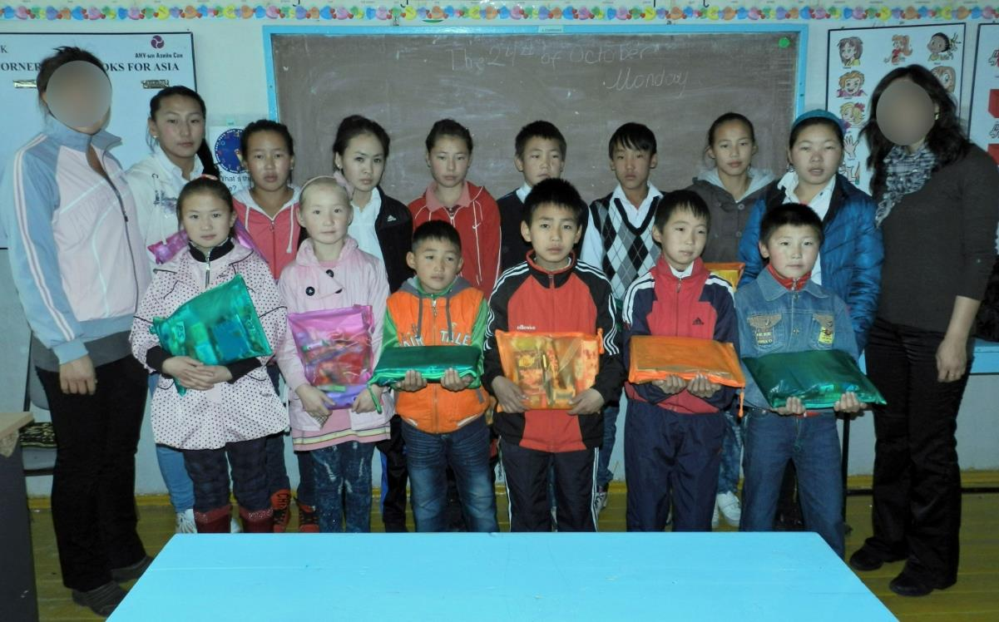
Orphan Care

Slide 35
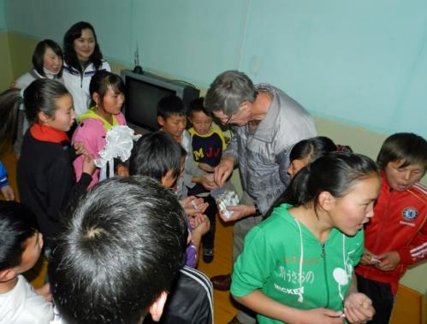
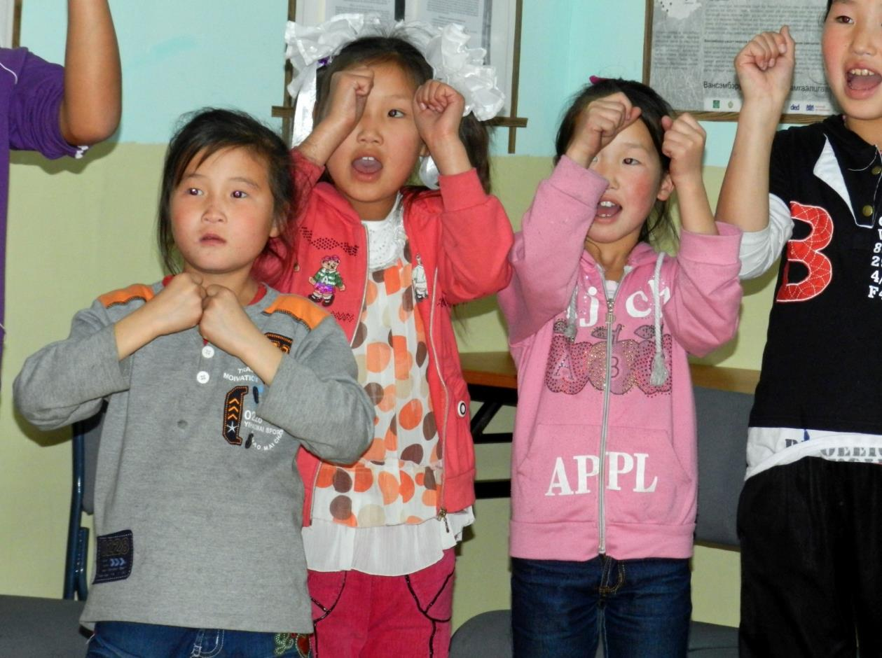
Loving on Kids

Slide 36
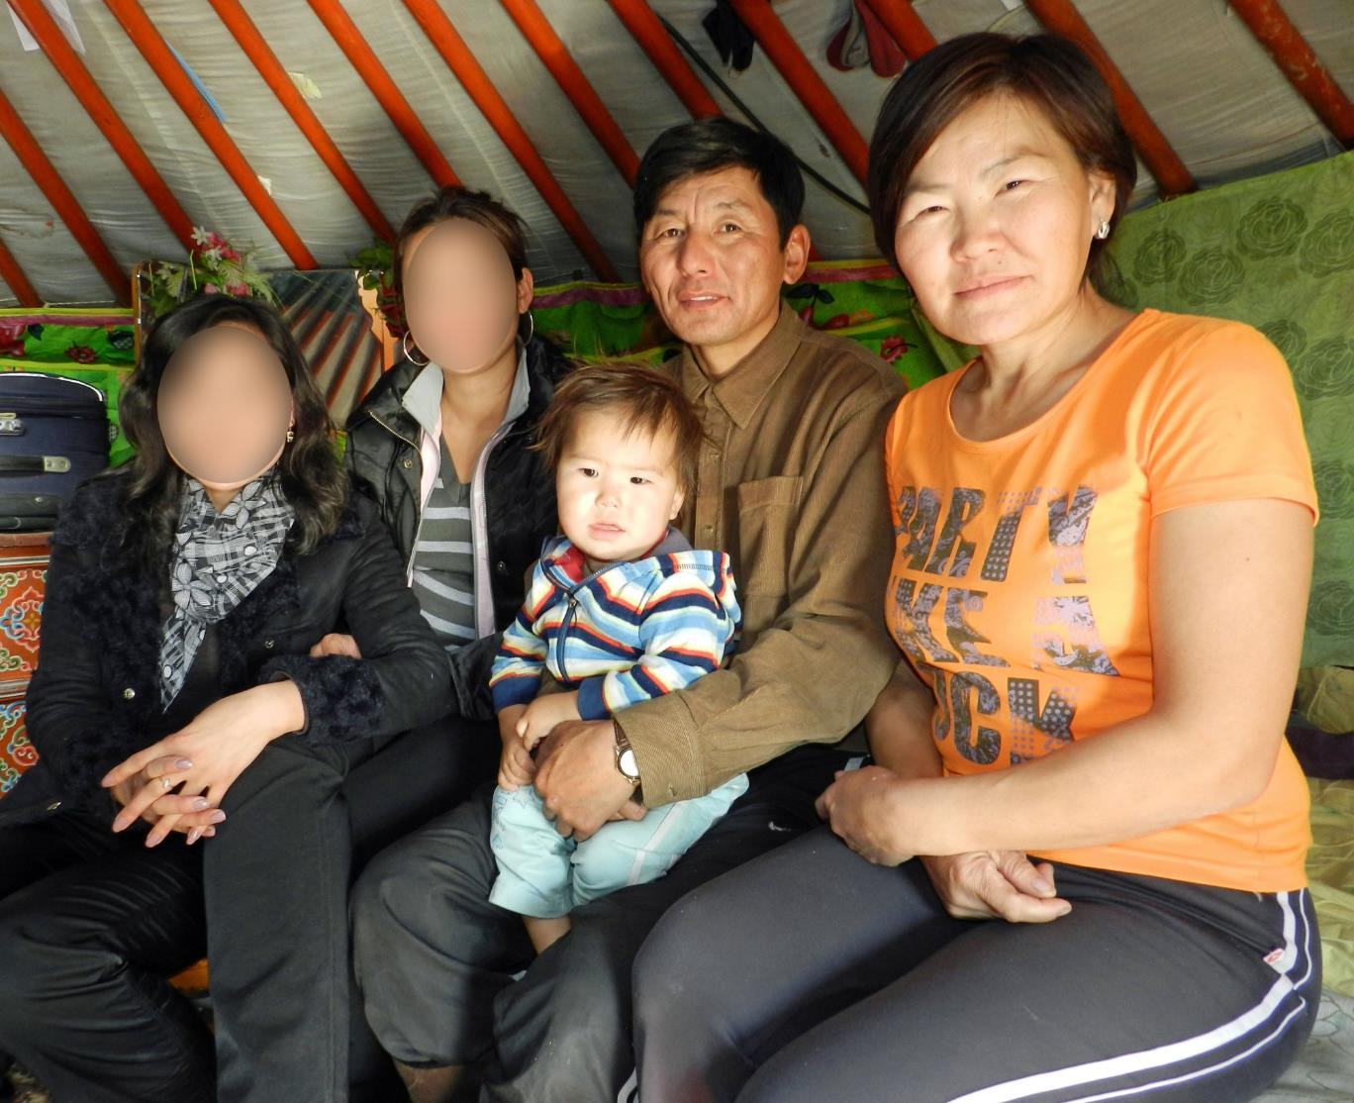
Developing Friendships

Slide 37
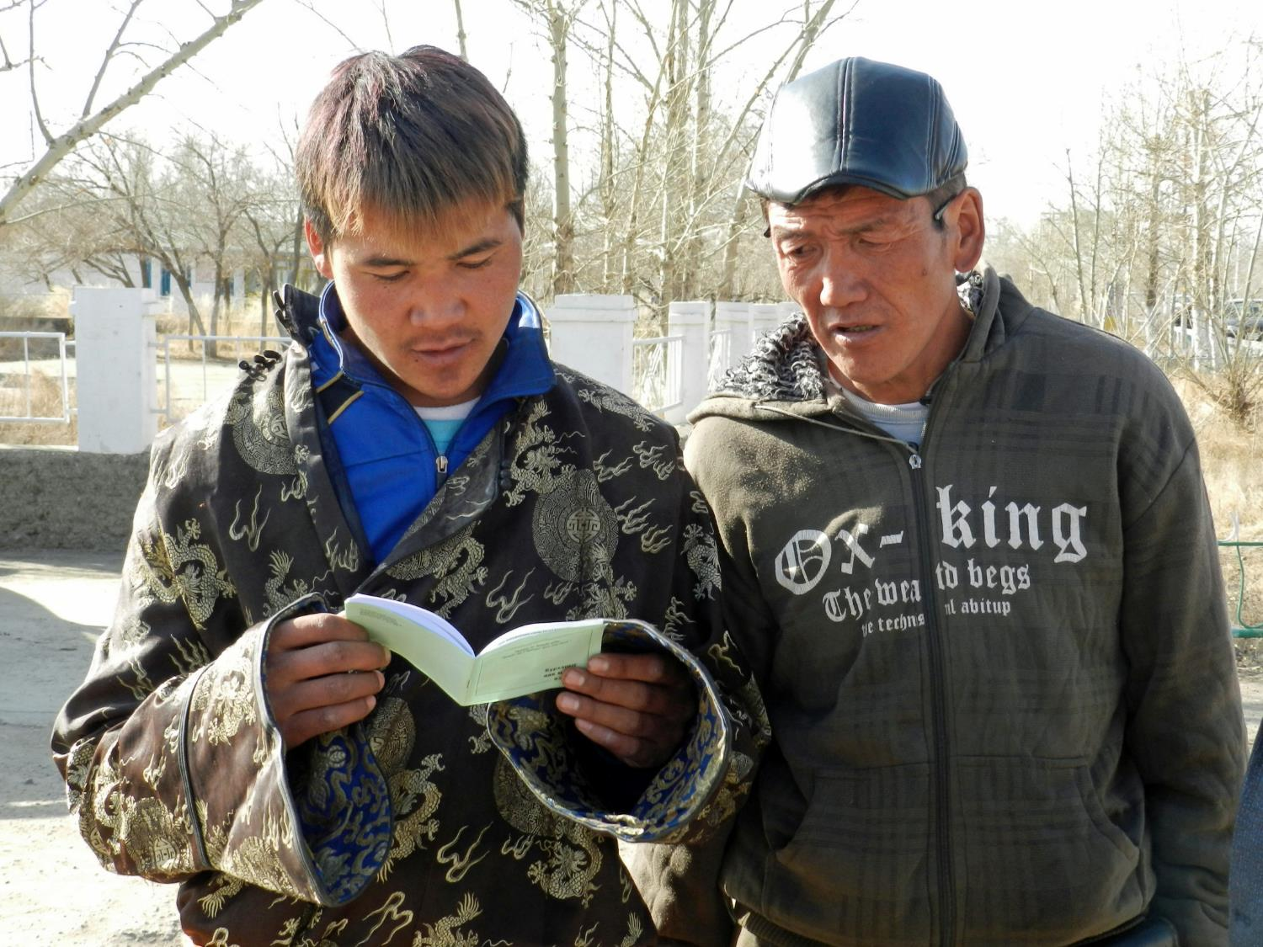

Slide 38
Prayer
For the Good News to penetrate Mongolia.
For VET NET, which is facing funding challenges for its teaching staff
Alcoholism is a great problem (vodka).
Unemployment is about 20% in UlaanBaatar.
For the teams, as they enter the countryside through schools and community services.
For the growth of small churches and the church nationally.

