Slide 1
Reconciliation Ministries Network, Inc. www.RMNI.org
Jim Sutherland, PhD, Director
Jim@RMNI.org

Slide 2
The Need for African Americans in the Global Mission Field
The Great Omission

Slide 3
What is Christian Missions?

Slide 4
A Basic Definition of Missions
Christian mission brings the message of salvation in Christ alone to all ethnic groups so that they have the clear opportunity to become new persons in Christ (2 Cor. 5:17).
Matthew 24:14 And this gospel of the kingdom will be preached in the whole world as a testimony to all nations, and then the end will come. (The NIV is used, unless noted.)
Romans 15:20 It has always been my ambition to preach the gospel where Christ was not known, so that I would not be building on someone else's foundation.
Luke 24:46 He told them, "This is what is written: The Christ will suffer and rise from the dead on the third day, 47 and repentance and forgiveness of sins will be preached in his name to all nations, beginning at Jerusalem.
Mission glorifies God by bringing new worshippers to Him “from every nation, tribe, people and language”—Rev. 7:9-10.

Slide 5
A Broad Definition of Missions
More generally, mission is continuing to do Jesus’ work.
“As the Father has sent me, I am sending you.”--John 20:21 (out of our comfort).
“The Son of Man came to seek and to save what was lost.”—Luke 19:10
To destroy the Devil’s work—1 John 3:8—where do you see the Devil at work?
“preach Good News to the poor…free the prisoners…release the oppressed”—Luke 4:18—where do you find the poor, the oppressed?

Slide 6
WHAT IS A CHRISTIAN MISSIONARY ?
A Christian missionary is God’s ambassador bringing the message of salvation in Christ alone to another people, so that members will have the opportunity to be born from above.
John 3:3 In reply Jesus declared, "I tell you the truth, no one can see the kingdom of God unless he is born again."
This is at the heart of classic Christian mission. Certainly Christian support personnel and those in mercy ministries in cross-cultural ministries are missionaries.

Slide 7
Distinguishing Traits of a Missionary
A missionary is sent by God on a task. The word “missionary” is the Latin equivalent of the Greek “apostle,” or “sent one.”
A missionary usually goes to a different culture and ethnic group. Paul went to Gentiles and Peter to Jews (Gal. 2:8).
This distinguishes them from “witnesses,” the work of every Christian, and from local evangelists.
Missionaries are sent by God, through the Spirit, usually by local churches (Acts 13:3).

Slide 8
Missionaries are Called by God
Missionaries are distinguished by a “call” from God (Acts 13:2), although some believe Matt. 28:18-20 (“the Great Commission”) suffices for a call to everyone.
The call may be to a specific people—however defined, to a country, or to a kind of ministry, such as teaching or medicine.

Slide 9
A Missionary is Not:
Someone who simply does the work of a deacon, as important as this is:
Comforting the grieving
Taking food to the hungry (Acts 6:1-4), etc.
Someone who does the work of an evangelist among his or her own people.
“If everyone is a missionary, then no one is a missionary.” It has been defined away.

Slide 10
Spectrum of Missionaries
M-1 Frontier missionaries to the unreached
M-2 To non-Christians, already evangelized
M-3 Foreign missionaries to Christian lands
M-4 Cross-cultural home missionaries
M-5 Home missionaries—near culture
David Barrett & Todd Johnson, World Christian Trends AD 30-AD 2200, p. 31.

Slide 11
A short history of the African American missionary force

Slide 12
Perhaps 70 African American global missionaries served between 1790 and 1820¹.
Perhaps another 600 served in Africa between 1820 and 1980².
A survey in 1973 concluded that there were probably 240 foreign missionaries³.
102 were identified in 1998⁴, with another 140 likely. Possibly 400 serve today. African Americans are about 12 percent of the US population.
1 Marilyn Lewis, www.urbana.org/_articles.dfm?Recordid=230
2 Sylvia Jacobs, “African Missions and the Af-Am Christian Churches,” p. 22, Encyclopedia of Af-Am Religions, 1993.
3 Robert Gordon, “Black Man’s Burden,” Evangelical Missions Quarterly, Fall 1973, pp. 267-276.
4Jim Sutherland, Ph.D. dissertation, www.RMNI.org/dissertation, p. 5

Slide 13
John Marrant by 1775 had somehow preached the Gospel to the Cherokee, Creek, Catawar and Housaw Indians.
George Liele by 1791 had established a church of 350 in Jamaica, despite persecutions.
Outstanding AFAM Missionaries
Prince Williams established a church in the Bahamas in 1790 that spawned 164 other Baptist churches. He pastored from age 70 to 104.
Lott Carey in 1821 was the first African American missionary to Africa. He went to escape racism and to serve his motherland. He was sent by Baptists and the American Colonization Society, established to return Blacks to Africa.
Sources: Sylvia Jacobs, Marilyn Lewis, Alan Neely, Wm. Sereile, Wycliffe Translators

Slide 14
Dr. William Sheppard
Dr. Wm. Sheppard went to the Congo in 1821, becoming head of the American Presbyterian Congo Mission among the Bakuba tribe, going 1200 miles inland.
He built churches, day schools and homes for children rescued from slavery.
His wife published the first book and hymnal in the Bakuba language.
Sources: Wilbur Harr, Sylvia Jacobs, John Hendrick and Winifred Vass

Slide 15
Dr. Aaron McMillan was a physician and Nebraska legislator before going with the American Board of Commissioners in 1929 to head an Angolan hospital.
Dr. Aaron McMillan
He trained assistants, treated over 80,000 patients and performed over 3,000 surgeries during his medical ministry¹.
1 Wilbur Harr, 1945. “The Negro as an American Protestant missionary in Africa”. Ph.D. dissertation, microfilm, University of Chicago, pp 54-55.

Slide 16
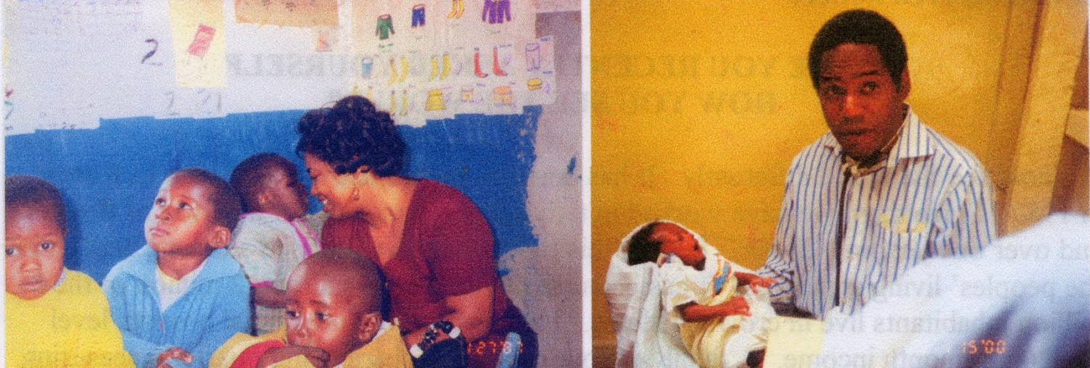
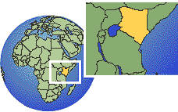
Dr. Michael & Kay Johnson
Dr. Michael Johnson serves with World Gospel Mission. He and Kay worked in Kenya, East Africa for about 17 years. He operated St. Mary’s hospital and, with his wife, served street children in the Kibera slums of Nairobi. He also trained Kenyan surgical residents.
Due to his wife Kay’s health, they returned to the US and have opened two Miriam Medical Clinics in Philadelphia, PA. For the past 5 years they have treated the forgotten and marginalized, and have bought guns off the streets.

Slide 17
Overseas AFAM Missionaries
RMNI located 179 African Americans serving at least 2 years overseas, by mid-2021, with another probable 6. This is about one-tenth of one percent of the 135,000 missionaries that the US sent in 2024 (World Christian Database).
They are located in approximately 154-160 places globally.
The complete research article is available for free download at https://rmni.org/files/afam/HistoryandResearch/African-American-Missionaries-Serving-Overseas.pdf
39.6 million Americans identified as non-Hispanic Black or “African American alone” in 2023. https://minorityhealth.hhs.gov/blackafrican-americanhealth#:~:text=According%20to%20the%20U.S.%20Census,Black%20or%20African%20American%20alone.

Slide 18
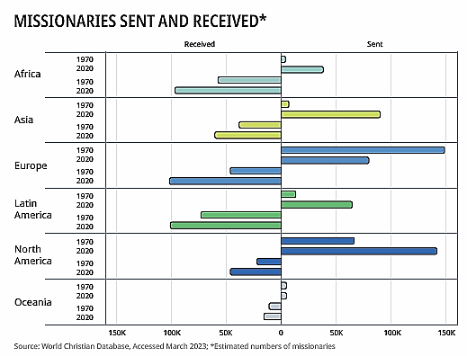
2023 Estimated
“State of the Great Commission: A report on the current + future state. Lausanne Movement, p. 14

Slide 19
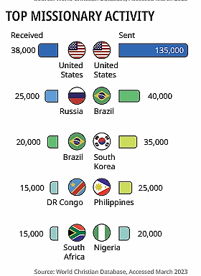
2023
“State of the Great Commission: A report on the current + future state. Lausanne Movement, p. 14

Slide 20
Outstanding African American Missions Church
New Song Bible Church of Bowie, MD (Dr. Bernard Fuller, Pastor) is a strong, globally missional church www.nsbfc.org .
Christ Kingdom Church, Glen Arden, MD (Bishop David Perrin) https://www.christkingdomchurch.org/outreach
2819 Church, Atlanta, G (Pastor Philip Anthony Mitchell) https://www.2819church.org

Slide 21
Why are there so few African American missionaries? Historically it was due to slavery, oppression and widespread racism in colonial powers and White mission organizations, particularly into the 1950s and 60s.

Slide 22
AME AMEZ CME Nat. Bapt. Conv.
Reconstruction
Sources: Lerone Bennett, Jr., Before the Mayflower, 5th ed., 1982; Sylvia Jacobs, “African Missions and the African American Christian Churches,” 1983; U.S. Census Bureau http://www.census.gov/hhes/income/income00/incxrace.html

Slide 23
Sources: Wilbur Harr, “The Negro as an American Protestant missionary in Africa,” 1945. Sylvia Jacobs, “African Missions and the African American Christian churches,” 1993; Marilyn Lewis, “Overcoming obstacles: The broad sweep of the African American and Missions,” 2001; Wm. Seraile, “Black American Missionaries,” 1972; U.S. Census Bureau, “Historical income tables—households, Table H-5, 1967-2000”

Slide 24
Theological hindrances to fielding African American missionaries

Slide 25
Not Believing the Bible
According to a major 2007 Pew Forum survey, 59% in historically Black churches hold that “many religions can lead to eternal life.” Fifty-seven percent of evangelicals believe this. This belief kills missionary motivation. Why go to others if their own religion serves as well? John 14:6 ?

Slide 26
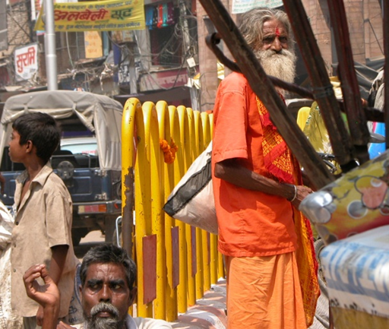
Are Those Who Don’t Hear Of Jesus Really Lost ?
Those who do reject Jesus will not have eternal life in heaven (John 3:36; 12:48). JESUS said that none come to the Father apart from Him (John 14:6).
Everyone sins, but sinners don’t normally seek God (Rom. 3:23, 11-12; John 6:44). Pagans even suppress the knowledge of God obvious to them in nature (Rom. 1:18-20). They don’t accept the light already given.

Slide 27
Are Those Who Don’t Hear Of Jesus Really Lost ?
Pagans also violate their own moral standards– thus condemning themselves (Rom. 2:14-16).
Everyone comes into this world condemned by Adam’s sin (Romans 5:18). Each of us also sins individually and sin results in spiritual death (Romans 3:23; 6:23). Forgiveness comes by repentance and faith in Christ (Acts 2:38; 10:43; Romans 10:9-10). Forgiveness doesn’t come automatically by Christ’s death, or by baptism.
If even one of the parents is a Christian, his or her child is “holy” or set apart (1 Corinthians 7:14).

Slide 28
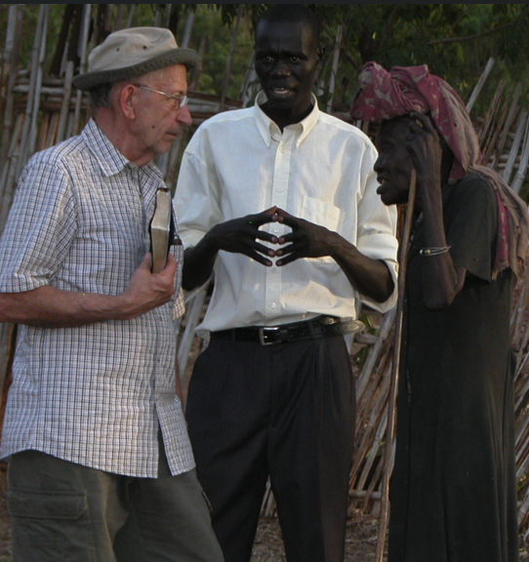
Missionary, come home?
If all are saved who don’t hear of Christ, the best strategy is to immediately withdraw all missionaries, so that all will be saved.
D. James Kennedy

Slide 29
Cultural hindrances to fielding African American missionaries

Slide 30
Blacks have had to focus upon survival and security
Very understandably, the first need of the African American church has been to care for their enslaved, then emancipated members. The Black church had to care for her flock during “Jim Crow” oppression, and since then.
With the severe breakdown of the Black family, and other devastating social and health problems, it has become almost second nature to assume that “We are the needy.” Why try to solve the problems of other people groups?
The problem with this thinking is that Christ has commanded His people to share their salvation with others around the globe.

Slide 31
Head/Heart Disconnect
African Americans surpass other US ethnic groups in almost every measure of self-reported Christian spirituality—including church attendance, Bible reading, and prayer.
Pew Research asked if “people of faith have a religious duty to try to convert nonbelievers”, 51% of U.S.-born Blacks agree, 69% of Black Protestants who attend a Black church agree, while among all U.S. adults, only 34% agree (Pew, 2021: 67; survey size=8,660 Black adults).
A 2021 study by Barna.com, billed as “The most robust study of the Black Church in 20+ years….”, in its 160 pages, there is only one allusion to “missionaries”, and that is to women in the context of other local church work.

Slide 32
“Missionary…” Churches?
Global missions is essentially irrelevant and ignored in the vast majority of African American churches.
In the Barna study just mentioned, responding to the question, “What are the top issues Black churches should address?” among 20 issues identified, none concerned cross-cultural or global missions (Barna Group, 2021: 82). The issues were identified by 950 Black US adults familiar with the Black church, and an additional 293 Black pastors whose churches were at least 50% Black.

Slide 33
Do we care about the lost?
The people of Judah were disobedient to God, but thought that as long as they focused upon the Temple, God would not destroy it or them. They said, “We are delivered!” (Jer. 7:10). They were wrong. They should have repented (7:3).
African American churches magnify the worship service and each week proclaim God’s deliverance. “Our God is able!” “He is a “Way-maker!”— “He’s an on-time God!”
Isn’t God also interested in making a way for those who haven’t yet heard of Christ? Are we interested only in a way being made for us? Why can’t He use US to deliver others?
We want justice for ourselves. Is it just for us to have the Gospel, and do nothing to enable others to hear the Gospel?

Slide 34
Do we CARE about the lost?
Many are “doing church” while disobedient to the command to go with the gospel (Matt. 28:18-20). Some appear to think that if we have CHURCH, we can forget any consequences for keeping the Gospel among our own people. “God woke us up this morning,” but do we ask about those He didn’t wake up?
God didn’t wake up about 40,000 this morning who were without Jesus Christ. Does this disturb our worship or sleep? Global missions are usually neglected in the pulpit, and the fulltime missionary is an almost invisible church vocation.
We must reform our actions. Having church doesn’t remove responsibility for the nations. Religion is satisfied with security, staying inside church walls, and having church. God isn’t.

Slide 35
Is a high-energy choir more important than missions?
Which has higher priority in your church—the choir or global missions?
Whites sometimes think that if they say something needs to be done, they are off the hook.
If our Black choir sings “Send the Light!” is the church off the hook for sending that light?

Slide 36
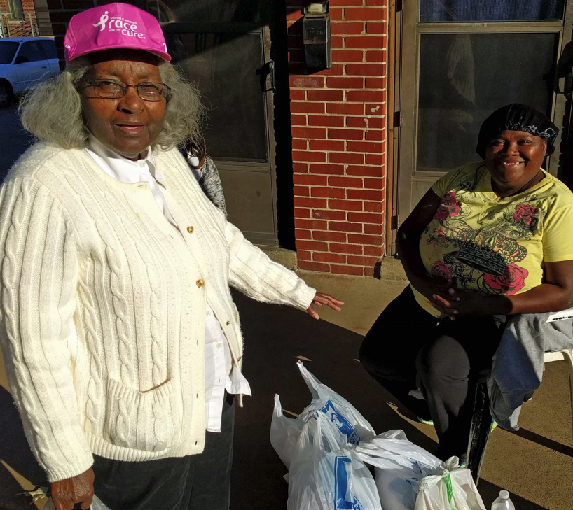
But what about our folk ?
If you protest sending money and people overseas to evangelize and serve, because needs are great at home, do you actually evangelize and serve well in your neighborhoods?
Can God provide for global missions through your church, and still provide for local needs?
Is God more likely to bless a church that spreads the Good News of His Son globally, or a church that, in fact, keeps Jesus to herself?
“The light that shines the farthest shines brightest at home.” Brian Johnson

Slide 37
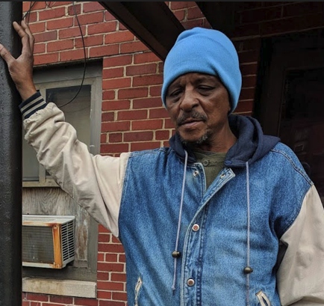
But what about our folk ?
Unsaved people are born daily among
our own people, and yes, we have tremendous needs. We should try to meet them.
But all the ethnic churches are to partner in such a way that every ethnic group is evangelized. Our “Jerusalem” is another Christian’s “uttermost.” The Lord of the Harvest will ensure that every people group will have the Gospel if we obey.
Short-term missionaries can assist national churches and these workers return to assist home church outreach.

Slide 38
Missions, Seriously ?
A church of 25,000 planned a trip to Kenya in July 2003 to see their bishop “preach to the masses.”
Members stayed in 5-star hotels, ate at gourmet restaurants, flew in hot-air balloons and went on safari. They could visit their supported missionaries, at extra charge. They would spend more in one night at one of the hotels than they would spend on one of their missionaries in four years. At the crusade they would attend workshops. They would go to consume and enjoy—instead of to serve—encouraged by their own church to do so.

Slide 39
Missions hindered by proliferating USA churches
The missionary vocation is generally so obscured in the AFAM church that AFAM evangelists focus upon planting (stacking) churches in Black communities already over-saturated with churches.
Each requires a building, PA system, bus and support of the pastor, etc.
Some “new wine skins” are needed. But there are peoples that are no more than one tenth of 1% Christian. Why not plant a church there?

Slide 40
Missions is hindered by pastors without a global vision
The missionary vocation is so obscured that those sensing a missionary call often end up simply assisting the pastor locally. The pastor may not know what to do with the associate, and only one is going to preach on Sunday.
Many missionaries end up sitting on the platform on Sunday mornings, instead of serving cross-culturally.

Slide 41
Poor Missions Education David Cornelius Southern Baptist International Mission Board
No Comprehensive Missions Education in Churches for All Ages
Little Emphasis by Key Leaders
Poor Understanding of “The Call”
Incomplete Interpretation of the Great Commission
Few Relevant Models
Failure to Relate Missions, Evangelism and Church Growth
Notes:
The Basic Problem:
Lack of knowledge and/or understanding of one’s part in God’s mission.
What Scripture Says about it:
Matthew 28:20; Deuteronomy 6:6-7; Psalm 78:5-8; Proverbs 22:6
Principle:
The church is to teach her people and train them in the ways of her Lord.

Slide 42
Financial hindrances to fielding African American missionaries

Slide 43
African American Personal Finances
The total income of all US Blacks (“Black alone”) over 15 years of age in 2020 was approximately 1.2 trillion dollars, and average income for the 29.4 million “with income” was $41,567 (US Census Bureau, 2020). This is the first or second generation with a great chance to have a “piece of the rock.”
US Census Bureau, 2020

Slide 44
African American Mission Power
How can a nation such as Nigeria, with a Gross Domestic Product of only 441 billion US dollars in 2021, send 20,000 missionaries outside their nation?
Sasu D (2022), Key Indicators of Nigeria’s Economy-Statistics and Facts.
Johnson T and Zurlo G (eds.) (2022) World Christian Database. Leiden/Boston: Brill. (accessed 26 July 2022).

Slide 45
Two Black Churches and Global Missions
One traditional church in Chattanooga with a budget of $120,000 spent .4 % on evangelistic home missions (to Blacks).
This church spent NOTHING on global missions. More was spent on the annual men’s breakfast and on the copy machine than on missions.
Another church proposed spending over $2000/year on garbage removal, and nothing at all on missions.
How much of your church budget goes to cross-cultural/global ministry?

Slide 46
The “Missions” Switch
Money is designated on the offering envelope for “missions,” but stays either inside the church, or in the neighborhood.
“Missions” money is often lumped with local benevolences, and local needs often overshadow regular missionary support. If someone gets burned out, “missions” money may be used, while the foreign missionary has no recourse or voice. The greatest problem for many AFAM missionaries is low support.

Slide 47
The “Missions” Switch
Dr. Michael Johnson, AFAM missionary surgeon to Kenya, writes:
“Many of the problems in our fellowships are due to the fact that we have taken money given for foreign missions and used it to build a parking lot, or buy flowers for the altar.”
From Making the Lame Man Blind, 2nd ed., by Michael Johnson, MD.

Slide 48
The Hindrance of Self-centeredness

Slide 49
Is Christianity mostly about God serving ME ?
Some Gospel-literate churches focus upon personal peace, wholeness and prosperity.
“Many/most AFAM are 1st generation ‘haves.’ Those who are ‘have nots’ are usually unwilling to leave all for Christ. Until 2nd generation ‘haves’ are born again few if any will leave their community to serve others. Once 2nd generation ‘haves’ move out of AFAM stereotypes of success, a typical service can be affirmed.”
Kyshia Whitlock—African American missionary to Honduras

Slide 50
Is Christianity mostly about God serving ME ?
Is our emphasis upon what God will do for us? Is it upon personal wholeness, health and wealth?
Going “to the next level” means humbling ourselves to go lower, and to serve more people. The way up is down, in the Kingdom (Phil 2:5-11).

Slide 51
Is Christianity mostly about God serving ME ?
Philippians 2:5-9 “Have this attitude in yourselves which was also in Christ Jesus, ⁶ who, although He existed in the form of God, did not regard equality with God a thing to be grasped, ⁷ but emptied Himself, taking the form of a bond-servant, and being made in the likeness of men. ⁸ Being found in appearance as a man, He humbled Himself by becoming obedient to the point of death, even death on a cross. ⁹ For this reason also, God highly exalted Him…” NASB

Slide 52
Do we really need foreign missionaries today?

Slide 53
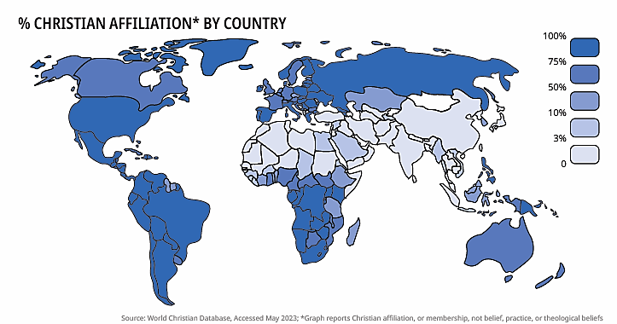
2023 (affiliation, not necessarily belief or practice)
“State of the Great Commission: A report on the current + future state. Lausanne Movement, p. 10. World Christian Database, 2023

Slide 54
World Religions by Percentage--2025
Source: Gina A Zurlo and Todd M. Johnson, eds., World Christian Database (Leiden/Boston, acceded January 2025), www.worldchristiandatabase.org

Slide 55
World Religions by Population—Mid-2025
Christians | 2,645,317,000
Muslims | 2,061,718,000
Hindus | 1,129,155,000
Buddhists | 538,173,000
Chinese folk religions | 448,283,000
Ethnoreligionists | 294,801,000
New Religionists | 67,690,000
Sikhs | 31,433,000
Jews | 15,357,000
Agnostics/Atheists | 906,567,000
Other Beliefs | 53,494,000
Source: Gina A Zurlo and Todd M. Johnson, eds., World Christian Database (Leiden/Boston, accessed January 2025), www.worldchristiandatabase.org

Slide 56
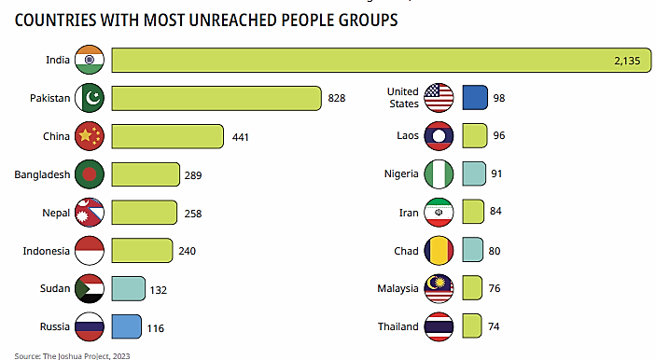
2.2 Billion Are Unevangelized
“State of the Great Commission: A report on the current + future state. Lausanne Movement, p. 16; Joshua Project 2023
27% of the world’s population is unevangelized (2.2 billion people). Source: Gina A Zurlo and Todd M. Johnson, eds., World Christian Database (Leiden/Boston, accessed January 2025), www.worldchristiandatabase.org

Slide 57
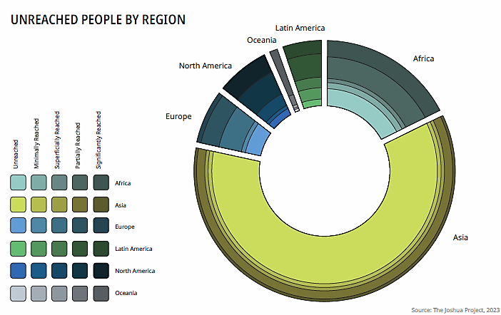
“State of the Great Commission: A report on the current + future state. Lausanne Movement, p. 16; Joshua Project 2023

Slide 58
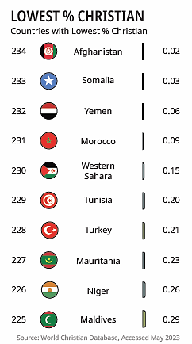
“State of the Great Commission: A report on the current + future state. Lausanne Movement, p. 10

Slide 59
Why African American missionaries?

Slide 60
Now is the Time To Engage Global Missions
White-led mission organizations eagerly accept African Americans.
Excellent schools will prepare Black missionaries.
Strong African American mission boards now exist. (sowingseedsofjoy.org)
Black income steadily rises.
Short-term missions abound with ease of travel.

Slide 61
Global missions is not the job of the White church. The African American church is a full partner among the world’s sister churches.
Blacks have a unique role in world mission—especially to people of color, and particularly to the oppressed.
Blacks understand oppression and suffering well, and can easily relate to the oppressed.
As urban-dwellers, they understand the city, where probably the majority of unreached people live.
African Americans can sometimes go where whites cannot go.

Slide 62
Stewardship of personal trials
If American-Americans believe in hell the most strongly of all Americans, this belief should be a motivation to help anyone avoid it, including non-African Americans.
Not only has there been cultural oppression, there is much familial dysfunction in the African American family—many broken families. The majority of children are born outside of marriage, for example. These experiences again can be stewarded to the comfort of many.

Slide 63
You have a stewardship of affliction
2 Corinthians 1:3-5 Praise be to the God and Father of our Lord Jesus Christ, the Father of compassion and the God of all comfort, ⁴ who comforts us in all our troubles, so that we can comfort those in any trouble with the comfort we ourselves have received from God. ⁵ For just as the sufferings of Christ flow over into our lives, so also through Christ our comfort overflows.
You represent victory over affliction.

Slide 64
African Americans have a hearing
Oppressed people know that an African American can possibly become the most powerful man on the globe.
In Africa they want to know where the African American brothers and sisters are. African Americans are their success story. They want to serve in missions together with you.
African Americans can bring not only hope for this life, but have gained a hearing to present hope of eternal life with God through Christ.

Slide 65
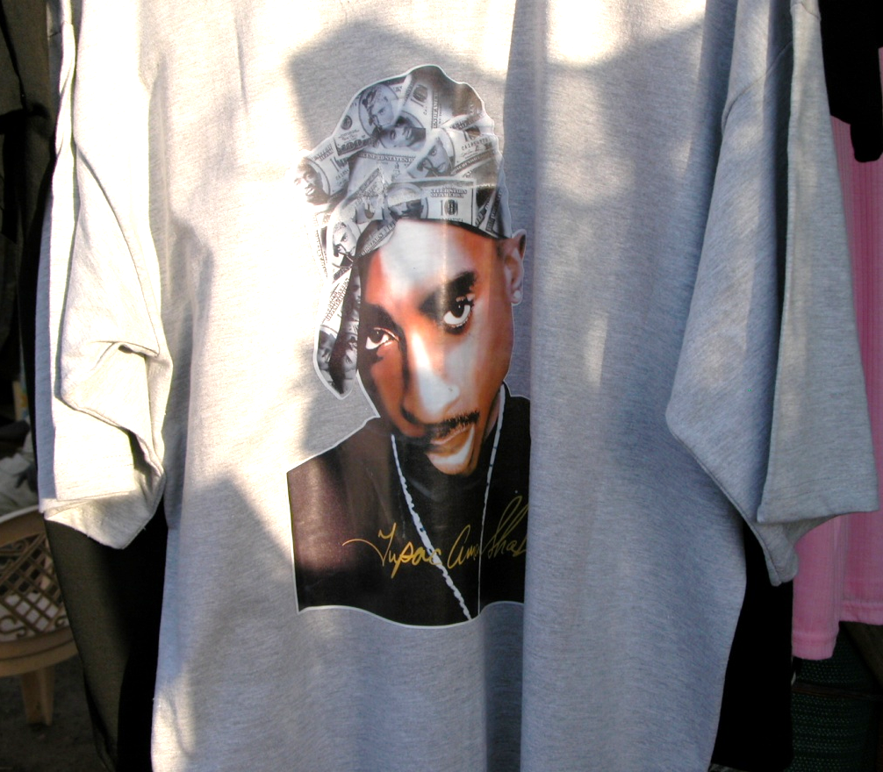
African American culture has it “goin’ on” globally
This T-shirt with deceased rapper Tupac Shakur’s image on it was hanging in a booth in Torit, Southern Sudan, July 2008. On TV in India are Hindu-style rappers. In mini-buses in Kampala you can hear rap songs. What other culture has so dominated global music? Japanese want to listen to high-energy black choirs. The choir can become a mission outreach. African Americans are seen as part of a cool, successful culture.

Slide 66
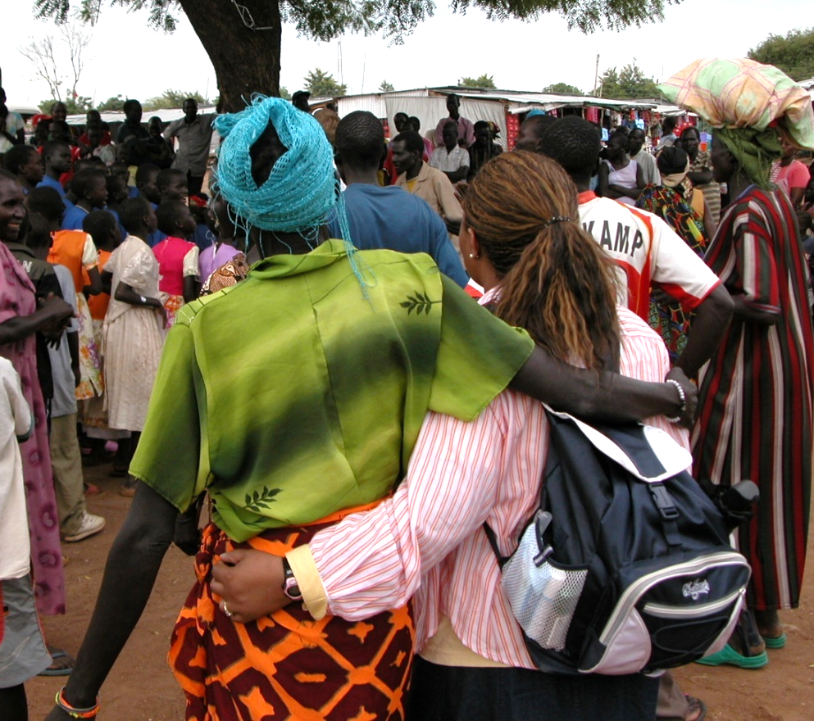
Africans and African Americans have an affinity in mission
Pastor Larry Arnold, Eagle’s Nest Comm. Church of Atlanta, Georgia, describing how deeply ministry in Sudan in 2008 had impacted him
Dr. Margo Williams (right) with one of the ladies she taught during four days in Sudan.

Slide 67
The African American church needs global missions
As the African American church engages global mission, losing her life, sending out her resources of funds and people, she will save her life.
Church members will experience revival, not just attend revival meetings.
Obedience to God in sharing the Gospel globally may or may not add members to the local church, but obedience is simply right, regardless of consequences.

Slide 68
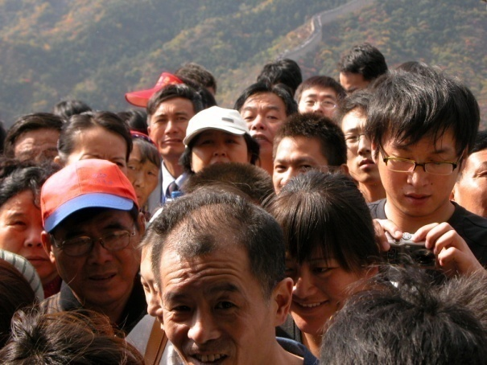
The Chinese Church Goes
In China Christians have been persecuted for their faith for over 75 years.
Chinese have had a vision since the 1920s to take the Gospel back to Jerusalem via the Silk Road, going to the 10/40 Window. This means evangelizing Buddhist, Hindu, and Muslim peoples along the way. They hope to send 100,000 missionaries. http://ctlibrary.com/ct/2004/april/5.84.html
I asked the leader of a fellowship of 4.5 million Christians in 2009 if his people resisted going globally. He didn’t understand the question. They don’t hesitate going even to arch-enemy Japan.

Slide 69
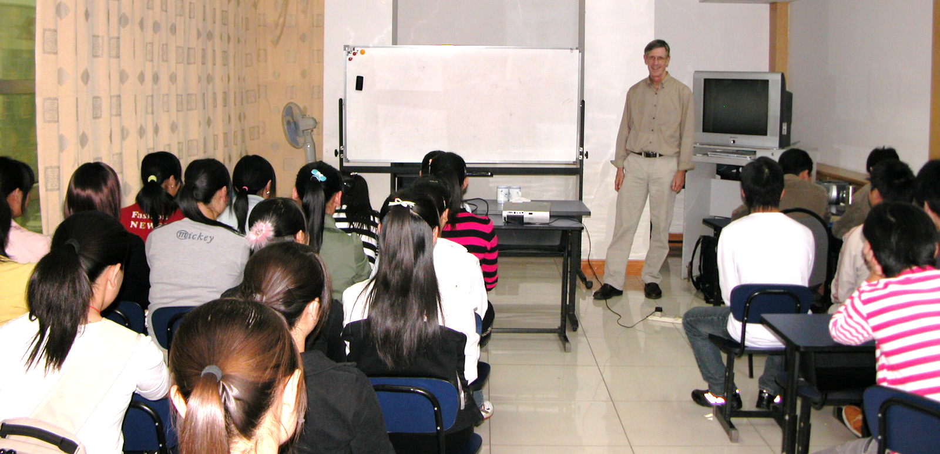
The Chinese Church Goes
Missionary training, China
Another Chinese fellowship of 7 million Christians has trained 300 cross-cultural workers in two missionary-training schools, deployed mostly inside China.
A third fellowship of about 7.5 million believers has global missions as their first priority.
A fourth fellowship of 3 million believers has two missionary training schools and about 45 missionaries distributed in Pakistan, Burma, Yemen, and Cambodia, as well as in every mainland province except one.

Slide 70
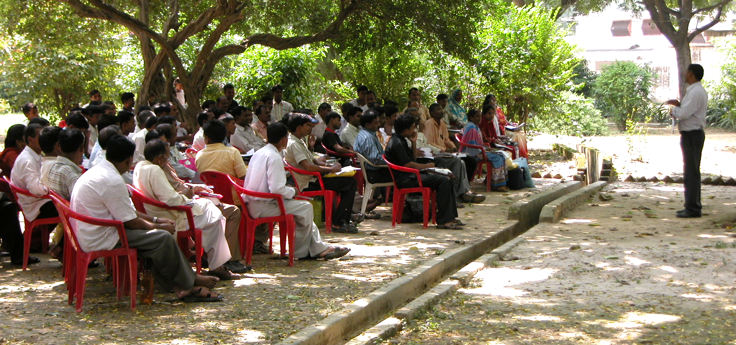
The Indian Church Goes
Indian missionaries learning about suffering for Christ
Although less than 1.5% of the population of India’s Uttar Pradesh province of 183 million people in 2003, Christians were targeting every district in that province for church planting, despite persecution.
I visited a ministry in Uttar Pradesh in 2008 that was working to plant 10,000 house churches, and to win 200,000 Indians to Christ by 2012. They had already planted 1114 house churches in 5 years, and had seen 20,000 professions of faith.

Slide 71
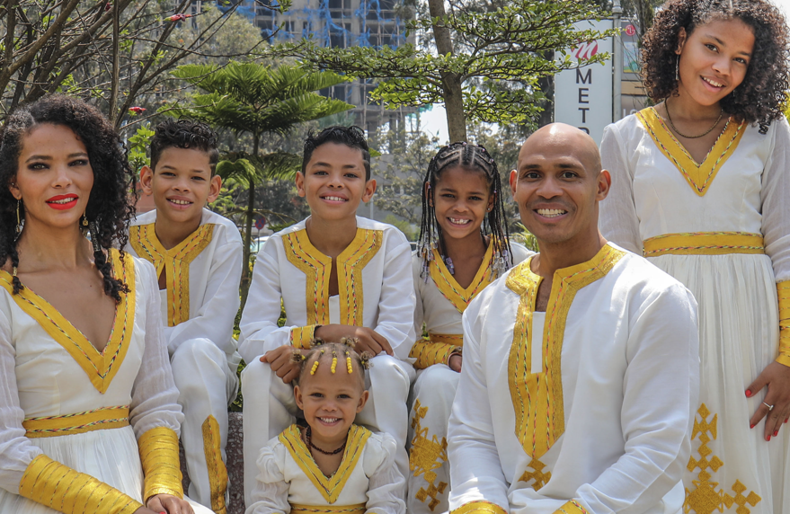
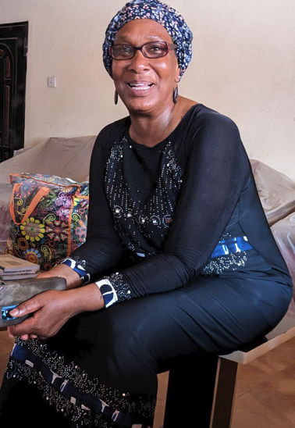
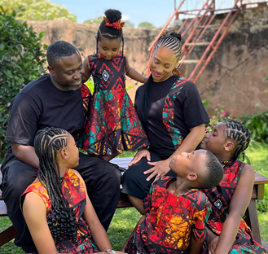
Am I willing to go, or to financially support or pray for those who do go?
For example, clockwise from left, Sherry Thomas, Nigeria;
the Colemans, Ethiopia; the Byrds, Zambia

