Slide 1
Networking With You
Jim Sutherland, Jim@RMNI.org www.RMNI.org

Slide 2
Ministry Background
While in seminary, a black seminarian shared his heart about the needs of African Americans after the 1967-68 Detroit riots.
I decided that this would be my mission field.
After graduation and marriage in 1972, my wife and I moved to Brewton, Alabama and Southern Normal School, an all-black Christian high school. I taught, and was campus pastor, eventually becoming pastor of the predominately black church located on campus.

Slide 3
Cedine Bible Institute; Inner City Ministries
In 1976 we moved to Spring City, TN, and I taught at the AfAm Cedine Bible Institute until 1988, when it closed.
In 1990 we moved to Chattanooga, TN and I joined Inner City Ministries, working in housing projects and pursuing a doctorate.
Upon graduation from Trinity Evangelical Divinity School in 1998, I began RMNI.

Slide 4
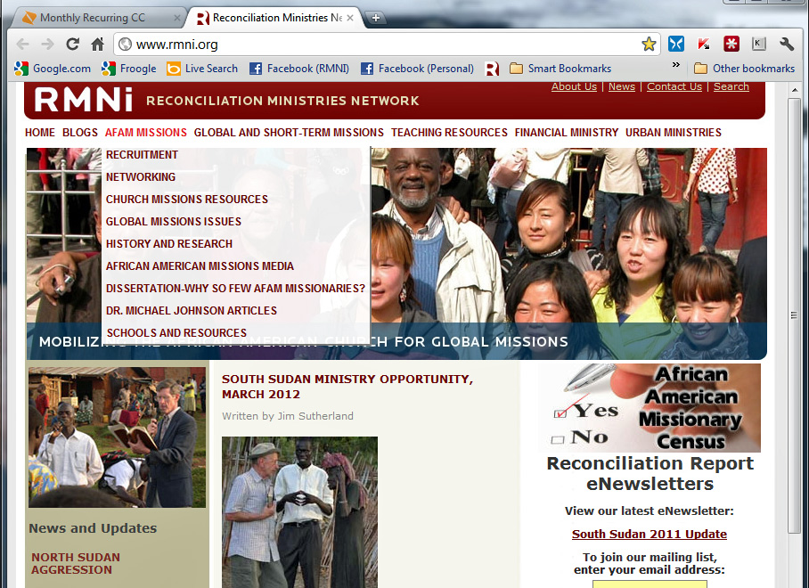
www.RMNI.org AfAm Missions Resources

Slide 5
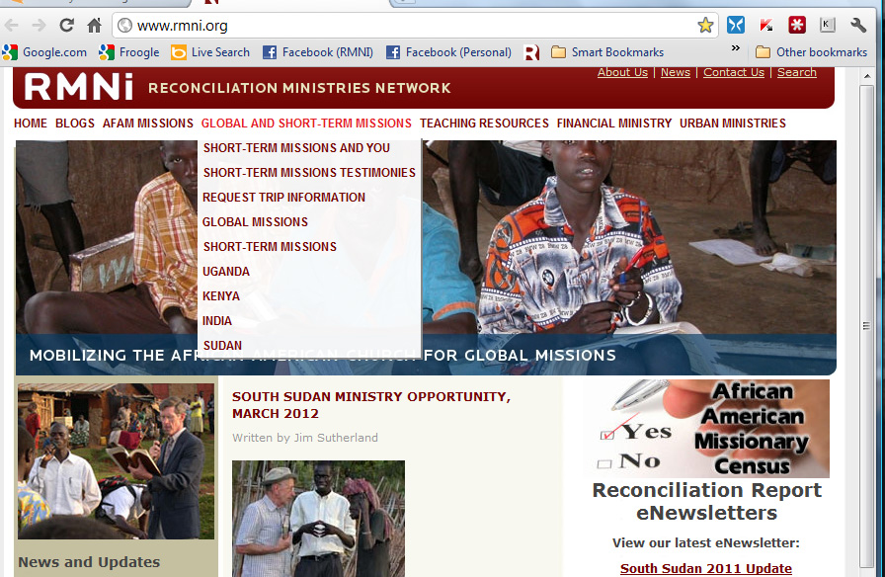
Global Missions & Short Term Trips

Slide 6
Join us in June 2013 in South Sudan, our seventh trip there.

Slide 7
India Ministry
Join us Aug. 12-26, 2012, in central India. This is our fifth ministry trip to India.
We use your spiritual and vocational gifts.

Slide 8
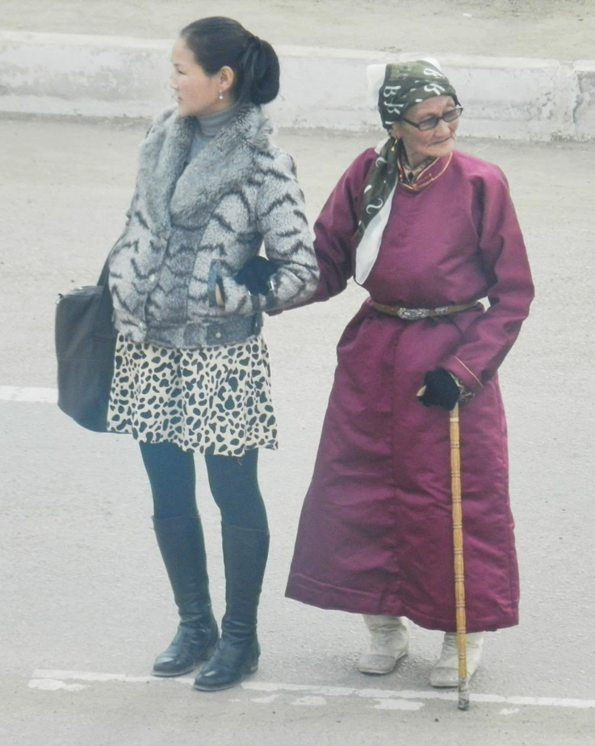
Mongolia Ministry: October 2012
Our second trip, working with VetNet, a Christian veterinary ministry, discipling teachers working in some very remote areas of Mongolia.

Slide 9
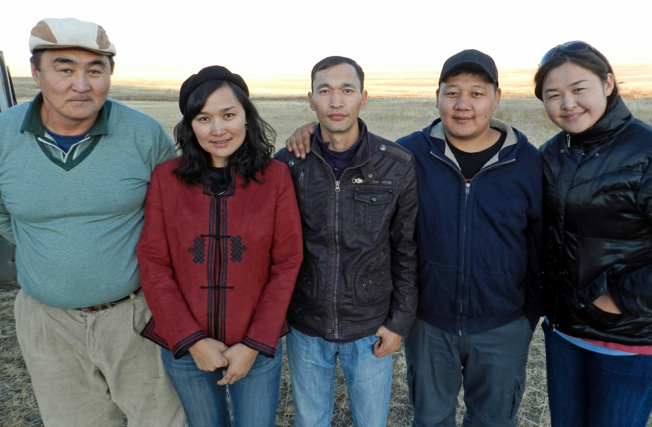
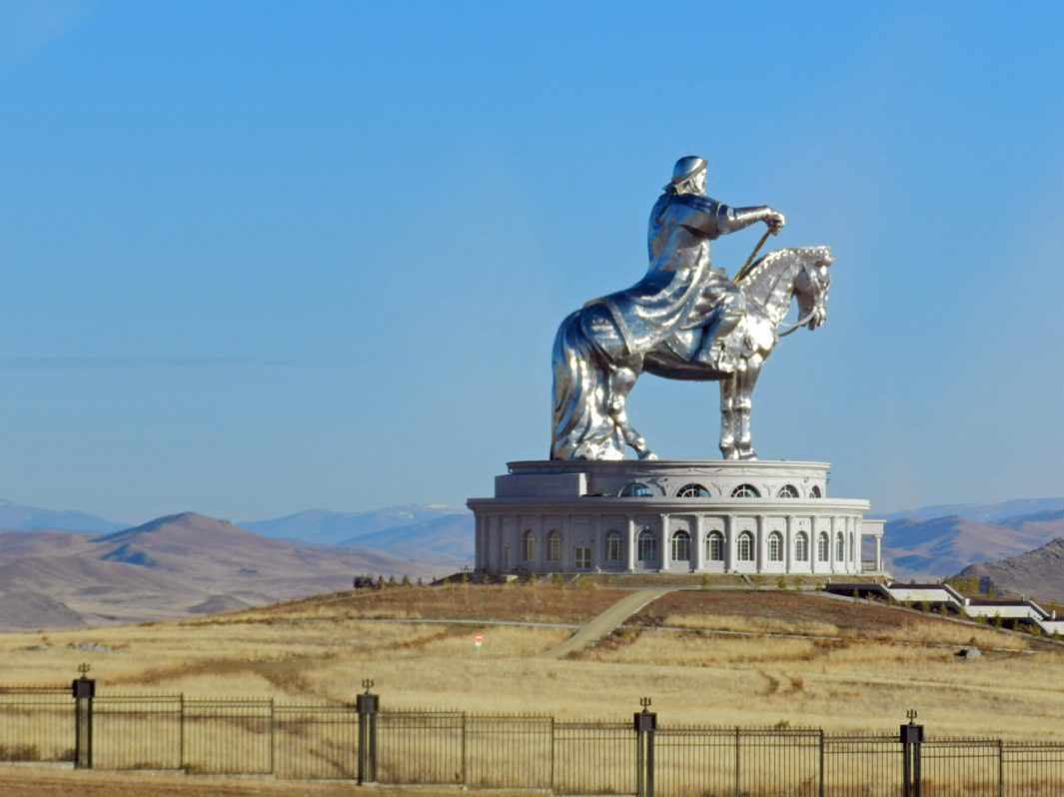
2011
Nergui (driver), Tsende (leader), Pujee, Bodjio, Tede (assistant leader, from left)

Slide 10
Teaching Resources

Slide 11
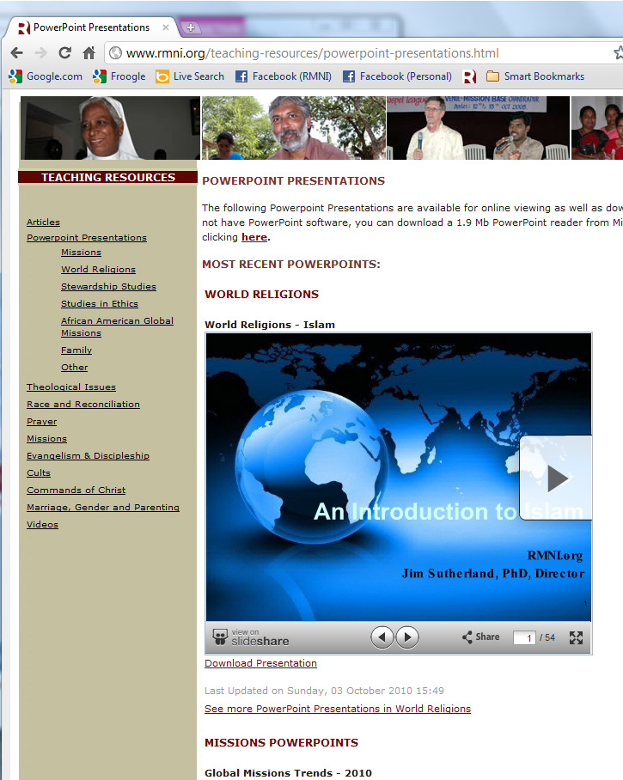
Free PowerPoint Downloads

Slide 12
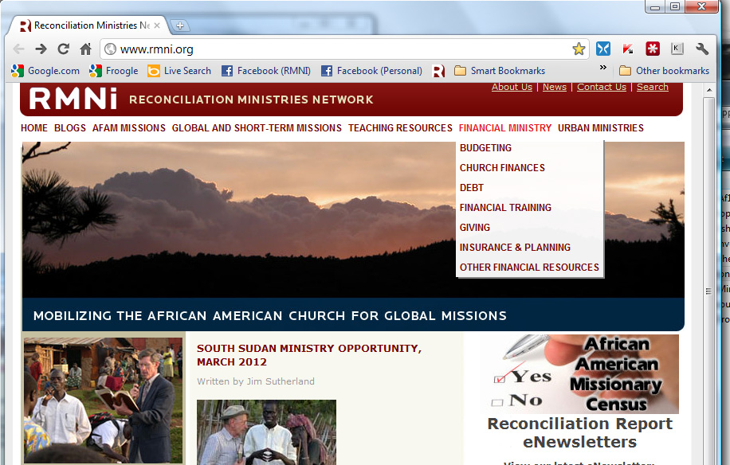
Freeing Funds for Global Missions
Ongoing AfAm Missionary Census

Slide 13
Inner City: College Hill Courts
RMNI partners with churches, ministries and others to serve residents at the Westside.
We’re attempting to be and share Good News.

Slide 14
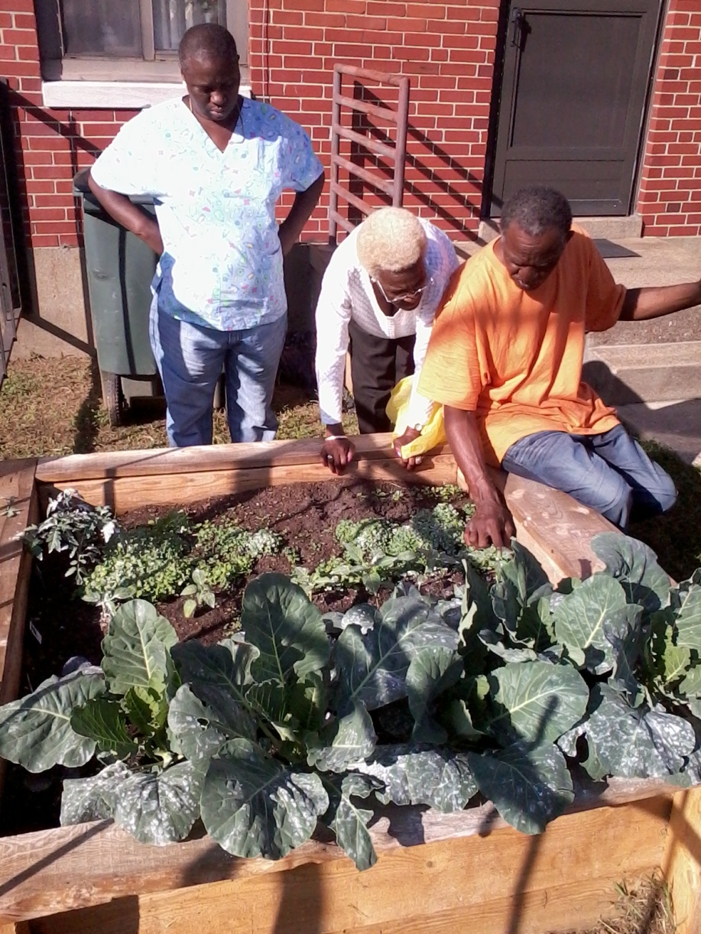
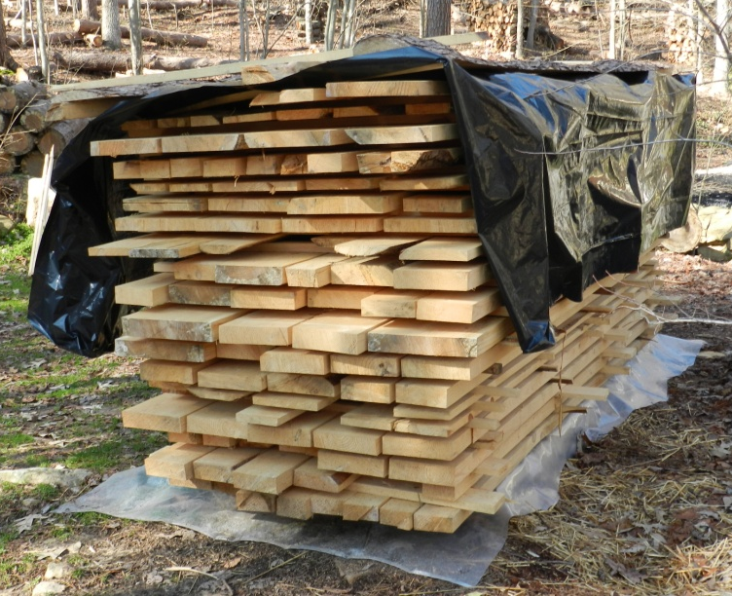
Raised-bed Gardens
A RMNI Board member and I provide lumber for gardens at the Westside, and others build them.

Slide 15
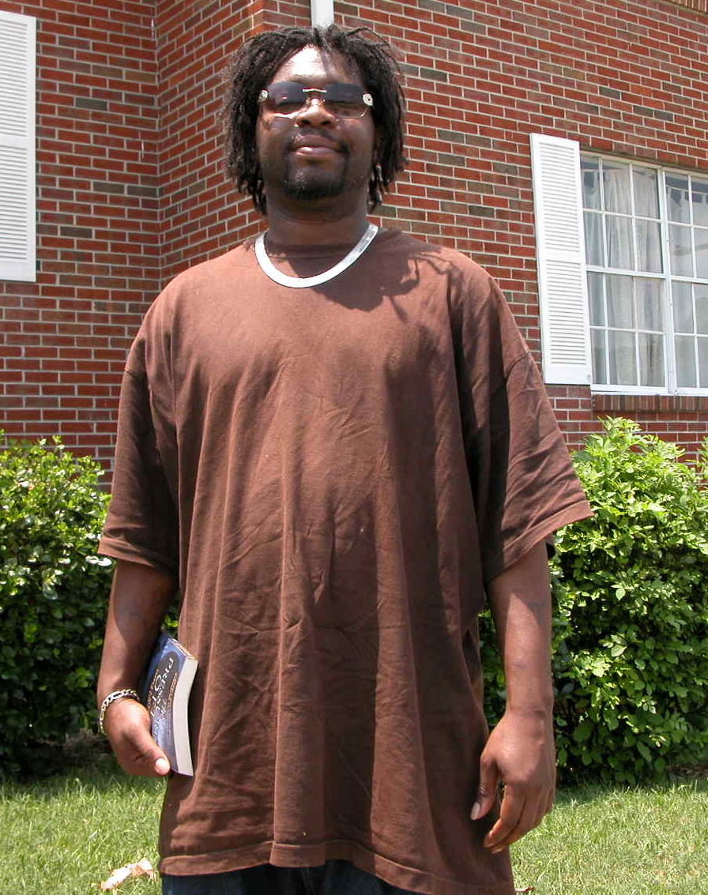
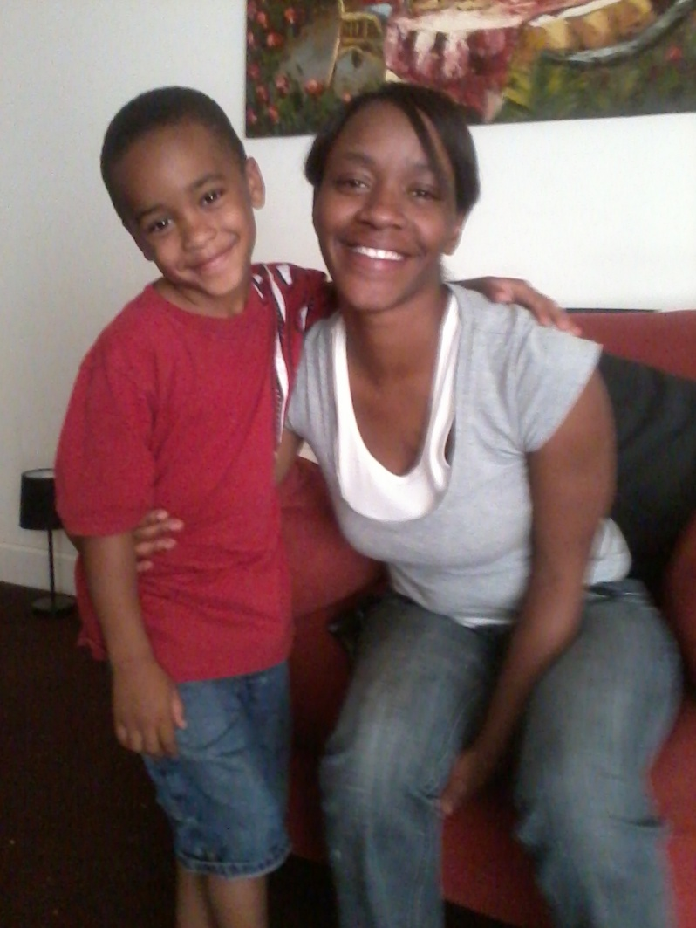
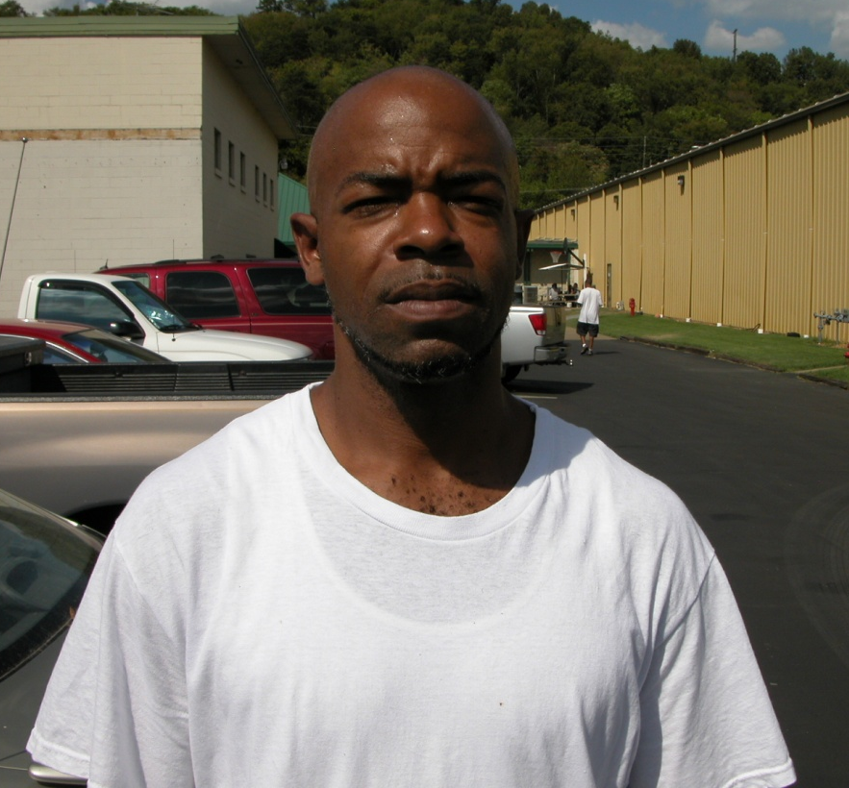
Evangelism and Discipleship

Slide 16
Observations re: AfAm Missions Mobilization
Locate receptive pastors through mutual pastor friends, and offer to serve.
Members can win a pastor to missions by short-term trip reports.
Missions education is the key only for some. Some refuse to serve non-AfAms and will discourage those who do. Dr. Michael Johnson was removed as a deacon, for going into missions.

Slide 17
Observations:
Independent churches are generally more open to missions, being often more grounded in Scripture.
Generally, the younger generations, including pastors, are more open to cross cultural missions.
There has never been a better time to recruit.

Slide 18
Short-term missions are powerful to change worldviews.
Scripture is even more powerful. AfAms are quite honest when confronted with the Word, and will witness against themselves, as needed. Many have a high view of Scripture, which is a great assett.

