Slide 1

Time
Stewardship
RMNI.org
Jim Sutherland, Ph.D.

Slide 2
GOALS
Goal Determination
Objectify goals into the short and long terms
Accurately keep records
Learn from your records
Stay focused on your goals

Slide 3
God Controls Our Time
Acts 17:26 From one man he made every nation of men, that they should inhabit the whole earth; and he determined the times set for them and the exact places where they should live. (NIV used)
Psalm 139:16 your eyes saw my unformed body. All the days ordained for me were written in your book before one of them came to be.
Psalm 31:15 My times are in your hands…

Slide 4
Our Time is Short
Psalm 39:4 "Show me, O LORD, my life's end and the number of my days; let me know how fleeting is my life.
Psalm 90:10 The length of our days is seventy years-- or eighty, if we have the strength; yet their span {10 Or yet the best of them} is but trouble and sorrow, for they quickly pass, and we fly away.

Slide 5
Our Time is Short
John 9:4 4 As long as it is day, we must do the work of him who sent me. Night is coming, when no one can work.
Ecclesiastes 9:10 Whatever your hand finds to do, do it with all your might, for in the grave, where you are going, there is neither working nor planning nor knowledge nor wisdom.

Slide 6
Time vs. Money
Time is more valuable, since it is non-renewable. Giving your time is ultimately more precious than giving your dollars.
  Volunteering is a significant investment.
We have all the time there is at the moment; we do not have all the money there is at the moment.
  More than four dimensions may exist, but we cannot presently access them.

Slide 7
Time vs. Money
Laziness is ingratitude to God for the non-renewable resource of time. Wasting money is ingratitude to God for the gift of power.
Diligent use of time produces money; laziness costs money.
  Proverbs 10:4 Lazy hands make a man poor, but diligent hands bring wealth.
  Ecclesiastes 10:18 If a man is lazy, the rafters sag; if his hands are idle, the house leaks.

Slide 8
Make the Most of Your Time
Ephesians 5:15-16 Be very careful, then, how you live-- not as unwise but as wise, 16 making the most of every opportunity, because the days are evil.
  Colossians 4:5 Be wise in the way you act toward outsiders; make the most of every opportunity.

Slide 9
Call to Wake Up
Romans 13:11-14 11 And do this, understanding the present time. The hour has come for you to wake up from your slumber, because our salvation is nearer now than when we first believed. 12 The night is nearly over; the day is almost here. So let us put aside the deeds of darkness and put on the armor of light. 13 Let us behave decently, as in the daytime, not in orgies and drunkenness, not in sexual immorality and debauchery, not in dissension and jealousy. 14 Rather, clothe yourselves with the Lord Jesus Christ, and do not think about how to gratify the desires of the sinful nature.

Slide 10
Simply Keep Up With God
Galatians 5:25 Since we live by the Spirit, let us keep in step with the Spirit.
Galatians 5:22-23 But the fruit of the Spirit is …. self-control.
  Unless we’re self-controlled and have goals, we will waste time.
We have all the time we need to accomplish all the work that GOD has given us to do.
  Ephesians 2:10 For we are God's workmanship, created in Christ Jesus to do good works, which God prepared in advance for us to do.

Slide 11
Shorterm Goals
Use MS Outlook® or similar task-management software, or a simple To Do List to list and categorize your goals.
  Each Item can also be given a low or high priority. Enter new tasks immediately.
Consider the ABC system of prioritization.
  A= urgent, B= Important, C= If have time left

Slide 12
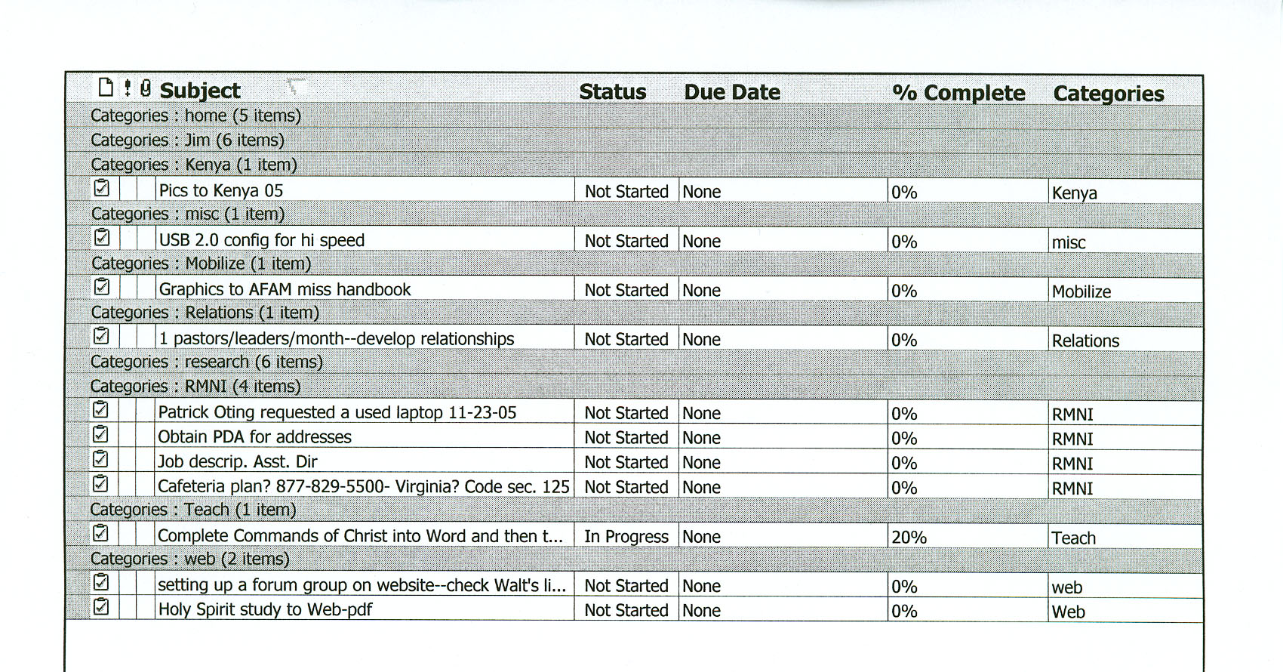
Ongoing To Do List—MS Outlook®

Slide 13
Long-range Goals: Graph Your Time Left, Based on 80 Years
now
Have 4 kids Save 4 college Pay off all consumer debt Grad school ? | Pay off house Begin business Save 4 college Save 4 weddings Old age $ | Debt-free Estate and Kingdom goals Old Age $ Travel & mission trips | Second career? Finishers.org Old Age $ Travel & mission trips | Mentoring Funding Praying Encourag-ing
30
40
50
60
70
80
Take a day or weekend with your spouse to pray over and plan for longterm goals.

Slide 14
Time Tips
Track time use with a paper planner (a PDA [personal digital assistant] may work—but I doubt it). Bracket time segments and label them. Note any data that needs to be totaled. [Use the same page to track financial expenses.]
If you complete a job, ask yourself, “What is the most important thing that I need to do?”
  When needing a resource, ask yourself, “Who REALLY knows about this?”

Slide 15
Time Tips
Commit your way to the Lord at the start of the day.
  Proverbs 3:5-6 Trust in the LORD with all your heart and lean not on your own understanding; in all your ways acknowledge him, and he will make your paths straight.
  Proverbs 16:3 Commit to the LORD whatever you do, and your plans will succeed.
Bring time-stuffers with you, such as a book, magazine, laptop, prayer list, scripture verses, etc. in case you are delayed.

Slide 16
Time Tips
Work from a clean desktop.
Exercise regularly and work from an ergonomic chair.
Use trays to place items for further consideration.
DO IT NOW! Don’t procrastinate with what should be done today.
  It took me 2.5 years to read The Now Habit.

Slide 17
Time Tips
Creative work in the AM and busy work in PM—does this work for you?
Handle paper once. Throw unwanted mail away before it hits the desk.
Delegate tasks when legitimate.
Write down questions before making a call.
Keep God the focus of the day, not time or people or money.

Slide 18
Time Tips
Consider audio books and courses when driving longer distances. Borrow from the library or buy from a used-book store.
  www.Teach12.com has excellent courses.
Use Post-It® notes to aide memory. Use larger, lined pads for ToDo lists.
Review your calendar at the end of the month to followup on the undone.
Be thankful for what you have accomplished during the day—don’t focus upon what was not done (Minerirth-Meier Clinic).

Slide 19
Beware Time Traps
Set boundaries to work. Plan to play. Take time for God, family and others. I set aside Saturdays to work around the house and for leisure.
Too much TV, movies, video games, reading, playing.
If time is short, let the answering machine take calls.
Set an ideal time to go to bed and to get up, and try to keep it.
Set a time to leisurely browse the Internet.

