Slide 1
Inner-city team manual (the westside, chattanooga, Tenn.)
Jim Sutherland
Reconciliation Ministries Network, Inc.
www.RMNI.org
423-822-1091

Slide 2
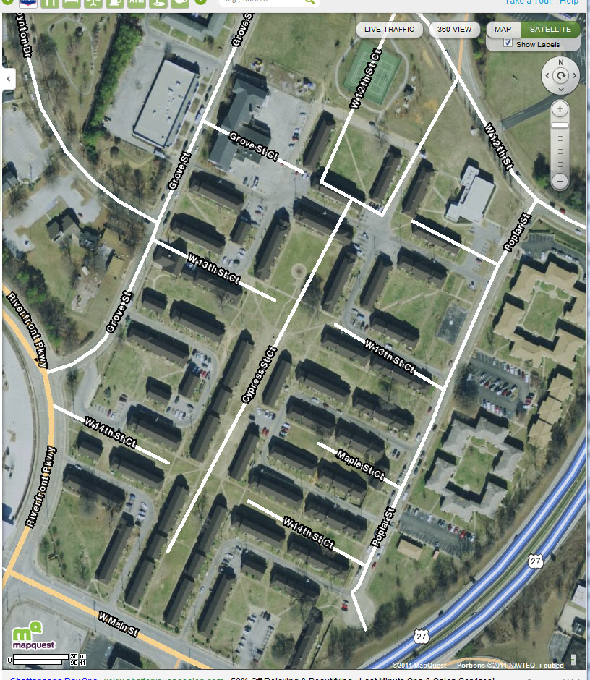
Location-- Main and Riverfront
Park and meet here

Slide 3
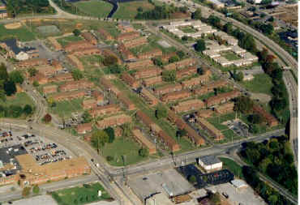
Aerial View

Slide 4
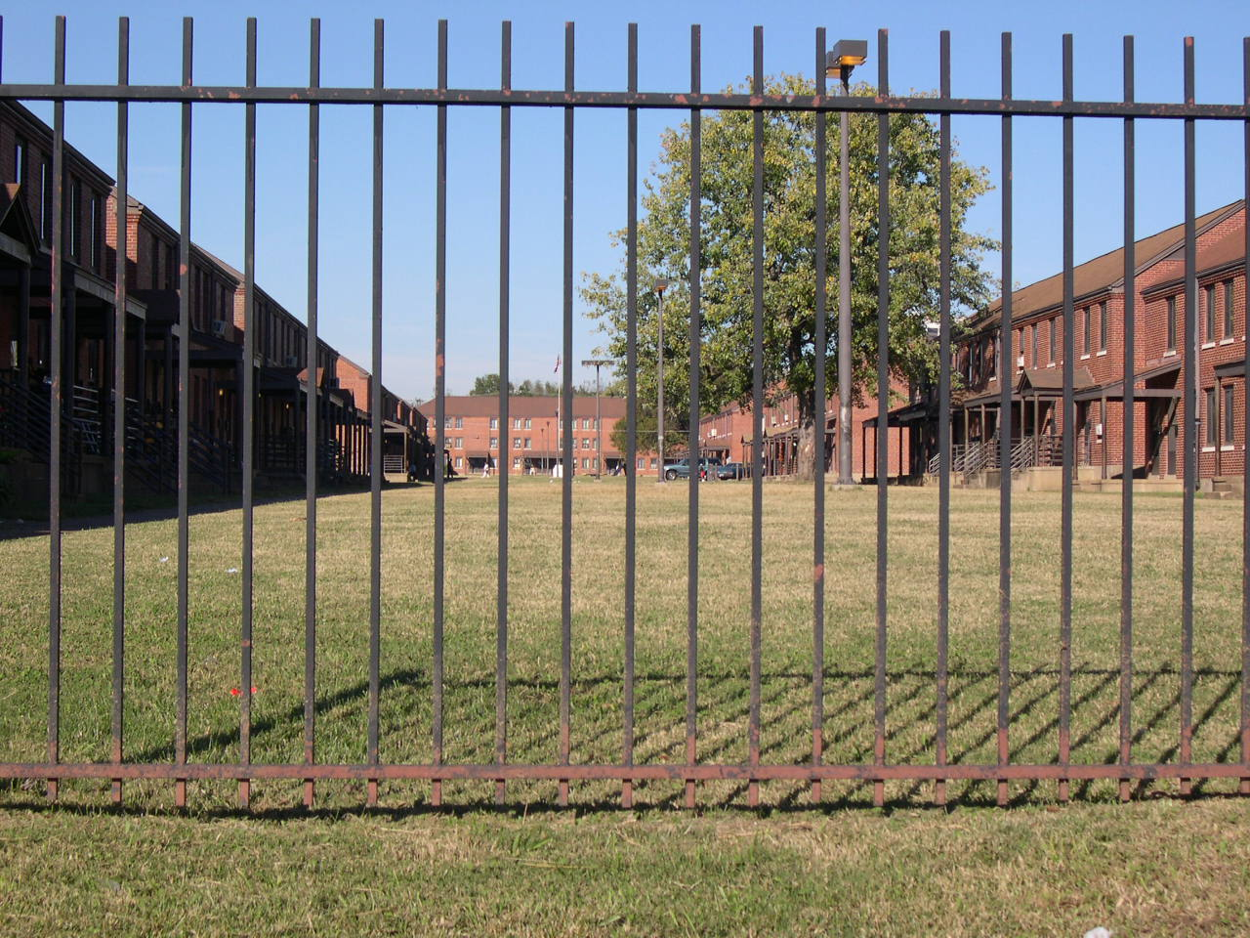
Main Court at College Hill Courts

Slide 5
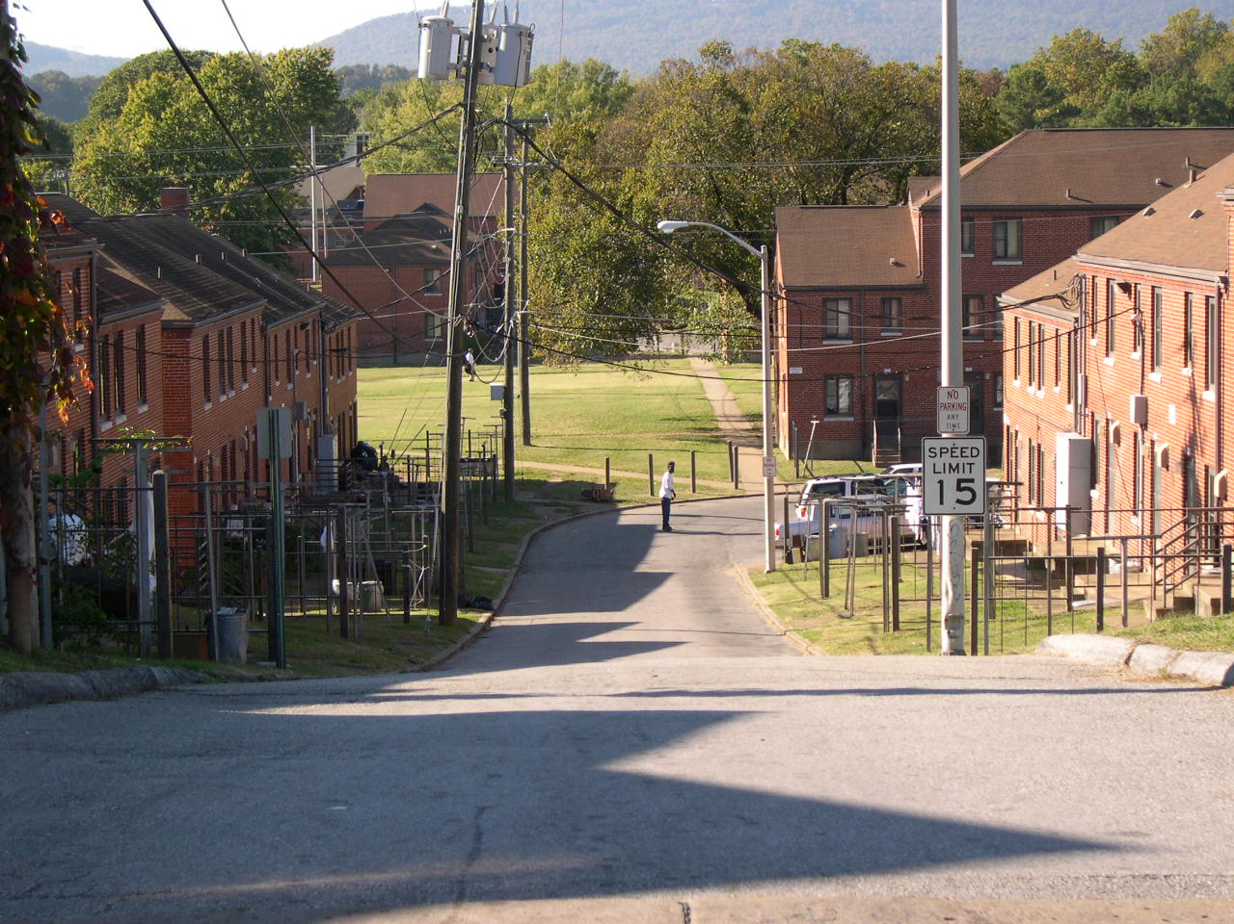
North End of Westside

Slide 6
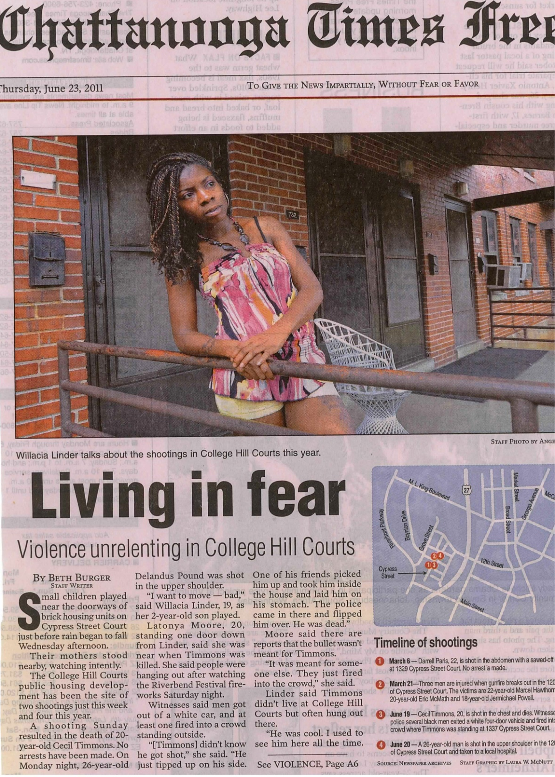
Violence

Slide 7
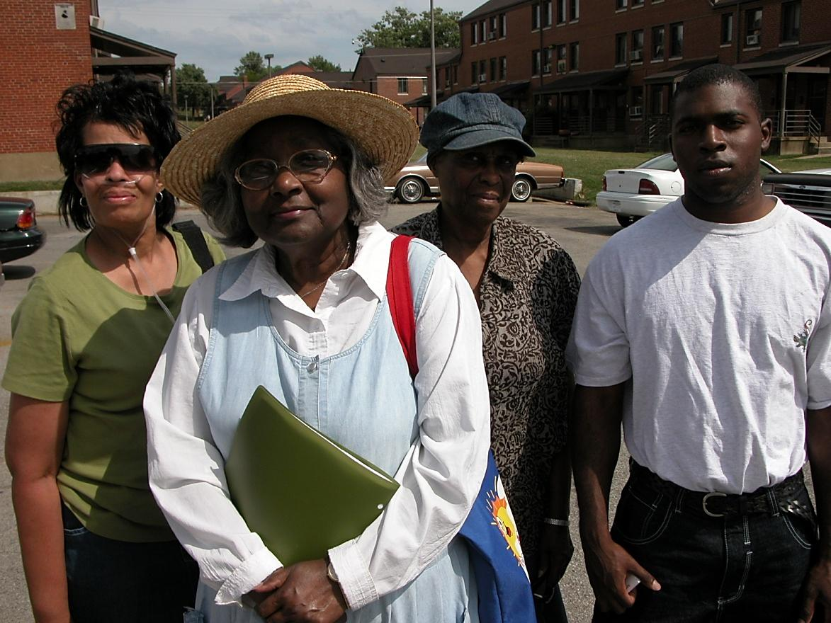
Longtime Westside Volunteers
We meet around 3:30 PM on Thursdays until about 5 PM. Call 423-822-1091 to join us.

Slide 8
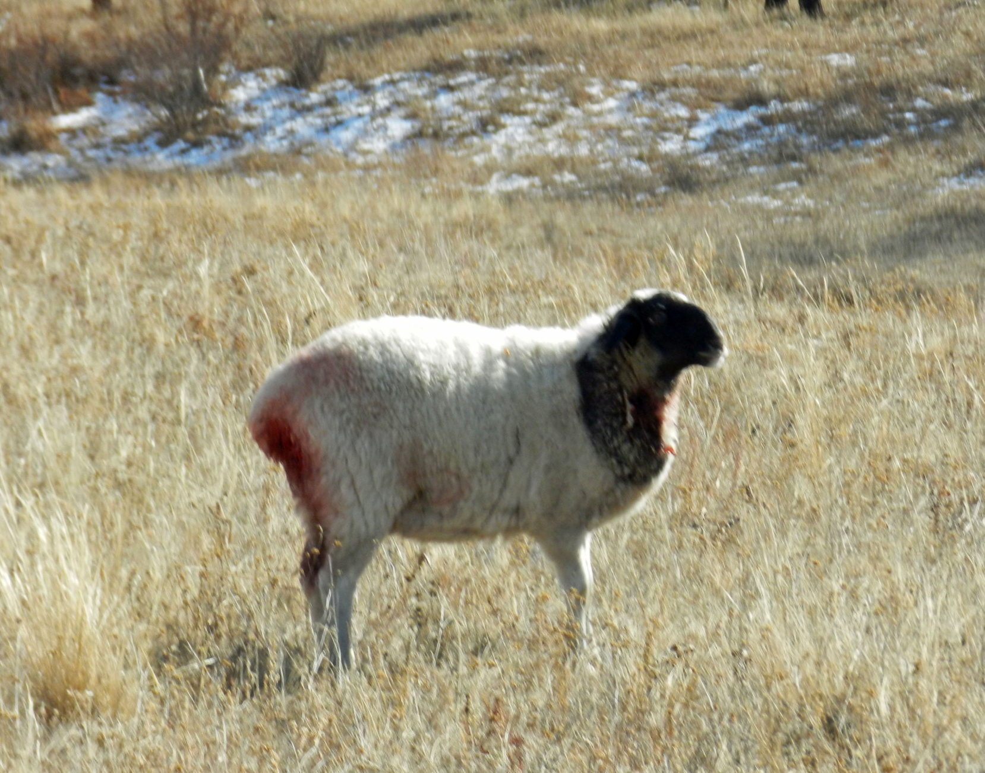
This sheep spent the night with wolves, October 2011

Slide 9
Going to the Wolves
“I am sending you out like sheep among wolves. Therefore be as shrewd as snakes and as innocent as doves.” (Mat 10:16 NIV)
“Jesus was saying to his disciples then—and, by implication, to you and me now--“I am sending you to dangerous places, where you will find yourself in the middle of evil, vicious people. And you will be there by my design.” Jesus told them, “Go to great danger, and let it be said of you what people would say of sheep wandering into the middle of wolves. ‘They’re crazy! They’re clueless! They have no idea what kind of danger they are getting into!’ This is what it means to be my disciple.’”

Slide 10
The Criteria of Danger
“We don’t think like this. We say things such as, ‘The safest place to be is in the center of God’s will.’ We think, If it’s danger, God must not be in it. If it’s risky, if it’s unsafe, if it’s costly, it must not be God’s will. But what if these factors are actually the criteria by which we determine something is God’s will? What if we began to look at the design of God as the most dangerous option before us? What if the center of God’s will is in reality the most unsafe place for us to be?” David Platt, Radical, pp. 164-5

Slide 11
Decent or Dangerous?
“When we gather at the [church] building, we learn to be good. Being good is defined by what we avoid in the world. [e.g. idols] We are holy because of what we don’t participate in (and at this point we may be the only organization in the world defining success by what we don’t do). We live decent lives in decent homes with decent jobs and decent families as decent citizens. We are decent church members with little more impact on the world than we had before we were saved.” David Platt, Radical, ISBN: 9781601422217, p. 105

Slide 12
Light of the World
¹⁴ "You are the light of the world. A city on a hill cannot be hidden. ¹⁵ Neither do people light a lamp and put it under a bowl. Instead they put it on its stand, and it gives light to everyone in the house. ¹⁶ In the same way, let your light shine before men, that they may see your good deeds and praise your Father in heaven. (Mat 5:14-16 NIV)
Light is brightest in the deepest darkness.

Slide 13
Salt of the Earth
¹³ "You are the salt of the earth. But if the salt loses its saltiness, how can it be made salty again? It is no longer good for anything, except to be thrown out and trampled by men. (Mat 5:13 NIV)
Unless salt comes into contact with something or someone, it is worthless.

Slide 14
Surprises
Many are credibly saved, but are against going to church.
The younger the person, the less inclined to want to go to church.
The Church has very few boots on the ground. Buses come by on Wednesdays and Sundays to pick up people to come to church. SDA students come on Friday afternoons to play tag football. Jehovah-Witnesses are also there, as are Muslims and atheists.
It’s very difficult to get Gospel-preaching Black churches interested in going to the Westside. They often have a “come” mentality, and reward those who put in the most “pew time” at their church. Pastors may create so many meetings so as to keep people off the streets and out of trouble. Church is about what goes on inside the building. Pictures on church bulletin boards show fun Christian gatherings.

Slide 15
Relationships
As you probably know, the key to ministry is having good relationships. We need to balance boldly sharing Christ with keeping the door open with the person so that we or another Christian can return.
When you feel there is enough trust, ask for their name, and for their nickname or street name. Use the street name, unless told not to.

Slide 16
Suspicion
There is suspicion of new people and of people generally. What do they want? What is the real deal? Are we being used?
I’d like to walk around the hood with you, so that people associate you with a (somewhat) known person.
A great fear in the black community is having someone’s “business” shared with others. So keep confidences.
Even neighbors often do not know neighbors. Some people just stay inside to stay out of trouble.

Slide 17
Who are you?
Tell them that you are from Lookout Mountain Presbyterian Church, or the church you attend and work with Reconciliation Ministries Network.
You may be suspected of being undercover police. If it comes up, simply deny it.
You may be mistaken for a cult, so simply say that you’re simply a Christian, not a member of ______.
You may be mistaken for being with the Westside Community Association or Chattanooga Organized for Action (community organizers).

Slide 18
Gangs
Avoid mentioning or discussing gangs, unless someone else brings it up. We are concerned with individuals, not combatting gangs. Jesus can meet all the needs that gangs meet, and far more.
It’s OK to be informed about gangs. Here are some sites: http://www.gangsorus.com/ http://gangresearch.net/Archives/hagedorn/articles.html
http://www.youtube.com/watch?v=j8bAzSPxO30&feature=player_embedded#!

Slide 19
What to wear
Dress for the hood. If warm enough, a simple T-shirt is good, with jeans or casual pants. Look at what is worn, and see if you can wear something that identifies.
In order not to turn off people before you talk with them, avoid wearing a lot of gang colors (red-Bloods, and blue-Crips). While black is also a gang color, I find that to be OK, and green, brown and other colors. It’s the instinctive reaction that may be an issue. However, people are very forgiving and understand you’re not in a gang.

Slide 20
Fights
If many people are running toward an area there’s a fight.
Like one who seizes a dog by the ears is a passer-by who meddles in a quarrel not his own. (Pro 26:17 NIV)
You may also see people running away from police.
You’ll probably hear much profanity.
If police stop you, tell them that you are there working with Jim Sutherland, Reconciliation Ministries Network, with the knowledge of the College Hill Courts Chattanooga Housing Authority office and the Westside Resident Council. We’ve worked at the Westside since about 2004.

Slide 21
Young Women team members
We have found that an attractive girl will (also) have the interest of guys in the hood. They may want pretend to have an interest in Christ, and want to go to church with you and may even profess Christ. We’ve found that motives may not be pure. Let guys take guys to church and let guys develop relationships with guys. You may represent a challenge to the guys.
Focus on reaching girls and older women and children. Let men work with the men.

Slide 22
Being Good News
Visit in jail and write to the person if s/he goes to jail.
Share Christ, which is more important than being liked. It’s easier to just be friendly and not be rejected. But only Christ can deliver.
Hang out. Life at the Westside goes in slow motion. I have to consciously slow down my speech, expectations and plans. Moving from doing to being in an instant. Everything slows down.
Pray for divine appointments and that the Lord will bring to us those He wants us to serve.
Focus upon developing relationships.

Slide 23
Be Good News—Incarnate the Gospel
You might help to create resumes. We can send them to employers once we get to know them. We have sample forms.
People often want you to lead them in prayer together before leaving, even on the sidewalk. Please pray during the week for your friends.
Meet needs of the moment if possible. You can refer to an agency, comfort, and be a friend.

Slide 24
Give a Gift
A gift opens the way for the giver and ushers him into the presence of the great. (Pro 18:16 NIV).
We’ve found two good ways to initiate conversations. First, to offer a free New Testament. Judging by how that is received, we proceed to learn where they are spiritually by asking questions, or we don’t proceed (and pray that the NT will be used well). We’ll provide you with NT’s. http://www.crossway.org/bibles/esv-share-the-good-newsreg-outreach-new-1356-tpb/
Second, we offer job information, including specific companies, contacts, etc., and more generally, websites. Often those with no interest in the Bible will show definite interest in job information. We’ll provide this info for distribution.
We provide a form and templates for resumes.

Slide 25
Ideas for Service
We don’t focus upon one-time evangelistic presentations, although we need to share Christ. We focus upon developing friendships with those who are willing.
If you enjoy kids, have an organized play time for kids. First get to know the Moms. They are watching.
Have a Good News club (Child Evangelism Fellowship model).
Possibly provide training in areas where there is a felt need.
For example, classes in gardening, followed by helping to plant gardens in the housing project
Teaching on how to become financially free.
Cooking and sewing mentoring, etc.

Slide 26
Be as Consistent as Possible
Consistently residents criticize people who come, promise and disappear, or come, ask for signatures for a grant, and disappear.
If you simply can be relied upon to show up, you will be pure gold to folks at the Westside. They may not say so at the time, but they will notice. Showing up is about 50% of ministry at the Westside. This isn’t designed to guilt-trip you to come. It’s simply what works, to build relationships.
If you’re a college student, just let your contacts know when you can’t be there. Communicate, and they will understand.
You are a volunteer, not a full-time missionary—that is understood. If we forget, remind us.

Slide 27
Resource Local Christian Leaders
Provide resources to local leaders, who will do a much better job of reaching people than we will. Ask for wisdom to locate local leaders.
The form of discipleship changes over time, from regular personal time to providing resources for their ministry—more time to less time, typically (Neil Cole).
Help may take the form of books they want, Bibles that they can hand out, trainings, etc.
Relationship “The key to everything is relationships with many to find just one. The man or woman you are looking for is the one that God has prepared to bring the Gospel into the community—the one Luke 10 calls the ‘Man of Peace.’” http://newgenerationsintl.org/church-planting/our-process.php

Slide 28
Whom Do I See?
Ask God to lead you to those He is drawing to Christ.
"No one can come to me unless the Father who sent me draws him (Joh 6:44 NIV)
Ask for “divine appointments”. Further, that since our time is brief onsite, ask the Lord to have people He wants us to serve to come to us. Many times this prayer has been answered.
Usually, we meet people already outside, or call on those we’ve met before, for whom we have an address and phone number (which often changes).

Slide 29
Giving
Generally, we are to give to those who ask, within reason (Matt. 5:42). As you do, you give to the Lord (Matt. 5:37-40). I usually give the first time. Some people will hit you up for something almost every time they see you. If you detect this, tell them that you have decided not to give them anything more. You are not called to be used and exploited. Set boundaries, and hold them. You can mention that a gift is a one-time gift. Don’t give what you cannot afford to give. If a person wants to use money for alcohol or cigarettes, I tell them that I love them too much to give them money.

Slide 30
Giving Rides
This requires a lot of wisdom. A criticism of people who come to the Westside is that they don’t want to get physically close to residents, including letting them get into their car, or having a meal together.
However, you can get robbed or worse. Unless you are very close to a person and have no anxiety about it, I would not give a ride. Men are advised not to give a ride to a woman unless another volunteer is present. Women, do not give men a ride.

Slide 31
Bible Studies
We would like to develop these. They can center around questions and interests and topics. We use the commands of Christ as one appropriate topic (available to you in handout form, Matt. 28:20). You can do a study in the Gospels. Jesus is an excellent focus. People may reject the Church, and dislike Christians, but few reject Jesus who know about Him.
This might develop into a group that includes mutual accountability and confession of sin, evangelism, worship and the Word (see Neil Cole, Organic Church).

Slide 32
Debriefing and intercession
We can learn from each other and share experiences and prayer requests. I’d like to meet together for a meal periodically, and also invite you to join our weekly conference prayer call for the Westside at 12:15 on Thursdays.
There is no cost other than standard long-distance charges to connect to the conference.
Rondee Free Conf. Call: 916-209-4534, PIN: 37409#
You are not expected to call in—but you’re welcome.

Slide 33
Discipleship
Our focus, upon friendship with a believer, is discipleship (Matt. 28:19).
One great way to disciple has been developed by Neil Cole—a Life Change Group. See http://www.cmaresources.org/files/LifeChangeGroup2011Sample.pdf
He also has an excellent book on discipleship, Search and Rescue. See http://www.cmaresources.org/search-and-rescue

Slide 34
Other Resources
http://www.cmaresources.org/catalog/27
http://www.rmni.org/urban-ministries/inner-city-evangelism.html This is our website, with an inner city evangelism sample presentation.
See the presentation: “How to do Personal Evangelism” at http://www.rmni.org/teaching-resources/powerpoint-presentations/other.html

Slide 35
Christian Urban Penetration
118,000 new non-Christian urbanites are added per day
Christians are 21% of the urban population, while 33.3% of world population.
David Barrett, Todd M. Johnson & Peter Crossing, “Status of Global Mission, 2010” Int’l Bulletin of Missionary Research, Jan. 2010, p.36.

Slide 36
Increasing Global Urbanization
2009-- 51% of Earth’s population is urban¹
2025-- 57% will live in cities¹
2050-- 66% will live in cities²
By 2015 only one city in an advanced nation will be among the 10 largest cities. In rank order: Tokyo, Bombay (Mumbai), Lagos, Shanghai, Jakarta, São Paulo, Karachi, Beijing, Dhaka, México²
1 David Barrett, Todd M. Johnson & Peter Crossing, “Status of Global Mission,” Int’l Bulletin of Missionary Research, Jan. 2010, p. 36.
2 Philip Jenkins, The Next Christendom, 2002, p. 93, based upon UN statistics, ISBN: 0195168917

